Slide 1
Turtle dreaming
Gordon Dunsire
Presented to the seminar
“Five years on”
British Library, London, 27 April 2012

Slide 2
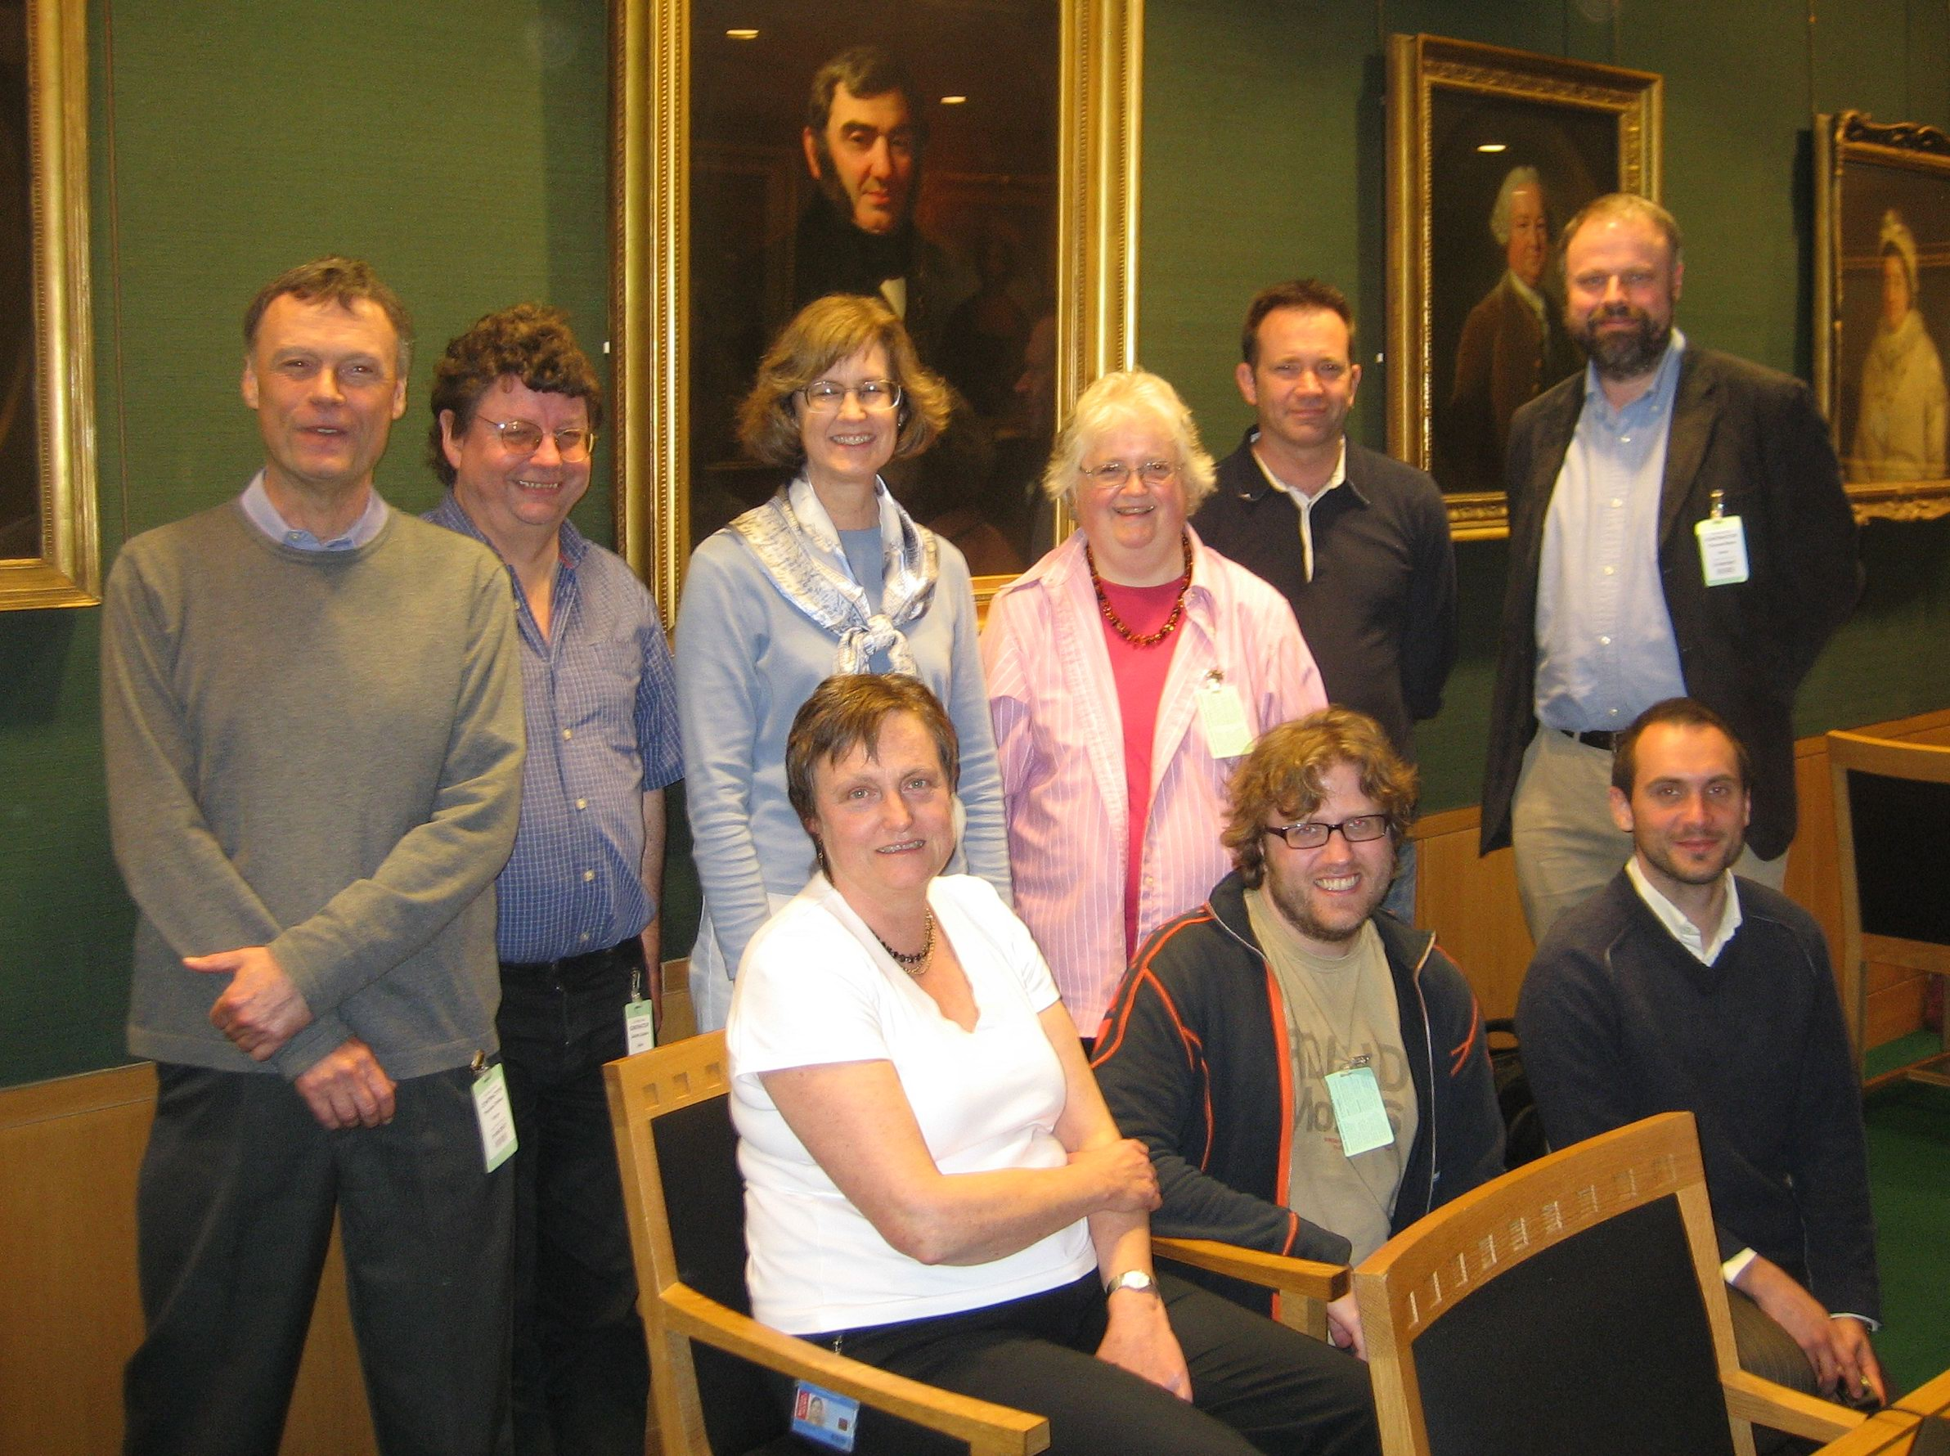
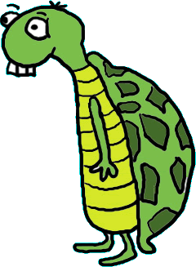
Introducing my new wee pal
Terry the turtle

Slide 3
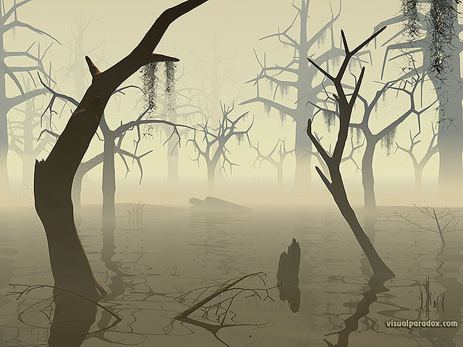


MARC21 Swamp

Slide 4
Out of the primordial soup
URI =
m21:M008BK22
Label =
“Target audience of Books”
Leader character position 06 - Type of record =
a (Language material)
Tag 008 - Fixed-Length Data Elements =
Configuration for Books
Character position 22 – Target audience

Slide 5

This thing has target audience
for books code j (juvenile)
ex:1
m21:M008BK22
m21t:commonaud#j .
I’m a triple!*
(in ttl)
*Linkable!

Slide 6
Wanna link up with me?
m21:M008BK22
m21terms:
commonaud#j
ex:1
skos:prefLabel
I look my best
as an RDF graph
“juvenile”

Slide 7
Are you feeling lonely and unlinked?
Want to meet similar turtles?
Take the sub-property
ladder to new places!
Nobody
notices me
anymore
Dumb-up today!
Arrive without
travelling!

Slide 8
The sub-property ladder
m21:
“Target audience”
rdfs:subPropertyOf
m21:
“Target audience of
visual materials”
m21:
“Target audience of
music”
m21:
“Target audience of
books”
m21:
“Target audience of
language material”

Slide 9
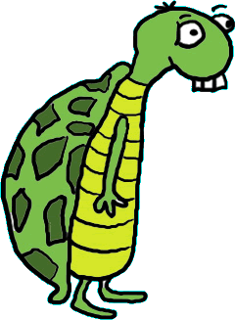
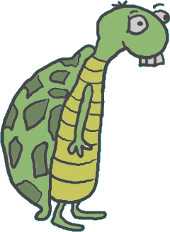
Entailed triples …
“juvenile”
m21:
“Target audience
for books”
m21terms:
commonaud#j
skos:
preferred label
ex:1
m21:
“Target audience”
… (Dumber)
Cloned turtles

Slide 10
“Audience” map
unconstrained:
“has note on
use or audience”
rdfs:subPropertyOf
isbd:
“has note on
use or audience”
unconstrained:
“Intended audience”
m21:
“Target audience”
dct:
“audience”
rdfs:
subPropertyOf
rda:
“Intended audience”
frbrer:
“has intended
audience”

Slide 11




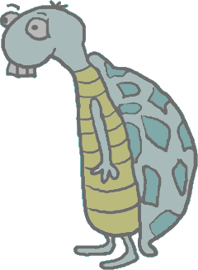
FRBR
Zoo!
MARC21
Swamp
Everglades of
Dublin Core!
ISBD
Marsh!
Bog of RDA!

Slide 12

Terry’s cousin Timmy
URI =
m21:M260__c
ex:2
m21:M260__c
“2009”
(that’s me!)
Label =
“Date of publication,
distribution, etc. in
Publication,
Distribution, etc.
(Imprint) (Not
applicable or No
information provided
or Earliest available
publisher)”

Slide 13
Timmy has a problem
Timmy can use the sub-property
Ladder to mingle with other
date-ish turtles:
m21:M260__c rdfs:subPropertyOf dct:date.
But Timmy also wants to be part
of the instance group for turtles
based on other MARC21 260
elements …

Slide 14

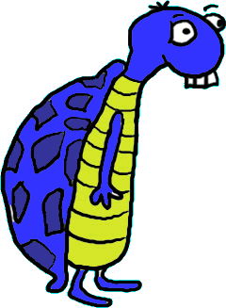
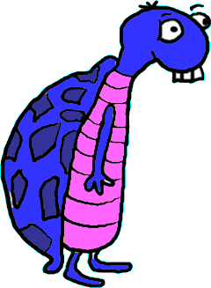
Publication, etc. statement
It’s aggregating, I know,
but we’re all in this together!

Slide 15
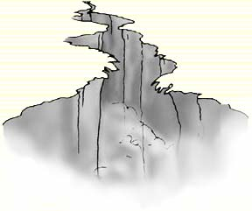


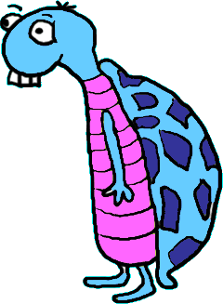
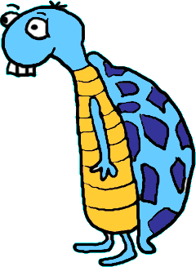
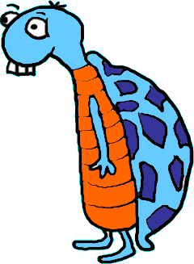
The DCAM/DCAP Deep
?!*
Come join us!

Slide 16

Bridging the gap
RDF
Working
Group
DCMI
Architecture
Forum
Description sets
OWL
Named graphs
Application profiles
Syntax encoding schemes

Slide 17

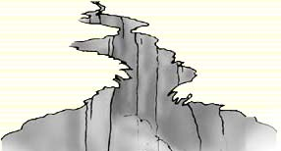
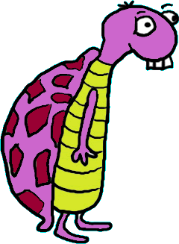

While Timmy waits …
W
We are FRBR
E
M
I
… Terry has turtle dreams

Slide 18
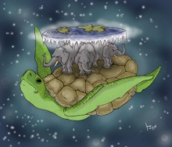
One
triple
to rule
them all
?
The Great A’Tuin

Slide 19
Thank you!
gordon@gordondunsire.com
Blog posts on Metadata matters
  http://managemetadata.com/blog/

Slide 20
Graphics
Turtle cartoon: Church House Clipart
  http://www.churchhouseclipart.com/
Swamp640: Copyright Brian S. Kissinger
  http://visualparadox.com/wallpapers/wallpaper_640x480.asp?wallpaper=swamp
Speech bubble: Free Stock Photos.biz
  http://www.freestockphotos.biz/stockphoto/6969
Chasm drawing
  http://www.silverbearcafe.com/chasm.html
Bridging the gap http://www.newdirectionsconsulting.com/2011/07/the-us-vs-them-mentality-bridging-the-gap-between-operation-administration/
Gran A’Tuin: Kyudomugen
  http://kyudomugen.deviantart.com/art/Gran-A-Tuin-209451068

