Slide 1
Tomorrow never knows
Gordon Dunsire
Presented at Metadata and Discovery Group Scotland
Annual General Meeting, Edinburgh, 25 Nov 2022

Slide 2
Uncertainty
Notes:
This is my single word description of the current state of bibliographic metadata.

Slide 3
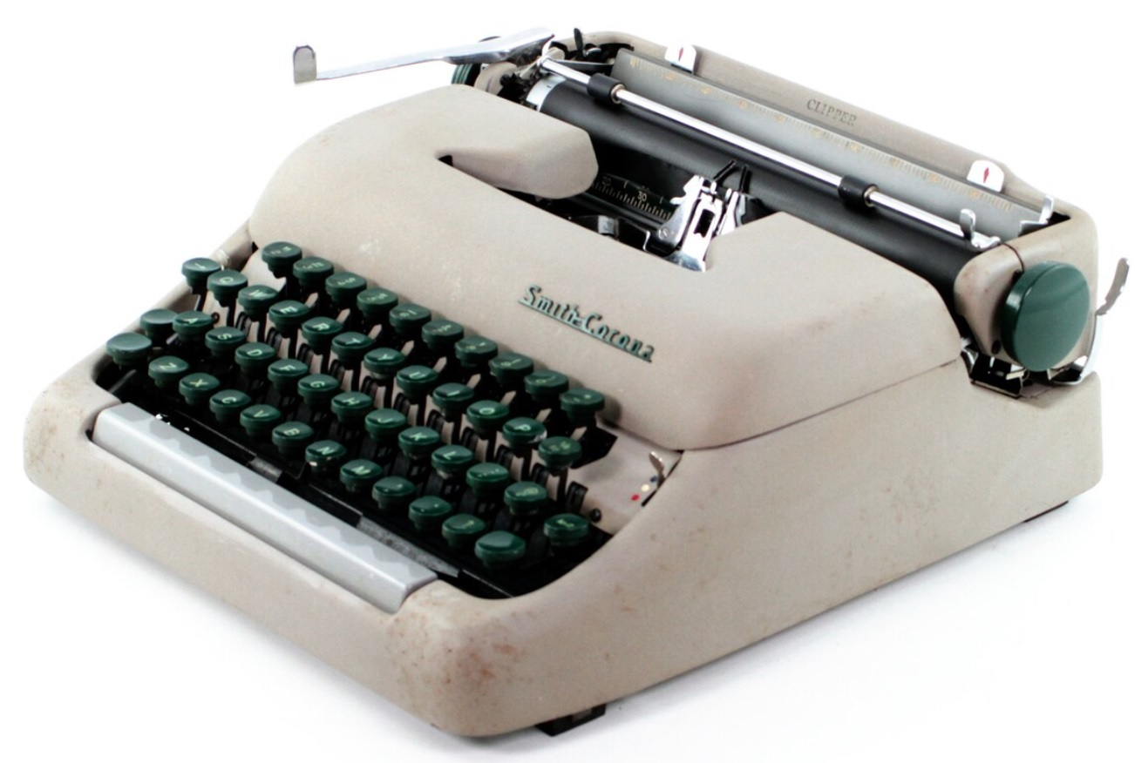
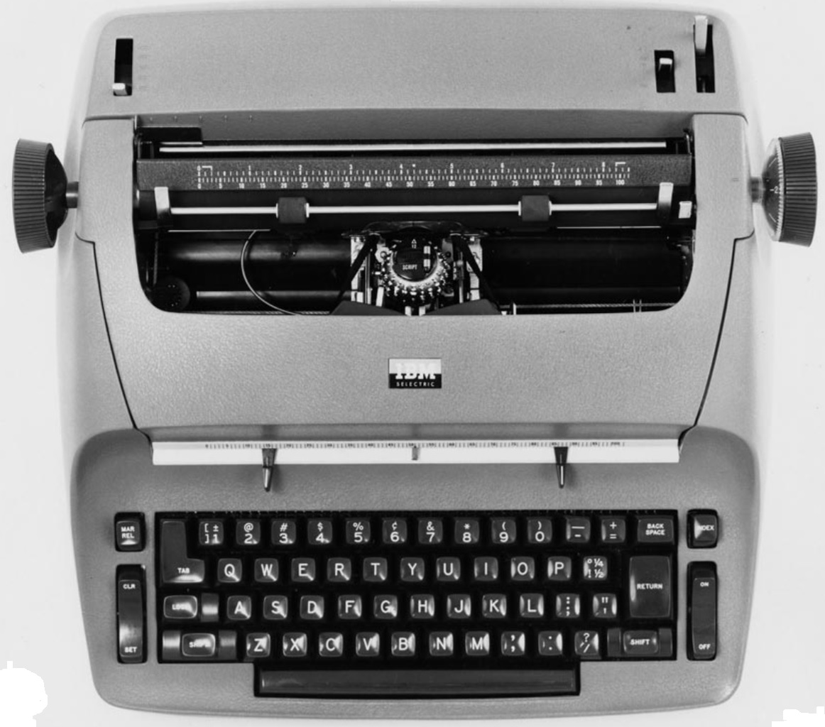
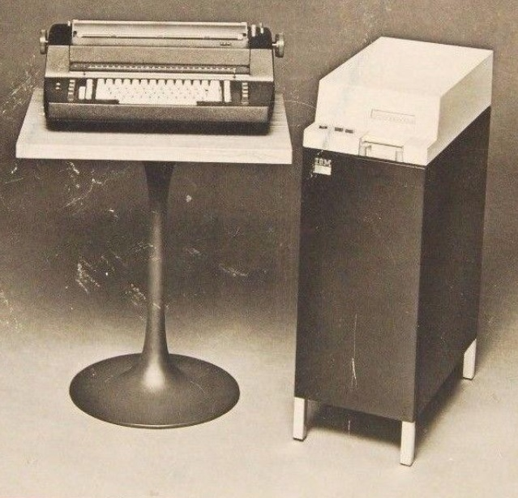
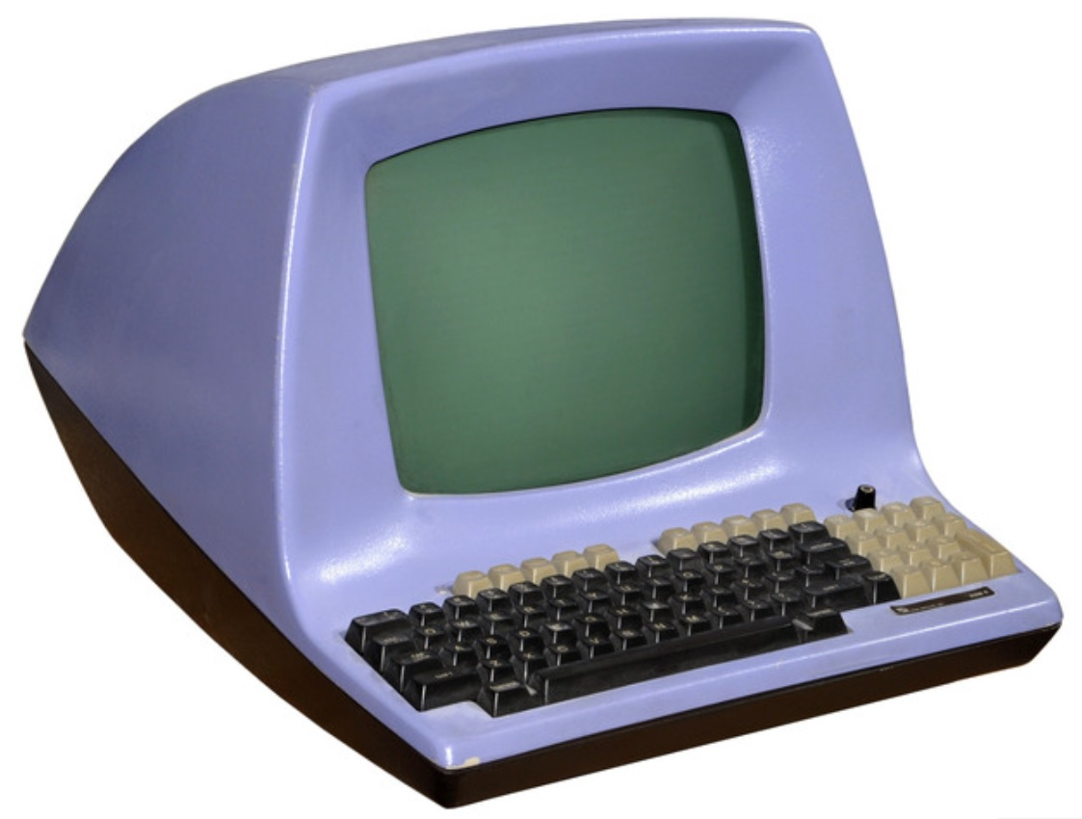
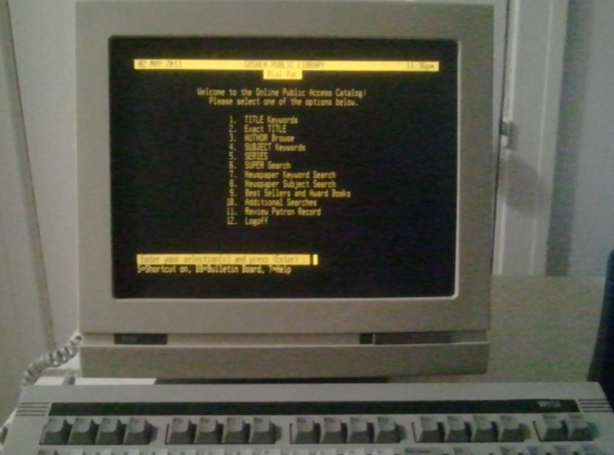

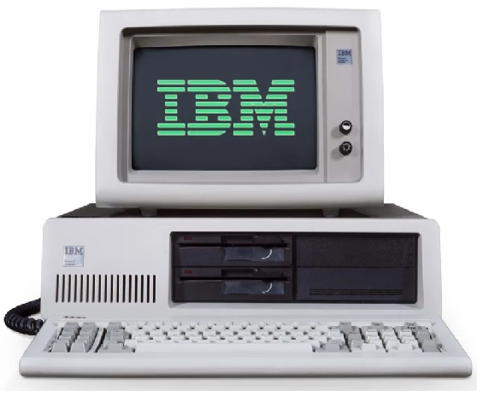

Creating metadata
A personal history
?
Notes:
First, a brief overview of my personal experience of the evolution of machines that support the creation of metadata, aka cataloguing.
In the beginning was the manual typewriter for creating metadata on catalogue cards. This was quickly supplanted by the electric typewriter, with the significant productivity boost of a correction ribbon. A year or so later, the electric typewriter was paired with a magnetic recording device (that big box on the floor) which could store an entire side of A4 typing and then re-type it at the touch of a button – great for reproducing the ‘body’ of catalogue cards under different headings.
Next came the British Library’s BibDes terminal (‘bibliographic description’) for keying ISBNs and original UKMARC records onto a magnetic tape cartridge which was snail-mailed to the BL’s microfiche catalogue production service. That helped use convert the card catalogue to machine-readable format.
Full-scale automation followed with the Dynix cataloguing (and OPAC) terminal which came in a choice of text colour: amber or green. Then came the IBM PC, latterly with flat screen and mouse. Today, the smartphone is ubiquitous, modern cataloguing interfaces are adaptive, but … who is using mobile technology for metadata creation?

Slide 4
Records and rules
1978: Anglo-American Cataloguing Rules (2nd edition)
1998: Functional Requirements for Bibliographic Records
2009: Functional Requirements for Authority Data
2017: IFLA Library Reference Model
2010: RDA: resource description and access
2021: RDA (3R update)
Notes:
In parallel with the technology, the metadata content standards I used have undergone fundamental changes in theory and practice.
There has been a shift from control of the content using prescriptive rules to control of the data structures that carry the content. This is reflected in the titles of the standards.
The first indication of a significant change was the replacement of ‘records’ with ‘data’ in the second of the IFLA family of ‘functional requirements’ models. By the time the models were consolidated the distinction between metadata model and metadata content was complete.
A similar evolution occurred with the content standards. The data model behind AACR2 was analysed to identify entities and match them to FRBR; the outcome was a decision to develop a new standard based directly on FRBR, and subsequently parts of FRAD. This resulted in RDA, which remained in an incomplete state during the consolidation of the models.
RDA was finally completed as an implementation of the LRM by the 3R Project.

Slide 5
Cataloguer judgement
Fail
Top-down universal bibliographic control
No rules in RDA
“Core” <> mandatory
Instructions are options
Policy statements; application profiles;
implementation scenarios
Tell me what to do!
Notes:
The shift from control of metadata content to control of metadata structure and semantics (data model) was a symptom of the failure by IFLA to establish universal bibliographic control by prescribing content in a top-down process.
Practice has evolved from prescriptive ‘rules’ to cataloguer ‘judgement’. RDA is a successor to AACR2, but the term ‘rule’ is only used in RDA to refer to “court rules” as a kind of work. Even the ‘core’ elements in the original RDA are optional, not mandatory.
The RDA instructions for determining the content of metadata are optional, not prescriptive.
Local bibliographic control is exercised by embedding policy statements for instructions in RDA Toolkit, or by using external application profiles that select which entities, elements, and instructions to use. The data model is complete, neutral, and international; the semantics ensure bibliographic control from the bottom up.
This is where the balance lies between cataloguer judgement, requiring more expertise, and telling the cataloguer what to do, requiring little expertise.

Slide 6
Cataloguer skills
Keyboard: touch typing?
Other input channels
Optical transcription (OCR)
Voice transcription
Using information processing machines
How do they work (computers)?
How do they process (meta)data?
How do other humans interact with computers?
How do we engage end-users?
Notes:
The reaction of cataloguers to this evolution is a feeling of uncertainty that too much variation in metadata content will impair the utilities of universal bibliographic control. There is little appreciation of the functionality of semantic data processing, and there are no general operational systems to gain experience from.
In fact, there is little appreciation of the functionality of data processing itself, despite the evolution of metadata input devices.
Straw polls indicate that about 50 percent of cataloguers cannot touch-type (use a keyboard to its designed efficiency), and very few cataloguers use other channels to input metadata even though optical character recognition and voice transcription is ubiquitous in general computer operating systems.
There is a need to improve basic cataloguer skills so that data processing is used to its full potential to sustain and improve metadata services. This needs to cover how computers operate and process metadata at an application level; not ones and zeroes, but words.
Words are also how most humans interact with computers, including users of catalogues, but we only seem interested in the mis-use of words.

Slide 7
End users (meanwhile)
Google effect
Known item retrieval 
Library ‘opac’
Not catalogue cards, etc. 
Little else has changed 
2010: MARC must die 
Monetisation of metadata
Barrier to access and interaction 
Notes:
Meanwhile, users are interacting with search engines and creating their own metadata without any form of control. If control is not necessary, why catalogue?
Search engines like Google are essentially full-text keyword indexing services. This is great for searching for resources when an associated name or title is already known because recall is high. But it is not good for retrieving unknown resources because precision is low.
The library online public access catalogue is not presented as a card catalogue, but there has been no significant change in indexing, retrieval, or presentation of bibliographic metadata.
This may be a reflection of the persistence of MARC 21 encoding, originally designed to be applied to card catalogue production. There has been professional concern at the resulting drag on metadata evolution since 2010 and the (in)famous declaration that “MARC must die”.
Another factor that presents a barrier to access to and interaction with library metadata is monetization which impedes innovative development.

Slide 8
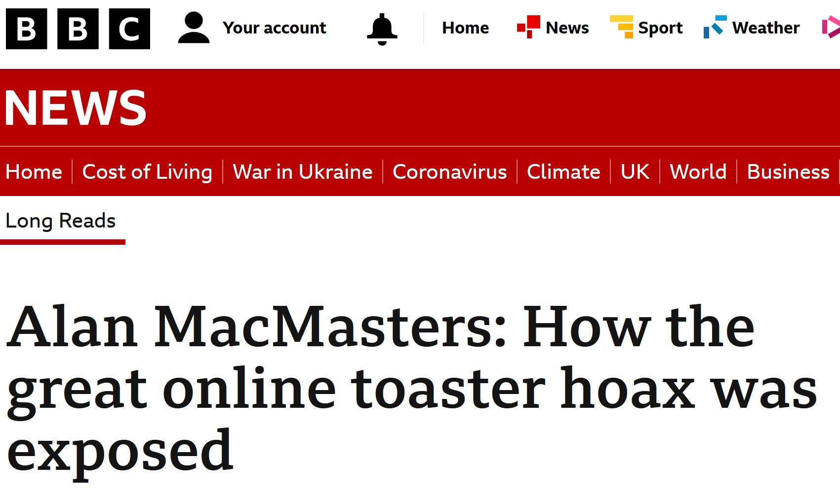
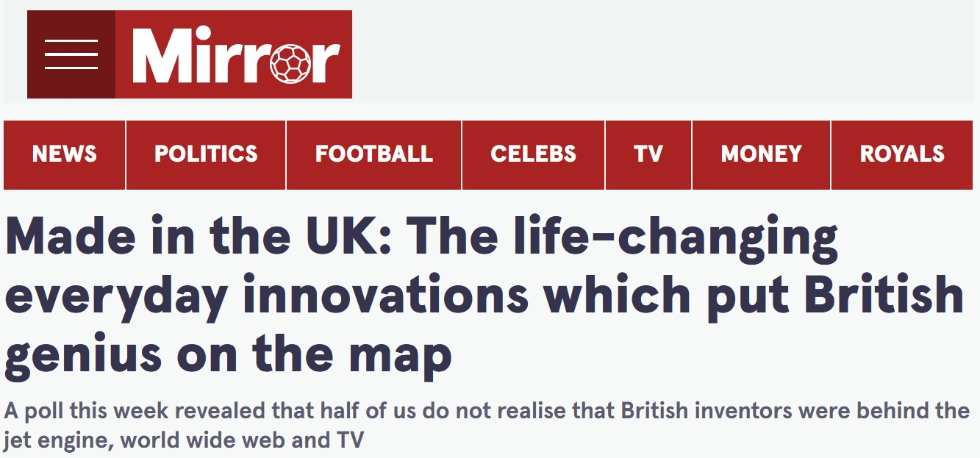
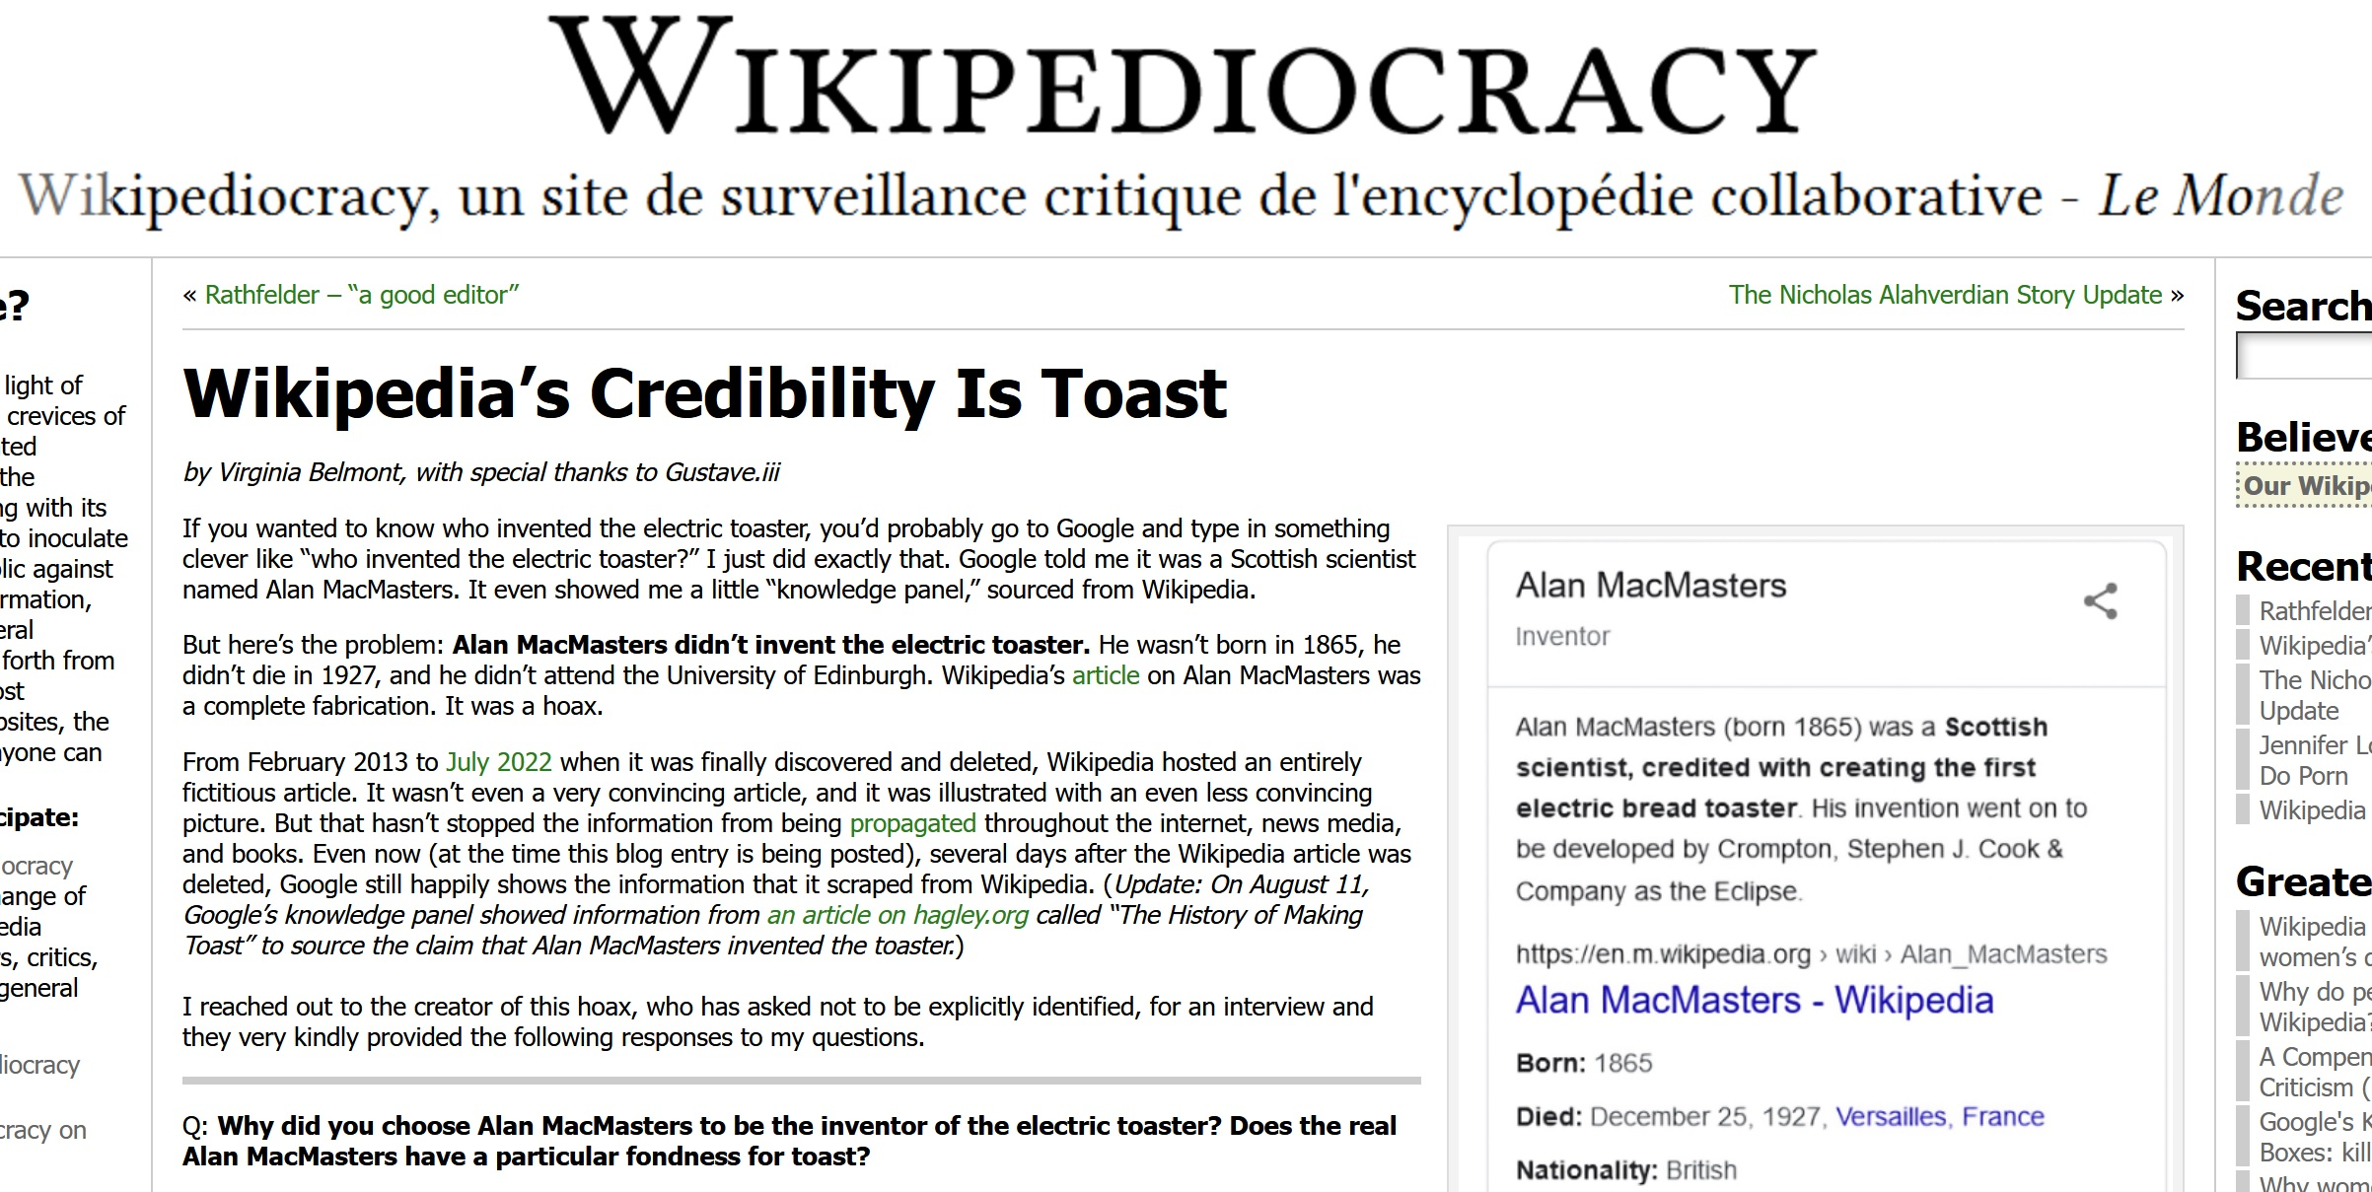
Notes:
The increase of “fake news” in online resources and metadata may encourage governments and other sources of library funding to invest in improving the balance between precision and recall in information retrieval services.
This example should be a wake-up call. A Wikipedia article about a Scot who invented the electric toaster turned out to be completely fabricated. Although Wikipedia relies on contributors cross-checking and correcting each other’s work, this article remained in Wikipedia for nine years.
The consequences are not trivial. The fake information was included in a list of “British genius” in a national newspaper, thus diminishing the achievements of the other persons listed.
The Wikipedia heading “Alan MacMasters” now redirects to “Reliability of Wikipedia”.
I guess this is similar to using the Dewey Decimal Classification 001.9 for “controversial knowledge”, recently augmented by 001.98 for “consipiracy theories”. Closer to home we have 001.944 “monsters and related phenomena”. Fine for “fake resources”, but what about “fake metadata”?

Slide 9
Conclusion
Turn off your mind
No, no, no; don’t rely on AI
Relax and float down stream
No, no, no; fight fake news
It is not dying
Mibbe ☺
Notes:
In conclusion, I think we should be using our intellectual powers more, not less. “Artificial intelligence” shows no signs of understanding the semantic and cultural environment of bibliographic resources or producing adequate metadata for improved precision in retrieval systems.
The set of skills required to create such metadata is now required to fight fake news and preserve the degree of neutrality and objectivity that the library profession extols.
We must actively develop and promote our skills in the current environment if the cataloguing profession is to survive.
The situation is uncertain.

Slide 10
The end?
Entity-based cataloguing
ISBD; UNIMARC; [RDA; BF]
National cultural identity in global framework
ISNI, etc.; localisation
Wikidata
Bottom-up UBC
Slainte!
Notes:
But there are signs of such skills development and promotion.
There is now a strong trend towards entity-based cataloguing, which will improve the interoperability between bibliographic metadata and the real-world metadata ecosystem of open linked data, folk metadata (social media), and machine-generated metadata. RDA and BIBFRAME are already optimized for entity-based cataloguing, and the IFLA standards ISBD and UNIMARC are being developed for it.
National agencies, including libraries and metadata creators, are becoming embedded in the administration and maintenance of cultural identifier systems such as the International Standard Name Identifier (ISNI) service. This is a form of localization within a global framework that improves metadata interoperability.
Wikidata is an open platform for publishing metadata in linked data format. It has the potential to be a major tool for “bottom-up” universal bibliographic control. But some of Wikidata is derived from Wikipedia, and is vulnerable to fake metadata.
“All play the game existence to the end of the beginning”

