Slide 1
Survival in the common information environment
Gordon Dunsire
Presented at 25. Seminar Arhivi, Knjižnice, Muzeji
Poreč, Croatia, 23 November 2022

Slide 2
Then (recorded memory)
Notes:
This presentation reviews the development of the theory and practice of the common information environment since it was first discussed at the AKM seminar in 2005.
These are the first and last slides of the 2005 presentation.

Slide 3
Then (again)
Notes:
A presentation given the following year, 2006, discussed the possible future outcomes of developing and maintaining a common information environment.

Slide 4
Now …
Notes:
Now, 16 years later, the outcome seems to be a jungle.

Slide 5
Jungles vs Parks
Notes:
The 2006 presentation contrasted the characteristics of a curated information environment, the ‘park’, with an environment that has little or no curation or professional intermediation.

Slide 6
In the meantime
Some significant changes:
Fake news (social media)
Pandemic (lockdown)
Wikidata (linked data)
Entity-based metadata
Notes:
There have been some significant changes in the information environment since 2006.
These four topics are selected to illustrate threats and opportunities for a curated environment, and to exemplify the connections between what appear to be disconnected developments.

Slide 7
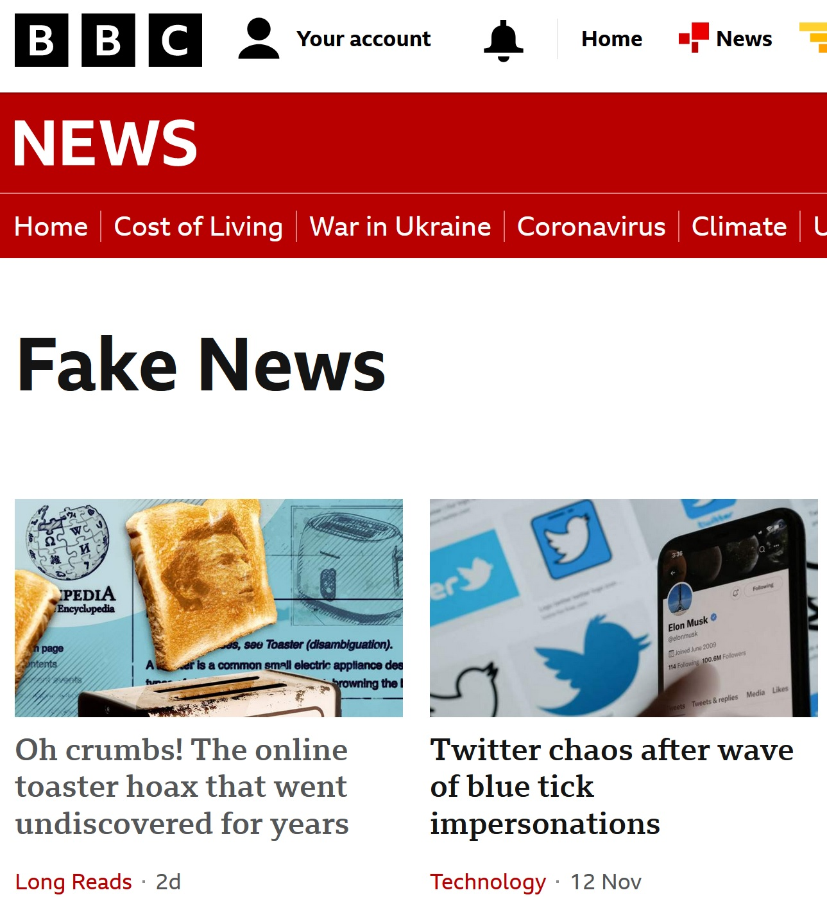
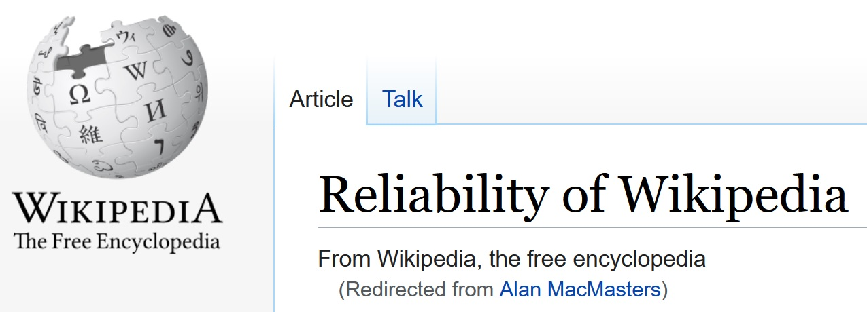
Fake news
Anyone can say Anything about Any thing
Famous Scot – not!
Notes:
Fake news, including low quality or false metadata, has become a major social problem.
It is a consequence of the Semantic Web’s AAA principle.
It is a ubiquitous problem; even the BBC has a special category for fake news.
The latest news item presented here is about a fake article in Wikipedia which remained undetected for over 10 years. The information in the article has been repeated by newspapers and discussions on the impact of national cultures on the international culture of the modern world.
The article claims that the electric toaster was invented by a Scot, Alan McMasters, but it is a prank. It survived for so long because its references are circular and it was assumed that the checks and processes used by Wikipedia editors were sufficient.
The incident is amusing, but it may also have serious, negative consequences; will it deter a tourist from visiting Scotland as the ‘home of modern engineering’?

Slide 8
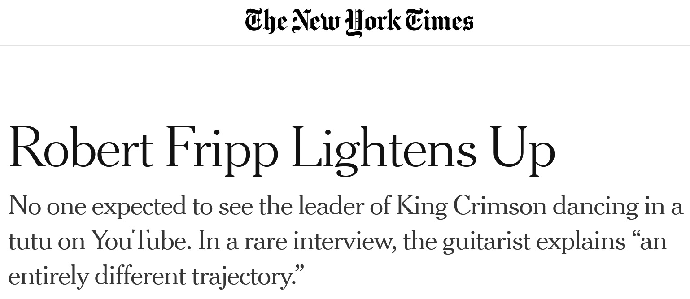
Pandemic
A major impact event?
Decentralisation of “infotainment”
Working from home
And playing, learning, creating …
Notes:
The COVID-19 pandemic is likely, in due course, to have a huge impact on the information environment for cultural heritage.
National lockdowns prevented access to the collections of cultural heritage organizations, and end-users had to find other ways of obtaining, and creating, information to support working from home, and other infotainment activities.
The impact on the creation of cultural artefacts is already apparent. The processes of production and publication of cultural output can be ‘in-house’; the AAA principle allows any person to be any kind of agent in the creation and dissemination of any cultural object.

Slide 9
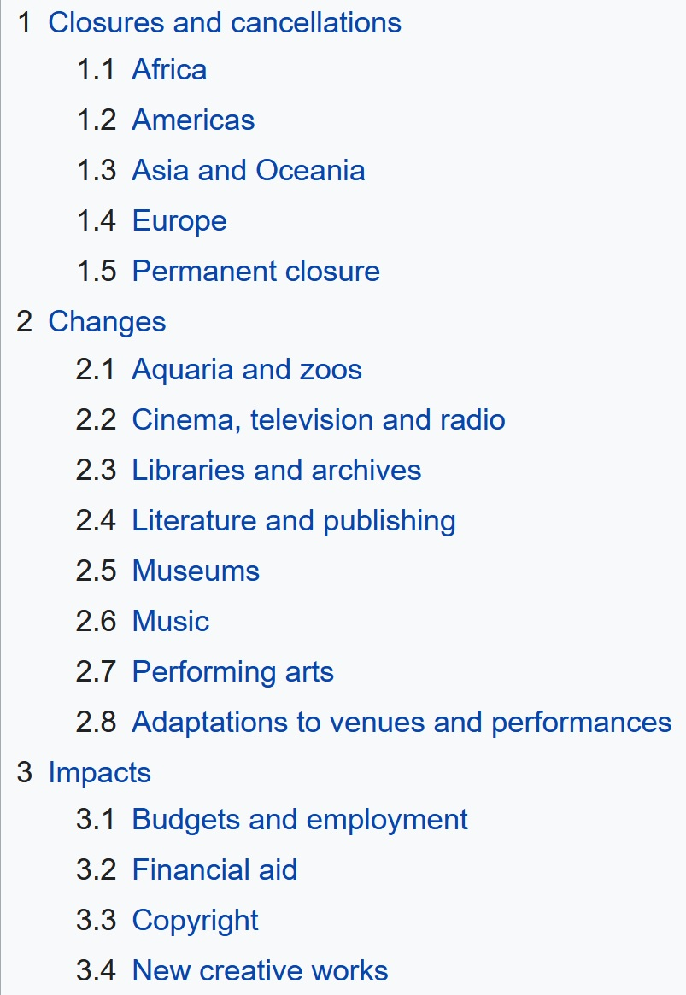
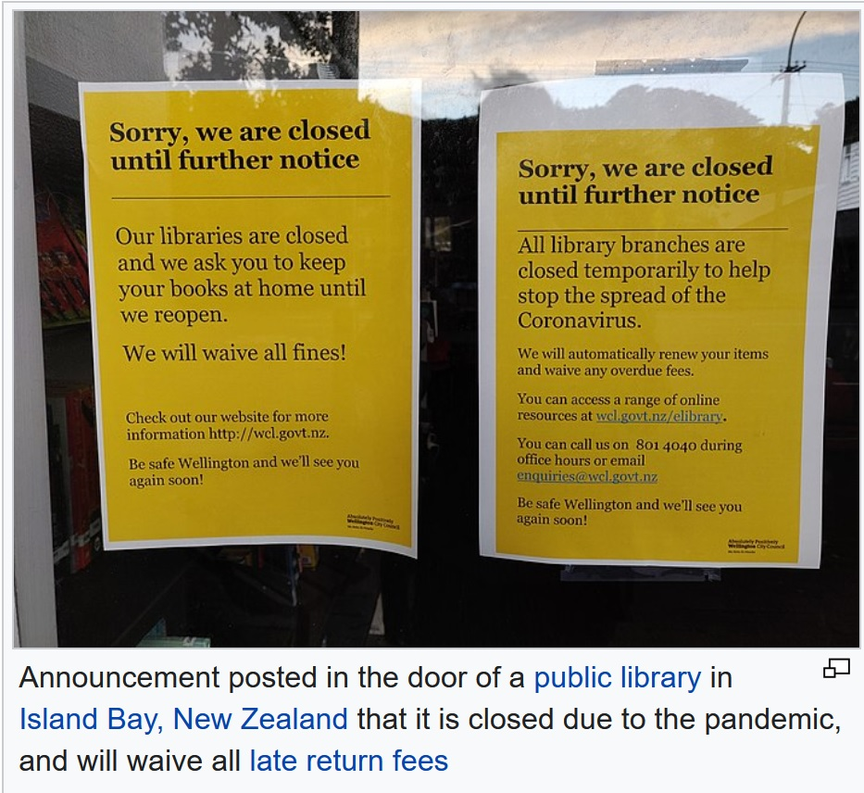
Notes:
Wikipedia, if it is to be believed, has a lengthy article on the impact of the pandemic on cultural heritage.
It calls attention to the disruption of physical access to information resources with an illustration of a ‘closed’ notice at a public library.
And it is interesting to note the contents headings, which specifically focus on the impact on libraries, archives, and museums.
The long-term effect is likely to be an increase in remote access to cultural heritage, using digitization and online metadata. This is an opportunity for developing the common information environment by applying common standards and changing focus from curation (archive, library, or museum) to content.

Slide 10
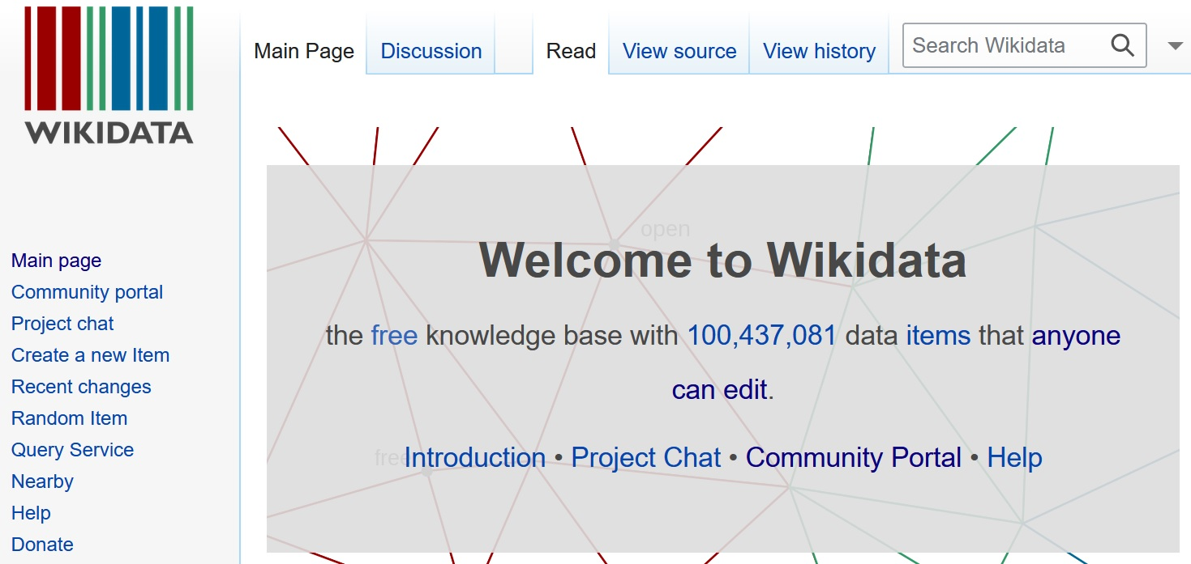
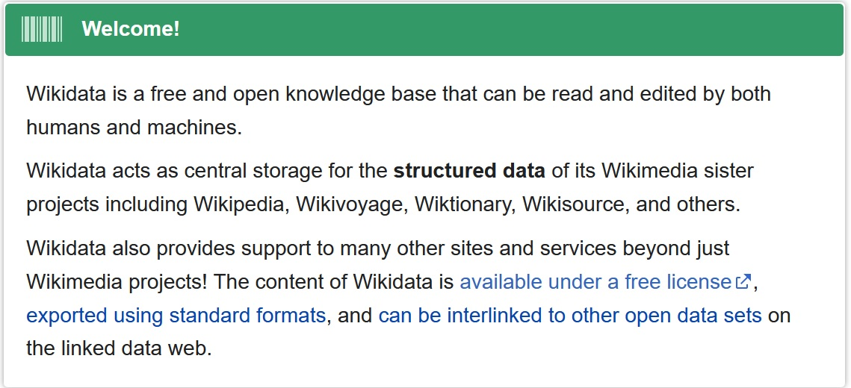
Notes:
Wikidata offers another opportunity for the common information environment.
The availability and functionality of commercial information management systems has declined rather than improved in the past 10 years. Wikidata offers a common platform for cultural heritage metadata that is intended for the Semantic Web and linked open data.
It is free and easy to access, and is suitable for bottom-up, ad hoc metadata publishing. Minimal barriers to re-use and application of the metadata help to encourage the development of a new generation of online information retrieval systems.

Slide 11
Entity-based metadata
Describing one thing at a time
IFLA Library Reference Model
ISBD
UNIMARC
RDA: resource description and access
CIDOC Conceptual Reference Model
Records in Context
BIBFRAME
Relationships + Interoperability
> Description + Display
Notes:
The recent trend towards entity-based metadata will also support development of the common information environment.
A focus on individual kinds of thing allows combinations of entities to be constructed for a wider range of contexts and functions. Metadata for an instance of an entity can be used in different description sets (‘records’) for library, archive, and museum applications.
The move towards entity-based metadata is having a big effect on the development of metadata standards across the cultural heritage communities.
One feature of this trend is a greater emphasis on relationships and interoperability of metadata for different entities.

Slide 12
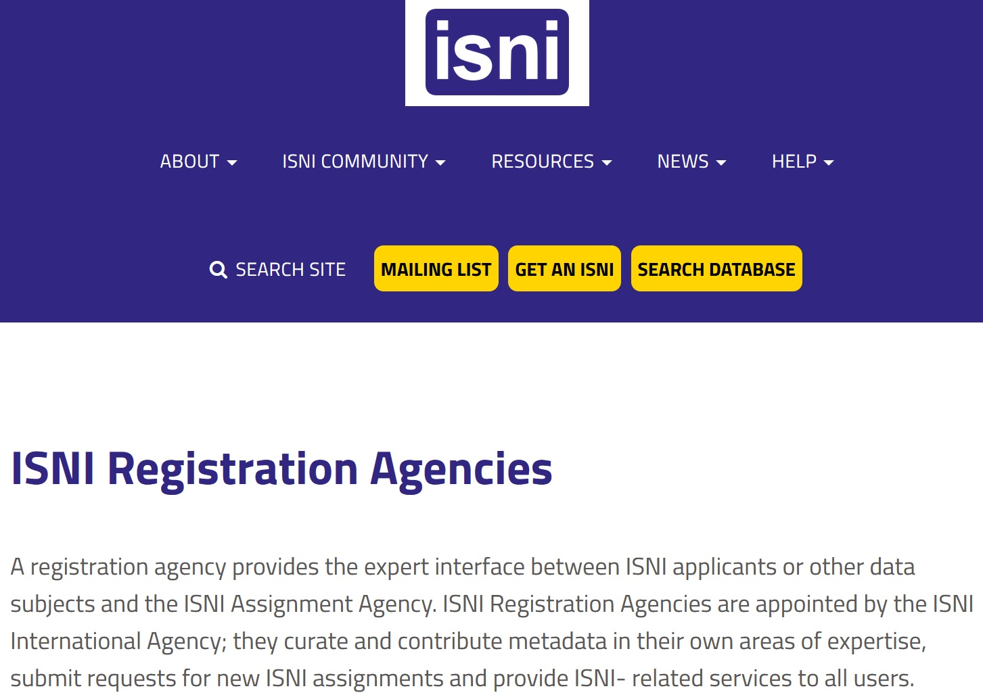
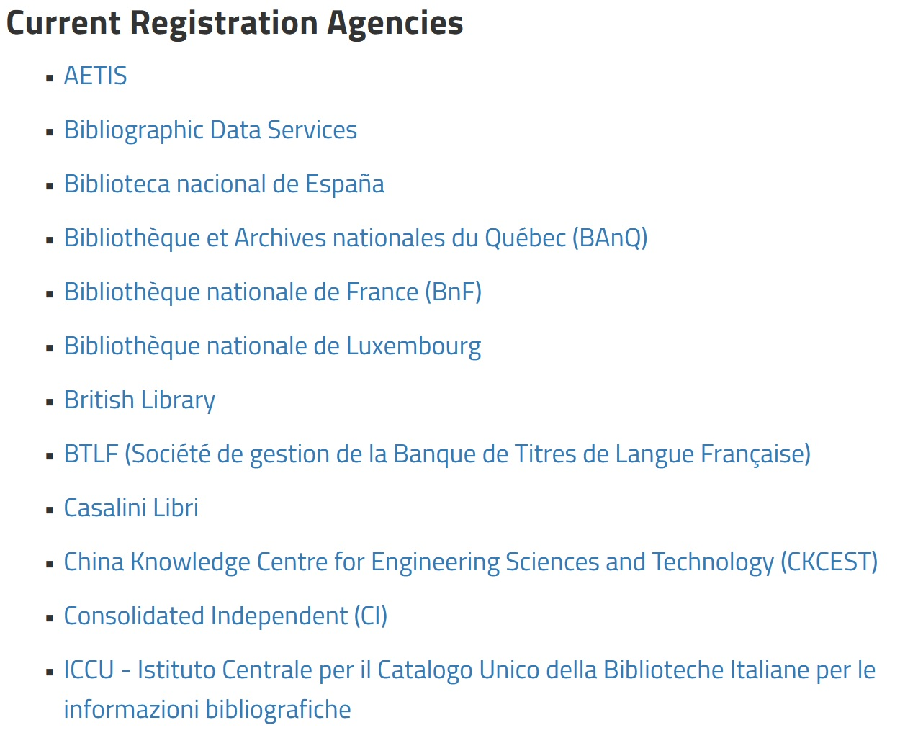
Cultural reference
Notes:
The trend towards entity-based metadata has encouraged the development of international identifier management. This supports metadata interoperability and linked open data by providing a “reference” identifier instances of entities that can be used to refer to a specific instance and link to it from other instances.
An example is ISNI, the International Standard Name Identifier. It has attracted the participation of many national libraries as registration agencies, and as experts in their national cultural environments.

Slide 13
In summary
Progress in cultivating the common information environment is slow
Resource, tradition, motivation drags
Direction of evolution generally remains the same
Environment continues to be impacted by events outside of professional control
Stay alert; stay focused; prepare to seize opportunities
Notes:
To summarise:
Progress in improving the common information environment has been slower than the 2005 presentation anticipated. The reasons are many and varied, but include lack of resourcing and funding, the problems of evolving traditional processes and applications, and the negative impact on motivation for ‘thinking globally’ in an unstable international geopolitical world.
However, there is no sign that the direction of evolution of the information environment has changed; we are still heading towards collaboration and commonality of purpose (which is to connect the user to their information resource).
The cultural heritage communities must expect the environment to suffer “the slings and arrows of outrageous fortune” that is beyond professional control.
But these communities should remain alert and focused on using the opportunities that will arise in a rapidly-changing scenario. The antidote to fake news is a well-curated cultural heritage collection.

Slide 14
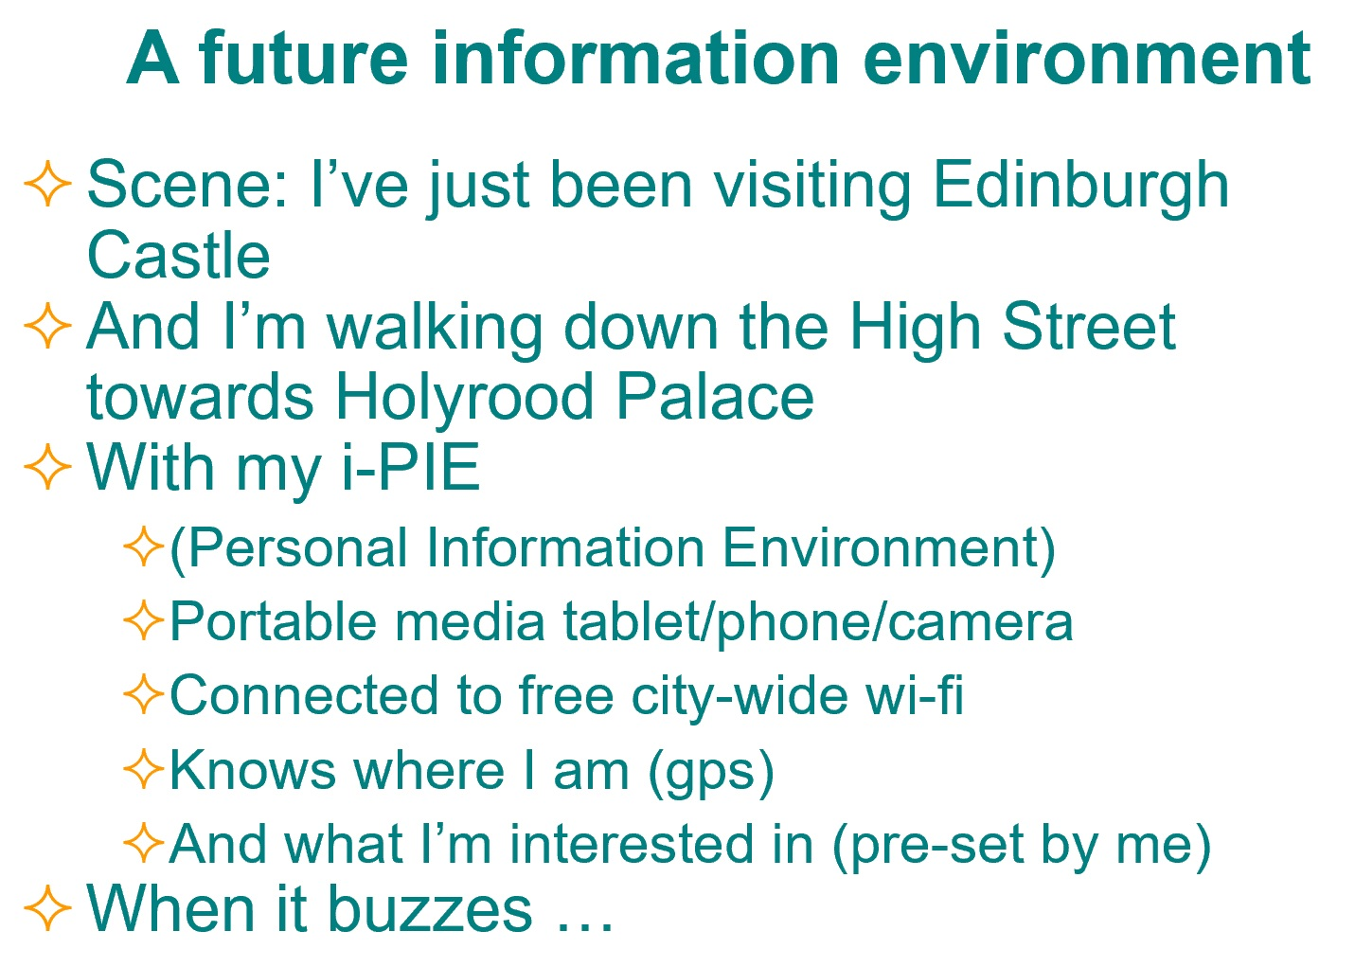
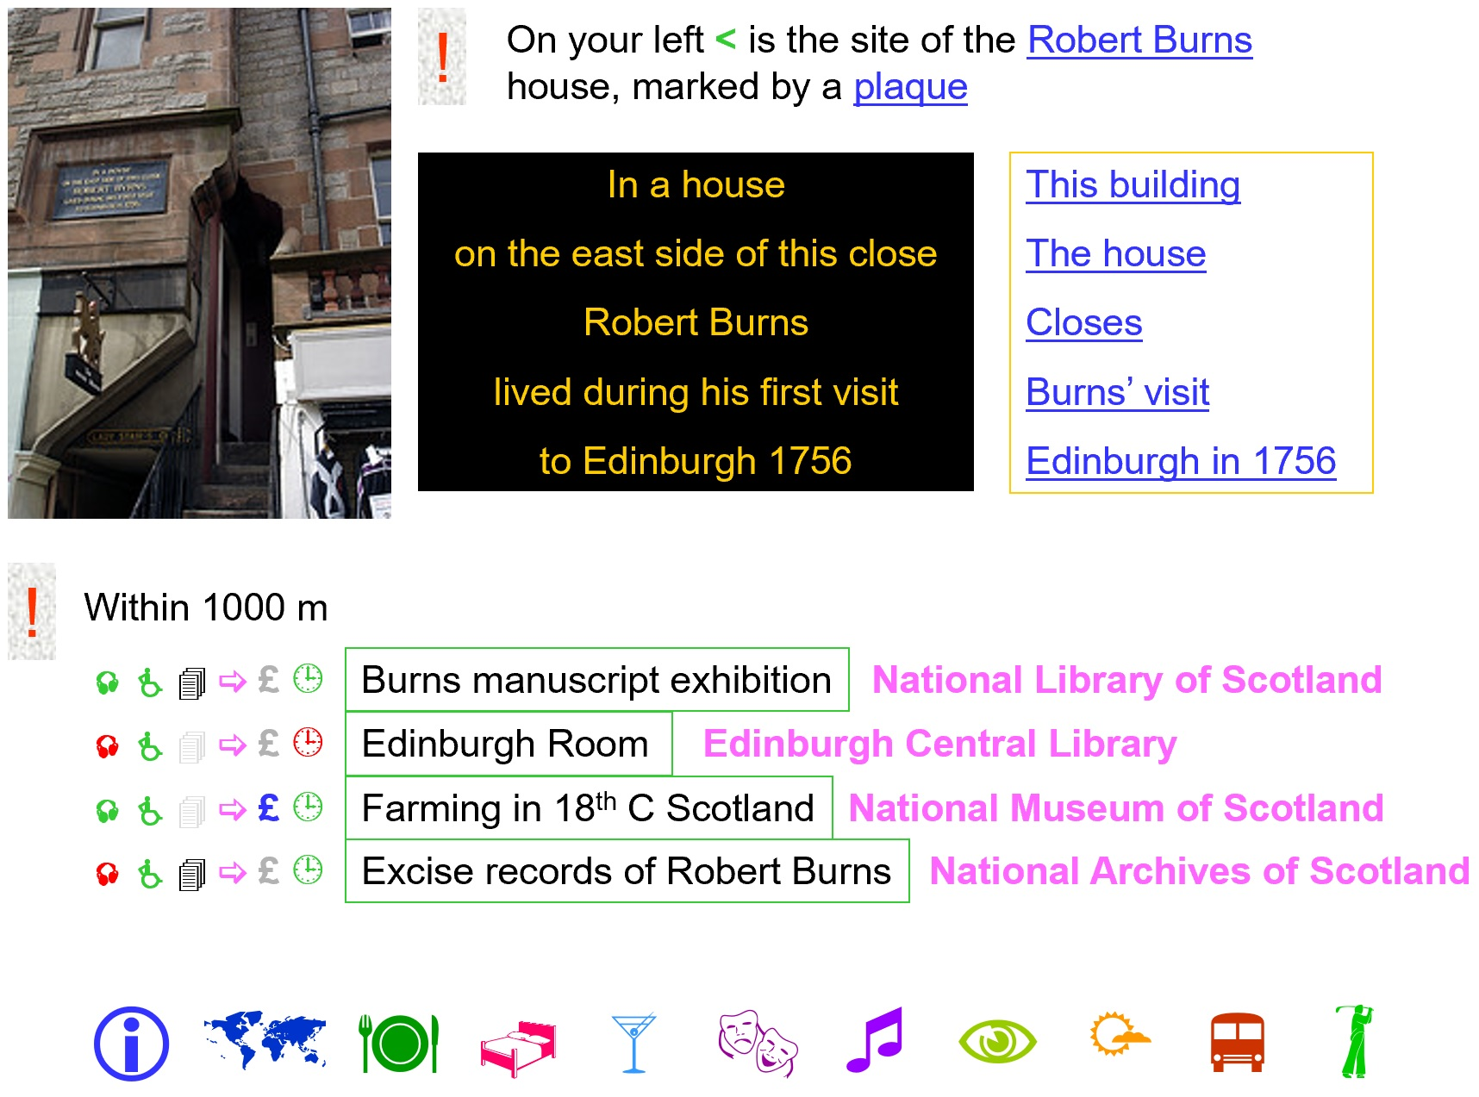
Real soon now …
Notes:
This was the vision in 2006.
It remains a valid vision for 2022.

Slide 15
Thank you!
Paper (2005)
https://www.researchgate.net/publication/228757541_The_Common_information_environment_a_newly_emerged_concept
Paper (2006)
https://www.researchgate.net/publication/28810200_Future_information_environments_deserts_jungles_or_parks
Next slides: Presentations (2005, 2006)
Notes:
The content of the original 2005 and 2006 presentations is appended for information.

Slide 16
The Common Information Environment: a newly emerged concept
Gordon Dunsire
Presented at Archives, Libraries, Museums 9 (AKM9), Porec, Croatia, 2005

Slide 17
Overview
Background and emergence
Scope
Issues
Scale
Scotland
Notes:
The presentation describes the background to, and emergence of, the idea of a common information environment.
It covers the scope of the environment, and briefly discusses some related issues.
The importance of scale is demonstrated, and recent developments in the common information environment of Scotland are presented.

Slide 18
Background
2001: UK Joint Information Systems Committee (JISC) Information Environment
Online service “that will offer convenient access to a comprehensive collection of scholarly and educational materials”
“a range of services, tools and mechanisms for colleges and universities to exploit fully the value of online resources and services.”
“the set of network or online services that support publishing and use of information and learning resources”
Notes:
The United Kingdom’s Joint Information Systems Committee started to develop the idea of a common information environment in 2001. These quotes are taken from its website at http://www.jisc.ac.uk/
The 1st quote is from Strategic Activities: Information Environment; see: http://www.jisc.ac.uk/index.cfm?name=about_info_env
The 2nd quote is from Investing in the Future: Developing an Online Information Environment; see: http://www.jisc.ac.uk/index.cfm?name=ie_home
The 3rd quote is from Information Environment: Development Strategy 2001 – 2005; see: http://www.jisc.ac.uk/index.cfm?name=strat_ieds0105_draft2
Emphases are not present in the original documents.

Slide 19
Background
2004: JISC Integrated Information Environment committee
“to develop an integrated information environment to support online resources of all types and wherever possible to develop common solutions across research, learning and teaching and digital libraries.”
Common Information Environment Working Group …
Notes:
Following the 2001 initiative, in 2004 JISC set up a committee to further develop the idea of an integrated information environment.
As the name suggests, this involves an information environment offering integrated sets of services, information and resources.
The quote is taken from JISC Integrated Information Environment committee terms of reference; see: http://www.jisc.ac.uk/index.cfm?name=jcie_tor
One of the first actions of the committee was to create the Common Information Environment Working Group.

Slide 20
Background
2004: Common Information Environment
“a group of significant public sector stakeholders working together to deliver information, services, and empowerment across a range of sectors in order to meet the cross-domain real world needs of the citizens of the UK.”
Includes British Library, UK e-Science Core Programme, JISC, Museums Libraries Archives (MLA), BBC, English Heritage, National Archives, e-Government Unit, National Library of Scotland, Scottish Library and Information Council,
Notes:
A common information environment extends the original JISC concept to encompass a wider range of services and resources, beyond Further and Higher Education and research interests.
It also includes physical as well as digital resources.
The quote is taken from Common Information Environment: about CIE; see: http://www.common-info.org.uk/about.shtml

Slide 21
Common Information Environment
Environment
Seamless; Joined-up; Everything related to everything else
Information
Find – Identify – Obtain – Use ( - Create – Manage – Preserve)
Common
All things to all people; Widest range of resources for widest range of users
Digital and physical
Notes:
The scope of a common information environment can be described under each of the component words of the phrase.
The environment contains seamless and joined-up services, with the underlying assumption that each information resource is potentially related to every other resource, for the benefit of the user.
The environment supplies services and resources to support the user’s needs for processing information, including the standard tasks of finding, identifying, obtaining, and using defined by the Functional requirements for bibliographic records (FRBR) produced by the International Federation of Library Associations and Institutions (IFLA). Other tasks required by professionals and mediators include the creation, management, and preservation of information resources.
The environment is common to all potential users, and recognises that any one user may undertake many different tasks for a wide range of purposes. The environment therefore offers the widest range of resources, including physical and digital information.

Slide 22
Issues
Access to the environment
Public access to computers and networks; social inclusion
Find-Identify resources
Metadata at collection and item level to allow initial “landscaping” and subsequent searching; metadata interoperability
Notes:
A range of issues associated with a common information environment can be readily identified. Those mentioned here are illustrative, and by no means exhaustive.
The environment must be accessible to a wide range of users. This involves ensuring that the public has access to appropriate computers and networks, and that problems of social inclusion are recognised and ameliorated. Factors such as educational background and level, language, cultural background, and motivation can be significant barriers to access even if the hardware is available.
Finding and identifying relevant items from a very wide range and quantity of information resources requires metadata at both collection and item level. Collection-level metadata can be used to make an initial selection of sets of resources for subsequent searching.
Interoperability of metadata at and between collection and item levels is a necessary requirement.

Slide 23
Issues
Obtain-Use resources
Inter-lending; document delivery; on-demand digitisation
Create resources
Digitisation frameworks, strategies and plans; intellectual property rights
Preserve resources
Digitisation; data security; digital preservation; web archiving
Notes:
Services to improve the user’s ability to obtain and use information resources must include inter-lending of physical items, physical and electronic duplication of documents for faster delivery, and digitisation of physical items as and when the user requires them. Appropriate software for accessing and displaying digital materials must be readily available and easy to use.
The creation of digital resources involves digitisation frameworks, strategies and plans to avoid duplication of effort, ensure a coherent approach, and share technical skills. The whole area of copyright and other intellectual property rights requires careful consideration to avoid complicated legal problems.
The preservation of resources involves the digitisation of fragile physical items, the complex issues of preservation of digital items, and the archiving of web sites.

Slide 24
Issues
Manage resources
Digital “libraries”; repositories; digital life-cycle
Curatorial boundaries are blurred in digital environments
Common approach needed
Standards for interoperability
High-level coordination
Sharing skills and infrastructure
Notes:
The management of digital information resources requires the development of digital libraries and institutional repositories, and acknowledgement of the digital life-cycle from creation to destruction or long-term preservation.
The term “digital libraries” can be misleading, as the traditional differences in approach undertaken by archives, libraries and museums tend to blur when resources are digitised and made available in a digital environment.
In fact, concepts and practices from all three of these domains are necessary to develop a truly common information environment. Some kind of common approach is required, to ensure the use of metadata interoperability standards and improve the sharing of skills, experience and infrastructure. High-level coordination between archives, libraries and museums is essential to achieve this.

Slide 25
Scale
Larger environment always acknowledged
JISC IE refers to global online infrastructure
Smaller scale environments predate JISC IE
Common (regional) or specific subjects or formats
Library cataloguing cooperatives, cross-sectoral and some cross-domain cooperatives
Example: Ayrshire Libraries Forum (1998)
“To make available services, facilities and materials for local access in support of the public's lifelong learning needs … to enable these services and facilities to form a part of the wider national grid for learning ”
Notes:
The scale or coverage of a common information environment is influenced by a number of factors.
The idea of an environment larger than the United Kingdom has been present in JISC’s thinking from the outset, with reference to a global scale. Indeed, the Internet itself is a component of a global infrastructure.
However, environments on a scale smaller than the UK were developed well before the JISC initiative. These are often based on regions, specific subjects, or specific formats of resources. The shared library cataloguing cooperatives of the 1960s are domain-specific (non-common) environments. These have been followed by numerous examples of consortia of public and education libraries, and some cross-domain initiatives involving archives, libraries and/or museums.
An example of a library information environment from Scotland is the Ayrshire Libraries Forum, created in 1996.
The quote is taken from Ayrshire Libraries Forum mission statement; see: http://library.paisley.ac.uk/alf/alfomiss.htm

Slide 26
Scale
Overall concept/model is therefore hierarchical
Practical issues in scale (granularity)
Critical mass is required to make investment efficient and effective, but larger-scale coverage is more difficult to achieve
Natural focus at regional/national level
Common IE is not topic-specific
Culture, education, laws, language offer well-defined, co-extensive boundaries
Notes:
The overall model of a common information environment is therefore hierarchical. Any particular environment is likely to include smaller, autonomous environments, and itself is likely to be part of ever-larger environments which eventually reach global level.
However, the current state of development of the common information environment is patchy, with some components well-established and others still at the research and planning stages. Significant investment is still required, with a reasonably quick return in the form of functional services.
This suggests that environments should be planned for critical mass; not too small so that central infrastructure investment is justified, and not too large so that the results of investment can be made available without long delays.
Natural scales taking these factors into account already exist in the form of small nations or the regions of larger countries. The common information environment based on national or regional boundaries provides a general approach covering all topics, and does not come into conflict with cultural, educational, legal or linguistic issues which usually share the same boundaries.

Slide 27
Scotland
1998-2005: Research and development of databanks and services
Project-based
Scottish Collections Network (SCONE); distributed union library catalogue (CAIRNS)
Co-ordinated by Confederation of Scottish Mini-Cooperatives (CoSMiC)
Informal umbrella for Ayrshire Libraries Forum, etc. and national bodies for archives, libraries and museums
Notes:
A common information environment for Scotland has been in development since 1998. From this date, a number of projects have involved the research and development of nationally-scoped databanks and services, resulting in the embryonic collection-level metadata service SCONE and the Z39.50-based distributed catalogue of the Cooperative Information Retrieval Network for Scotland (CAIRNS). See: http://cairns.lib.strath.ac.uk/ and http://scone.strath.ac.uk/service/index.cfm
These initiatives have been coordinated by CoSMiC, which is an umbrella group seeking to foster collaboration between archives, libraries and museums. It is informal, without official sanction or independent funds. It was originally set-up to coordinate the activities of regional library environments such as the Ayrshire Libraries Forum, but now has representatives of the national organisations for archives, libraries and museums in Scotland; see: http://cosmic.cdlr.strath.ac.uk/

Slide 28
Scotland
Sep 2005: Report on digital media services for the Scottish Executive
“the nascent common information environment that has been developed in Scotland”
“an interoperability framework and collection of common services and data”
Notes:
Recently, these developments have been acknowledged in a consultants’ report on digital media services commissioned by the Scottish Executive.
For the first time, the phrase “common information environment” has been formally brought to the attention of the Scottish government.
The quotes are taken from An audit of digital media services in Scotland’s tourist, sporting and cultural organisations; see: http://www.scotland.gov.uk/Publications/2005/09/2784132/41331

Slide 29
Scotland
Dec 2005: Cultural Technical Group
Discuss and promote technical standards for cultural organisations
Reports to Common Infrastructure Standards Advisory Group (CISAG) of the Scottish Executive
Openscotland Information Age Framework (OSIAF): Delivering interoperability through common standards across the Scottish public sector
Notes:
Further development of the Scottish common information environment will be significantly aided by the recent formation of a Cultural Technical Group reporting to the Scottish Executive through CISAG.
The CTG will coordinate and promote the use of technical standards for information resources and services offered by cultural organisations in Scotland. This should improve interoperability and strengthen the common information environment.
CISAG itself has been operating for a number of years. One of its most important activities is the development of OSIAF to improve interoperability across all services and resources within publicly-funded organisations in Scotland; see: http://www.scotland.gov.uk/topics/government/open-scotland/19913/21663

Slide 30
Scotland
Waiting for …
Action on recommendations of the Cultural Commission (June 2005)
Scottish Executive digital media strategy
National digitisation framework
Funds!
Notes:
Other factors affecting further development of the common information environment for Scotland are pending.
The Cultural Commission set-up by the Scottish Executive reported in June 2005, and action on its recommendations is imminent; see: http://www.culturalcommission.org.uk/cultural/files/Final%20Report%20June%2005.pdf
The outcomes of the report on digital media strategy are also awaited.
There has been much talk of a national digitisation framework for Scotland, but little practical development so far.
And investment funds are always required.

Slide 31
In other words
A common information environment offers easy, convenient access to the widest range of information resources catering for the widest range of needs of the widest range of users
It requires the collaboration of archives, libraries, museums and governments
AKM continues the process for Croatia …
Notes:
To sum up:
A common information environment seeks to benefit the user, and it requires the collaboration of archives, libraries, and museums.
The AKM series of seminars for Croatian archivists, librarians, and museologists is now in its 9th year, and is a necessary and significant activity for the development of a common information environment for Croatia.
But it is essentially a bottom-up approach, driven by practioners with high professional ideals. To build on this work, it is necessary to develop a complementary top-down approach involving the government which can ensure existing efforts are properly supported for the benefit of the country as a whole.

Slide 32
Thank you
g.dunsire@strath.ac.uk

Slide 33
References (1)
JISC
Strategic Activities: Information Environment
http://www.jisc.ac.uk/index.cfm?name=about_info_env
Investing in the Future: Developing an Online Information Environment
http://www.jisc.ac.uk/index.cfm?name=ie_home
Information Environment: Development Strategy 2001 – 2005
http://www.jisc.ac.uk/index.cfm?name=strat_ieds0105_draft2
JISC Integrated Information Environment committee terms of reference
http://www.jisc.ac.uk/index.cfm?name=jcie_tor

Slide 34
References (2)
Common Information Environment: about CIE
http://www.common-info.org.uk/about.shtml
Ayrshire Libraries Forum mission statement
http://library.paisley.ac.uk/alf/alfomiss.htm
Scottish Collections Network (SCONE)
http://scone.strath.ac.uk/service/index.cfm
Cooperative Information Retrieval Network for Scotland (CAIRNS)
http://cairns.lib.strath.ac.uk/

Slide 35
References (3)
CoSMiC
http://cosmic.cdlr.strath.ac.uk/
An audit of digital media services in Scotland’s tourist, sporting and cultural organisations
http://www.scotland.gov.uk/Publications/2005/09/2784132/41331
Openscotland Information Age Framework (OSIAF)
http://www.scotland.gov.uk/topics/government/open-scotland/19913/21663
Our next major enterprise: final report of the Cultural Commission
http://www.culturalcommission.org.uk/cultural/files/Final%20Report%20June%2005.pdf

Slide 36
Future information environments: deserts, jungles or parks?
Gordon Dunsire
Presented at Archives, Libraries, Museums 10 (AKM10), Porec, Croatia, 2006

Slide 37
Information environment
From AKM9:
“A common information environment offers easy, convenient access to the widest range of information resources catering for the widest range of needs of the widest range of users
It requires the collaboration of archives, libraries, museums and governments”

Slide 38
Landscaping
Identifies collections of resources likely to meet an enquirer’s information needs
In the common information environment of archives, libraries, museums, …
Identifies item-level finding-aids for those collections
Cross-searchable or separate

Slide 39
Ideal landscaping service
Is transparent to the enquirer
Enquirer inputs what they are interested in
Person, organisation, place, event, subject
Service outputs information about relevant resources
What items, where they are located, when they can be accessed, how they can be used

Slide 40
Deserts
Metadata for collections or items is
Incomplete and inconsistent
Out-of-date and unreliable
Difficult to find and use
Sparse, scattered, disconnected

Slide 41
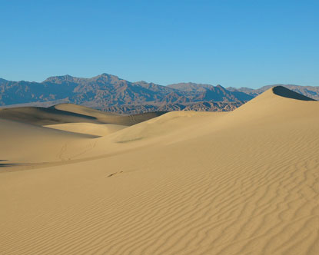
The Old 5-star Information Mine
There?
Over here?
Here?
Or is it here?
Try digging here

Slide 42
Jungles
Metadata is:
Inconsistent
Duplicated many times over
In multiple versions and formats
Produced by commercial and political groups as well as cultural organisations
Circuitous to use
Dense, undifferentiated

Slide 43
The Elixir of Universal Answers
Is in here!
!
!
!
!
!
!
!
!
!
Somewhere …

Slide 44
Parks
Metadata is:
Consistent, coherent and complete
Rich enough to be used flexibly
Contextualised, appropriate, and relevant
Clear, distinguishable

Slide 45
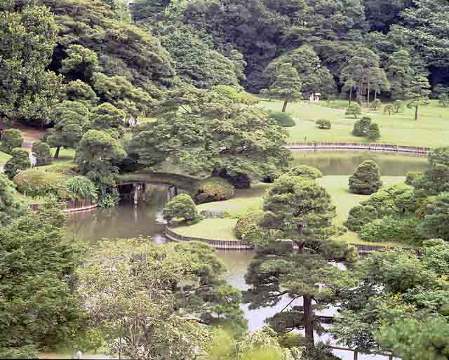
The well-professed garden
Look here
And here
And here
Please explore – all paths are signposted

Slide 46
Some gardening tools
Authoritative headings
Metadata at all levels of granularity using consistent and coherent labels for referencing “cultural” objects
People, organisations, places, events, themes, topics
Quality control and metadata workflows
Currency and completeness
Versions and duplicates
Full-text indexing and “smart” tagging
Digital/digitised texts
Not just primary information resources
Secondary (abstracts, summaries, indexes)
Tertiary (directories)

Slide 47
A future information environment
Scene: I’ve just been visiting Edinburgh Castle
And I’m walking down the High Street towards Holyrood Palace
With my i-PIE
(Personal Information Environment)
Portable media tablet/phone/camera
Connected to free city-wide wi-fi
Knows where I am (gps)
And what I’m interested in (pre-set by me)
When it buzzes …

Slide 48
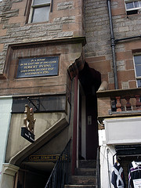
!
On your left < is the site of the Robert Burns house, marked by a plaque
In a house
on the east side of this close
Robert Burns
lived during his first visit
to Edinburgh 1756
This building
The house
Closes
Burns’ visit
Edinburgh in 1756
!
Within 1000 m
 ⬆   £ 
Burns manuscript exhibition
National Library of Scotland
 ⬆   £ 
Edinburgh Room
Edinburgh Central Library
 ⬆   £ 
Farming in 18th C Scotland
National Museum of Scotland
 ⬆   £ 
Excise records of Robert Burns
National Archives of Scotland
 ✗         

Slide 49
Thank you
With fingers crossed that some of this will happen!
g.dunsire@strath.ac.uk

