Slide 1
RDA Toolkit - the facilities within the new version
Gordon Dunsire, RDA Technical Team Liaison Officer
Presented at IFLA Satellite meeting on RDA, Aristotle University of Thessaloniki, 21 August, 2019

Slide 3
Submit feedback
BETA!
Under development
Not authorized

Slide 4
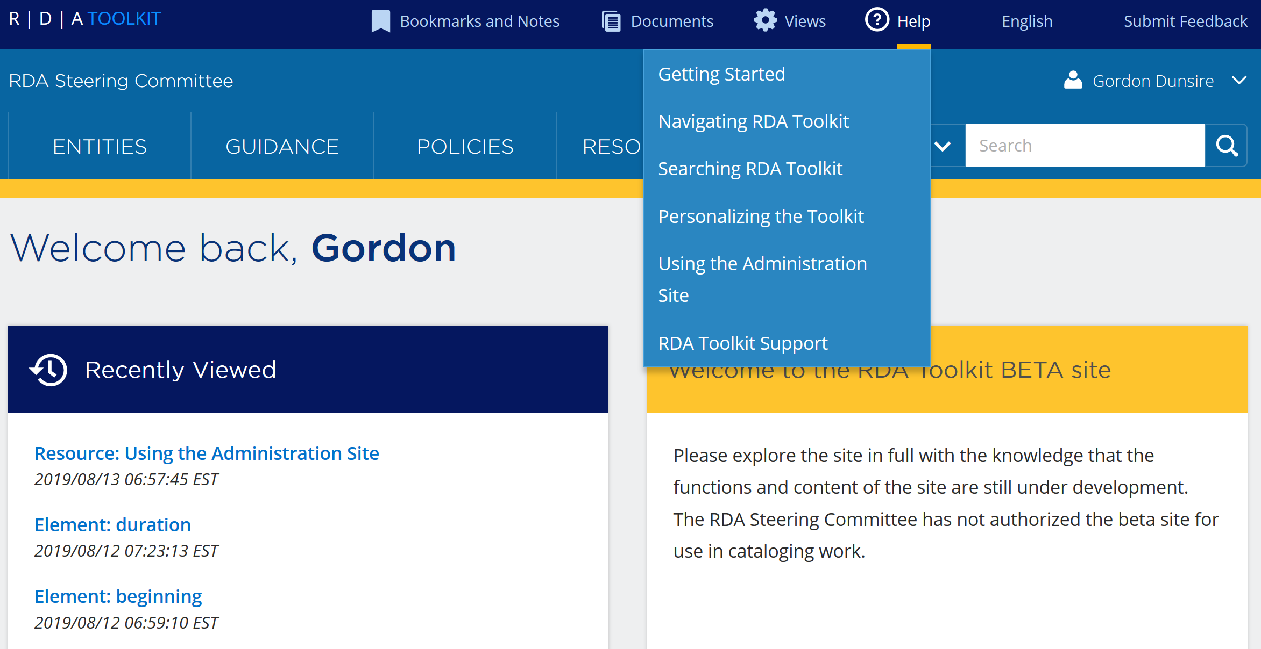

Slide 5
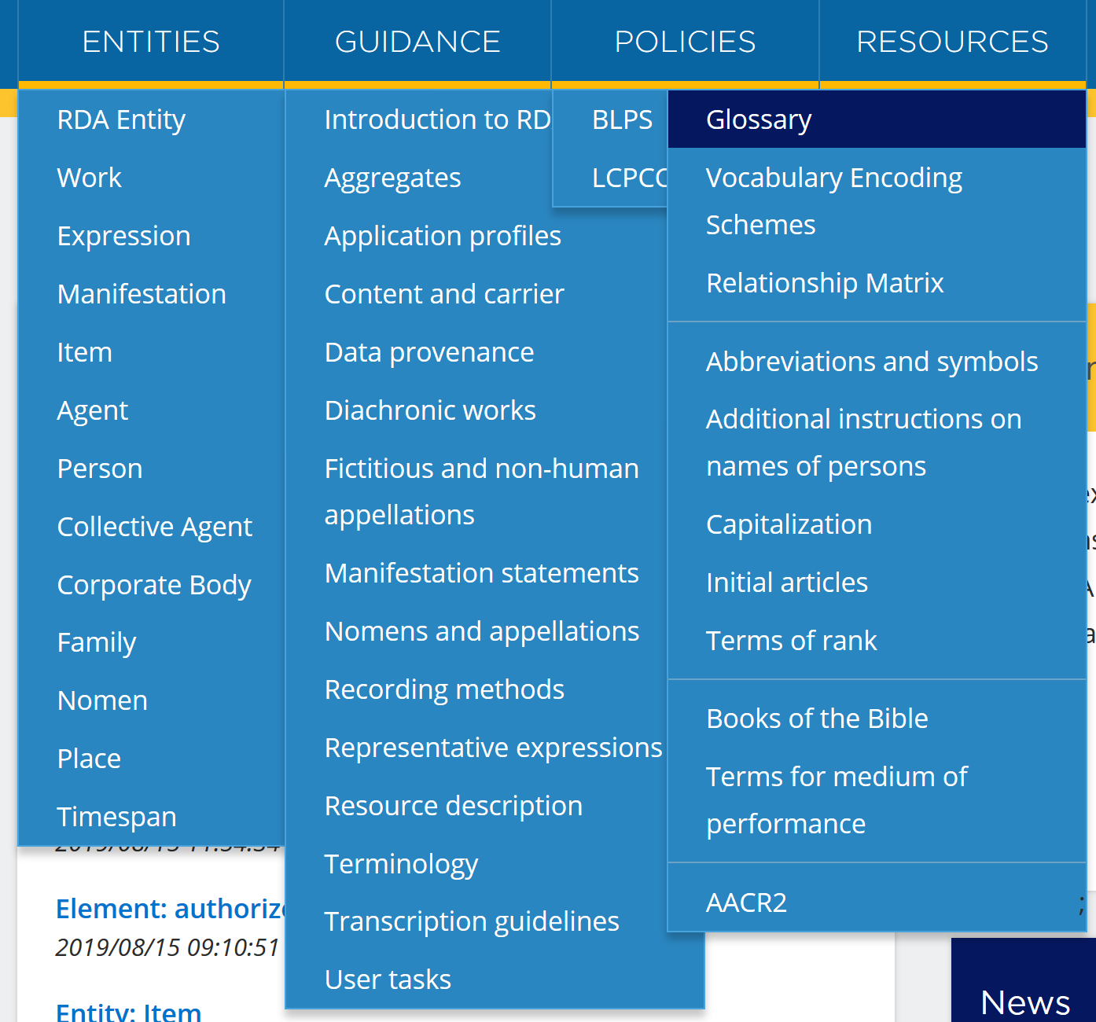
Main menus

Slide 6
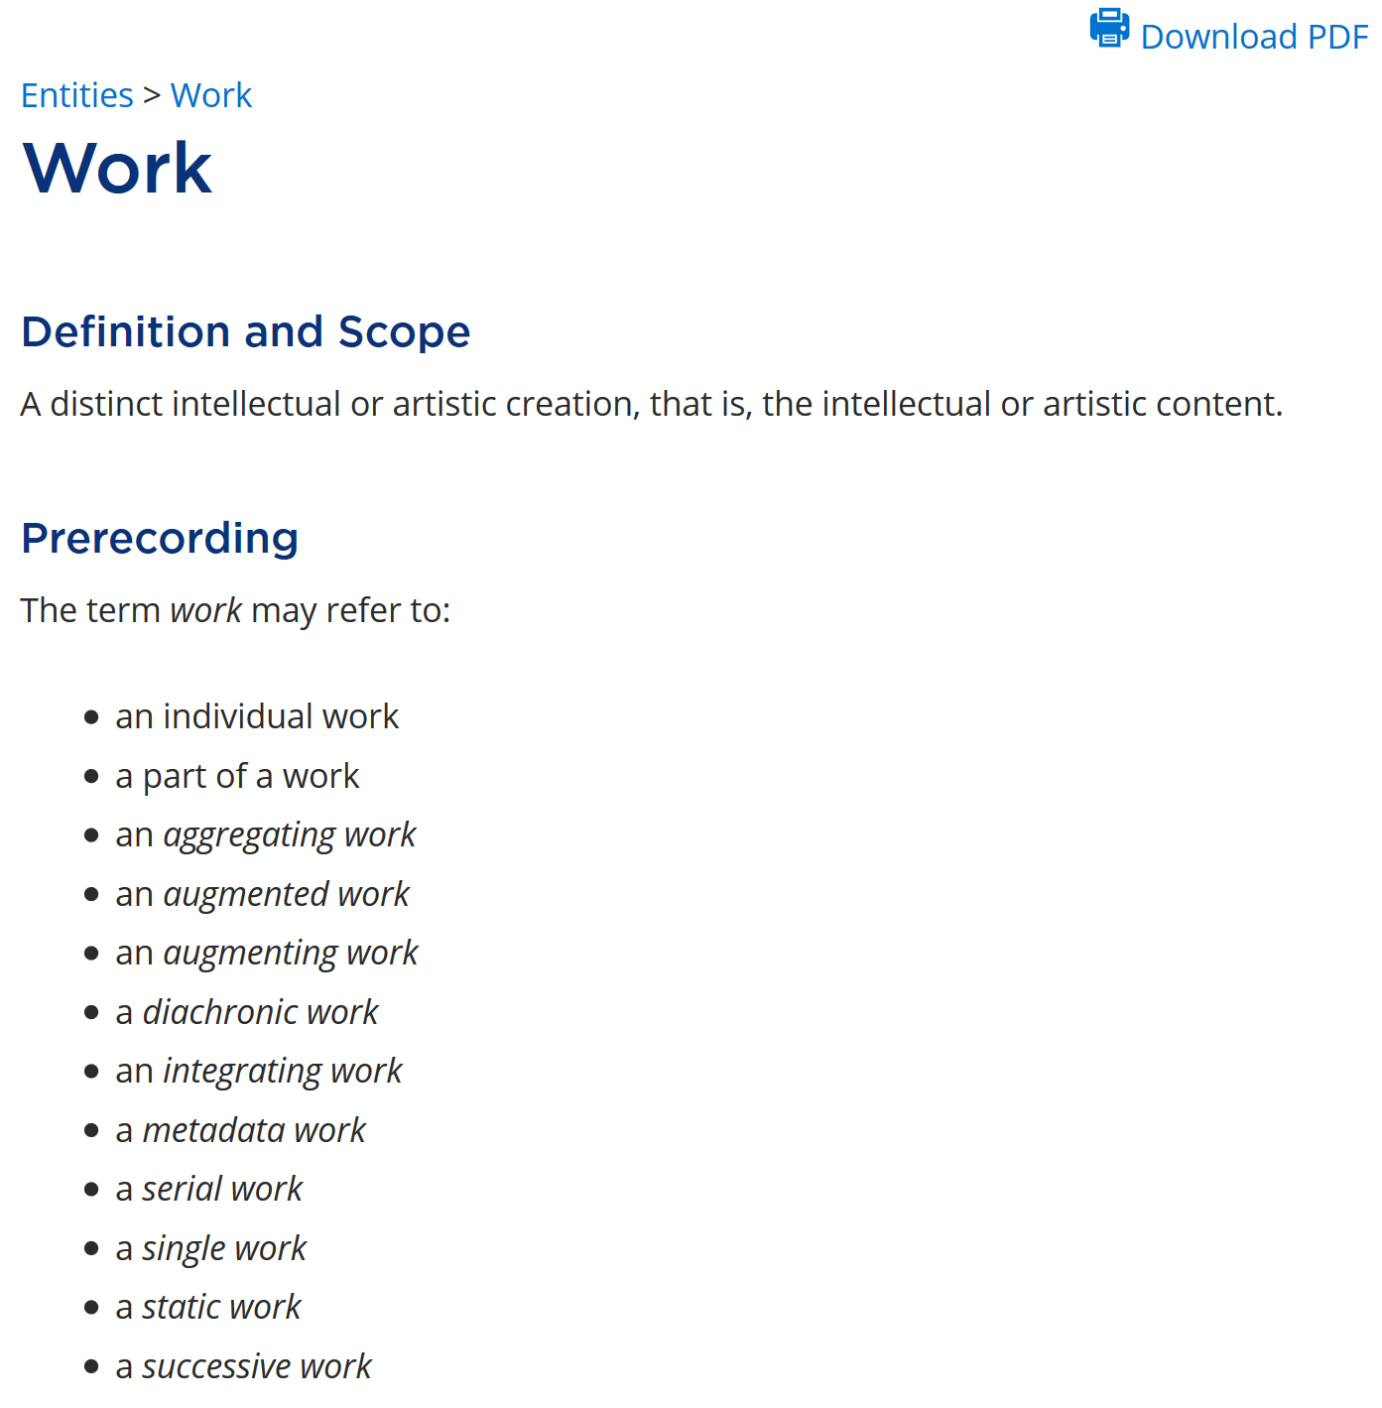
Entity page

Slide 7
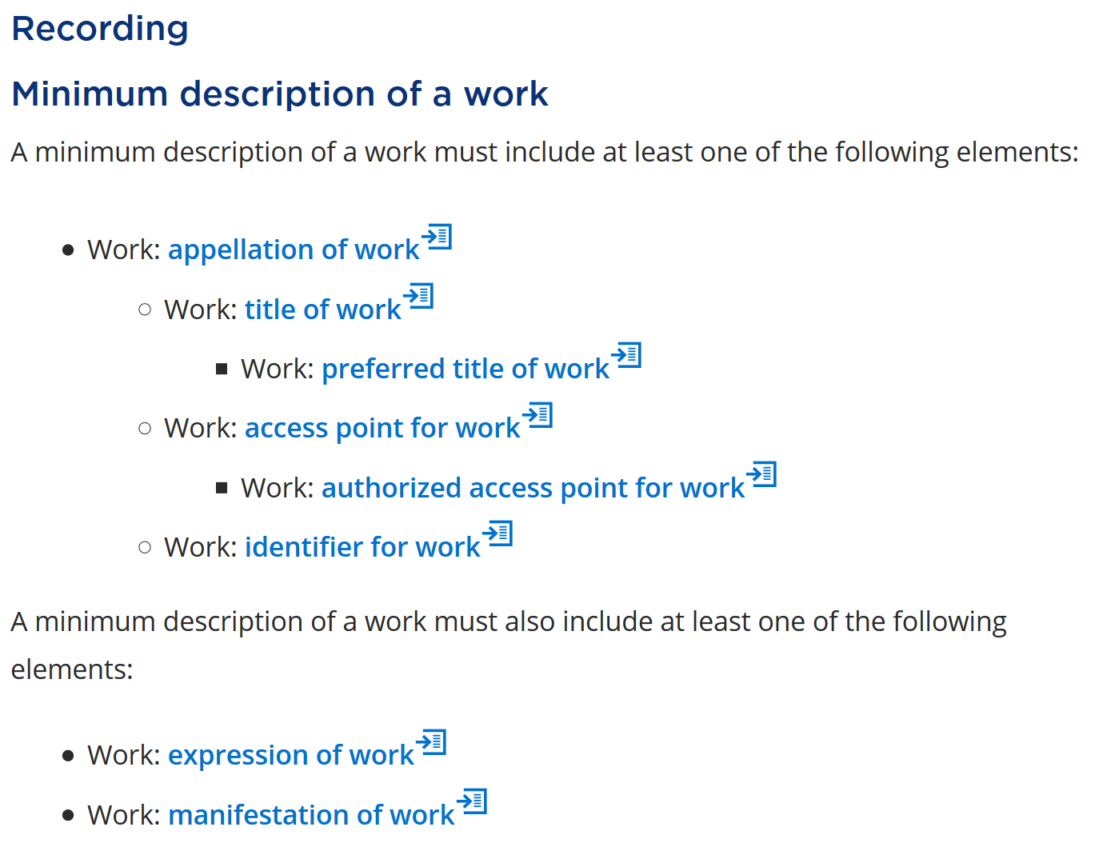

Slide 8
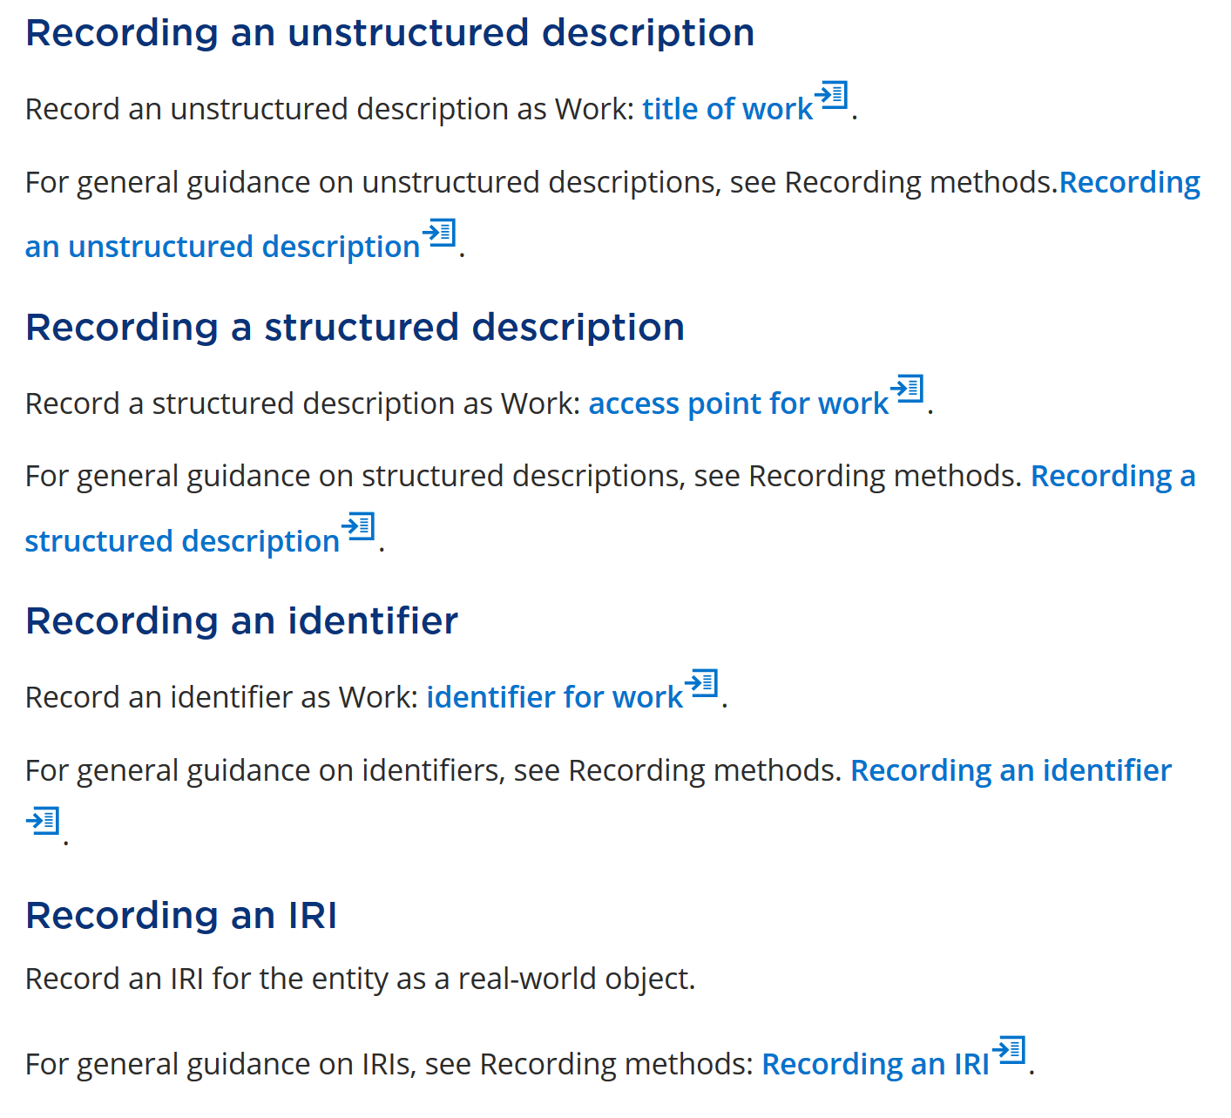

Slide 9
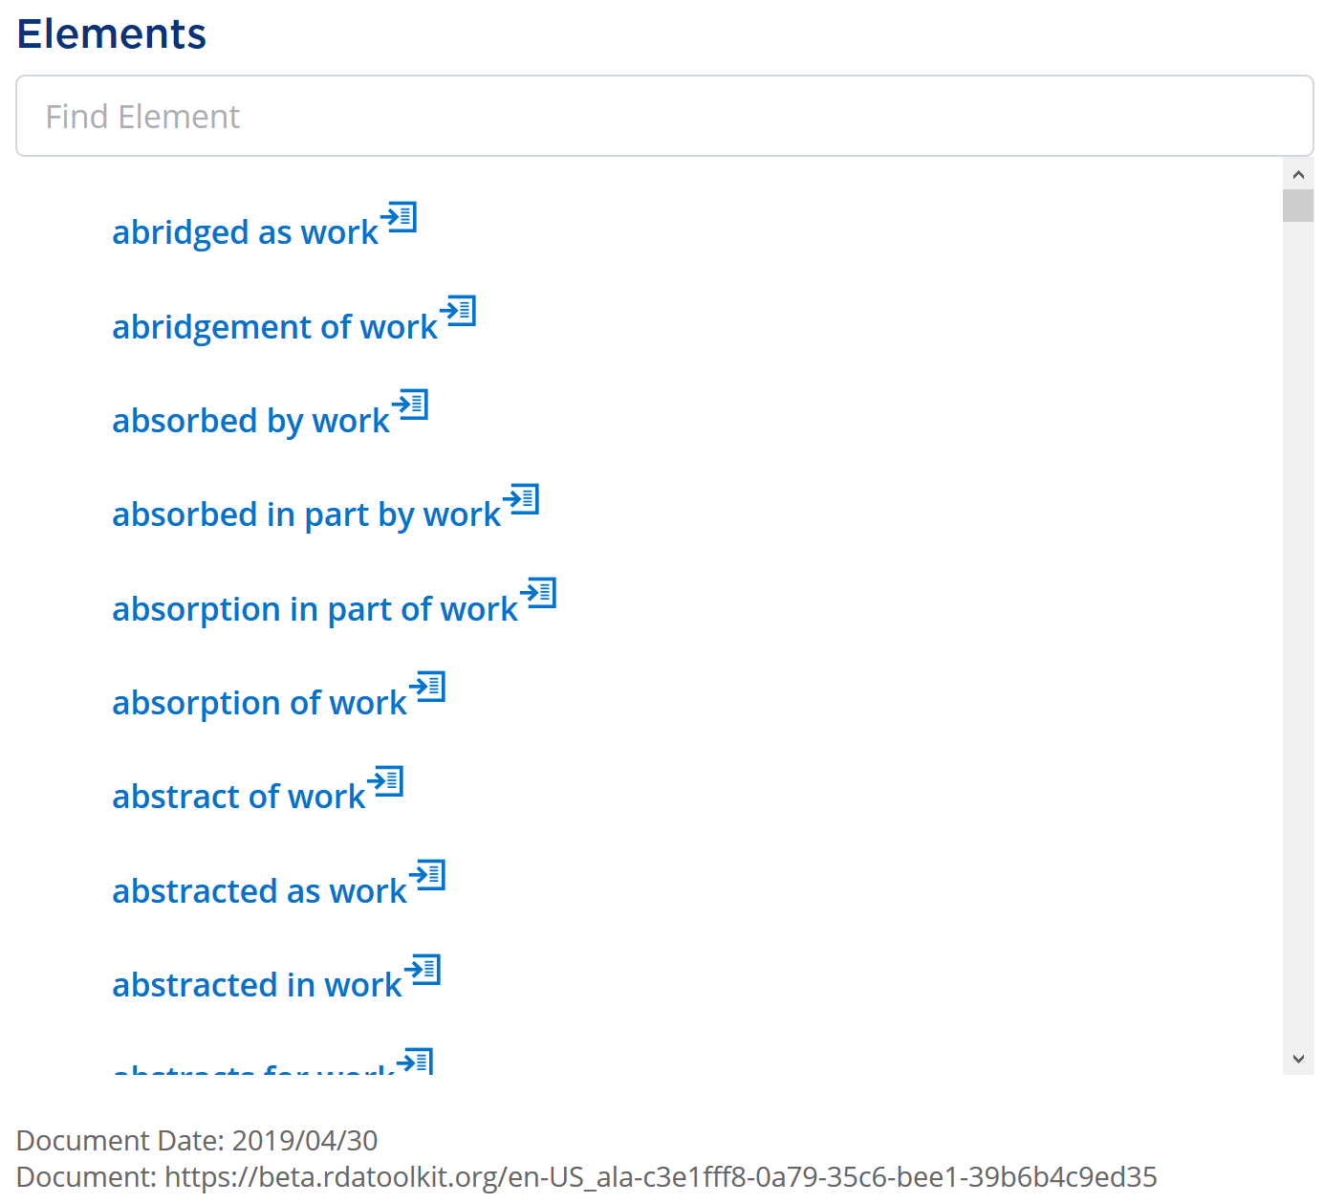
Page URL

Slide 10
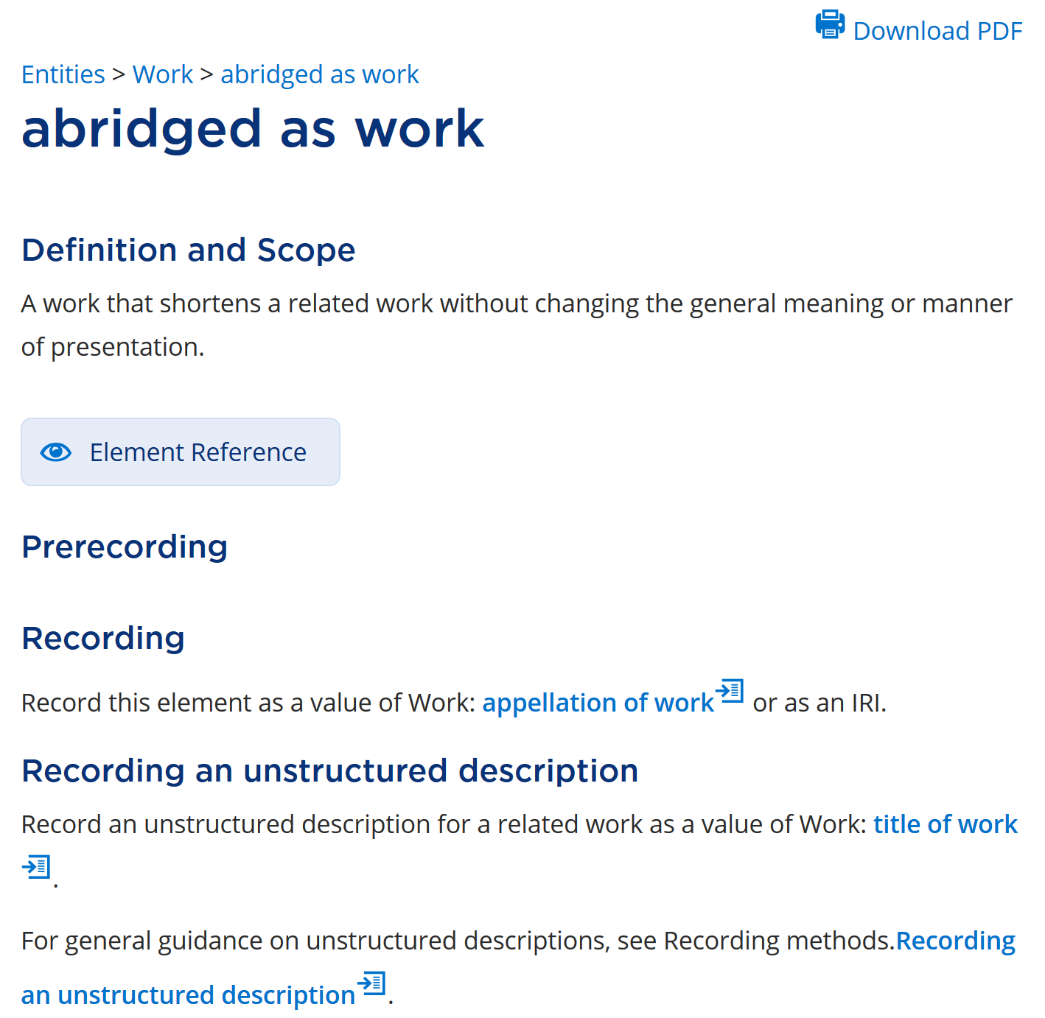
Element page

Slide 11
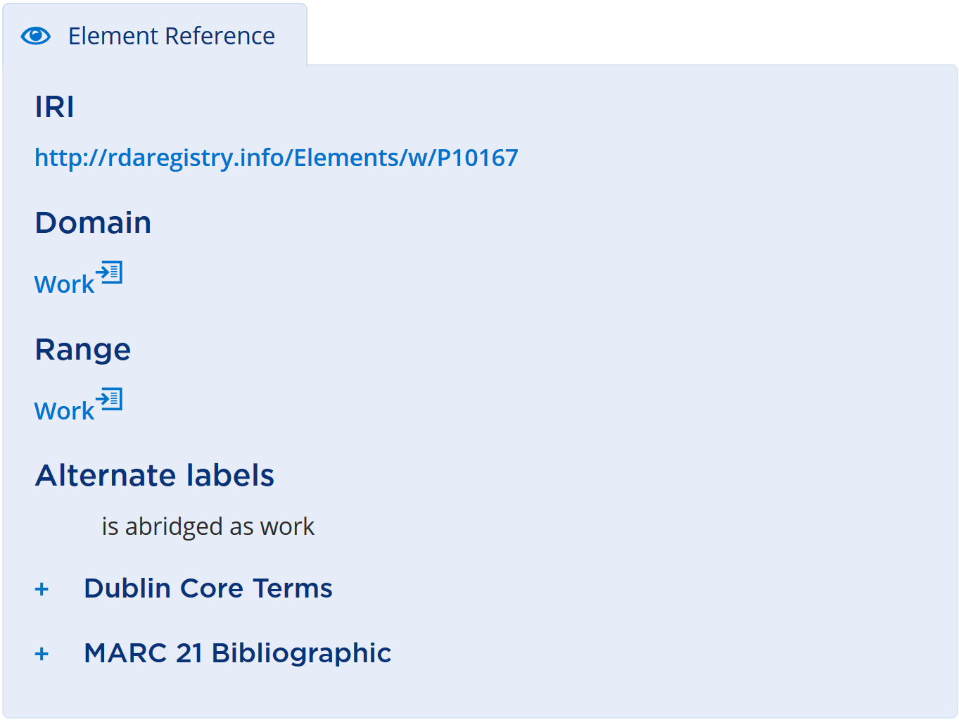
Semantic
context

Slide 12
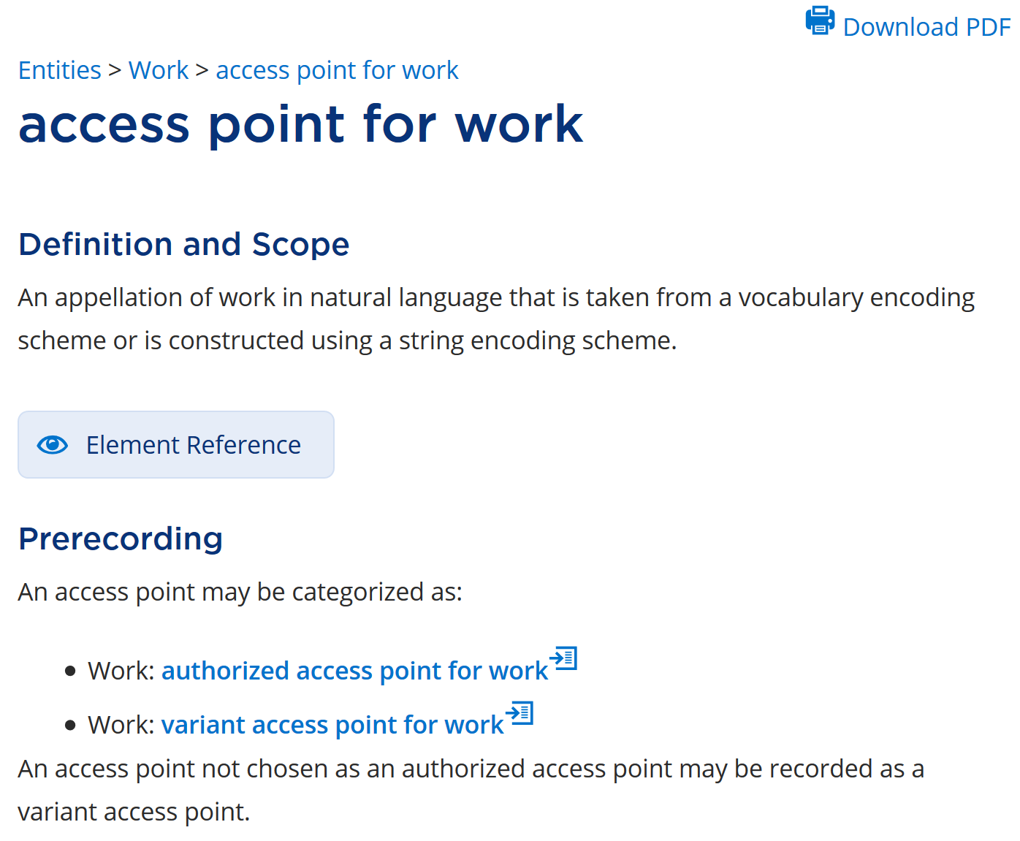

Slide 13
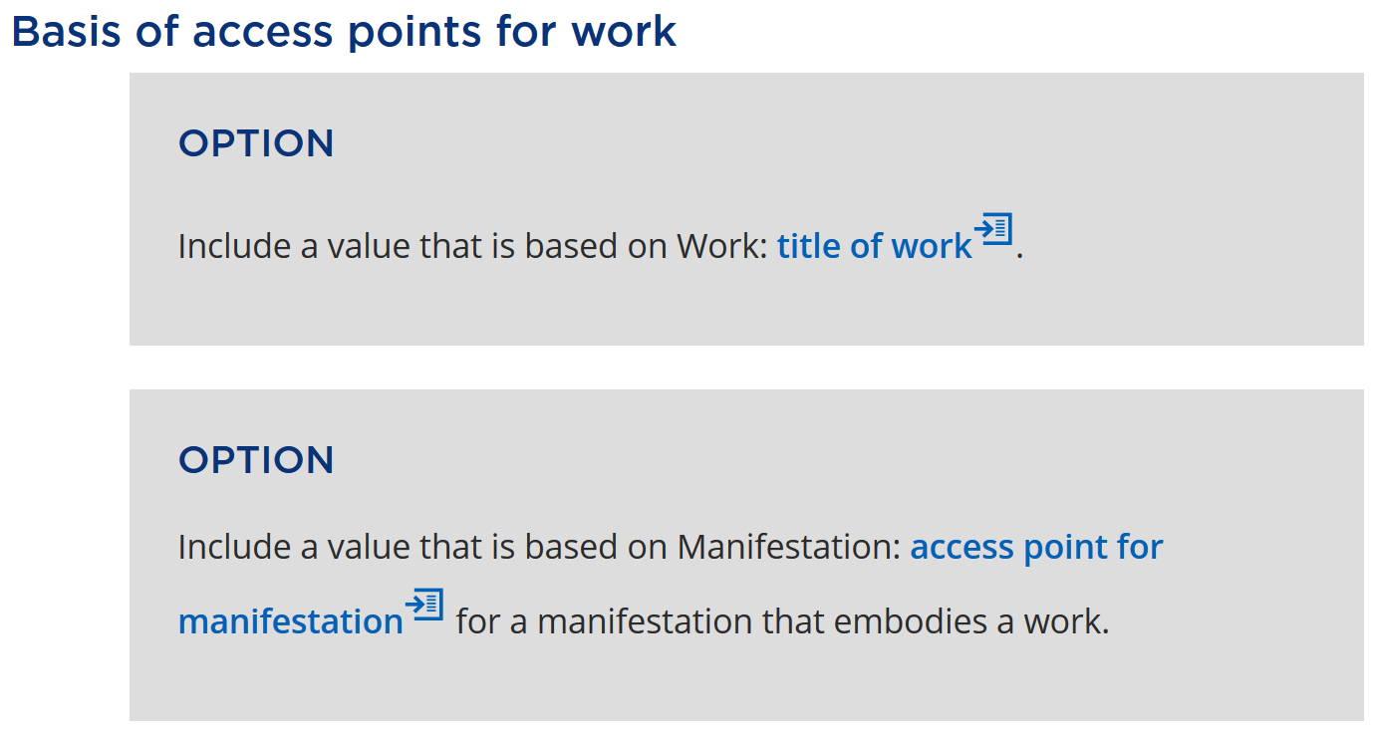

Slide 14
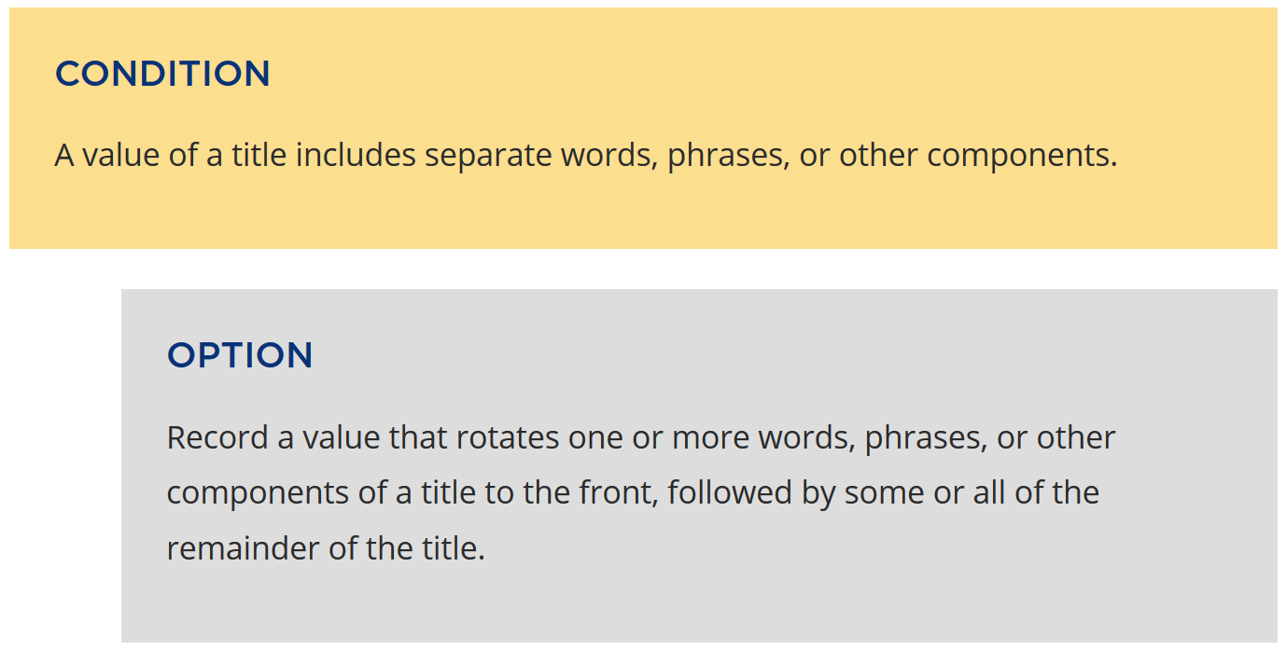

Slide 15
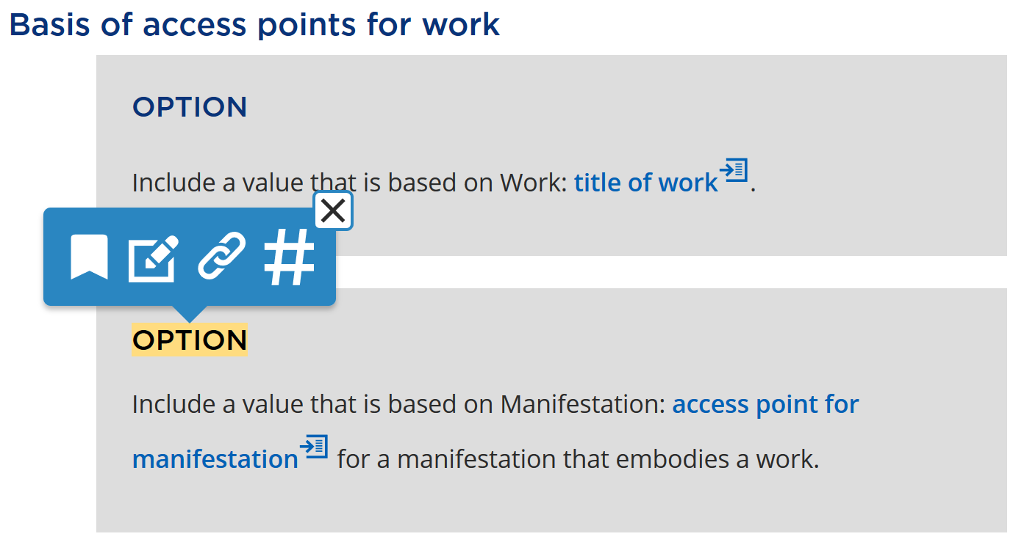
Bookmark
Note
URL
Citation number
User-supplied

Slide 16
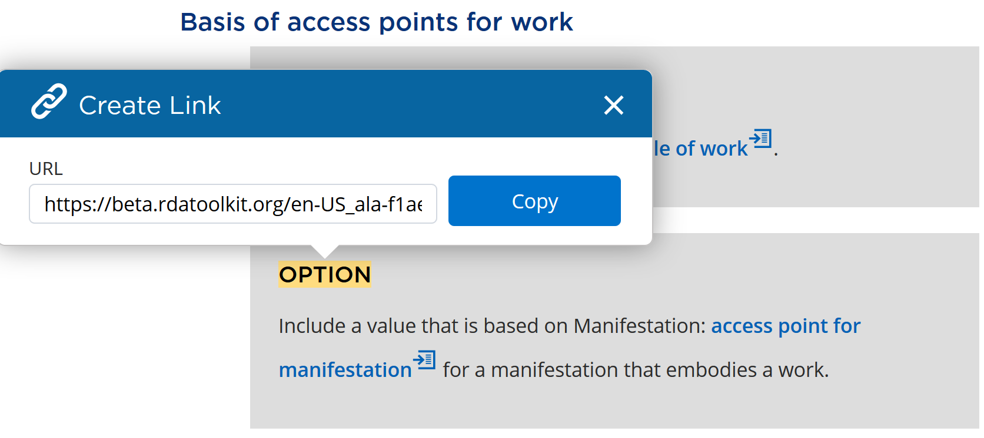

Slide 17
Customization
Use URLs for options, recording methods, elements, etc. to create ‘my Toolkit’ for local applications
Facilities for customizing the RDA Toolkit include:
User-supplied documentation
Bookmarks, notes, documents
Policy statements [under construction]
Application profiles [under construction]

Slide 18
Practical tools
New RDA Toolkit is a comprehensive set of tools for creating well-formed interoperable metadata for library and cultural heritage collections
Instructions for data values
Elements and entities for data recording
Choice of granularity (general vs specific)
Choice of recording methods
Modular customization

Slide 19
Thank you!
techo@rdatoolkit.org

