Slide 1
National libraries and identity in the Semantic Web
Gordon Dunsire
BNE, Madrid, 14 Dec 2011

Slide 2
Overview
Rapid evolution of digital environment
Linked data and the Semantic Web
Identifiers
Role of national libraries and bibliographic agencies
Notes:
This presentation will discuss the rapid evolution of the digital environment, and in particular linked data and the Semantic Web.
It will describe the importance of identifiers for bibliographic metadata, and discuss the impact these development have on the role of national libraries and other bibliographic agencies.

Slide 3
A Uniform Resource Name (URN) is a standard, persistent and unique identifier for digital
resources on the Internet. URNs and URLs are forms of Uniform Resource Identifiers (URIs) … To link to the resource from the URN, a resolver service is required.
- Guidelines for National Bibliographies in the Electronic Age (IFLA, 2009)
URI
Semantic Web
linked data
RDF (resource description framework)
Notes:
*Just 2 years ago, in 2009, IFLA published Guidelines for National Bibliographies in the Electronic Age. One of the three goals of the Guidelines is to “develop guidelines for publishing bibliographies in electronic form”.
*This quote from the Guidelines is the only reference to Uniform Resource Identifiers, or URIs, which are essential for publishing metadata in the Semantic Web environment. The context of the reference is the identification of online digital resources, and there is no discussion of the use of URIs to identify any real-world object, including non-digital resources and bibliographic metadata.
*The Guidelines do not mention the Semantic Web, linked data, or Resource Description Framework. RDF is the basic data model of the Semantic Web, and is how linked data is expressed.

Slide 4
RDF graphs and linked data
Name
“Name2”
Person2
“Title1”
Author
Place3
Title
Subject
Resource1
Publication
Resource1 has author Person2
Person2 has name “Name2”
Resource1 has title ”Title1”
Person2 is author of Resource1
Notes:
*RDF supports simple metadata statements in the three-part linguistic form of subject-predicate-object, known as a triple. An example is the statement that some identified resource has as its author some identified person: “Resource 1 has author Person2”, with Resource1 as the subject, “has author” as the predicate, and Person2 as the object of the triple.
*This RDF triple can be expressed, or serialized, as a simple graph, where the subject and object are represented as nodes, and the predicate as a connecting line with direction towards the object indicated by an arrowhead.
Graphs can be connected if they share a node identified by the same URI.
*So we can take a second example triple, stating that the person identified as the object of the first triple has a name in the form of a literal string, and connect it in the graph.
The graph now expresses linked data. An application can follow the chain from the identified resource to the name of its author.
*And so on. A third triple states that the identified resource has a title, also in the form of a literal string.
RDF supports semantic reasoning, allowing new triples to be inferred from existing triples.
*This graph implies a triple which states the reciprocal of the first triple: the identified person is the author of the identified resource.
This is important, because links in the graph can only be followed in the direction of the arrowheads.
*Adding further triples increases the utility of the linked data. Each node may be the focus of a separate application, focussing on resources, people, or places in this example.

Slide 5
RDF graphs and identifiers
“Name2”
Person2
“Title1”
Place3
Resource1
URIs matched by computer
to create linked chains
URI1
URI2
URI3
Unsafe to match strings by computer
(ambiguity of language) = no chain
“Literal”
Notes:
Any real application will involve many, many triples. Connecting them in a single graph requires the object of one triple to be matched to the subject of another triple.
*Machine-processing of metadata in the form of triples is achieved by using URIs to identify the subjects and objects. A computer can match URIs very, very quickly to create RDF graphs.
*However, the objects of some triples are literals. These cannot be accurately matched by computer because of the ambiguity of language. A term or phrase may be the name of a person, the title of a resource, or the caption of a subject heading. The integrity of the graph cannot be compromised by ambiguous links, so an object which is a literal is not matched to any other node. This is indicated by using a rectangular node for a literal, in contrast to an elliptical node identified by a URI.
This forms a dead-end for any chain of linked data; the literal is a terminator. Literal objects in triples are generally used for display; what the user sees are the ends of long chains of linked data connected to the focus of interest, such as a resource, person, or place.

Slide 6
Things to identify with URIs
Cultural objects
Including books, images, sound recordings, etc.
Things associated with cultural objects
People, organizations, families
Places, times, events
Subject topics
Other cultural objects!
Notes:
It is important, therefore, to identify as many real-world things as possible with URIs rather than human-readable but ambiguous labels. The more things that are identified with URIs, the longer the chains that connect a focus of interest to human-readable data, including notes and full-text as well as titles, names, captions, and other labels.
*In the context of national libraries and bibliographies, it is obvious that cultural objects need to be given URIs if they are to be referenced in the Semantic Web. These include books and other texts, images such as photographs, paintings, and films, sound recordings, and so on.
*But, as the example graph showed, URIs are also needed for things associated with cultural objects.
*These include people, organizations, and families.
*And places, times, and events of cultural significance.
*And subject topics.
*And, of course, cultural objects are associated with other cultural objects.
National libraries currently identify cultural objects and associated entities for bibliographic purposes. Metadata records for cultural objects are kept in the form of bibliographies and catalogues, with records for associated entities kept as authority files.
Existing identifiers are designed for local scope, and are not suitable for direct use as URIs. But URIs can easily be based on local identifiers added to an http domain which is by definition globally unique.
National libraries are therefore well-placed to create and assign the URIs necessary for linked data in the Semantic Web.

Slide 7
Conversely, in a graph-based ecosystem an organization can supply individual statements about a resource, and all statements provided about a particular uniquely identified resource can be aggregated into a global graph. For example, one library could contribute their country's national bibliography number for a resource, while another might supply a translated title.
- W3C Library Linked Data Incubator Group Final Report (2011)
Agencies responsible for the creation of catalog records and other metadata, such as national bibliographies, are the logical organizations to take a leading role in creating URIs for their described resources.
- W3C Library Linked Data Incubator Group Final Report (2011)
Notes:
*This has been recognized in the final report of the W3C Library Linked Data Incubator Group, published a few months ago.
*This quote notes that publishing linked data can be a collaboration between libraries. A national library might publish the triples giving the national bibliography numbers for its resources, while another library might publish the triples giving translated titles. The two libraries need not be in the same country. Other libraries might publish the triples giving different subject headings and classifications assigned to the resources, and so on.
But this assumes that all the libraries know the URIs of the resources; otherwise their data cannot be linked.
*The final report acknowledges the leading role that national libraries have, in creating and assigning URIs to their resources.
*Taken together, the two quotes indicate that national libraries have a significant role in assigning URIs to their resources, and then using them to publish triples for the national bibliography numbers. Indeed, there are powerful reasons why this should be seen as a priority, and that other national and international bibliographic identifiers, such as International Standard Book Numbers, should be included in such an exercise.

Slide 8
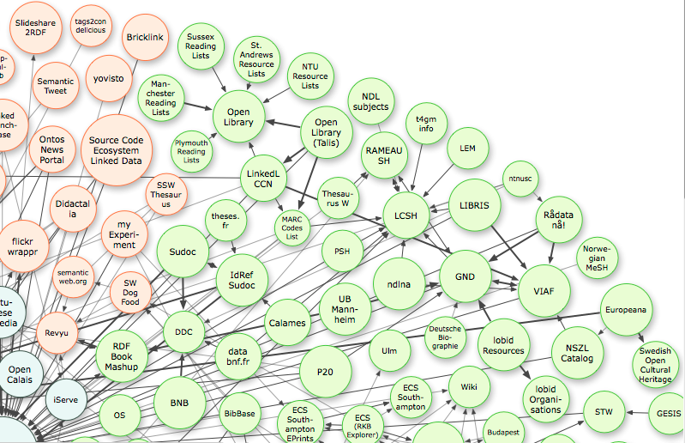
Linking Open Data cloud diagram, by Richard Cyganiak and Anja Jentzsch.
http://lod-cloud.net/
National bibliographies/catalogues
UK
France
Hungary
… Germany
…
Notes:
This is the so-called library corner of the famous linking open data cloud.
The diagram is a very high-level RDF graph. Each node represents a collection of triples about cultural objects, as already discussed, or triples about elements and vocabularies used to describe cultural objects. Each predicate line in the diagram refers to the same property: “has links to”.
So the cloud represents the surface of an interlinked set of many, many triples.
*Several national bibliographies or catalogues have been published as linked data.
*The cloud shows nodes for the British National Bibliography, the Bibliotheque national de France, and the Hungarian National Library (NSZL) catalog.
*The Deutsche Nationalbibliothek is in the process of publishing its linked data, and other national libraries are following …

Slide 9
National resource identity
National bibliographies and catalogues try to cover all significant cultural resources of a nation
Multiple copies of catalogue records exist
Within a country and elsewhere
Each copy can be used to create linked data
Thus creating a different URI for each copy
Multiple URIs for the same thing
= identity crisis!
Costly to create/maintain/resolve
Single, national URIs for global collaborative use
Notes:
Why should national libraries get involved in creating URIs for cultural objects, and why should this be a priority?
It is an extension of their current role in recording the significant cultural resources of a nation. Usually, only the national library is in a position to do this comprehensively.
But many other libraries include copies of published works in their collections, and therefore include records for them in their catalogues. This results in multiple copies of records in different catalogues. Those copies are not usually exact because each library may make local additions or amendments. It is notoriously difficult to get accurate machine de-duplication of such records; indeed, many large-scale union catalogues which aggregate records from different libraries find it too costly to attempt.
But the cloud diagram shows that not only national libraries have been publishing their catalogues as linked data. A number of large university libraries are also experimenting with linked data, and many more libraries are sure to follow as Semantic Web tools become easier to use.
There is a clear danger, therefore, that the same resource held in multiple libraries will end up with multiple URIs.
A computer can only link URIs which are the same. If a resource has more than one URI, then the computer must be told, using RDF triples, that each URI refers to the same thing.
This is a “double whammy” for the libraries who publish linked data. They incur costs in creating and maintaining URIs for resources which already have an assigned URI, and they incur costs in creating and maintaining the triples used to resolve the identity crisis.
These costs can be significantly reduced if the national library publishes its triples first, and in a way that allows the resource URIs to be easily found. Ideally, the national library should publish all of the national bibliography as triples, but a priority should be to publish the local identifiers available to local cataloguers, such as the bibliography numbers, ISBNs, ISSNs, and others. These local identifiers can then be used to find the global identifier, the URI, for any cultural resource. And local triples using the national URI can be automatically added to the national resource graph.

Slide 10
Many Linked Data vocabularies are essentially cultural reference works, giving authoritative information about people, places, events, and concepts within regional, national, or international contexts. As such, preservation of Linked Data vocabularies is a natural, and essential, extension of the activity of memory institutions.
- W3C Library Linked Data Incubator Group Final Report (2011)
Notes:
*The Library Linked Data final report also refers to the role of national libraries, as memory institutions, in developing, publishing, and preserving data about entities associated with cultural objects.
*The Linked Data vocabularies mentioned in this quote include the data found in library authority files, and the metadata schema used to construct authority and bibliographic description records. This is an extension of current efforts to preserve the technical schema underlying various digital carrier formats in order to maintain access to the content.
It is essential that these vocabularies are preserved over long timescales, to prevent parts of the global RDF graph becoming lost to future generations.

Slide 11
Linking Open Data cloud diagram, by Richard Cyganiak and Anja Jentzsch.
http://lod-cloud.net/
National authority files
Japan
France
Norway
Germany
…
Notes:
Here is the library corner of the linking open data cloud.
*Several national libraries have published authority files as linked data.
*These include Japan, France, Norway, and Germany, and many others are likely to follow.

Slide 12
National authority identity
National authority files try to cover all significant persons, places, topics, etc. associated with cultural resources of a nation
Persons, places, some topics, etc. tend also to be associated with the nation
Different national rules result in different names, labels, headings, etc.
But URIs can be the same
Or identified as referring to the same entity
Notes:
Why should national libraries publish their authority files as linked data?
The national files cover all of the significant entities, including people, places, and subject topics, associated with the cultural resources of the nation. These entities are therefore associated with the nation, and with national identity.
Different countries apply different rules for determining authorized forms of names, labels, and headings, and use different transliteration schemes and scripts. This results in authorized forms which vary from country to country.
As each country publishes its authority files, the result is multiple URIs for the same entity with the same problems as for cultural objects. As before, future proliferation of new URIs for the same entity can be reduced by publishing national authority files as a priority.
This does not resolve the problem of existing multiple URIs for the same entity, especially if it is of international significance.

Slide 13
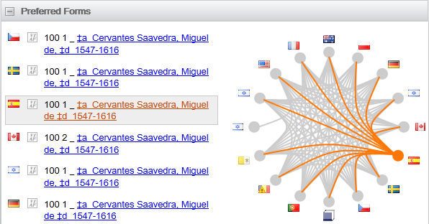
VIAF
Virtual International Authority File
http://viaf.org/
Identifying Cervantes: Spain (or Canada, Germany, etc.?)
Notes:
The Virtual International Authority File is attempting to alleviate the problem of multiple authority forms, and therefore of multiple URIs, for the same person, by bringing together RDF triples from several national name authority files and linking the different URIs.
In this example, the authorized form of heading for Cervantes supplied by the National Library of Spain is linked to headings from other national libraries. Those headings may be identical to the Spanish version, as in this partial screen, or they may be different.
This provides a mechanism for improving interoperability between bibliographic metadata referencing people. It is being extended to cover organizations and other corporate bodies, and other types of entity.
It is likely that there will be a convergence of authorized forms of heading as VIAF and similar services develop. Libraries will be tempted to use existing URIs rather than incur the expense of creating their own, and will thus use the heading associated with that URI.
The question then becomes: which agency is best for maintaining the authority data for Cervantes in the global RDF graph?

Slide 14
Role of national agencies (1)
Create, publish, maintain, preserve identifiers (URIs) for national cultural resources, to:
Avoid duplication
Encourage collaborative description
By professionals, the crowd, machines
Continue existing roles in a global context
Promotion and preservation of national heritage
Notes:
To sum up, national libraries and bibliographic agencies have two major roles to play in the development and utility of linked data and the Semantic Web.
The first is to create, publish, maintain, and preserve Uniform Resource Identifiers for the cultural objects and resources of the nation.
This will reduce unnecessary and costly duplication of identifiers.
It will encourage collaborative activities to create and maintain descriptive metadata, engaging the national agency with other professionals involved in similar work. National agencies also need to provide leadership and collaborate with the social tagging efforts of the public via crowd-sourcing, and the generation of metadata by machine through full-text indexing, pattern recognition, and so on.
This is a continuation of existing roles in the promotion and preservation of national heritage, but in a truly global environment based on Resource Description Framework.

Slide 15
Role of national agencies (2)
Create, publish, maintain, preserve identifiers and labels for people, places, events, etc. associated with the nation, to:
Provide national and cultural authority and visibility
Encourage linked data across domains and communities
Also interested in people, places, events, etc.
Continue existing roles in a global context
Notes:
The second role of national agencies is again to create, publish, maintain, and preserve identifiers, but for the people, places, events, and other entities associated with national heritage.
This provides national and cultural authority and visibility in an international environment.
It also encourages the creation and use of linked data across different domains and communities which have a common focus of interest. Authoritative data about a person, place, or event is likely to be of use to archives, libraries, museums, encyclopedias, tourist agencies, souvenir manufacturers and vendors, and so on. The linking open data cloud diagram connects the library corner to everything else.
Again, this is a continuation of existing roles in the promotion and preservation of national heritage, but in the truly global, interoperable environment of the Semantic Web.

Slide 16
Thank you
gordon@gordondunsire.com
W3C Library Linked Data Incubator Group final report
http://www.w3.org/2005/Incubator/lld/XGR-lld-20111025/
Notes:
Thank you for your attention.
Please feel free to email me to discuss the issues I have raised.
It is well worth reading the whole of the final report of the W3C Library Linked Data Incubator Group.

