Slide 1
Versioning vocabularies in a linked data world
Diane I. Hillmann, Gordon Dunsire, Jon Phipps
Presented to Linked Data in Libraries: Let's make it happen!,
IFLA Satellite Meeting, 14 August 2014, Paris, France

Slide 2
Overview
30 mins
It’s about time …

Slide 3

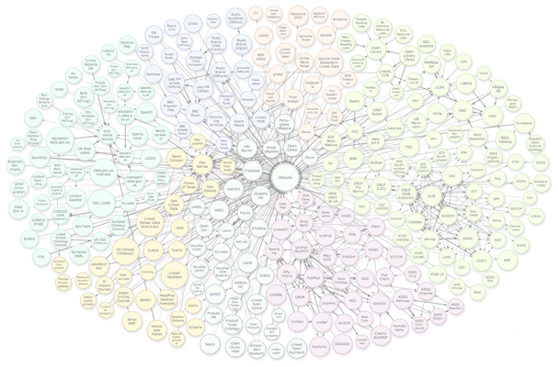








Linked Data (RDF) Vocabularies
Element sets
Value vocabularies
Datasets

Slide 4
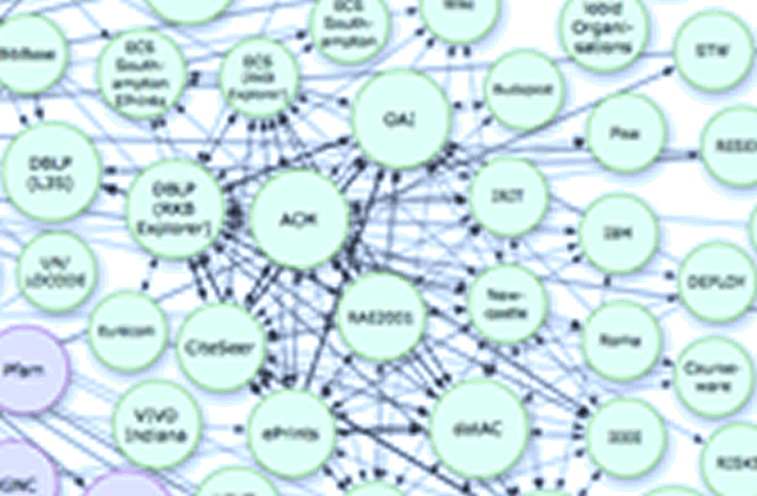
Synchronization?
What version?

Slide 5
Semantic versions: the “other” case
Value vocabulary: “Things”
Time
Label
Definition
A
A thing that is old.
B
A thing that is borrowed.
C
A thing that is blue.
Version 1
Other
A thing that is not an A, a B, or a C.
D
A thing that is new.
Version 2
Other
A thing that is not an A, a B, a C, or a D.
Version 1 and Version 2 have different meanings
Version 1 and 2 datasets have different semantics
Applications have inconsistent or incoherent results

Slide 6
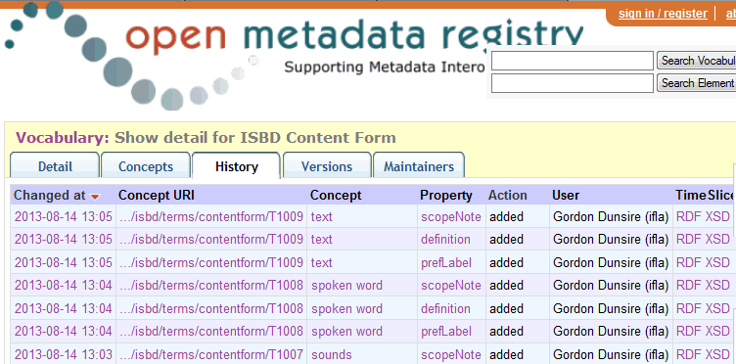
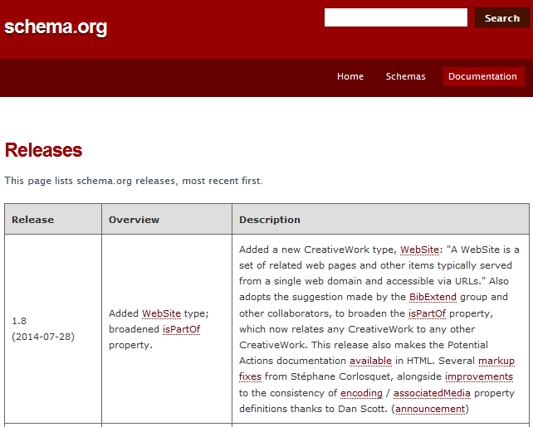
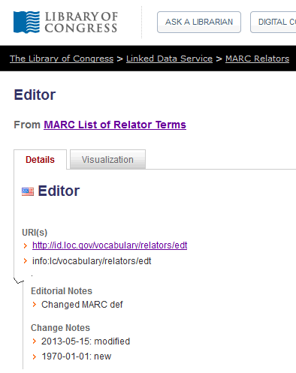
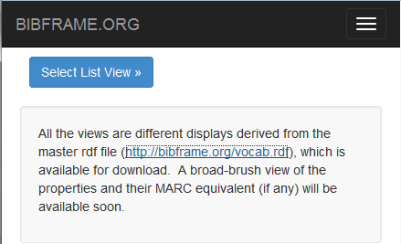
http://dewey.info/class/641/2009/08/about.fr.rdf
Many versions
of version
control!
Dated URI
Access to old
versions?
Last date only
Fine granularity at transaction level
No demand for version aggregation
Dated release number
Lack of change data

Slide 7
Semantic versioning (semver.org/)
3-tier numbering system: major.minor.patch
X
.
X
.
X
Major: breaks backwards semantic compatibility
Minor: change in semantics of any property
of any element
Patch: no change in semantics of any element

Slide 8
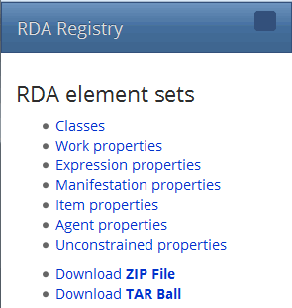
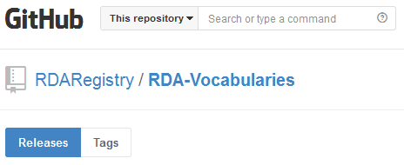
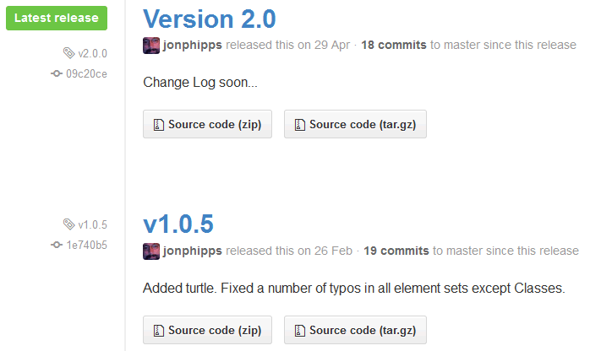
Older versions remain available

Slide 9
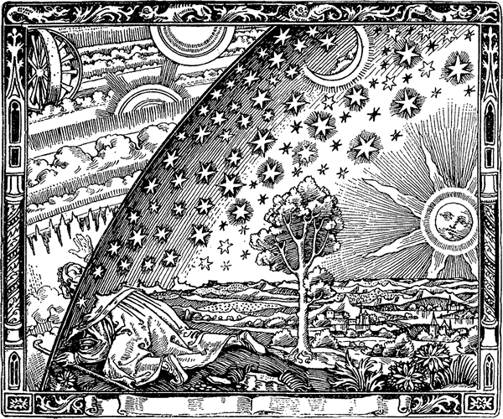
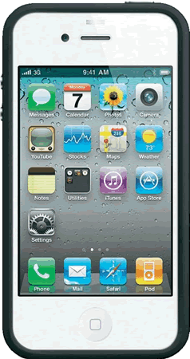
Local applications; global data
Maintaining
local order
in
global chaos

Slide 10
Smart semantic clouds
Smooth interaction between app and vocab
Transparent to the user crowd
Until major change requires validation of context
Distributed version control (Git, etc.)
Vocabulary managers trusted to comply with (simple) semantic versioning
And encouraged to provide details of semantic breakage between major versions
App developers encouraged to provide backwards compatibility with version ranges

Slide 11
Concluding questions
What conditions categorize major/minor semantic changes?
Can dataset semantics be versioned?
Beyond data dumps …
Inherited element set and value vocabulary versions?
Impact of syntactic or structural breakage?
E.g. change from RDFS to OWL versions of an element set
Is it time to get serious about linked data management?

Slide 12
Thank you!
Linking Open Data cloud diagram, by Richard Cyganiak and Anja Jentzsch. http://lod-cloud.net/
Flammarion engraving: artist unknown
We are here

