Slide 1
Under the lid of RDA
Gordon Dunsire
Presented to the Cataloguing and Indexing Group in Scotland’s post-AGM seminar - RDA: a bigger picture
National Library of Scotland, Edinburgh, 19 May 2014

Slide 2
Overview
RDA elements: relationships and attributes
Extending RDA: place and extent
RDA linked data
“What does an RDA record look like?“
Is this a record?

Slide 3
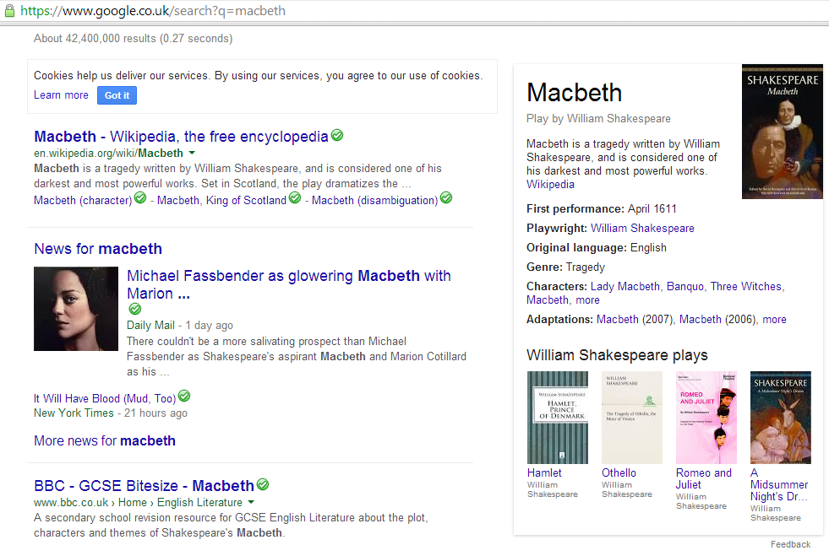
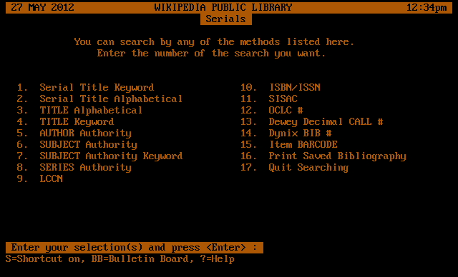
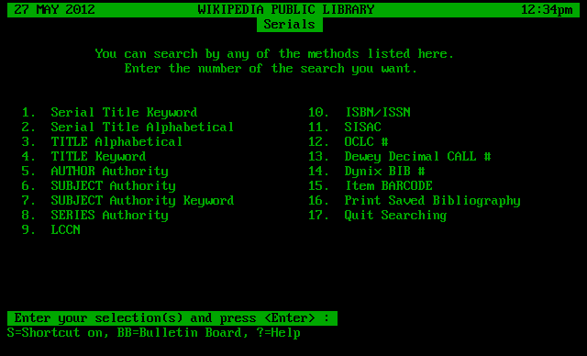
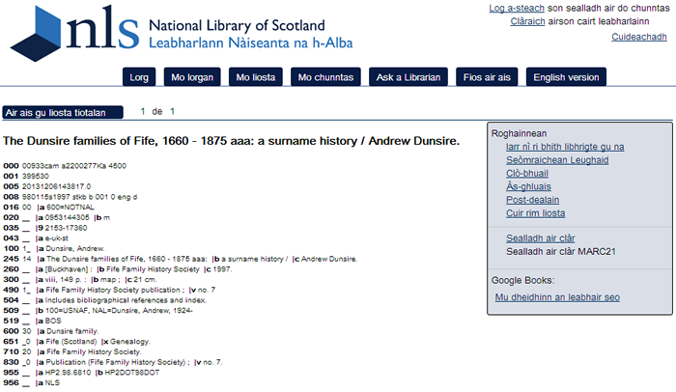
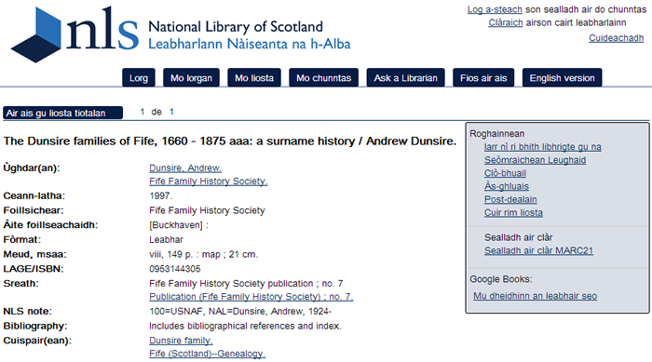
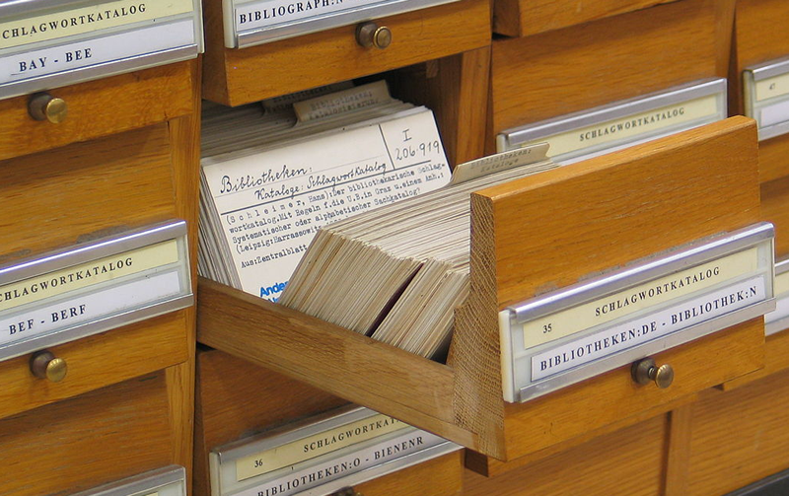
What is a record?
Where is it?
Is this a record?

Slide 4
Distinct
FRBR/FRAD Entities
Work
One and
only one
Person
Expression
Agent
Family
Manifestation
Corporate Body
One or
more
Item
Primary/high-level relationships

Slide 5
RDA Entity relationships
Work
Person
Expression
Family
Manifestation
Corporate Body
Item
pov: Description -> Access

Slide 6
Place: new RDA entity?
Work
Person
Expression
Family
Manifestation
Corporate Body
Place
Item
pov: Access -> Item (content)

Slide 7
Is this a record?
Entity attributes
Carry values of specific
aspects of the entity
Manifestation
carrier type
“volume”
distributor’s name
“BookXpress”
extent
“24 pages ; 23 cm”
place of publication
“Edinburgh”
title proper
“Metadata manual”

Slide 8
s ths a rcrd?
Is this a record?
Linked entity record
Vocabulary
encoding scheme
Manifestation
carrier type
“volume”
VES
Corporate
Body
distributor’s name
“BookXpress”
extent
“24 pages ; 23 cm”
place of publication
“Edinburgh”
Place
title proper
“Metadata manual”

Slide 9
Common entity attributes
Main label
Manifestation
title proper
“Metadata manual”
carrier type
“volume”
distributor’s name
“BookXpress”
extent
“24 pages ; 23 cm”
place of publication
“Edinburgh”
Work
preferred title for the work
Person
preferred name for the person
Family
preferred name for the family

Slide 10
Identifiers
Attributes
for
Relationships
Work
identifier for the work
authorized access point
preferred title for the work
date of work, …
place of origin of the work
Person
identifier for the person
authorized access point
preferred name for the person
date of birth, …

Slide 11
s ths a rcrd?
Entity record
Manifestation
carrier type
“volume”
VES
Corporate
Body
distributor’s name
“BookXpress”
extent
“24 pages ; 23 cm”
place of publication
“Edinburgh”
Place
title proper
“Metadata manual”

Slide 12
Extent
Need for machine-actionability
Number of pages to be digitized
Utility of finer-grained content and carrier categories for search filters
American Library Association (ALA) Committee on Cataloging: Description and Access (CC:DA) Task Force
Discussion papers and recommendations submitted to JSC

Slide 13
Extent: the Aspect-Unit-Quantity model
24 pages ; 23 cm
Aspect: | [length, pagination]
Unit: | pages
Quantity: | 24
Aspect: | height
Unit: | centimeters
Quantity: | 23

Slide 14
Unit as category
Page: A unit of extent consisting of a single side of a leaf.
Leaf: A unit of extent consisting of a single bound or fastened sheet as a subunit of a volume; each leaf consists of two pages, one on each side, either or both of which may be blank.
Plate: A leaf containing illustrative content, with or without explanatory text, that does not form part of either the preliminary or the main sequence of pages or leaves.
Relationship with carrier and content types?
E.g. Volume

Slide 15
s ths a rcrd?
Entity record
Manifestation
carrier type
“volume”
VES
Corporate
Body
distributor’s name
“BookXpress”
extent
“24 pages ; 23 cm”
AUQ
place of publication
“Edinburgh”
Place
title proper
“Metadata manual”

Slide 16
RDA in RDF: element sets for linked data (rdaregistry.info)
RDA Entity => RDF class
RDA Attribute/element; Element sub-type; Relationship; Relationship designator => RDF property or sub-property
RDA Sub-element => [component of aggregated statement – is this a record?]
Element sets published in January 2014
Used in RLUK linked data records (15 million+)

Slide 17
Research Libraries UK Linked Open Data
@prefix rdaa: <http://rdaregistry.info/Elements/a/> .
@prefix rdac: <http://rdaregistry.info/Elements/c/> .
@prefix rdae: <http://rdaregistry.info/Elements/e/> .
@prefix rdam: <http://rdaregistry.info/Elements/m/> .
@prefix rdaw: <http://rdaregistry.info/Elements/w/> .
@prefix rdau: <http://rdaregistry.info/Elements/u/> .
…
<http://data.theeuropeanlibrary.org/BibliographicResource/3000087336858> a dcterms:BibliographicResource ;
rdam:P30004 "local identifier: http://data.copac.ac.uk/iid/70391419" ;
rdau:P60049 <http://rdvocab.info/termList/RDAContentType/1020> ;
rdam:P30003 "single unit"^^<http://rdvocab.info/termList/ModeIssue> ;
rdau:P60520 "Unkown"@en ;
rdam:P30004 "isbn: 0385603614" , "nbn: GBA4-2842" ;
rdam:P30156 "Duende a journey in search of flamenco" ;
rdau:P60339 "Jason Webster." .
Is this a record?

Slide 18
I i e o?
Entity record?
VES:
volume
Manifestation
carrier type
distributor’s name
CorpBody:
BookXpress
place of publication
Place:
Edinburgh
extent
A
U
Q
title proper
“Metadata manual”
s ths a rcrd?

Slide 19
Thank you!
Contact
jscchair@rdatoolkit.org
RDA Registry for developers (GitHub)
https://github.com/RDARegistry/RDA-Vocabularies
RLUK datasets
http://www.theeuropeanlibrary.org/tel4/access/data/lod

