Slide 1
Unleashing UNIMARC to the Semantic Web: UNIMARC in RDF
Gordon Dunsire, UK & Mirna Willer, Croatia
UNIMARC Workshop, Biblioteca Nacional de Portugal Lisbon, 6 April 2016

Slide 2
Overview
Based on presentation to IFLA 2015
With latest developments
Introduction to linked data and UNIMARC
UNIMARC vocabularies
Future research and plans

Slide 3
Introduction to linked data and UNIMARC

Slide 4
Background
Representation of IFLA standards for use in the Semantic Web
Work of the FRBR Namespaces project and IFLA Namespaces Task Group
Work of the ISBD/XML Study Group
Included a feasibility study of representation of UNIMARC
Representations allow legacy catalogue records to be published as linked data using RDF
Branding IFLA standards for authority & trust
Semantic Web lets “Anyone say Anything about Any resource”

Slide 5
Linked data and RDF
Resource Description Framework (RDF)
Designed for machine-processing of metadata at global scale (Semantic Web)
24/7/365
Trillions of operations per second
Everything must be dis-ambiguated
Machines are dumb
A simple approach helps!
Machine-readable identifiers

Slide 6
RDF triple
Metadata expressed as “atomic” statements
A simple, single, irreducible statement
The title of this book is “Cataloguing is fun!”
Constructed in 3 parts
“Triple”
The title of this book is “Cataloguing is fun!”
Subject of the statement = Subject: This book
Nature of the statement = Predicate: has title
Value of the statement = Object: “Cataloguing is fun!”
This book – has title – “Cataloguing is fun!”
subject – predicate - object

Slide 7
Machine-readable identifiers
Uniform Resource Identifier (URI)
Can be any unique combination of numbers and letters
No intrinsic meaning; it’s just an identifier
RDF requires the subject and predicate of triple to be URIs
Object can be a URI, or a literal string (“Cataloguing is fun!”)
URIs can be matched by machine to link triples together

Slide 8
Vocabularies, values and element sets
Controlled terminology represented as RDF “value” vocabulary
Entities, attributes, and relationships represented as RDF “element set” vocabulary
Attributes and relationships represented as RDF properties (“predicates”)
Entities represented in RDF as classes
UNIMARC-B has only 1 entity: Resource
ISBD already has an equivalent class for Resource

Slide 9
Element sets
“Bibliographic” format has same focus as International Standard Bibliographic Description (ISBD)
The entity [bibliographic] Resource ~ FRBR Manifestation
Attributes => RDF properties
RDF properties require URIs
IFLA/UNIMARC URL domain + local unique UNIMARC part
Lossless data requires finest level of granularity
Important for UNIMARC qualified coded subfield
UNIMARC in RDF: Workshop, Lisbon, 6 Apr 2016
9

Slide 10
UNIMARC element and concept identifiers
Element:
National bibliography number
Unique in
element set
tag:
020
1st ind.:
2nd ind.:
subfield:
b
Unique in
local namespace
U020__b
http:// iflastandards.info/ns/unimarc/unimarcb/elements/0XX/U020__b
Unique in
global namespace

Slide 11
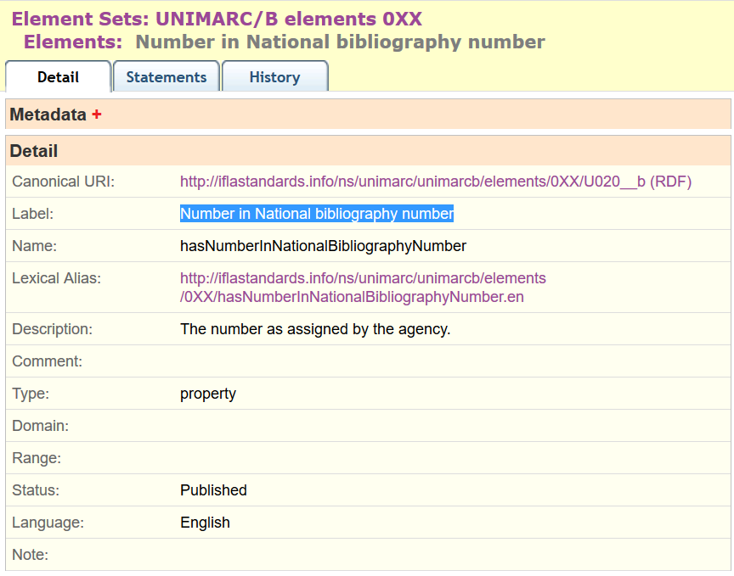

Slide 12
UNIMARC element and concept identifiers
Element:
Target audience code …
tag:
100
1st ind.:
2nd ind.:
subfield:
a
pos:
17-19
U100__a17-19
Concept:
adult, general
code:
m
tac#m
Unique in
value vocabulary
http:// iflastandards.info/ns/unimarc/terms/tac#m

Slide 13
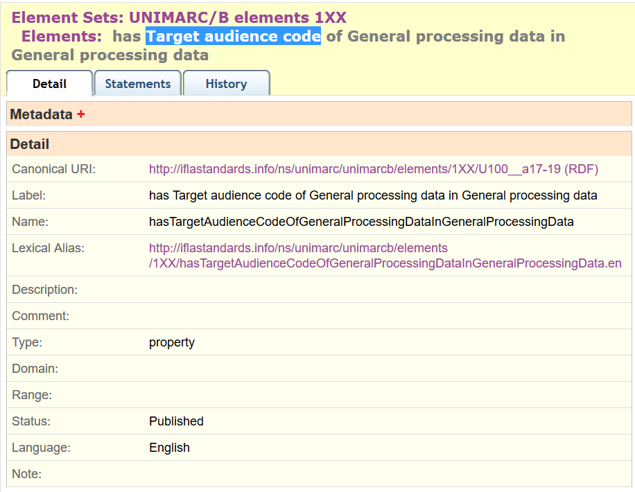
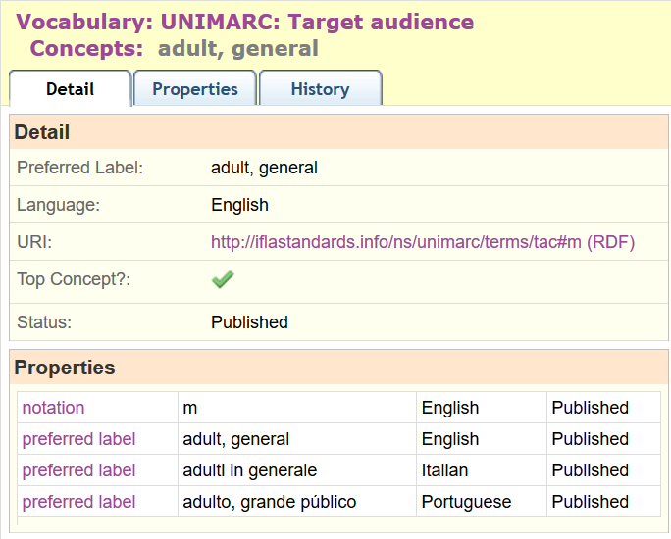

Slide 14
Exception! Semantic data embedded in content
200 1#$aBibliographica belgica
$fCommission belge de bibliographie
$f= Belgische Commissie voor bibliografie
“= “ : Parallel
U2001_f : First Statement of Responsibility
??? : Parallel First Statement of Responsibility
Notes:
Another complication with the element set is that some UNIMARC semantic information is extended beyond the usual MARC structure and is effectively embedded in the content of subfields.
In this example, the first subfield $f is represented with the URI U2001_f (reflecting the indicator values), and is the first statement of responsibility. But there is a second subfield f, which is not and cannot be a second “first” statement of responsibility. In fact, the equals (=) sign preceding the content is a generic indication that the subfield contains parallel information; in this case, a parallel first statement of responsibility.
The project is investigating ways of representing this semantic information in the element set.

Slide 15
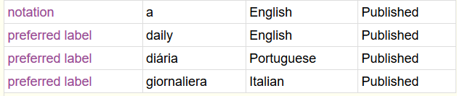
Translations
The same identifier is used for translated elements (captions, definitions, etc.) and vocabularies (preferred terms, definitions, etc.)
E.g. Frequency of continuing resources code.

Slide 16
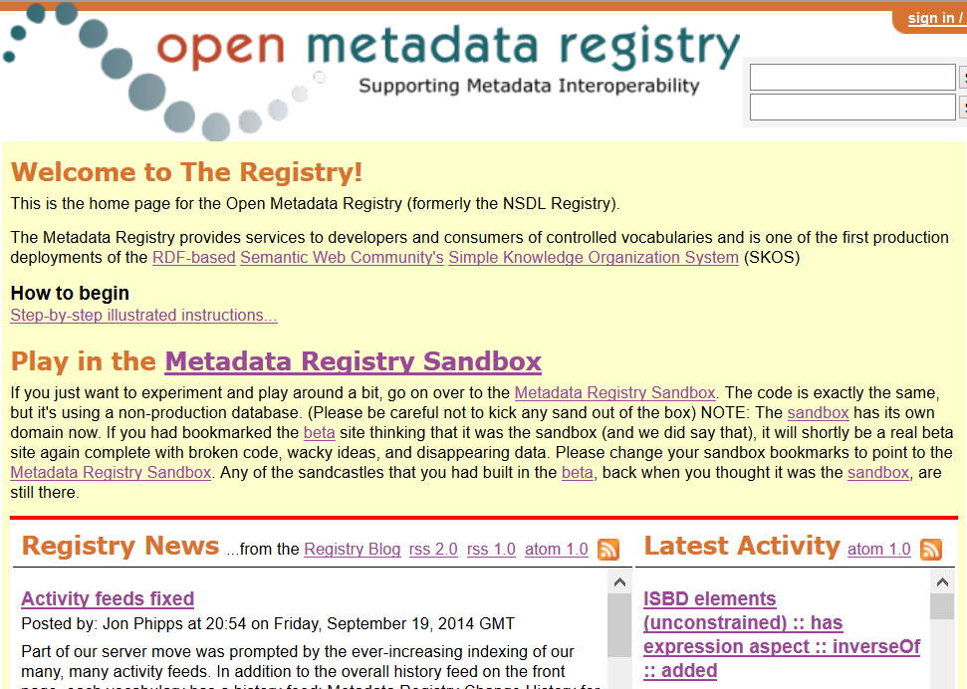
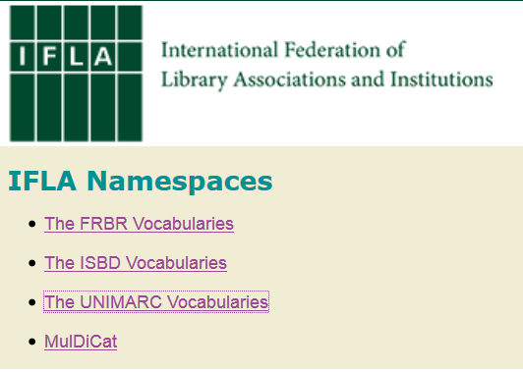
IFLA linked data vocabularies

Slide 17
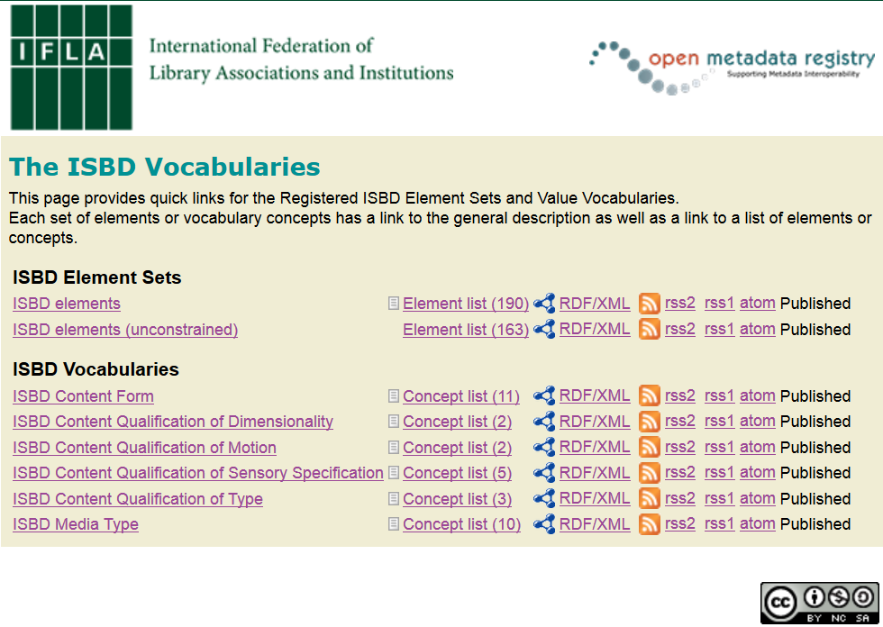

Slide 18
UNIMARC vocabularies

Slide 19
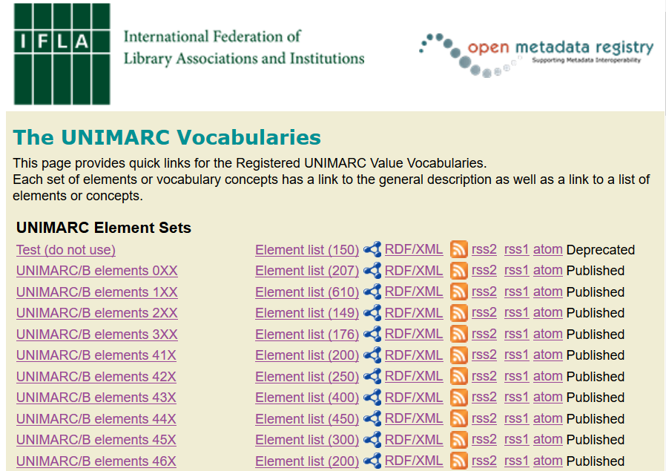
…

Slide 20
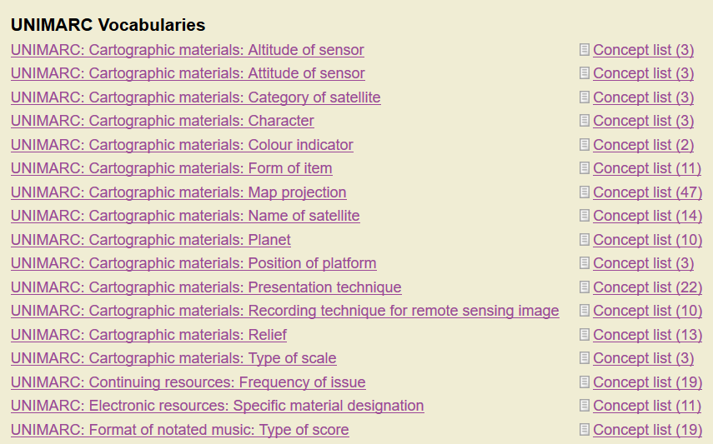
…

Slide 21
Value vocabularies
“thesauri, code lists, term lists, classification schemes, subject heading lists, …”
W3C Library Linked Data Incubator Group
Often represented in RDF using Simple Knowledge Organization System (SKOS)
Notes:
The UNIMARC Bibliographic format also specifies a large set of code lists to be used in coded information subfields. Such code lists can be represented as RDF value vocabularies, where each code in the list is assigned a URI. The attributes of the codes are then represented using properties from the Simple Knowledge Organization System (SKOS).

Slide 22
Value vocabularies
Coded information stored in tag block 1xx
Code lists specify notation, term, description, and scope
Represented as RDF/SKOS vocabularies
Italian and Portuguese translations – multilingual environment
Interoperability with vocabularies of other schema
50 published so far
For example: Target audience

Slide 23
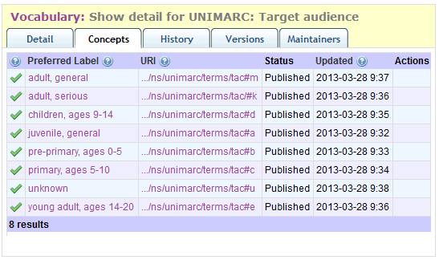
http:// metadataregistry.org/concept/list/vocabulary_id/322.html

Slide 24
Target audience code
Subfield a,
character positions 17-19,
of tag 100 General processing data
3 instances of one-character code
U100__a17-19
U100__a17
U100__a18
“applicable to records of materials in any media“
U100__a19
Order of position
carries no significance
in UNIMARC format
But content rules
may assign significance

Slide 25
Maps within element sets
U100__a17-19
sub-property of
U100__a17
U100__a18
U100__a19

Slide 26
Maps between vocabularies
Map of
“Audience”
Element sets (schema)
isbdu:
“has note on use or audience”
Unconstrained
versions
Value vocabularies (KOS)
isbd:
“has note on use or audience”
rdau:
“Intended audience”
rdfs:subPropertyOf
Broader/narrower/same?
dct:
“audience”
m21:
e
“adult”
BBFC:
18?
rdaw:
“Intended audience”
schema:
“audience”
MPAA:
NC-17?
pbcore:
adult
“adult”
m21:
“Target audience”
frbrer:
“has intended audience”
umarc:
m
“adult, general”
m21:
“Target audience of …”
umarc:
k
“adult, serious”

Slide 27
Publishing UNIMARC data in RDF
110 (CODED DATA FIELD: CONTINUING RESOURCES)
$a (Continuing Resource Coded Data)
Attribute | Character position | Value | Notes
Type designator | 0 | c | newspaper
Frequency of issue | l | a | daily
Regularity | 2 | a | regular
110 ##$acaa…
RDF linked data
Notes:
The method for assigning URIs to coded information subfields is an extension of the method for normal subfields. Coded subfields assign different types of code to different character positions with the subfield, so the character position, conventionally starting at 0, is added to the subfield URI to obtain a separate URI for each type of code.

Slide 28
Syntactic parsing
U110__a02
U110__a01
U110__a00
RDF properties
110 ##$acaa…
String
continuingtype#c
RDF objects
continuingfreq#a
continuingreg#a
RDF data triples
…
Myspace:Resource23 unimarcb:U110__a01 ufreq:a .
…

Slide 29
Semantic graph
“daily”@en
unimarcb:U110__a00
type:
c
“giornaliera”@it
“diária”@pt
resource:
123
unimarcb:U110__a01
freq:
a
skos:prefLabel
reg:
a
“a”
skos:notation
unimarcb:U110__a02
Frequency map for
Dublin Core, MARC 21, and RDA
Notes:
This example shows how a coded information subfield is related or linked to its corresponding value vocabulary.
The example is based on the daily newspaper example from the previous slide. The newspaper’s URI is 123, and is the subject of a set of data triples which use the RDF properties for the different types of code. The object of each triple is the URI of the particular code used.
The code URI can then link internally to its attributes in the value vocabulary, which include the code as notation, and the preferred labels of the code in multiple languages. The frequency value vocabulary has been published by the project, together with translations of the term in Italian and Portuguese.
The code URI can also link to external maps using alignments between specific codes or terms used in other value vocabularies, in this example taken from Dublin Core, MARC 21, and RDA: resource description and access. The data from the UNIMARC record can interoperate with data based on these other sources.

Slide 30
Future research and plans

Slide 31
Level 0: the finest level of granularity
Subfield qualified by indicators
“A defined unit of information within a field. See also Data Element”
“The smallest unit of information that is explicitly identified”
Field: “A defined character string, identified by a tag, which contains one or more subfields”
Coarser level of granularity (Level 1+) with structure of combinations of Level 0 elements
Indicator qualification is at field level, and redundant for Level 0 elements that are not in scope.

Slide 32
tag | tagCap | ind1 | ind1Cap | ind2 | ind2Cap | sub | subCap | definition
210 | PUBLICATION, DISTRIBUTION, ETC. | # | Not applicable / Earliest available publisher | # | Produced in multiple copies, usually published or publically distributed | a | Place of Publication, Distribution, etc. | The town or other locality where the item is published or distributed or, in the case of a manuscript, written.
210 | PUBLICATION, DISTRIBUTION, ETC. | 0 | Intervening publisher | # | Produced in multiple copies, usually published or publically distributed | a | Place of Publication, Distribution, etc. | The town or other locality where the item is published or distributed or, in the case of a manuscript, written.
210 | PUBLICATION, DISTRIBUTION, ETC. | 1 | Current or latest publisher | # | Produced in multiple copies, usually published or publically distributed | a | Place of Publication, Distribution, etc. | The town or other locality where the item is published or distributed or, in the case of a manuscript, written.
210 | PUBLICATION, DISTRIBUTION, ETC. | # | Not applicable / Earliest available publisher | 1 | Not published or publically distributed | a | Place of Publication, Distribution, etc. | The town or other locality where the item is published or distributed or, in the case of a manuscript, written.
210 | PUBLICATION, DISTRIBUTION, ETC. | 0 | Intervening publisher | 1 | Not published or publically distributed | a | Place of Publication, Distribution, etc. | The town or other locality where the item is published or distributed or, in the case of a manuscript, written.
210 | PUBLICATION, DISTRIBUTION, ETC. | 1 | Current or latest publisher | 1 | Not published or publically distributed | a | Place of Publication, Distribution, etc. | The town or other locality where the item is published or distributed or, in the case of a manuscript, written.
URI
Label
U21011a
Place of publication … in Publication, distribution, etc. (Current or latest publisher) (Not published …)
Notes:
One advantage of using a spread-sheet is that repetitive data can be easily copied. The finest level of granularity corresponds to the unique combination of UNIMARC tag, first and second indicators, and subfield. This requires a lot of data to be repeated while a single component varies.
In this example there are 3 different first indicators and two different second indicators, resulting in 6 unique combinations.
The URI of each combination is derived directly from the tag, indicators, and subfield.
The label of each combination is derived from the subfield, tag, and indicator captions.
The derivations are automated using spread-sheet formulas.
However, the definition and scope note for each subfield has to be extracted manually from the UNIMARC text, which conflates definitions, scope notes, and usage notes. This requires significant intellectual intervention.

Slide 33
U21011a
Place of publication … in Publication, distribution, etc. (Current or latest publisher) (Not published …)
U210_1a
Place of publication … in Publication, distribution, etc. (Not applicable …) (Not published …)
U21001a
Place of publication … in Publication, distribution, etc. (Intervening publisher) (Not published …)
U2101_a
Place of publication … in Publication, distribution, etc. (Current or latest publisher) (Produced in multiple copies …)

Slide 34
Publication …
u:210
is aggregated by
Place …
u:210a
is sub-property of
Place …
u:210__a
Place …
u:2100_a
Place …
u:2101_a
Place …
u:210XXa

Slide 35
Publication …
Statement 1
Publication …
Statement 2
Place 1
Place 2
Place 3
Place 4

Slide 36
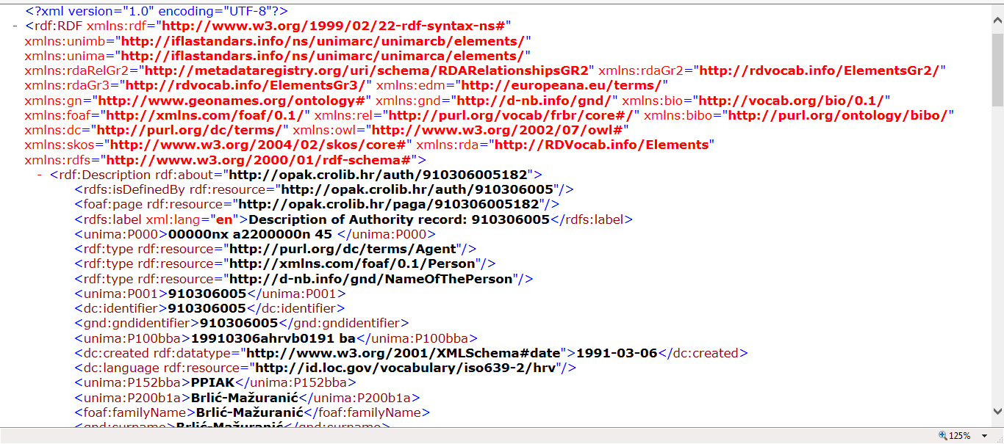
Representing UNIMARC authorities in RDF

Slide 37
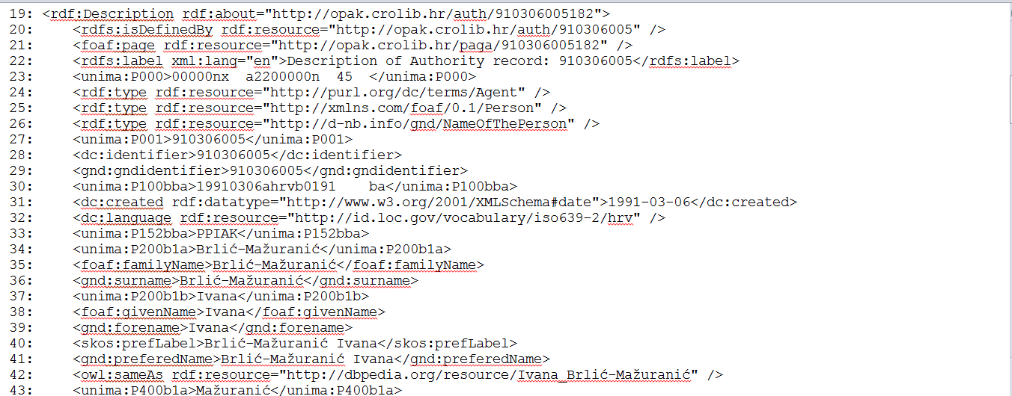
Representing UNIMARC authorities in RDF: use of parallel vocabularies

Slide 38
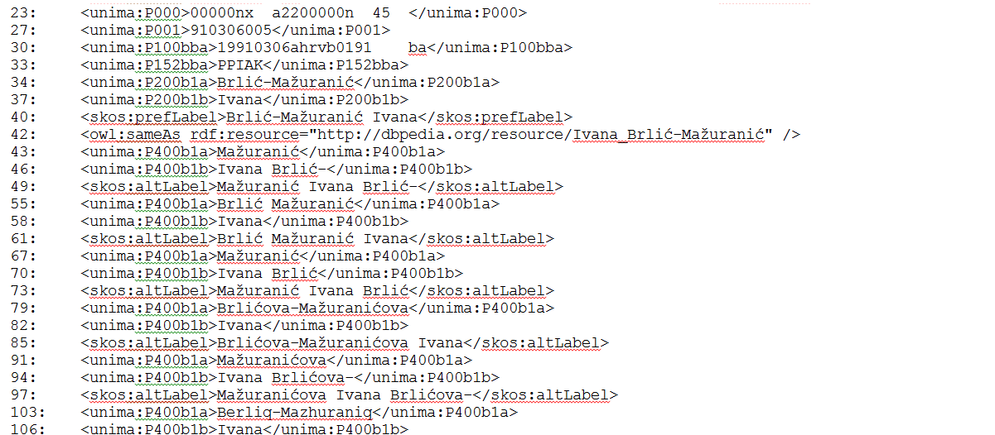
Representing UNIMARC authorities in RDF: authorised and variant forms of a name

Slide 39
Mappings
UNIMARC tags and subfields have corresponding ISBD “elements”
Now out-of-date after publication of ISBD consolidated edition
Category of alignment relationship to be determined
Equivalent or broader/narrower
To be used as basis for sub-property mappings
Mappings from UNIMARC to other vocabularies being developed

Slide 40
UNIMARC and ISBD properties
Element identifier/URI: unimarcb:U205__b
Label (English): (has) issue statement
Equivalent ISBD URI: isbd:P1011
Label (English): has additional edition statement
The meaning is the same, but the identifiers and labels are different
unimarcb:U205__b same as isbd:P1011 (in RDF)
Or use isbd:P1011 instead of unimarcb:U205__b

Slide 41
UNIMARC Alignment with ISBD
UNIMARC |  |  | ISBD
Property | Label | A | Property | Label
U200__a | Title proper | = <> | P1004 | has title proper
 |  |  | P1117 | has title of individual work by same author
 |  |  | P1137 | has common title of title proper
Alignment is equal, broader, and narrower!
Notes:
UNIMARC is aligned with ISBD, and a lot of alignment information is present in the text of UNIMARC. This information can be used to create RDF maps between the UNIMARC element set and the ISBD element set to support semantic interoperability between data from both sources.
General alignments can indicate that the UNIMARC and ISBD elements are equivalent, or that one is broader in semantic scope than the other.
Preliminary examination of the UNIMARC alignments with ISBD discloses cases where all three types of alignment seem to exist between the same pairs of elements, as shown in this example. This arises because the different semantics of some UNIMARC subfields are dependent on the presence of other subfields within the same tag. Again, the project will investigate how best to represent these cases in RDF.

Slide 42
UNIMARC and MARC21 (BIBFRAME)
UNIMARC Level 0 approach is based on publication of MARC21 element sets in the Open Metadata Registry
BIBFRAME has a coarser granularity, but is extensible
Sub-properties and sub-classes can be added to refine the semantics
BF is lossy at current levels of granularity
UNIMARC separates content (values) from structure (encoding) in most cases
= Parallel is an exception
BF model is based on data in legacy records
Extensive “archaeology” required to trace semantics and syntax.

Slide 43
Granularity
Intellectual value of UNIMARC is preserved by a finest-grained semantic representation
Data can always be dumbed-down to the level of coarseness required by applications
Processed with shared open maps
Including schema.org and dct!
And BIBFRAME too …
Data should be published without loss
For semantically rich applications
Universal Bibliographic Control ~ Semantic Web

Slide 44
Thank you!

Slide 45
References
Dunsire, Gordon; Mirna Willer. UNIMARC and Linked Data. // IFLA Journal 37, 4(December 2011), 314-326, http://www.ifla.org/files/hq/publications/ifla-journal/ifla-journal-37-4_2011.pdf
Dunsire, G. Using the sub-property ladder, [blog] 2012, http://managemetadata.com/blog/2012/05/12/using-the-sub-property-ladder/
Hillmann, D., G. Dunsire, J. Phipps. Maps and Gaps: Strategies for Vocabulary Design and Development. In Proc. Int’l Conf. on Dublin Core and Metadata Applications 2013, 82-89, http://dcevents.dublincore.org/IntConf/dc-2013/paper/view/185/80;
Willer, M., G. Dunsire. Bibliographic information organization in the Semantic Web. Oxford: Chandos, 2013.

Slide 46
Note
This presentation is an updated version of the workshop held at IFLA 2015, Cape Town, Session 105 under the title “UNIMARC in RDF: Representation of UNIMARC Bibliographic Format in Resource Description Framework for Linked Data”.

