Slide 1
Some thoughts on technology and LIS: a future past today
Gordon Dunsire
Presented at UCL Department of Information Studies Employers’ Forum, 15 June 2015

Slide 2
From 1965 to 2015: Media
The Beatles
Colour tv, magazines, newspapers!
Recordable media
Portable affordable recording devices
Audio, still image, moving image
InterWeb
Localisation of content creation
Globalisation of content access

Slide 3


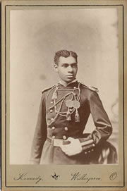
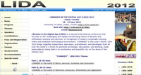
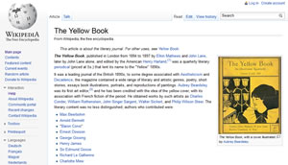







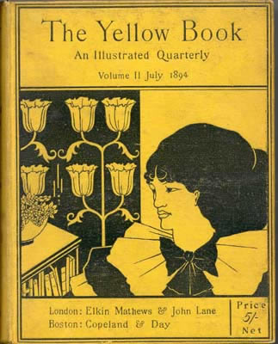


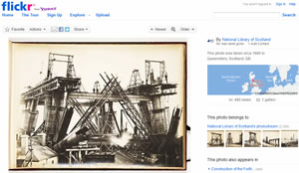
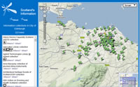

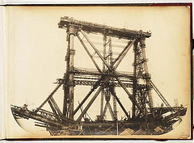
Media explosion

Slide 4
From 1965 to 2015: Metadata
Catalogue cards/indexes
Automation of card production
Database of card production records (office automation)
Database of descriptive records for collection acquisition and access
Online public access catalogues
Authority record control for descriptive record access
Aggregated databases of records
Linked data from aggregations of records

Slide 5
From Internet to Semantic Web
Skynet: the web of smart machines*
Semantic Web: the web of data
Web: the web of documents
Internet: the web of machines
* Waiting for Ar tificial Intelligence nie …

Slide 6
From document to data
Catalogue record as textual surrogate for document described
Is the record necessary if the document (text) is digital?
Should a record be allowed to be bigger than the document described?
If the document is fixed, then the record is fixed
Metadata = stuff to be filed (in the bureau)
Data about data
Data processing vs document processing
From FRBR to FRAD

Slide 7
From record to statement
Closed-world assumptions
Top-down Universal Bibliographic Control
Formats for exchange of metadata
The “authority” record
Open-world assumptions
Anyone can say Anything about Any thing (AAA)
Absence of data does not mean “not applicable” (OWA)
The record is always incomplete
RDF is the Twitter of metadata

Slide 8
From description to relation
Digital capture of sources of description is easy
Visual metadata (thumbnails) expected
Recorded attribute data less important for identification/disambiguation in linked data applications
Relationships between information resources/objects are proliferating
Digitisation
Sequels, prequels, film and tv adaptations
Translations, global culture
Relations are navigation paths

Slide 9
Outside looking in
It’s free!
Users seem to like it
New features are constantly emerging (from nowhere)
Requires minimal intermediation
It’s cheap …
It’s magic!
Only the data wizards know how

Slide 10
Inside looking out
No quality control
Ignorance and naivety “dumb rules ok!”
A disaster waiting to happen
Cyberwar
A new Dark Age for information
Using brains where machines fail
Common brains: the crowd, paraprofessionals, retired cataloguers
Trained brains: curating data for humanity’s memory

Slide 11
Thank you!
Questions and discussion
gordon@gordondunsire.com

