Slide 1
Telling tails: metadata standards and the digital humanities
Gordon Dunsire
Presented to 2nd International Symposium
Digital humanities: empowering visibility of Croatian cultural heritage
6-8 November 2017, University of Zadar, Croatia

Slide 2
Overview
The long tail of humanities resources
And its entanglement in time
IFLA Library Reference Model
Context
RDA: Resource description and access

Slide 3
The long tail
time
= a tangled tale
has commentary
R
Rx
R
Original
resource
R
has derivation
Ry
R
R
Rz
is subject of
R
Information resources remain relevant for a longer time in the Humanities than in other research disciplines:
The longer something is relevant, the more likely it will be associated with other resources
Notes:
The LRM uses a super-entity, "Res", to model high-level relationships and attributes for all other entities. In RDA, the super-entity "RDA Entity" is used in place of Res for all other RDA entities. RDA Entity is a sub-type (sub-class in RDF) of Res.
This RDF graph shows new RDA entities taken from the LRM: Nomen, Place, Time-span, Collective Agent, and Agent. Current RDA entities are labelled only with their initials. The graph also shows the high-level relationships between the new and current entities.
The only RDA entity which does not fit without significant modification is Person. In the LRM, the definition of this entity restricts it to a human being, and non-humans including animals, fictitious and legendary beings, and natural phemomena, are excluded.
The integrated semantic structure of the LRM and RDA entities allows the RDA relationships to be refinements of the high-level LRM relationships, as element sub-types (sub-properties in RDF).

Slide 4
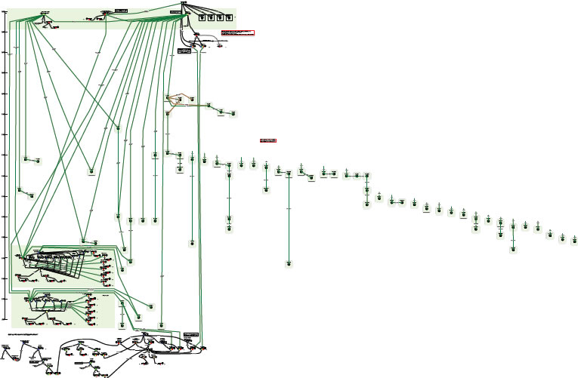
Complexity of relationships: Moby Dick
Diagram using FRBR entities and relationships
Printed editions
“OrsonWhales” mash-up (YouTube)
Ronald J. Murray: From Moby Dick to mash-ups
http://www.slideshare.net/RonMurray/from-mobydick-to-mashups
Notes:
RDA data is designed to reflect the complexity of relationships found in library and cultural heritage resources.
This is an example of a paper exercise to draw the relationships between the various printed editions of Herman Melville’s novel “Moby Dick”.
The complex sub-graph at the bottom represents a multimedia mash-up of Moby Dick with Orson Welles (who acted in the film of Moby Dick).
This diagram can be readily extended.
We could add the film starring Gregory Peck as Captain Ahab, and other film and tv adaptations, in multiple formats and editions. And the various recordings of the instrumental “Moby Dick” (for solo drummer!) by Led Zeppelin, and all the other recordings by the group, in multiple formats and editions. And so on.

Slide 5
Explosion of digital resources
Mass digitization of archive, library, and museum documents and objects
Born-digital: "Traditional" resources; emails, tweets; blogs; photographs; videos; …
Uncovering the past with digital technologies:
Drones; remote-sensing; detectorists (archaeology)
X-rays, CAT/MRS/etc. ("palimpsests")
Reconstruction; comparison; pattern detection (palaeography) …
Notes:
The LRM uses a super-entity, "Res", to model high-level relationships and attributes for all other entities. In RDA, the super-entity "RDA Entity" is used in place of Res for all other RDA entities. RDA Entity is a sub-type (sub-class in RDF) of Res.
This RDF graph shows new RDA entities taken from the LRM: Nomen, Place, Time-span, Collective Agent, and Agent. Current RDA entities are labelled only with their initials. The graph also shows the high-level relationships between the new and current entities.
The only RDA entity which does not fit without significant modification is Person. In the LRM, the definition of this entity restricts it to a human being, and non-humans including animals, fictitious and legendary beings, and natural phemomena, are excluded.
The integrated semantic structure of the LRM and RDA entities allows the RDA relationships to be refinements of the high-level LRM relationships, as element sub-types (sub-properties in RDF).

Slide 6
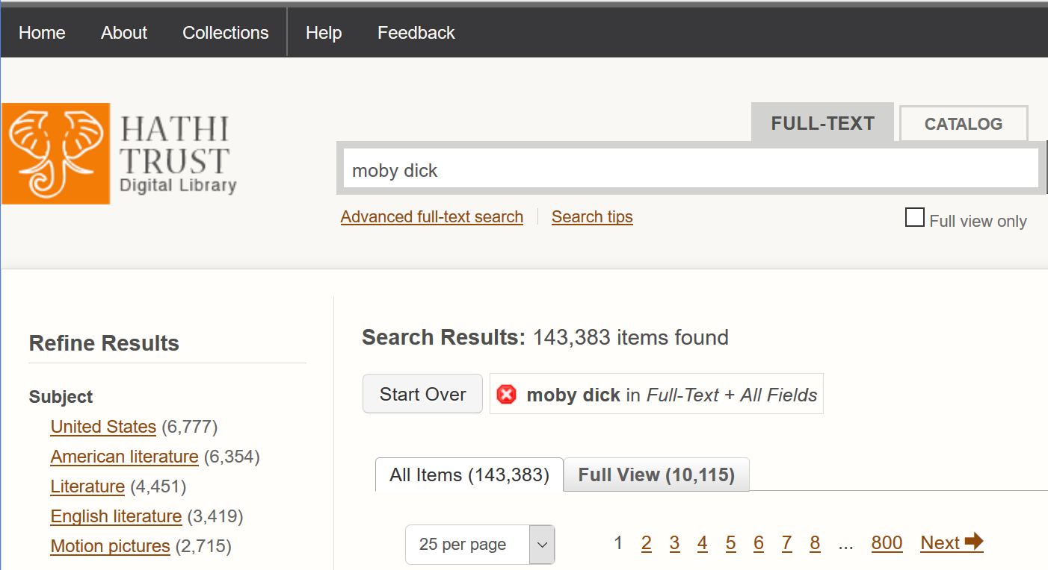
Moby Dick: 143,383 items; 4,451 "literature", 2715 films, …

Slide 7
IFLA LRM
Library Reference Model: published in August 2017 by the International Federation of Library Associations and Institutions
Consolidates Functional Requirements for Bibliographic Records (FRBR), Functional Requirements for Authority Data (FRAD), Functional Requirements for Subject Authority Data (FRSAD), and the report of the IFLA Working Group on Aggregates
Compatible with CIDOC CRM (via FRBRoo)
Notes:
The LRM uses a super-entity, "Res", to model high-level relationships and attributes for all other entities. In RDA, the super-entity "RDA Entity" is used in place of Res for all other RDA entities. RDA Entity is a sub-type (sub-class in RDF) of Res.
This RDF graph shows new RDA entities taken from the LRM: Nomen, Place, Time-span, Collective Agent, and Agent. Current RDA entities are labelled only with their initials. The graph also shows the high-level relationships between the new and current entities.
The only RDA entity which does not fit without significant modification is Person. In the LRM, the definition of this entity restricts it to a human being, and non-humans including animals, fictitious and legendary beings, and natural phemomena, are excluded.
The integrated semantic structure of the LRM and RDA entities allows the RDA relationships to be refinements of the high-level LRM relationships, as element sub-types (sub-properties in RDF).

Slide 8
IFLA LRM entities
Res
is sub-class of
Work
Expression
Nomen
Manifestation
Place
Agent
Item
Time-span
Collective Agent
Person
Notes:
The LRM uses a super-entity, "Res", to model high-level relationships and attributes for all other entities. In RDA, the super-entity "RDA Entity" is used in place of Res for all other RDA entities. RDA Entity is a sub-type (sub-class in RDF) of Res.
This RDF graph shows new RDA entities taken from the LRM: Nomen, Place, Time-span, Collective Agent, and Agent. Current RDA entities are labelled only with their initials. The graph also shows the high-level relationships between the new and current entities.
The only RDA entity which does not fit without significant modification is Person. In the LRM, the definition of this entity restricts it to a human being, and non-humans including animals, fictitious and legendary beings, and natural phemomena, are excluded.
The integrated semantic structure of the LRM and RDA entities allows the RDA relationships to be refinements of the high-level LRM relationships, as element sub-types (sub-properties in RDF).

Slide 9
Work: the intellectual basis of a resource
Work
was transformed into
Work
is realized through
Expression
precedes
Work
is embodied in
is inspiration for
Manifestation
Work
is exemplified through
Item
Work
accompanies / complements
Notes:
The LRM uses a super-entity, "Res", to model high-level relationships and attributes for all other entities. In RDA, the super-entity "RDA Entity" is used in place of Res for all other RDA entities. RDA Entity is a sub-type (sub-class in RDF) of Res.
This RDF graph shows new RDA entities taken from the LRM: Nomen, Place, Time-span, Collective Agent, and Agent. Current RDA entities are labelled only with their initials. The graph also shows the high-level relationships between the new and current entities.
The only RDA entity which does not fit without significant modification is Person. In the LRM, the definition of this entity restricts it to a human being, and non-humans including animals, fictitious and legendary beings, and natural phemomena, are excluded.
The integrated semantic structure of the LRM and RDA entities allows the RDA relationships to be refinements of the high-level LRM relationships, as element sub-types (sub-properties in RDF).

Slide 10
Agent: who?
All agents are human beings
created
(author, artist, etc.)
Agent
Work
created
(translator, etc.)
Expression
created
(publisher, etc.)
Person
Manifestation
Collective Agent
(2+ persons)
modified
Item
Notes:
The LRM uses a super-entity, "Res", to model high-level relationships and attributes for all other entities. In RDA, the super-entity "RDA Entity" is used in place of Res for all other RDA entities. RDA Entity is a sub-type (sub-class in RDF) of Res.
This RDF graph shows new RDA entities taken from the LRM: Nomen, Place, Time-span, Collective Agent, and Agent. Current RDA entities are labelled only with their initials. The graph also shows the high-level relationships between the new and current entities.
The only RDA entity which does not fit without significant modification is Person. In the LRM, the definition of this entity restricts it to a human being, and non-humans including animals, fictitious and legendary beings, and natural phemomena, are excluded.
The integrated semantic structure of the LRM and RDA entities allows the RDA relationships to be refinements of the high-level LRM relationships, as element sub-types (sub-properties in RDF).

Slide 11
Place: where?
is associated with
Place
Res
is part of
Place
location
"boundary"
category
"type of place"
Inherited from Res – category – "type of thing"
Notes:
The LRM uses a super-entity, "Res", to model high-level relationships and attributes for all other entities. In RDA, the super-entity "RDA Entity" is used in place of Res for all other RDA entities. RDA Entity is a sub-type (sub-class in RDF) of Res.
This RDF graph shows new RDA entities taken from the LRM: Nomen, Place, Time-span, Collective Agent, and Agent. Current RDA entities are labelled only with their initials. The graph also shows the high-level relationships between the new and current entities.
The only RDA entity which does not fit without significant modification is Person. In the LRM, the definition of this entity restricts it to a human being, and non-humans including animals, fictitious and legendary beings, and natural phemomena, are excluded.
The integrated semantic structure of the LRM and RDA entities allows the RDA relationships to be refinements of the high-level LRM relationships, as element sub-types (sub-properties in RDF).

Slide 12
Time-span: when?
is associated with
Time-span
Res
is part of
Time-span
beginning
"date/time"
ending
"date/time"
Notes:
The LRM uses a super-entity, "Res", to model high-level relationships and attributes for all other entities. In RDA, the super-entity "RDA Entity" is used in place of Res for all other RDA entities. RDA Entity is a sub-type (sub-class in RDF) of Res.
This RDF graph shows new RDA entities taken from the LRM: Nomen, Place, Time-span, Collective Agent, and Agent. Current RDA entities are labelled only with their initials. The graph also shows the high-level relationships between the new and current entities.
The only RDA entity which does not fit without significant modification is Person. In the LRM, the definition of this entity restricts it to a human being, and non-humans including animals, fictitious and legendary beings, and natural phemomena, are excluded.
The integrated semantic structure of the LRM and RDA entities allows the RDA relationships to be refinements of the high-level LRM relationships, as element sub-types (sub-properties in RDF).

Slide 13
Nomen: the name of a thing
Every thing has a name (title, label, etc.)
Res
Nomen
"name"
has appellation
has nomen
string
is derived from
Nomen
"another name"
"script"
"context of use"
has script
has context
Notes:
The LRM uses a super-entity, "Res", to model high-level relationships and attributes for all other entities. In RDA, the super-entity "RDA Entity" is used in place of Res for all other RDA entities. RDA Entity is a sub-type (sub-class in RDF) of Res.
This RDF graph shows new RDA entities taken from the LRM: Nomen, Place, Time-span, Collective Agent, and Agent. Current RDA entities are labelled only with their initials. The graph also shows the high-level relationships between the new and current entities.
The only RDA entity which does not fit without significant modification is Person. In the LRM, the definition of this entity restricts it to a human being, and non-humans including animals, fictitious and legendary beings, and natural phemomena, are excluded.
The integrated semantic structure of the LRM and RDA entities allows the RDA relationships to be refinements of the high-level LRM relationships, as element sub-types (sub-properties in RDF).

Slide 14
Scope and context
LRM:
"covers bibliographic data … in a broad, general sense"
"The universe of (human) discourse"
"developed very much with semantic web technologies in mind"
Semantic Web:
Anyone can say Anything about Any thing
"Truth" is not assumed (e.g. fake news, bad metadata)
Open World Assumption
New statements can always be made about any thing

Slide 15
The metadata crisis
The deluge of digital resources is accompanied by metadata from a wide variety of sources: cataloguers; researchers; publishers; the public; computers; …
Some of it is "smart" (linked open data)
Some of it is informed (created by professionals)
Some of it is ill-informed (created by amateurs)
Some of it is "dumb" (created by machine)
Some of it is mad or bad (fake news, dis-information)

Slide 16
RDA: Resource Description and Access
“RDA is a package of data elements, guidelines, and instructions for creating library and cultural heritage resource metadata that are well-formed according to international models for user-focussed linked data applications.”
RDA Toolkit Restructure and Redesign (3R) Project is developing RDA as an implementation and extension of the LRM
June 2018

Slide 17
RDA refinement of LRM
Work
was transformed into
Work
[has] derivative (work)
[is] abridged as (work)
[is] abstracted as (work)
[is] adapted as (work)
[is] adapted as motion picture (work)
[is] adapted as novel (work)
[is] adapted as opera (work)
[is] adapted as radio program (work)
[is] adapted as video game (work)
[is] dramatized as (work)
[is] digested as (work)
[is] expanded as (work)
[is] indexed in (work)
[is] summarized as (work)

Slide 18
RDA recording methods
Work
has related work
"dumb"
"Title of work"
unstructured description
(transcription, note, etc.)
"Access point for work"
structured description
(authority file, etc.)
"Identifier for work"
Identifier (local)
Work
Identifier (global)
"smart"

Slide 19
Conclusion
If LRM/RDA/metadata describe the products of human discourse …
Then digital humanities study the products of human discourse
And require rich, smart, and comprehensive metadata to support such study and "tell" the long tale

Slide 20
Thank you!
gordon@gordondunsire.com
http://www.gordondunsire.com/publications.htm
IFLA Library reference model:
https://www.ifla.org/publications/node/11412
RDA: Resource Description and Access:
http://www.rda-rsc.org/content/about-rda

