Slide 1
Shrinking the silo boundary: data and schema in the Semantic Web
Gordon Dunsire
Presented at AKM 16, Poreč, 2012

Slide 2
Task: To publish local structured metadata as global linked data in the Semantic Web
So that users inside the local environment can benefit from data/information from outside
And users outside the local environment can benefit from data/information from inside

Slide 3
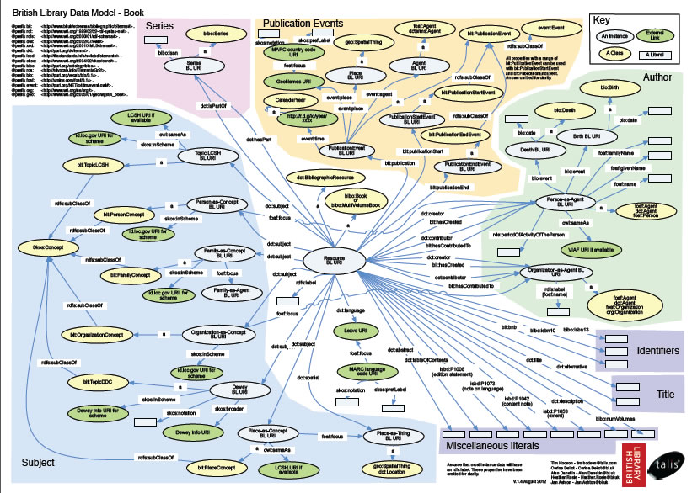
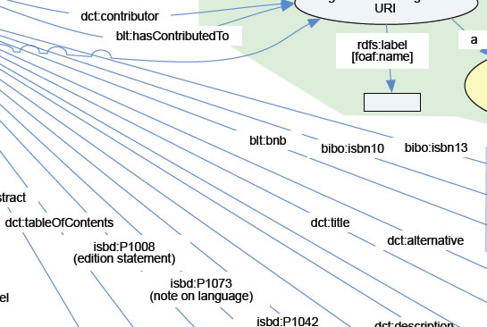
Bibliographic Ontology
Dublin Core
ISBD
Etc.
Mapping from MARC 21 to multiple linked data element sets

Slide 4
Mapping from local schema (MARC 21) to linked data (global) schema can be “lossy”
Some information may be lost, because the local attribute must have the same or narrower meaning as the global property to maintain semantic coherency
E.g.: MARC 21 Uniform Title to DC Title

Slide 5
To avoid losing local information in the global Semantic Web, we should represent the local schema as an RDF element set
British National Bibliography needs an element set for MARC 21
But MARC 21 has “messy” semantics, mixed up with syntax of tags, indicators, and subfields

Slide 6
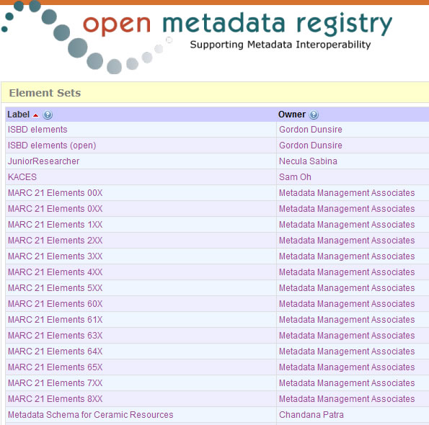
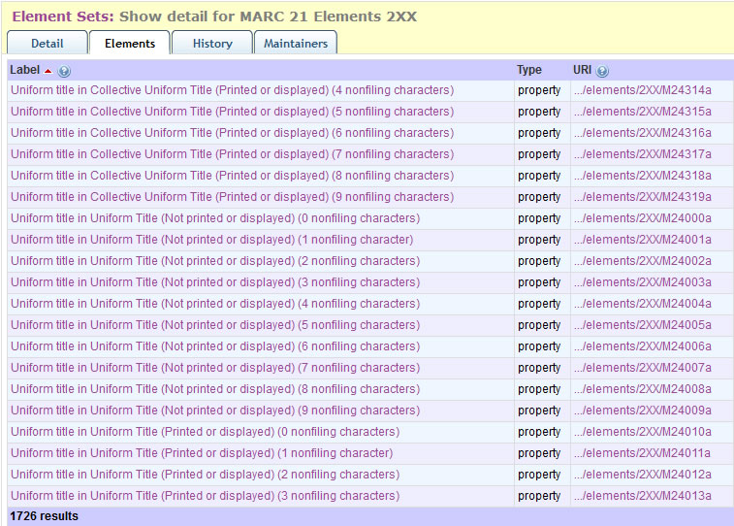
>14000 properties
Not every tag, yet!

Slide 7
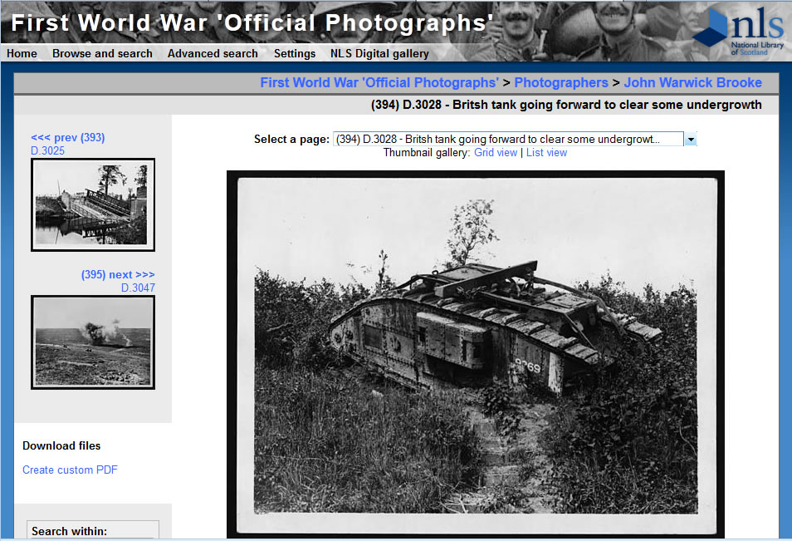
Something less complicated than MARC 21:

Slide 8
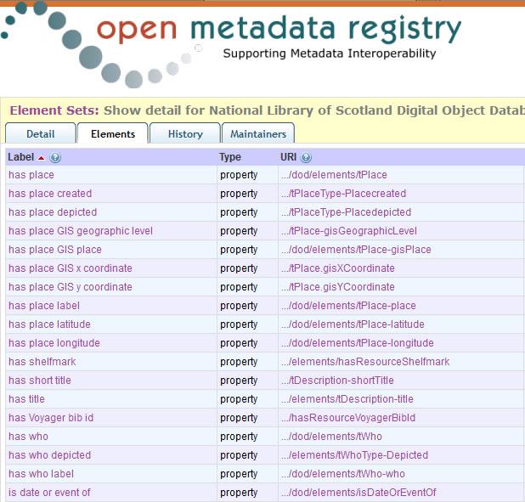
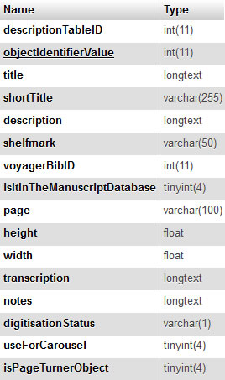

Slide 9
Advantages of local RDF element set
Published linked data loses no information
Other communities can see the semantics and structure of the local data schema
Where the linked data comes from
Other communities can re-use the schema
For their own local data
To map from their own local schema (lossy!)
Element set can still be mapped to other elements
Bibliographic Ontology, Dublin Core, ISBD, etc.
Have your cake, and eat it!

Slide 10
Semantic reasoning: the sub-property ladder
“sub-property of” is an RDF property which links two other properties
Ontological triple:
Property1 sub-property of Property2
Semantic rule:
If P1 sub-property of P2;
And data triple: Resource P1 “stuff”
Then data triple: Resource P2 “stuff”

Slide 11
Sub-property ladder
Ontology
Data triples
dct:title
Resource title “Tank”
rdfs:subPropertyOf
rda:variantTitle
Resource variantTitle “Tank”
rdfs:subPropertyOf
dod:hasShortTitle
Resource hasShortTitle “Tank”

Slide 12
Have your cake and eat it!
[You] Publish your local schema in RDF
[You] Publish your local data triples using local schema
[Anyone] Publish mappings from local schema to other, more global schema
[Anyone] Publish mapped global data triples using “reasoner” software

Slide 13
Shrinking the silo
Data
(RDBMS)
RDF dataset
Schema
(RDBMS)
RDF element set
Mappings
(XML/XSLT)
RDF ontology
Local silo
Global Semantic Web

Slide 14
Thank you!
gordon@gordondunsire.com

