Slide 1
Applications of IFLA Namespaces
Gordon Dunsire
IFLA Namespaces Technical Group
Session 185 — Tutorials and progress reports — Semantic Web Special Interest Group
IFLA World Library and Information Congress 11-17 August 2012, Helsinki, Finland

Slide 2
Dataset applications
“collections of structured metadata — descriptions of things, such as books … a collection of library records”
W3C Library Linked Data Incubator Group
Catalogue data is mapped to RDF elements from multiple namespaces
Mix-and-match
IFLA elements available in FR and ISBD namespaces

Slide 3
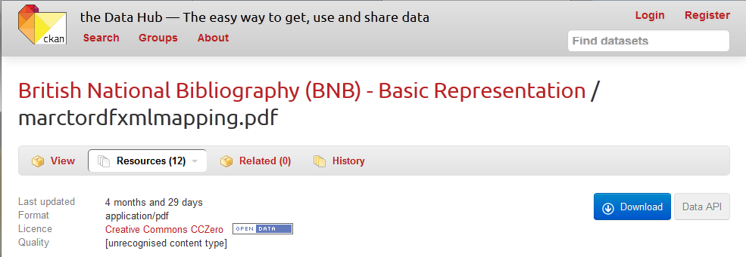
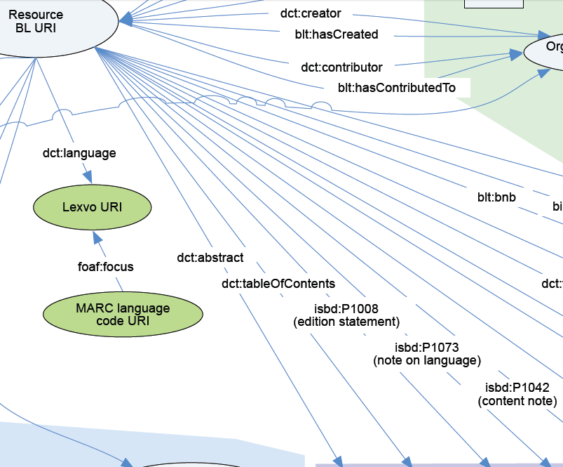
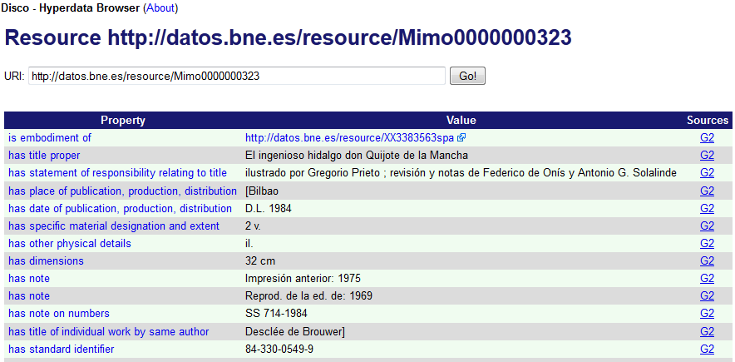
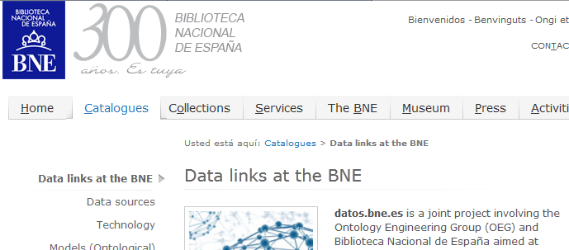
FRBR
ISBD

Slide 4
Element sets
“classes and attributes used to describe entities of interest … elements to be used by others to describe such entities”
W3C LLD
Metadata schema entities represented as RDF classes
Entity attributes (fields) and relationships represented as RDF properties

Slide 5
Element set applications
Interoperability of schema represented by relationships between RDF classes and properties in respective schema namespaces
Using ontological properties from W3C namespaces
E.g. RDF Schema (rdfs) subPropertyOf
Datasets can be processed against ontology maps to generate new data triples
The semantic in Semantic Web!

Slide 6
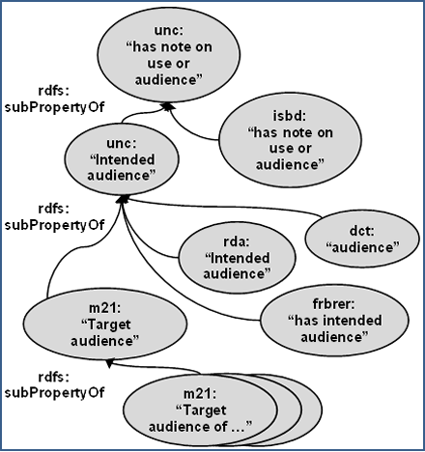
Interoperability
Audience element ontology:
ISBD
MARC21 (m21)
RDA
Dublin Core terms (dct)
Unconstrained commons

Slide 7
Global
Local

Slide 8
Value vocabularies
“a controlled list of allowed values for an element … include: thesauri, … authority files, …, and other types of knowledge organization systems.”
W3C LLD
E.g. MulDiCat
Multilingual dictionary of cataloguing
Useful for namespace translations, user displays, etc.

Slide 9
ISBD area 0 value vocabularies
Content form and media type
Development of RDF mappings to the RDA/ONIX Framework for Resource Categorization
RDA content form and media type already mapped
Improves interoperability of datasets and format-based resource discovery

Slide 10
RDA/ONIX Framework as hub
RDA
Ch:“language”
ISBD
SM:“hearing”
“spoken word”
“spoken word”
ID:“not applicable”
IM:“not applicable”
Sensory specification
qualifier
Ch:“language”
SM:“touch”
“tactile text”
“text”
ID:“not applicable”
+ “(tactile)”
IM:“not applicable”

Slide 11
IFLA Namespaces Technical Group
Representation from IFLA sections and groups
Guidelines on translating namespaces: in development
By end of 2012
Guidelines on using and extending namespaces: proposed for 2013
Investigation of “commons” namespaces for extension and interoperability: proposed for 2013

Slide 12
End
Thank you!
gordon@gordondunsire.com
IFLA Namespaces TG
http://www.ifla.org/en/node/5353
Open Metadata Repository
http://metadataregistry.org/
Blog posts on Metadata Matters
http://managemetadata.com/blog/

