Slide 1
Representation of the UNIMARC bibliographic data format in Resource Description Framework
Gordon Dunsire, Mirna Willer, Predrag Perožić
Presented at DC-2013, Lisbon, Portugal, 5 September 2013

Slide 2
UNIMARC
Universal Machine Readable Cataloguing
Maintained by the Permanent UNIMARC Committee (PUC) of the International Federation of Library Associations and Institutions (IFLA)
First published in 1977
Specifies formats for encoding Authority, Bibliographic, Classification and Holdings data
Based on ISO 2709, library content standards, etc.

Slide 3
Project
Representation of UNIMARC in RDF
Funded for first year by PUC
Will take more than 1 year …
Focus on UNIMARC Bibliographic format
To support production of datasets from UNIMARC catalogues
Used in Europe, North Africa, Russia, China, Japan
To support linked data interoperability with related IFLA standards and beyond

Slide 4
Element sets
“Bibliographic” format has same focus as International Standard Bibliographic Description (ISBD)
The entity [bibliographic] Resource ~ Manifestation
Attributes => RDF properties
Lossless data requires finest level of granularity
Qualified UNIMARC coded subfield

Slide 5
Value vocabularies
Coded information stored in tag block 1xx
Code lists specify notation, term, description, and scope
Represented as RDF/SKOS vocabularies
Italian and Portuguese translations – multilingual environment
Interoperability with vocabularies of other schema
12 published so far
For example: Target audience

Slide 6
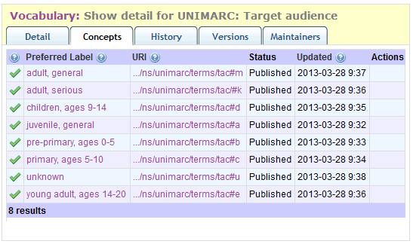
http://metadataregistry.org/concept/list/vocabulary_id/322.html

Slide 7
URI design templates
Value vocabulary granularity at code level.
Hash URIs used if code list is small, or self-referential (“other”, etc.)
Element set granularity at subfield level with superstructure of fields (tags) and 2 qualifiers (indicators). Coded subfields refined by character position.
Tag | Ind 1 | Ind 2 | Subfield | CharPos | URI | Attribute
200 | 1 | _ [blank] | a |  | 2001_a | Title proper
100 | _ | _ | a | 17 | 100__a17 | Target audience code 1
Vocabulary token | Code | URI | Vocabulary: Term
tac | m | tac#m | Target audience: adult, general

Slide 8
Target audience code
Subfield a,
character positions 17-19,
of tag 100 General processing data
“applicable to records of materials in any media“
3 instances of one-character code
100
_
_
a
17
100
_
_
a
17-19
100
_
_
a
18
100
_
_
a
19
Order of position
carries no significance
in UNIMARC format
But content rules
may assign significance

Slide 9
Mappings
UNIMARC tags and subfields have corresponding ISBD “elements”
Now out-of-date after publication of ISBD consolidated edition
Category of alignment relationship to be determined
Equivalent or broader/narrower
To be used as basis for sub-property mappings
Mappings from UNIMARC to other vocabularies being developed

Slide 10
DCT audience
UM
charPos 1
UM
charPos 2
UM
charPos 3
UM Target audience code
…
M21
codedType a
M21
codedType c
M21
codedType d
M21
codedType t
M21 Target audience code

Slide 11
Granularity
Intellectual value of UNIMARC is preserved by a finest-grained semantic representation
Data can always be dumbed-down to the level of coarseness required by applications
Processed with shared open maps
Including schema.org and dct!
And BIBFRAME too …
Data should be published without loss
For semantically rich applications
Universal Bibliographic Control ~ Semantic Web

Slide 12
Thank you!

