Slide 1
RSC Strategy
Gordon Dunsire, Chair, RDA Steering Committee
Presented at Casalini Libri meeting, 27 May 2016, Fiesole, Italy

Slide 2
RDA strategy
3 targets:
International communities
Cultural heritage communities
Linked data communities
RDA is a package of data elements, guidelines, and instructions for creating library and cultural heritage resource metadata that are well-formed according to international models for user-focussed linked data applications.

Slide 3
RDA data
RDA Toolkit provides the user-focussed elements, guidelines, and instructions.
RDA Registry provides the infrastructure for well-formed, linked, RDA data applications.
Open Metadata Registry provides the linked data representation of RDA Reference.
Notes:
The RDA data ecosystem is summed up in this sentence introducing the RDA Board’s announcement of RDA’s strategic directions.
The RDA package is delivered by an infrastructure of two interacting services.
The human-facing components, including the guidelines and instructions, are the Toolkit.
The data-facing components are contained in the Registry.
Applying the data capture and storage techniques in RDA Toolkit to the data architecture in the RDA Registry produces well-formed data for RDA applications.

Slide 4
RDA data infrastructure
RDA Reference data:
Elements, attributes, relationships, values
Open Metadata Registry (RDF)
RDA Registry
RDA Toolkit
Notes:
The RDA data ecosystem is summed up in this sentence introducing the RDA Board’s announcement of RDA’s strategic directions.
The RDA package is delivered by an infrastructure of two interacting services.
The human-facing components, including the guidelines and instructions, are the Toolkit.
The data-facing components are contained in the Registry.
Applying the data capture and storage techniques in RDA Toolkit to the data architecture in the RDA Registry produces well-formed data for RDA applications.

Slide 5
FRBR-LRM and RDA
LRM “a high-level conceptual model … intended as a guide or basis on which to elaborate cataloguing rules”
RDA guidance, instructions, elements
“operates at a greater level of generality than FRBRoo, which seeks to be comparable in terms of generality with CIDOC CRM”
RDA cultural heritage communities
LRM “this model is developed very much with semantic web technologies in mind”
RDA linked data communities

Slide 6
FRBR-LRM and RDA
RDA refines LRM relationships as element sub-types (RDF sub-properties)
Any Thing:
Covers all other types of thing
Res
has appellation
Nomen
is created by
W
E
Agent
M
is type of
Place
I
Collective
agent
is associated with
is modified by
Timespan
P
F
C

Slide 7
Refinements
Coarse/General
is associated with
Res1
Res2
has creator
has artist
Fine/Specific
is associated with
Res1
Res2
is derivative (E)
is adapted as (E)
is adapted as graphic novel (E)

Slide 8
Nomens and appellations
Res
Nomen
has appellation
M1
N1
“My title”
has title proper
has literal form
has title proper
has identifier …
has literal form
M1
N2
“0123-4567”
has identifier …

Slide 9
4-fold path
RDA database implementation
The “4-fold path” supports RDA data in catalogue cards, flat file schema, RDBMS, and linked data
Describing a related entity:
Unstructured description
Structured description
Identifier
URI
General guidance and instructions:
Simple
Less duplication
Easier to translate

Slide 10
Converging paths
N3
has related entity
Res1
Res2
N2
has appellation
N1
“0123-4567”
“[Authorized Access Point]”
“[Unstructured description]”
“[Variant Access Point]”

Slide 11
LRM-A6 Extent
LRM-A6 Extent
A quantification of the extent of the expression
The value of the Extent attribute must consist of three elements:
a type of extent (e.g., length of text, envisioned duration of performance of musical notation, actual duration of recorded performance, etc.),
a number,
and a measurement unit (words, minutes, etc.).

Slide 12
LRM-A16 Manifestation statement
A statement appearing in the manifestation and
deemed to be significant for users to understand
how the resource represents itself.
… normally transcribed from a source in a
manifestation. Transcription conventions are
codified by each implementation.
WYSISWYG transcription (computer mediated)
Conventional transcription (human mediated)

Slide 13
Attributes => Relationships
has manifestation
statement
Publication statement
Transcribed
has place of publication
Nomen
Place
has publisher’s name
M
C
Nomen
Recorded
Timespan
Nomen
has date of publication

Slide 14
Translations
RDA
Translations Policy
In process (RDA Toolkit):
Finnish
Italian
Translations in
RDA Registry:
German
French
Spanish
Chinese
In process (RDA Reference):
Arabic
Dutch
Swedish
Chinese

Slide 15
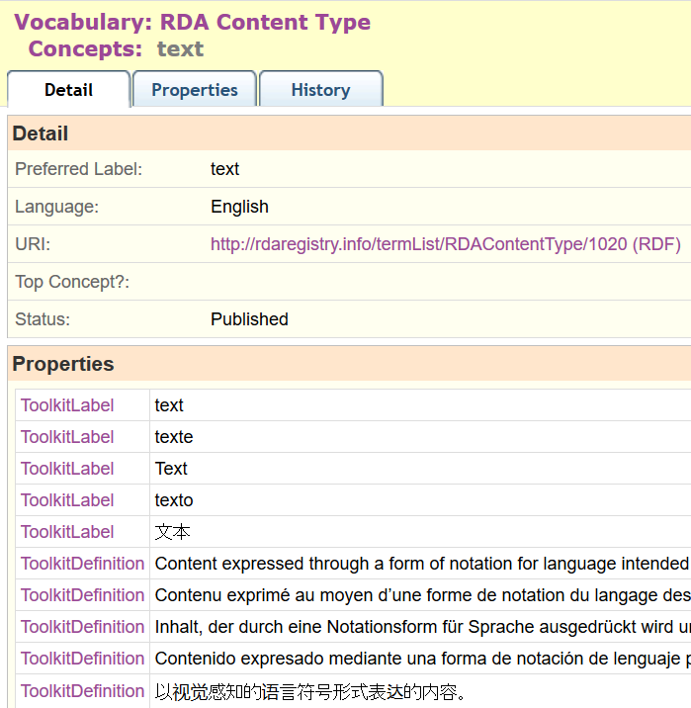
Semantic
Web

Slide 16
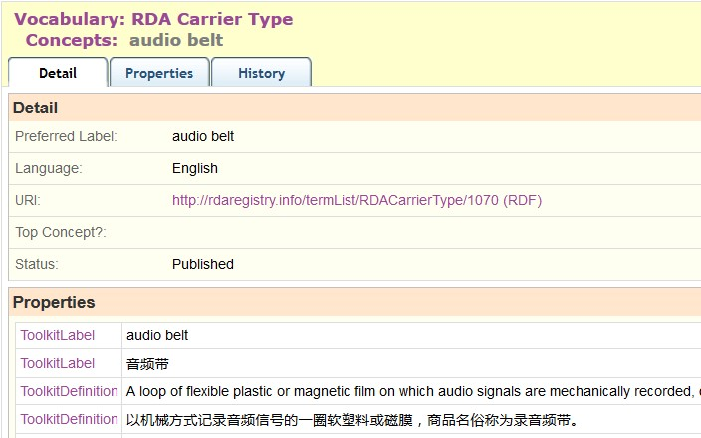
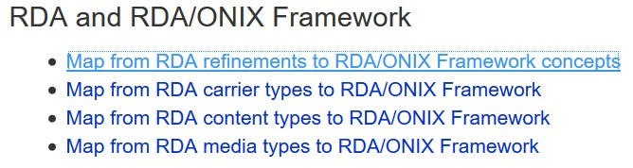
Local
refinement
“audio belt”: refinement to Carrier type
via RDA/ONIX Framework
Notes:
RDA is being developed to support refinements and extensions to RDA elements and vocabularies for local applications.
An example is “audio belt”, proposed by the Library of Congress as a new RDA Carrier type.
This was implemented as a local RDA refinement of a basic resource category in the RDA/ONIX Framework ontology.
The new type is included in the vocabulary, and the nature of the refinement is given in a machine-readable map in the RDA Registry.

Slide 17
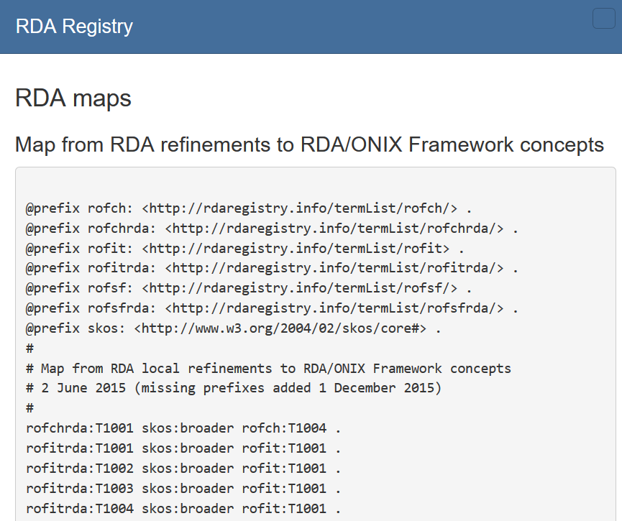
Maps for machines

Slide 18
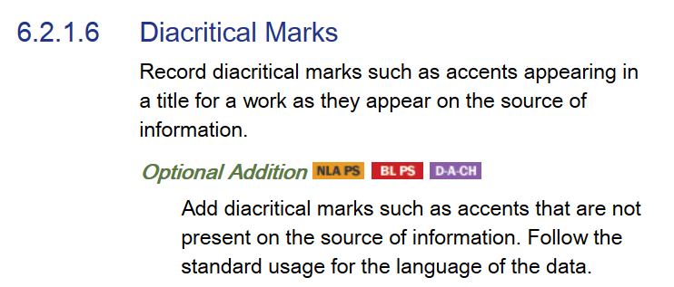
Local policies
National Library of Australia
Policy Statement
British Library
Policy Statement
Germany, Austria,
Switzerland
Notes:
RDA is being developed to support refinements and extensions to RDA elements and vocabularies for local applications.
An example is “audio belt”, proposed by the Library of Congress as a new RDA Carrier type.
This was implemented as a local RDA refinement of a basic resource category in the RDA/ONIX Framework ontology.
The new type is included in the vocabulary, and the nature of the refinement is given in a machine-readable map in the RDA Registry.

Slide 19
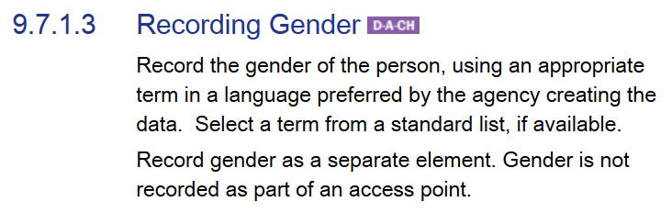
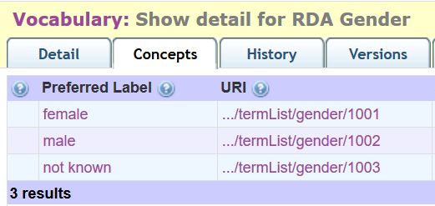
Local vocabularies
Vocabulary removed
from “global” RDA
becomes a “local” vocabulary
Notes:
RDA is being developed to support refinements and extensions to RDA elements and vocabularies for local applications.
An example is “audio belt”, proposed by the Library of Congress as a new RDA Carrier type.
This was implemented as a local RDA refinement of a basic resource category in the RDA/ONIX Framework ontology.
The new type is included in the vocabulary, and the nature of the refinement is given in a machine-readable map in the RDA Registry.

Slide 20
Thank you
rscchair@rdatoolkit.org
RSC website
http://www.rda-rsc.org/
RDA Toolkit
http://www.rdatoolkit.org/
RDA Registry
http://www.rdaregistry.info/
RDA data, Jane-athons, etc.
http://www.rballs.info/

