Slide 1
Preparing for the new RDA Toolkit: special topics
Gordon Dunsire, Deborah Fritz, Damian Iseminger
Presented at the RSC outreach seminar
National Library of Spain, Madrid, 23 Oct 2017
(amended)

Slide 2
Overview
Topic 1: Serials, aggregates, and changes over time
Topic 2: Types of description
Topic 3: Developing attributes as relationships
Slides 18 and 19 have been amended following discussion on meta-works vs work clusters by the RDA Steering Committee. Other slides have minor amendments.

Slide 3
1.1: Changes over time
Static and diachronic works
ROF extension attributes
Extension expectation vocabulary

Slide 4
Static and diachronic works
A static work is realized and embodied at the same time*.
A diachronic work is realized and embodied in a duration of time**.
* The content is issued in a single act
** The content is issued in a sequence of single acts that effectively change the content
***Time? Time-span entity?
Notes:
A distinction must be made between works that are intended to be issued in "one go" (static), and works that are intended to be issued over an extended period of time (diachronic).
Each iterative issue of a diachronic work changes the content that has been realized and embodied to date.
This is not specifically related to the LRM Time-span entity, or its attributes which recording the times at which a period of time begins and ends; although the entity may be used to record the period of issuance of a diachronic work.

Slide 5
Changing plans
The essence of a diachronic work is the plan for the change of content:
Replacement? = Integration
Accumulation? = Succession
The future may not conform with the plan …
The last episode of a TV serial is not made ☹
… so we cannot describe a diachronic work (or expression or manifestation) until it is complete
But we can describe the plan, and the distinct "issue" WEMs ☺
Notes:
The content of a diachronic work may be changed over time by replacement of previous content, that is integration of the content, or by accumulation by successive additions to the content.
The planned content may not be fully realized, for many reasons.
It is therefore not possible to properly describe the realization and embodiment of a diachronic work until is complete. Only the plan or intention of the work can be described, along with any iterations of the content to date.

Slide 6
ROF Extension attributes
RDA/ONIX Framework for Resource Categorization
Extension requirement:
Not applicable
Essential
Inessential
Static work
"Monographic" work
Continuing work
Qualified by Extension mode (integration, succession) and Extension termination (determinate, indeterminate) to form "Extension expectation" categories
Notes:
The RDA/ONIX Framework for Resource Categorization is used to define the categories of RDA carrier type, content type, and media type vocabulary encoding schemes, using the fixed and exhaustive values of several primitive attributes such as "sensory mode" and "intermediation device".
The Framework also contains attributes and values for "extension requirement", "extension mode", and "extension termination". These can be used to define a set of categories for a new RDA vocabulary encoding scheme for extension expectation (or intention).

Slide 7
"Extension expectation" terms
Static work | A work intended to be realized in one or more distinct expressions that are embodied simultaneously.
Integrating monographic work | A work intended to be realized in one distinct expression embodied during a fixed time-span.
Sequential monographic work | A work intended to be realized in multiple distinct expressions embodied during a fixed time-span.
Integrating continuing work | A work intended to be realized in one distinct expression embodied during a time-span with no ending.
Serial work | A work intended to be realized in multiple distinct expressions embodied during a time-span with no ending.
Aggregates?
Notes:
Various combinations of the Framework attribute values suggests categories with these terms and definitions for the new vocabulary encoding scheme.
These categories do not take into account whether a distinct expression of the work itself aggregates expressions of other individual works.

Slide 8
1.2: Serial works
Serial works and LRM relationships
Change in work plan; WEM lock
Boundary of serial work; ISSN and ISSN-L (clarified)

Slide 9
Serial work
A work intended to be realized in multiple distinct expressions embodied during a time-span with no ending.
Work-Work relationships
LRM-R19 precedes [logical, not chronological]
LRM-R22 was transformed into [by policy, etc.]
Expression-Expression relationship:
LRM-R25 was aggregated by
Notes:
A serial work is diachronic work that is issued successively with no intended termination.
The LRM offers three high-level relationships that can be used to model the complexity of a serial work and its issues.
LRM-R19 is used to place the works that are the individual issues in sequence according to their numerical and chronological enumeration, even if an issue is embodied in a different chronological order.
LRM=R22 is used to relate serial works that undergo a change of issuance plan, for example if the carrier type of the embodied issue changes from printed volume to online resource.
LRM-R25 is used to relate the expressions of individual issues to the expression of the serial work.

Slide 10
DiachronicW
1
transformed into
DiachronicW
2
DiachronicE
1
DiachronicE
2
aggregated by
aggregated by
IssueW
1A
IssueE
1A
IssueE
1B
IssueW
1B
precedes
precedes
IssueW
2A
IssueE
2A
IssueE
2B
IssueW
2B
AggregateM
AggregateM
Notes:
In this diagram, a serial work is transformed into a new, separate serial work.
Each work has an expression that aggregates the expressions of its issues.
Each work realized by an expression of an issue is related to the next issue in the sequence of enumeration.
The diagram does not indicate the structure of the aggregate manifestations. For example, both serial works may be embodied as a single online resource.

Slide 11
Changes in Serial work plans
LRM: The plan of a serial work includes the editorial concepts that guide the production of the issues that comprise an aggregate manifestation.
Any changes to the plan may result in a new serial work.
The national edition of El País is a different serial work than the Valencia edition of El País. The plan for the content has changed, resulting in a new serial work.

Slide 12
WEM lock (1)
Because a serial work is also a plan for how a serial will be expressed and manifested, it may only have one expression and one manifestation.
Just because something is true now, does not necessarily mean that it will be true in the future.
Notes:
A serial work is planned to be realized and embodied in a certain way.
This means that a serial work is realized in only one expression and embodied in only one manifestation.
The manifestation may be issued in one or more physical parts, but it remains a single manifestation.
It is impossible to predict in advance if the plan will remain the same or will change; if it changes, the result is usually a new serial work with its own expression and manifestation.

Slide 13
WEM lock (2)
Translated editions should be treated as different expressions of different serial works.
It is impossible to predict that a single serial work will always be published in both Spanish and Valencian. At some point, publication may cease for one of the language editions, but not the other.
Notes:
An expression of a serial work cannot be planned to be translated as a separate expression of the same serial work, because it is not possible to ensure that this will always happen.

Slide 14
WEM lock (3)
Similarly, a serial released in an online version and a print version should be considered instances of 2 different serial works
It is impossible to predict that a single serial work will always be published in both a print and online version.
It is also impossible to predict that the online and print versions will always share the same content.
Notes:
It is also not possible to ensure that the same serial expression will be embodied in separate manifestations with different carrier types.

Slide 15
Boundary of serial works
A new serial work is generated when the plan for an already existing serial work changes.
RDA will provide instructions for recording changes to elements associated with the plan for a serial work.
But RDA can provide only general guidance on determining when a change of plan results in a new work.
Notes:
A change of plan of a serial work usually results in a new serial work with a different plan.
The new work may reflect changes to one or more elements associated with the serial work, expression, or manifestation.
The RDA instructions will describe what elements may change and how such changes should be recorded, but the decision on whether a change should be recorded as a new work is dependent on the requirements and policies of local applications and agencies.

Slide 16
Significance
Change of:
Language
Frequency
Carrier type
Title
Timeline of serial work
SerialW
A1
transformed into
SerialW
A2
SerialW
B1
SerialW
B2
transformed into
transformed into
Notes:
Local applications of RDA will determine what kinds of change to a diachronic work plan are significant enough to indicate a new diachronic work.
For example, community A may decide that change of language and carrier type are significant, and change of frequency and title are insignificant, while community B has the opposite view..
When a serial work plan changes over time, the serial works recorded by community A will differ from those recorded by community B.
However, the high-level "transformation" relationship is transitive: if serial 1 is transformed into serial 2, and serial 2 is transformed into serial 3, then serial 1 is transformed into serial 3.
This allows the RDA data recorded by each community to interoperate in a coherent way.

Slide 17
Judging boundaries
It will be up to local policy and cataloguer’s judgment to:
Select the elements for describing the plan
Select the elements for recording changes in their value
Select the elements and values that justify the description of a new work
Select the issue or iteration that provides the values used in a serial work
This will prevent unnecessary proliferation of serial works.

Slide 18
ISSN and ISSN-L
Because of the WEM lock, an ISSN should be understood as an identifier for a serial work, as opposed to an identifier for a manifestation.
An ISSN-L should be understood as an identifier for a group of closely related serial works, i.e. a "work cluster". In this case it, is the same “work” in different “mediums.”
In RDA, the relationship between the ISSN-L work cluster and the ISSN serial work can be indicated by recording the ISSN-L for each serial work.
Notes:
The WEM lock means that there is one and only one manifestation of one and only one expression of an incomplete diachronic work. The WEM combination is therefore a unique "super-entity" that can be identified as a whole.
The LRM indicates that an ISSN that appears to identify a manifestation is really identifying the work that is embodied in the manifestation.
This implies that an ISSN-L identifies a group of diachronic works rather than a set of manifestations "gathered" by a single expression.
This can be implemented in RDA by recording an ISSN-L for each serial work, in addition to its own ISSN.

Slide 19
Serial work cluster
Serial Work
Cluster
Serial Work
1
has identifier
“ISSN 0264-2875”
“ISSN-L 0264-2875”
“ISSN-L 0264-2875”
Serial Work
2
“ISSN 1750-0095”
Notes:
This is a simplified diagram showing how a serial work cluster might be identified.
The LRM treats an identifier as a Nomen, so the ISSNs and two occurrences of ISSN-L are four separate nomens that identify two distinct works. Although the ISSN-L is the same nomen string, it forms a distinct nomen for each entity of which it is an appellation..
The serial work cluster can therefore be described in a note or context of use attribute for each nomen that has the ISSN-L as a nomen string.

Slide 20
1.3: Aggregates
Types of aggregate
Whole/part; Combination works
Short-cuts through aggregating expressions

Slide 21
Types of aggregates
An aggregate is a manifestation embodying multiple distinct expressions
Aggregated Work
1
Aggregated Work
2
realizes
Aggregated
Expression 1
Aggregated
Expression 2
embodies
Aggregate
Manifestation
Notes:
The LRM treats an aggregate resource as a manifestation that embodies more than one distinct expression.
Each expression realizes its own distinct work.
There is no "aggregate expression" or "aggregate work" that forms a single WEM stack with the aggregate manifestation; there are only the distinct works and expressions that are aggregated in the aggregate manifestation.

Slide 22
Types of aggregates: 1
Aggregate collections of expressions
W1: Danza ritual del fuego
W2: Sombrero de tres picos
realizes
E1: Performance by
Leonard Bernstein and the
New York Philharmonic
E2: Performance by
Leonard Bernstein and the
New York Philharmonic
embodies
M: España
(Columbia Records ML 6186)
Notes:
The LRM identifies three distinct types of aggregates.
The first type is a collection of independent expressions.
In this example, the aggregate manifestation embodies two expressions of distinct works. This is a typical collection of recordings of separate musical works gathered under a common theme, in this case "Spain".

Slide 23
Types of aggregates: 2
Aggregates resulting from augmentation
W1: Don Quixote by Cervantes
W2: Illustrations by Gustavo Doré
realizes
E1: Content Type:
Text
E2: Content type:
Still image
embodies
M: Don Quijote de la Mancha
(Madrid: Edimat Libros, 2004)
Notes:
The second type of aggregate manifestation embodies the expression of a distinct work with expressions that augment the content of the manifestation.
In this example, the work by Cervantes is embodied with illustrations that augment the work. The augmenting expression realizes its own distinct work.

Slide 24
Types of aggregates: 3
Aggregates of parallel expressions
W1: Beowulf (Epic poem)
realizes
E2: Text translated into
Modern English
by Seamus Heaney
E1: Text in Old English
embodies
Beowulf
(New York, 2000)
Notes:
The third type of aggregate manifestation embodies more than one expression of the same distinct work. These "parallel" expressions are often translations of each other.

Slide 25
Plans for aggregates (1)
Aggregate manifestations also embody an aggregating expression which realizes an aggregating work
Aggregating
Work
Aggregated Work
1
Aggregated Work
2
realizes
realizes
Aggregating
Expression
Aggregated
Expression
1
Aggregated
Expression
2
embodies
embodies
Aggregate
Manifestation
Notes:
An aggregate manifestation also embodies the plan that brings together the expressions embodied in the manifestation.

Slide 26
Plans for aggregates (2)
The aggregating work is the plan, realized in the aggregating expression, for the selection and arrangement of the distinct expressions in the aggregate manifestation.
AW: The plan for Understanding FRBR
W1: An introduction
to Functional …
W2: Understanding the …
AE: Expression of the
plan ….
E1: Text in English
E2: Text in English
Understanding
FRBR
(Libraries Unlimited, 2007)
Notes:
As with a serial work, the aggregating work is a plan that is realized by one and only one aggregating expression. The plan covers which expressions are selected for aggregation, the order in which they are embodied in the aggregate manifestation, etc.

Slide 27
Plans for aggregates (3)
The aggregating work does not contain the distinct works. There is no whole-part relationship…
AW: Work plan for
Selected poetry of Lord Byron
W1: She walks in beauty
W2: To Belshazzar
realizes
realizes
E1: Text in
English
E2:Text in
English
AE: Expression of the plan …
embodies
embodies
Selected poetry
of Lord Byron
(Modern Library, 2001)
Notes:
The aggregating work is only the plan, and it does not have a whole-part relationship with the aggregated works. The aggregating expression does not "contain" the aggregated expressions, and does not have a whole-part relationship with them.

Slide 28
Plans for aggregates (4)
What happens if the plan changes?
But there is a relationship, LRM-R25, between the aggregating expression and the expressions it selects
AW: Work plan for
Selected poetry of Lord Byron
W1: She walks in beauty
W2: To Belshazzar
E1: Text in
English
E2:Text in
English
AE: Expression of the plan …
aggregated by
Selected poetry
of Lord Byron
(Modern Library, 2001)
Notes:
The LRM provides a relationship between an aggregating expression and an aggregated expression: LRM-R25 aggregates/was aggregated by.
This provides an indirect relationship between an aggregated expression and an aggregate manifestation: Expression was aggregated by Expression is embodied in Manifestation.
This is useful when the same aggregating work and expression are embodied in multiple manifestations, for example with different carrier types. Only one set of LRM-R25 relationships needs to be recorded, instead of repeating the same set of "is embodied in" relationships for each manifestation.
A change of plan regarding which expressions are aggregated by a static aggregating expression results in a new static aggregating work with a different plan. But, as with all diachronic works, the plan of a diachronic aggregating work includes a plan for change, by the addition of aggregated expressions.

Slide 29
Whole/part works and expressions
Whole/part works are distinct from aggregating works. The parts are always intended to belong to the whole.
Each part of a whole/part work is realized by a corresponding part expression.
Whole work
1
is part of
is part of
W: Chapter 1
W: Chapter 2
realizes
E: Text of
Whole Work 1
E: Text of
Chapter 1
E: Text of
Chapter 2
is part of
is part of
Notes:
The LRM clearly distinguishes whole/part works from aggregating works.
For a whole/part work, the parts are always intended to belong to the whole.
This is reflected in the rest of the WEM stack: a part work of a whole work has a corresponding part expression of a whole expression, and a part manifestation of a whole manifestation.

Slide 30
Combination works
Works that are conceived as whole, with contributions by one or more agents intended to be integral to the whole. They are neither whole-part nor aggregating works.
Examples of combination works include:
Silent films (moving image + text)
Films with soundtracks (moving image + …)
Songs (music + text)
Graphic novels (still image + text)
Notes:
There is another type of work that appears to be either an augmentation aggregating work or a whole/part work, but only in potential.
That is, the work is conceived as whole, with one or more creators who make individual contributions to the content. However, the content is conceived as a whole, and the contributions are not intended to be realized or embodied separately. There are no existing expressions to aggregate, so this type of work is neither aggregating nor whole/part.

Slide 31
Types of combination work
Amalgamated content: Content of a single type that is associated with two or more different creator roles. The content cannot be separated from the combination work to derive a new work. Example: acting and lighting design in a motion picture
Composite content: Content of two or more types that is associated with one or more creator roles. The content can be separated from the combination work to derive a new work. Example: music and libretto in an opera
Performed expressions?
Notes:
There are two types of such a "combination work".
The content may be created by different agents but the content from each agent cannot be embodied as a separate expression.
For example, the agents involved in creating a moving image expression, such as actors and lighting designers, create their own content but it cannot be meaningfully extracted.
On the other hand, some kinds of content can be extracted as a separate expression embodied in a separate manifestation. This is usually possible if the content consists of two or more content types, such as text and notated music combined in an opera.
However, the content of the original combination work is not intended to be separated out in this way, even if this happens after the work is embodied.
A recording of a performance work is a combination work, often with both amalgamated and composite content.

Slide 32
2.1: Description in context
Description as (RDF) statements
Semantic web applications
  Open World Assumption
Attributes and relationships
  4-fold path; distinct "records"

Slide 33
Resource Description Framework
RDF (Resource Description Framework): the format of the Semantic Web
Data are recorded as triples: each triple is a single statement in subject-predicate-object order
A description ("record") is one or more triples with the same subject:
This Work – [has] title of work – "My title"
This Work – [has] creator – That Agent
Notes:
RDA is optimized for recording data using RDF, which is the format used for the Semantic Web
RDF allows the recording of data about things (or resources, as RDF calls them) as triple statements: the thing being described is the subject of a triple; the aspect being described is the predicate, and the value of the aspect of the actual thing is the object.
So a description of a thing is a set of one or more triple statements about the thing, which is the subject of each of the triples in the set.
The ‘subject’ in this example is “this Work” (a specific work) and the aspects described are its title and its creator.

Slide 34
Open world description
Semantic Web Open World Assumption:
No data does not imply "not applicable".
All description is open-ended; there is always something more that can be said about a subject entity.
Work1
[has] title of work
"My title"
[has] creator
Agent2
[has] expression of work
Expression3
[Etc …]
[is] remade as (work)
Work4
[Etc … ⇨ the future]
Notes:
The Semantic Web makes the "open world’ assumption' that just because certain data might not (yet) be recorded for a thing, that does not mean that the data is “not applicable” to the thing.
Different cataloguers may select different values for the title of a work.
The value of a creator of the work may be recorded as a IRI (another thing), or as a string that is the name, access point, or identifier of the agent.
The work may be the basis of a transformation into a new work.
And future transformations and relationships with other things cannot be predicted. There will always be something new to say about any thing.

Slide 35
Related descriptions
A related entity (triple object) can be recorded as a "string" label or as an IRI. An object IRI can be the subject of another triple statement; a related entity may have its own description.
Work1
[has] creator
Agent2
[Etc …]
Agent2
[has] name of agent
"Jane Doe"
[Etc …]
[is] creator of
Work1
Notes:
If the object or value of an aspect is recorded as the IRI of another thing, then it is possible that the other thing is itself the subject of other triples.
In this example, the value of the creator aspect of a specific work is the IRI for an agent.
Data about the related agent is a set of triples with the agent as subject; the description set of the specific work does not itself contain any human-readable data about the agent.
The same situation applies in reverse: the description set of the agent contains only the IRI of the work created by the agent, and the human-readable data about the work is contained in its description set.
It is easy for machines to find the related data, by matching the object IRI of a triple to the subject IRIs of the description set of the related entity.

Slide 36
Recording descriptions
A description can contain statements that mix "string" values with entity (or concept) IRIs. The same predicate element is used in statements with different kinds of object values.
Work1
[has] creator
Agent2
[has] creator
"Jane Doe"
[has] creator
"Doe, Jane, 1999-"
[has] creator
"DoeJ99"
Agent2
[has] name of agent
"Jane Doe"
[is] creator of
Work1
Notes:
The "string" vs "thing" approach for the value of a triple statement can be mixed in a dataset, and within a description set for a single entity.
In this example, the value of the creator aspect of a specific work is recorded as a IRI, a name, an authorized access point, and an identifier from an authority control file.
Some data may be repeated in the description set of the related creator agent; for example the name of the agent.
Such redundancy is a feature of linked open data; it allows a wide variety of data to be recorded and remain interoperable.

Slide 37
2.2: Relating WEM
Primary WEMI stack (locks)
  Item mediated thru Manifestation
"Component" relationship types
  Whole-part
  Aggregates
  "Complementary" combination components
Mode of issuance of manifestation
  Single and multi-unit

Slide 38
Primary WEMI relationships
WEMI "stack" (primary FRBR relationships)
Work
realizes [1 and only 1 work]
Expression
embodies [1 or more expressions]
Manifestation
exemplifies [1 and only 1 manifestation]
Item
In LRM, most Item attributes and relationships are mediated via the (one and only one) Manifestation
Notes:
The LRM preserves the primary relationships between works, expressions, manifestations, and items.
The cardinality of these relationships determines the "lock" between the WEMI entities associated with a resource.
An Expression is locked to one and only one Work, and an Item is locked to one and only one Manifestation.
There is no similar general lock between a Manifestation and Expression; a Manifestation can embody more than one Expression (the definition of an aggregated manifestation) and an Expression can be embodied in more than one Manifestation.
The LRM uses the Item/Manifestation lock to describe the common aspects of an item as manifestation data; all items exemplifying a specific manifestation are assumed to inherit all aspects of the manifestation.
This allows a simpler structure for the LRM. The only attributes and relationships associated with Item pertain to a specific item.

Slide 39
Whole-part WEM relationships
Whole "stack" has part "stacks"
W: Whole
has part
W: Part
realizes
realizes
E: Whole
has part
E: Part
embodies
embodies
M: Whole
has part
M: Part
Notes:
The "has part" relationships in a whole/part work pertain to each component of the WEM stack.
This results in a separate WEM stack for each part work.

Slide 40
Aggregate WEM relationships
W: Aggregating
W: Aggregated
realizes
realizes
E: Aggregating
aggregates
E: Aggregated
embodies
M: Aggregated
Notes:
The WEM stacks of an aggregating work and the works that it aggregates have a common Manifestation component.
The WEM stacks of the aggregated works do not have a direct relationship with the Work component of the aggregating Work stack, but there is the "aggregates" relationship between the aggregated expressions and the aggregating expression.

Slide 41
Serial WEM relationships
Manifestation embodies one and only one expression
W: Serial
???
W: Issue
realizes [1 and only 1 work]
E: Serial
aggregates
E: Issue
embodies [1 and only 1 expression]
M: Serial
???
M: Issue
Notes:
The only direct relationship between the WEM stack of an issue of a serial work and the WEM stack of the serial work itself is the "aggregates" relationship between the issue expression and the aggregating expression of the serial work.
It may be desirable to provide short-cut relationships between the Work and Manifestation components:
W:Issue is realized in E:Issue was aggregated by E:Serial realizes W:Serial
M:Issue embodies E:Issue was aggregated by E:Serial is embodied by M:Serial

Slide 42
Combination WEM relationships
Component WEM is only described if it is separately embodied
W: Combination
???
W: Libretto
realizes
E: Combination
has libretto
E: Libretto
embodies
???
M: Combination
M: Libretto
Notes:
A WEM stack for separable content embedded in a combination work only comes into existence when the separable content is embodied in another manifestation.
RDA provides several relationships between common combinations and their components, for example "has libretto" relations the expression of an opera with the independent expression of its text content.
Short-cut relationships between the Work and Manifestation components may be desirable.

Slide 43
Mode of issuance of a manifestation
A manifestation can be issued as either:
a single unit, consisting of a single physical or logical unit.
a multiple unit, consisting of two or more physical or logical units.
A single unit can be a component of a multiple unit manifestation
Manif1
[has] part
Manif2
[has] part
"Name of {Manif2}"
[has] part
“Includes 20 discs"
Manif2
[is] part of
Manif1
[is] part of
“A 20 disc set”
Notes:
Manifestations can be issued in a single physical unit (or logical unit if it is an online resource) or in multiple units, e.g., 2 volumes, an audio disc with 1 booklet, a kit with 36 pieces, a webpage which contains links to other webpages, or a box-set of DVDs.
A cataloguer can choose to describe the whole and/or one or more units of a multiple unit manifestation, depending on local policies and practice.
The relationship between the whole manifestation and a unit can be recorded using an unstructured description, a structured description such as an access point, an identifier, or an IRI.
In this example, the whole manifestation is related to one of its units by an IRI, the name of the unit (an unstructured description), and a general note about the units (also an unstructured description).
The unit is related to the whole by an IRI, and a general note.
This provides a great deal of flexibility in describing multi-unit manifestations.

Slide 44
2.3: Issues
Focus of description now entity-based
"Analytical description" is a set of statements describing a component of a larger entity, and one of those statements might have an IRI or a string label for the larger entity as its object
"Comprehensive description" is a set of statements describing a larger entity, and one of those statements might have an IRI or a string label for the component entity as its object
Relationship with "coreness"
Notes:
Here are some issues raised in this section:
The focus of a description is now entity-based, i.e., a cataloguer must decide how to describe each WEMI entity separately, so RDA will provide guidelines for describing each entity, and not just manifestations.
What RDA currently calls an “analytical description” is now considered to be a set of statements describing a component of a larger entity, using an IRI or a string label for the larger entity.
What RDA currently calls a “comprehensive description” is considered to be a set of statements describing a larger entity, using an IRI or a string label for the component entity
The number of statements in a description of an entity, including related larger or component entities, is related to the current RDA concept of “coreness”, but is, in the end, a local cataloguing decision.

Slide 45
3.1: Attribute/relationship duality
LRM
RDA 4-fold path
High-level relationship matrix

Slide 46
Attribute vs Relationship
Distinction is blurred in LRM
LRM optimized for Semantic Web applications
Distinction determined by data
Web Ontology Language (OWL):
Data value is a string (literal)
⇨ OWL datatype ⇨ attribute element
Data value is a thing (IRI): entity or concept/term
⇨ OWL object ⇨ relationship element
⇨ RDA Recording methods (4-fold path)
Notes:
The LRM blurs the traditional distinction between an attribute and a relationship of an entity.
The LRM is optimized for RDF and linked data, where both attributes and relationships are recorded as properties for use as predicates in triple statements.
The distinction is ultimately determined by the type of value recorded for the aspect of the entity, or as the object of a triple.
In a linked data application, a string value indicates an attribute while an IRI or thing value indicates a relationship.
This is clearly modelled in Web Ontology Language, and is reflected in the four types of recording method accommodated by RDA.
In a relational database application, an unstructured or structured description indicates an attribute while an identifier or IRI indicates a relationship.

Slide 47
Recording methods for related data
"note on related entity"
"access point for related entity"
RDA Entity
1
is associated with (related to)
"identifier for related entity"
has attribute /
relationship
RDA Entity
2
"unstructured description"
"structured description"
datatype property
"identifier"
IRI
object property
Notes:
The current RDA instructions allow an related entity to be described using three distinct types of string: an unstructured description, a structured description, or an identifier. In addition, RDA implicitly allows a related entity to be identified by an Internationalized Resource Identifier (IRI) or URI; the related entity is represented as a thing, not a string.
But all things have names: the related entity represented as a thing may have each of the equivalent strings as a nomen string of some related Nomen. It is a moot point whether an unstructured description is a nomen string …
RDA's 4-fold path is thus an extension of LRM's "has appellation" relationship.
[DF: see slide 61 for an alternative version]

Slide 48
High-level relationship matrix
is associated with (related to)
W
W
E
E
F
C
M
M
Collective
Agent
I
I
Agent
Agent
P
Nomen
Nomen
Place
Place
Time-span
Time-span
Notes:
RDA provides high-level relationships between each pair of RDA entities. These "related" relationship elements are the equivalent of the LRM "associated with" relationships.
This diagram shows the resulting matrix of high-level RDA relationships.
A Work has a separate relationship element linking it to another Work, or Expression, Manifestation, etc.
Reciprocal relationships have been omitted for clarity.
Similarly an Expression can be linked to another Expression, or Manifestation, etc. Note the relationship between Expression and Work has already been shown as a Work to Expression relationship.
And so on, for all of the RDA entities.
An added complication is the internal hierarchy for the agent entities. The Agent entity has Person and Collective Agent sub-types, and Collective Agent is further sub-typed with Corporate Body and Family.
So additional relationships are required between a Work and Collective Agent, Corporate Body, Family, and Person, and so on for all the RDA entities.

Slide 49
3.2: Impact on RDA elements
New LRM entities
Cross-over attribute elements
Hierarchies and inverses

Slide 50
Dates, names, and places
"madrid"
"Madrid"
"Madrid (Spain)"
has place of publication
"MAD"
Place
"2017"
m
has date of publication
Timespan
"title proper"
has title proper
Nomen
Notes:
The LRM introduces new entities for dates (Timespan), names (Nomen), and places (Place).
This requires many current RDA attribute elements to be treated as relationship elements.
For example, the Manifestation element "place of publication" becomes a relationship between Manifestation and Place.
The four RDA recording methods accommodate this change without requiring current policies and practice to be amended.
So a place of publication can continue to be recorded as an attribute with a string value, for example "madrid" (an unstructured description transcribed from a manifestation, "Madrid (Spain)“, (a structured description taken from an authority file), or "MAD" (an identifier taken from an authority file), or it can now be recorded as a relationship using linked data.
The diagram also shows an example of a "date" attribute, and a "name" attribute – in this case a title proper of a manifestation. The appellation relationship between an entity and a nomen can accommodate data from a "title authority file".

Slide 51
Work to Nomen relationship hierarchy
[has] related nomen
(work)
new element
[has] subject
(nomen)
sub-property of
[has] appellation of
work
[has] identifier for
work
[has] title of
work
[has] access point of
work
[has] preferred
title of
work
[has] variant
title of
work
[AAP]
[VAP]
Notes:
This diagram shows the RDA relationship elements between Works and Nomens. The diagram can be interpreted as an RDF graph of the relationship ontology if the connectors are assumed to be the RDFS sub-property relationship, or as a relationship hierarchy if the connectors are treated as element sub-type relationships. Nodes with solid outlines are existing RDA elements; nodes with dashed outlines are new RDA elements.
The "title" elements form a hierarchical cluster. But there is also the current relationship "[has] identifier for work": this is not a "title", so there is a requirement for a higher-level relationship of which both are sub-types or sub-properties; this is the high-level "has appellation" relationship between a Work and a Nomen.
And there is also the new relationship "[has] subject (nomen)" required for consistency with similar RDA relationships; this is not a refinement of the "has appellation of work" relationship, requiring an even higher-level relationship that is equivalent to the LRM's "has associated entity" relationship between two entities.
This allows the possibility of other new relationships, for example to link names found in a statement of responsibility directly with a Work.

Slide 52
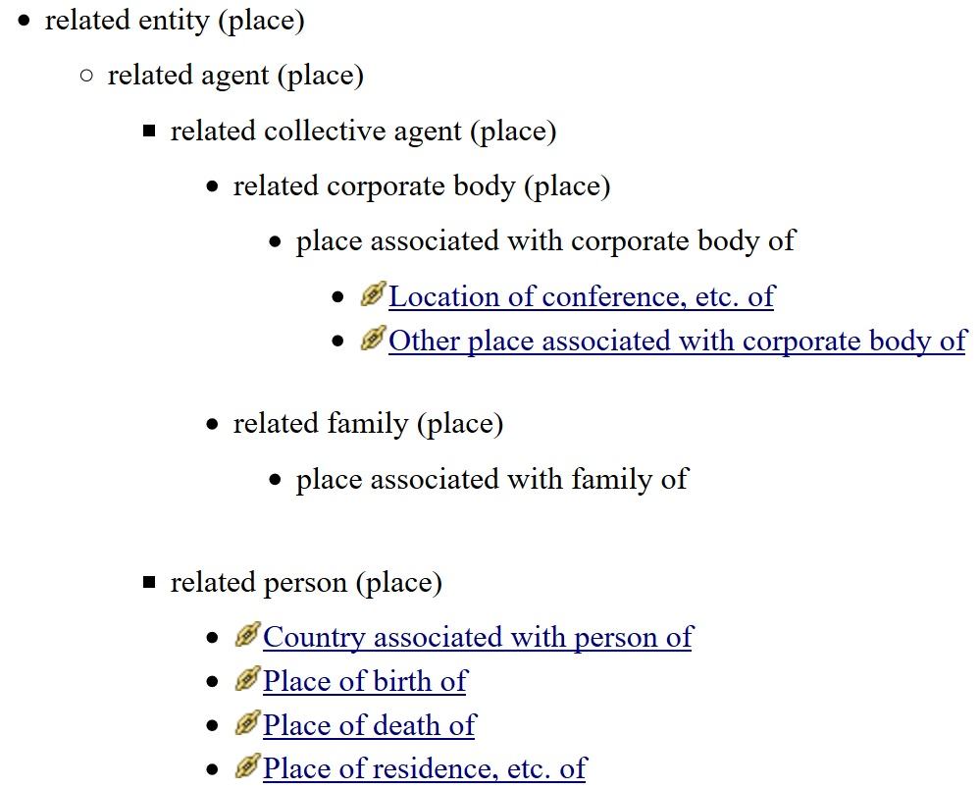
Place relationship hierarchy
Taken from CMS "chunk"
High-level relationship matrix
Inverse of current attribute ⇨ relationship element
Notes:
This screen-shot is taken from the content management system that is being developed for the 3R Project.
It shows a possible use of the relationship hierarchy for an entity, in this case Place, to provide semantic navigation between the fine granularity of RDA relationship elements.
One of the consequences of expanding an attribute element to a relationship element or designator is the generation of an inverse relationship. In this case, the "place" attributes of Corporate Body, Family, and Person entities become relationships with the Place entity and require reciprocal relationships between Place and the agent entities.

Slide 53
3.3: Impact on RDA Toolkit
Relationships as context and navigation
Related entities and 4-fold path
Micro and macro views of relationship elements/designators

Slide 54
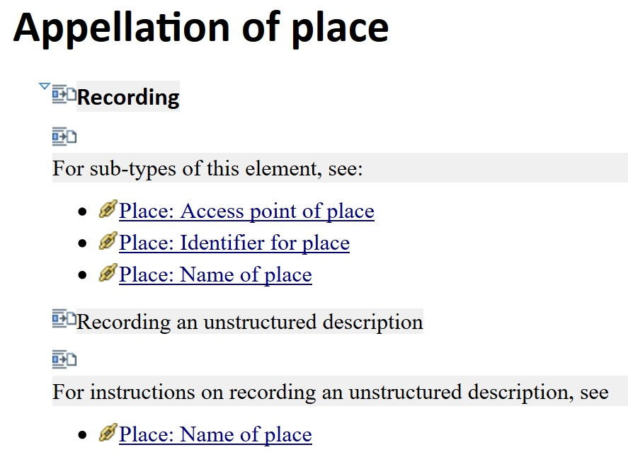
Hierarchy in context
Taken from CMS "chunk"
Hierarchy navigation
Context of Recording methods
Notes:
This screenshot shows the same hierarchy of Place relationships used in the context of a single Place element.
The immediate higher and lower levels of the hierarchy are used for navigation to the correct level of granularity.
Some specific attribute/relationship elements are applicable to only one recording method, but are part of the Nomen entity hierarchy (and its reciprocals). In this example, "name of place" applies only to an unstructured description.

Slide 55
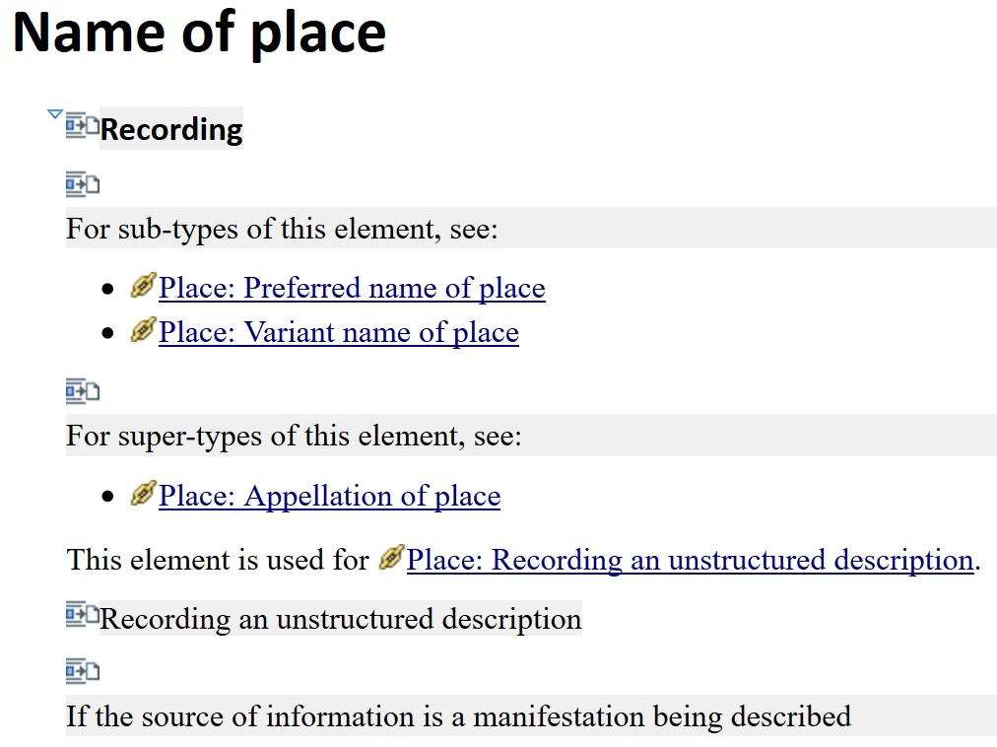
Hierarchy in context
Taken from CMS "chunk"
Hierarchy navigation
Context of Recording methods
Notes:
The hierarchies are applicable at all levels of granularity.
In this example, "name of place" has a broader (super-type) element and narrower (sub-type) elements.
The navigation structures for each RDA element will therefore be similar throughout the new Toolkit, providing a consistent and coherent approach that reduces the impact of the new entities on the current RDA elements.

Slide 56
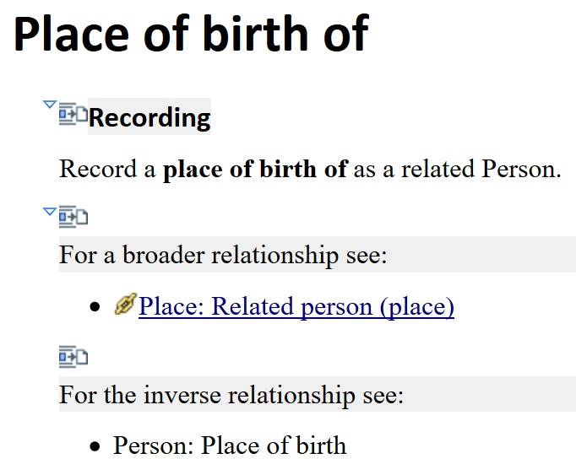
Hierarchy in relationship
Taken from CMS "chunk"
Navigation to related entity recording methods
Hierarchy navigation
Notes:
This example shows the same pattern of instructions and hierarchical navigation, applied to a new "place of birth of" relationship element that is the inverse of the existing attribute element "place of birth" that becomes a relationship between Person and Place.

Slide 57
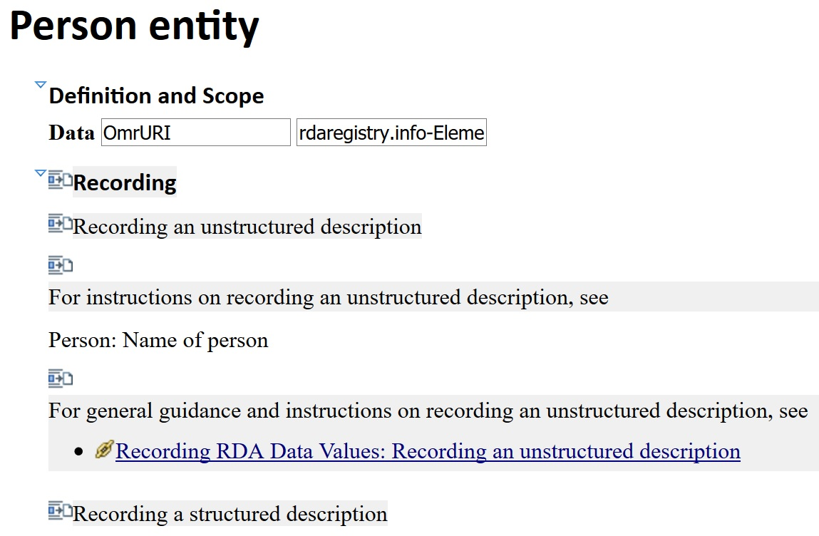
Recording an entity
Taken from CMS "chunk"
Notes:
Each RDA entity will be treated equally.
That means RDA will present a similar set of instructions for recording data for each entity, including the appropriate recording methods, high-level relationships with other RDA entities, and general guidance for entity description.

Slide 58
Many more "designators"
High-level relationship matrix (12 x 12 entities)
Cross-over attribute/relationship elements
New relationship elements (appellation hierarchy; aggregate/serial works; etc.
New relationship elements for consistent and complete hierarchies
Notes:
One of the main impacts of the LRM on RDA is a proliferation of relationship elements or designators. In the context of the LRM and "equal treatment" there is no distinction between a relationship element and designator.
The high-level relationship matrix requires N time N relationship elements for pair-wise links, so the 12 RDA entities require 144 elements.
Many attribute elements become relationship elements, and require new reciprocals or inverse relationships.
New relationships elements are required for various reasons. The hierarchy of "appellation" relationships between an entity and a Nomen adds new elements for access points. The LRM introduces new relationships for aggregates and diachronic works.
New elements are also required for consistency and completeness, For example, every entity requires an "identifier" element that is a relationship with Nomen.

Slide 59
The exploding designator appendix
Current Toolkit approach assumes primary (WEMI) and secondary (PFC) entities, and cannot scale
Toolkit data workflow allows flexible outputs:
Designators in context of element
Designators in context of entity
All designators in one giant "appendix"
Notes:
The result is an explosion in the number of "designators" that are currently accommodated in a set of appendices in the RDA Toolkit.
The current appendices assume some entities (WEMI) are more important or primary, while the other entities provide access to WEMI entities. This cannot easily scale with the additional LRM entities, and the distinction is no longer regarded as useful for the development of RDA.
The data in the current appendices is entirely derived from the RDA Registry, using the new data workflow developed in anticipation of the 3R Project. This infrastructure will be scaled up to provide consistent and flexible data for a variety of applications in the new Toolkit, including some of the features discussed in this presentation.
Relationship element and designator data from the Registry will be used in at least three separate contexts:
The instructions and guidance for each RDA element.
The elements associated with each RDA entity.
The overall hierarchy of linked entities.

Slide 60
Thank you!
Discussion!

