Slide 1
RDA and translations
Gordon Dunsire, Chair, RSC
Presented at “Diversity of Data: RDA in the international context”
23 August 2018
National Library of Malaysia, Kuala Lumpur, Malaysia

Slide 2
Overview
How does the new infrastructure of RDA facilitate translations?

Slide 3
RDA Translation Policy
Internationalization is a strategic goal of the
RDA standard …
Notes:
Support for international communities is one of the strategic goals for the development of RDA.
Other goals include support for cultural heritage and linked data communities.

Slide 4
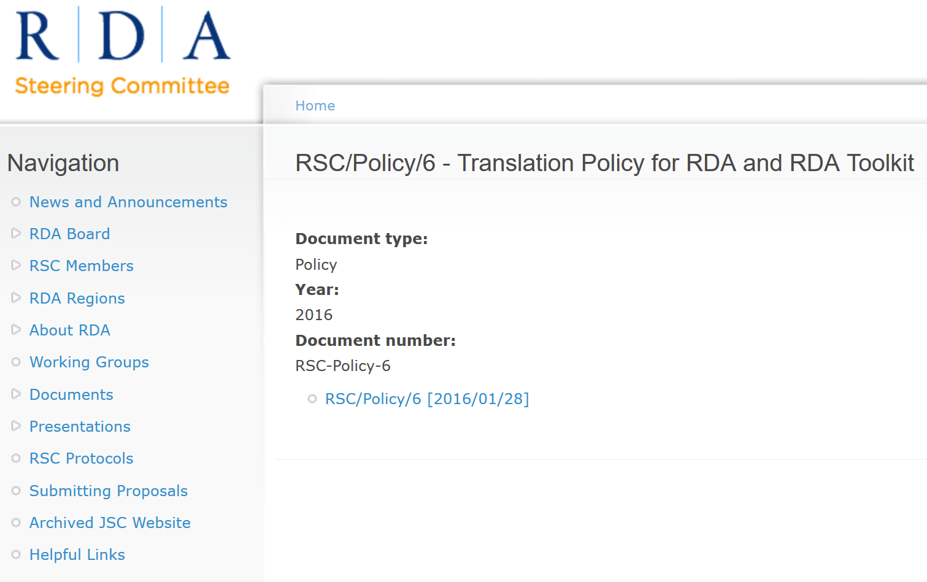
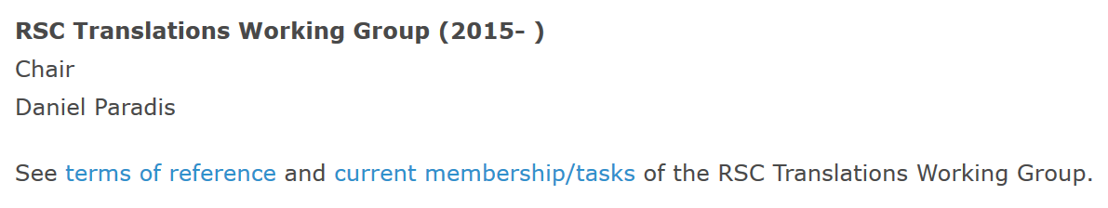
Notes:
The RDA Steering Committee (RSC) and ALA Publishing have a formal policy on translations.
This can be found at http://www.rda-rsc.org/sites/all/files/RSC-Policy-6.pdf
There is also an RSC Translations Working Group, established in 2015.
The Working Group is permanent, and its Chair is a full member of RSC.
The current Chair is Daniel Paradis, who leads the French translation of RDA.
Other members of the Working Group are involved in translations in Catalan, Finnish, German, Italian, and Spanish, which are translations of the complete RDA Toolkit. Another Working Group member represents the interests of partial translations of RDA Reference.
More information about the Working Group is available at http://www.rda-rsc.org/workinggroups

Slide 5
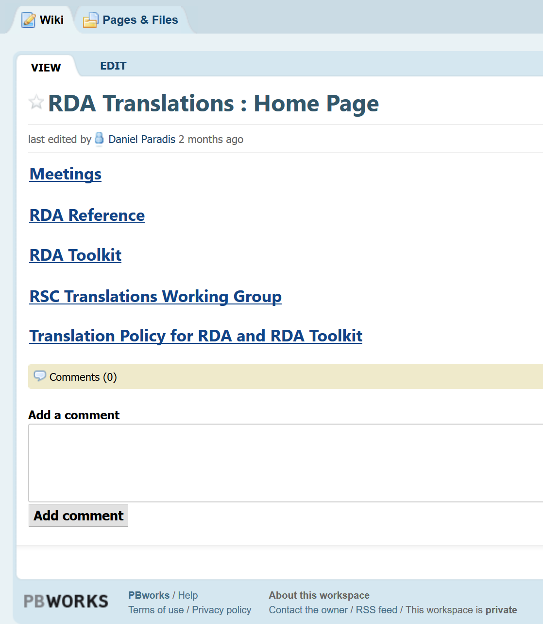
Notes:
There is a wiki for RDA Toolkit translators.
This contains information about the Translations Working Group and tools for translation.
The wiki also allows translators to discuss translation issues.

Slide 6
Infrastructure
Open Metadata Registry
for RDA
Translators
GitHub
RDA Vocabularies
SDL Trados
Content Management System
RDA Toolkit
Elements
Instructions
Notes:
The content of RDA Toolkit is maintained as two sets of data.
The Toolkit entities, elements, and controlled terminologies, collectively known as RDA Reference, are maintained in the Open Metadata Registry for RDA. These data are published in GitHub, which is an open data publishing and version control system. Data are extracted automatically from GitHub into the Toolkit Content Management System.
The Toolkit instructions are maintained directly in the Content Management System.
Translators update RDA Reference using Open Metadata Registry Tools.
Translators update the instructions in the Content Management System using the SDL Trados package supplied by ALA Publishing.

Slide 7
Modular structure
Every element page has the same basic structure.
RDA Reference data are displayed separately from guidance and instructions.
Notes:
The new RDA Toolkit has a modular structure based on the RDA elements.
Each element has a “page” in the Toolkit, and each element page has the same basic structure.
The structure separates the RDA Reference data from the guidance and instructions.

Slide 8
Element page structure
Definition and Scope
Element Reference
Prerecording
Recording
Recording an unstructured description
Recording a structured description
Recording an identifier
Recording an IRI
Instructions
RDA Reference
Related Elements
Notes:
This is an outline of the element page structure.
The RDA Reference data are displayed in the sections highlighted in gray.
All of these sections use content that has already been translated in the Open Metadata Registry.
The guidance and instructions are displayed in the sections highlighted in orange.
The content of these sections is translated in the Content Management System using Trados.
This allows translators to focus their work on specific areas of Toolkit content.

Slide 9
Boilerplate
Guidance, instruction, and navigation content components that are re-used in multiple pages in the Toolkit.
Re-usable components are updated once.
Re-usable components are translated once.
Notes:
The Toolkit uses boilerplate, or fixed, text as much as possible.
Standard paragraphs and other content syntax are used for guidance, instructions, and in-page navigation.
These paragraphs are re-used in multiple pages.
This allows the content to be updated once, and used many times.
A translator only needs to translate the re-usable content once.

Slide 10
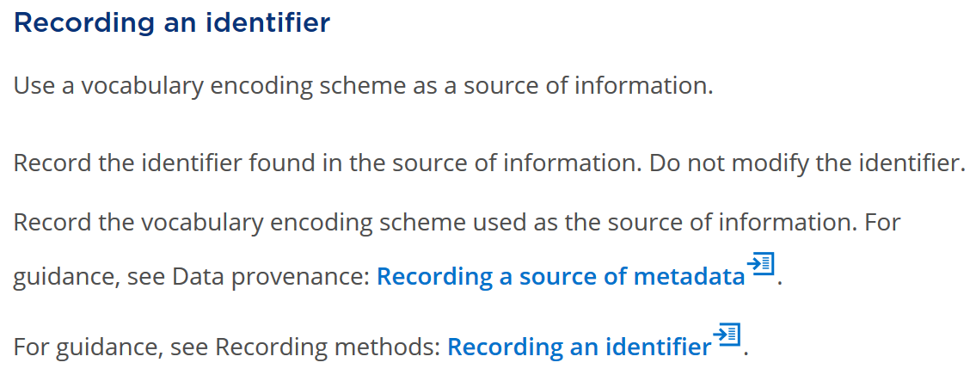
Example of boilerplate
Layout of boilerplate content can be changed to meet the requirements of a translation.
Notes:
Here is an example of boilerplate content displayed in the modular structure.
The Recording an identifier section is part of every element page.
Each of the blocks of text outlined in this example is a single piece of boilerplate.
As you can see, boilerplate can consist of a single sentence or paragraph, or multiple paragraphs.
Within a single piece of boilerplate, translators are free to re-arrange the structure to meet the requirements of the translation.
For example, separate paragraphs may be merged or re-arranged, and conversely a single paragraph can be split into two.

Slide 11
Relationship element
template
Regular layout
+
Boilerplate
=
Template
Same guidance and instructions in all basic relationship elements (designators) for each entity.
Notes:
Where appropriate, boilerplate is added to the standard layout of the modular structure to create a template.
This is applicable to elements that all have the same guidance and instructions, such as the basic relations elements.
These were formerly treated as relationship designators and listed in an appendix, but in the new Toolkit each has its own page. The same template is used for these pages.

Slide 12
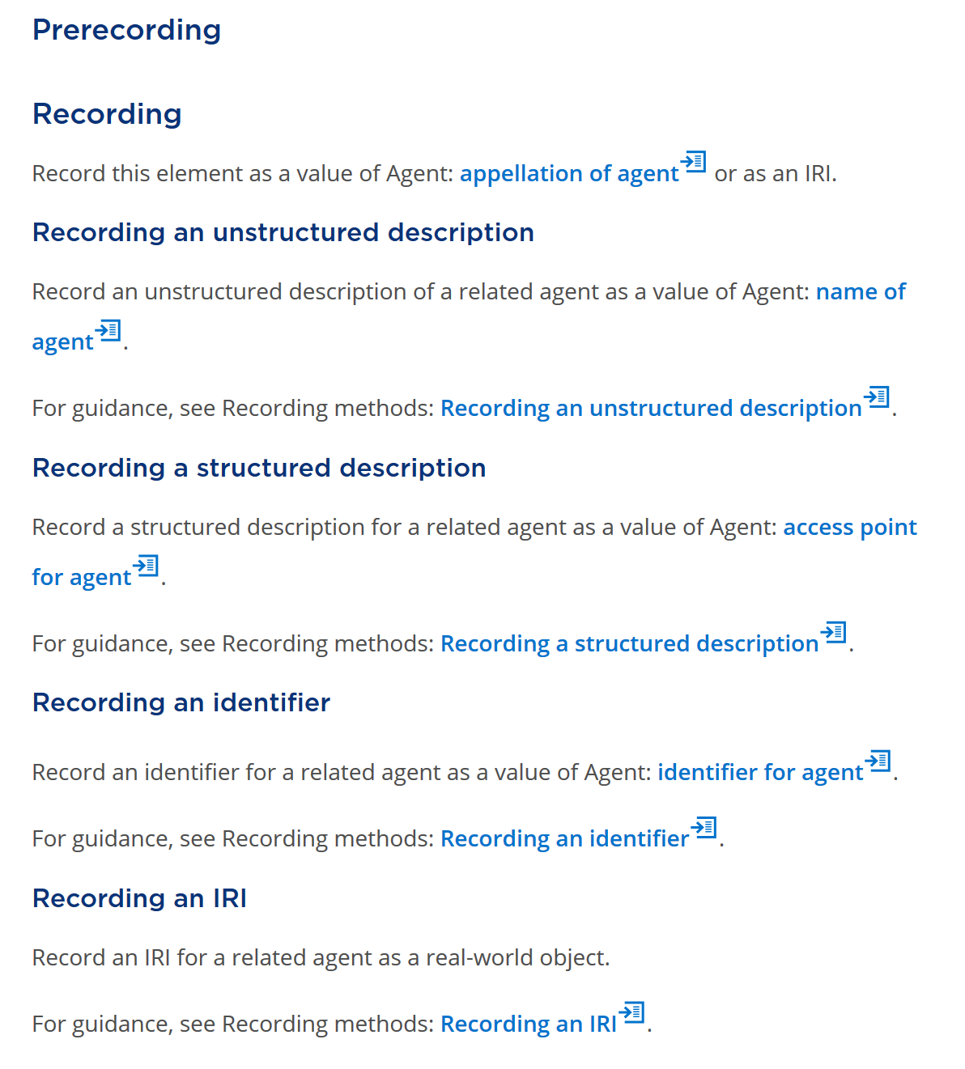
Automated generation of content of 800+ elements for each translation
Notes:
This is the template for a basic relationship element page.
Although there are over 800 basic relationship elements, each is generated automatically from the template.
This means the whole template needs to be translated only once.

Slide 13
Toolkit Resources
Glossary
Vocabulary Encoding Schemes
Relationship Matrix
Visual browser
Generated from RDA Reference
Notes:
Other large sections of the Toolkit are generated automatically from RDA Reference.
These include the whole Glossary, all of the controlled terminologies, known as Vocabulary Encoding Schemes, and the whole Relationship Matrix.
The Relationship Matrix consists of the hierarchical arrangement of all of the RDA Toolkit relationships elements. The Matrix will be the basis of a visual element browser that will be added to the new Toolkit around the end of 2018.
RDA Reference data are translated once in the Open Metadata Registry, and re-used in these sections of the Toolkit.

Slide 14
Examples
Basic Set
Resembles current examples
Recording Methods
The same data recorded in different ways
View as Relationship
Diagram: linked data graph
View in Context
A set of data elements for an entity
Notes:
There are four basic kinds of examples in the new Toolkit.
A Basic Set example is similar to the examples in the current Toolkit.
A Recording Methods example shows how the value of the same element is recorded in different ways, depending on the recording method used.
A View as Relationship example shows a linked data graph.
A View in Context example is a set of data elements for an entity, to show how the value of the element in focus relates to the values of other elements.

Slide 15
Examples in translation
3 methods for “translating” an example
Retain example
Translate caption and notes
Add example
Substitute example
Notes:
Translations of RDA Toolkit can choose one or more of three ways of processing examples.
An example from the English Toolkit can be retained as it is, with only the caption and notes requiring translation.
A new example suitable for the translation can be added.
An example from the English Toolkit can be replace with an example suitable for the translation.

Slide 16
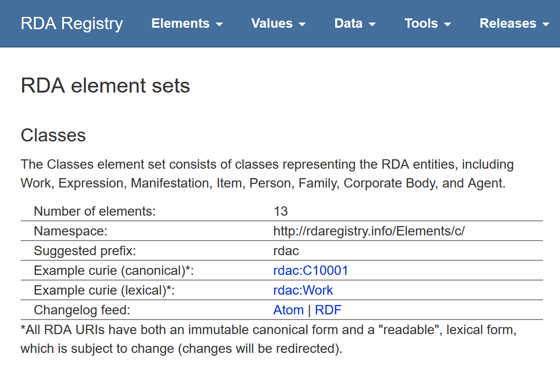
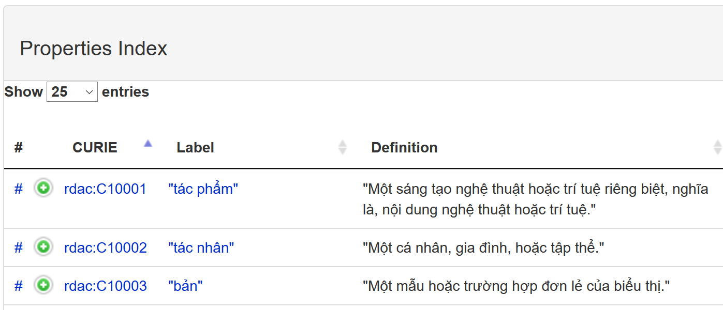
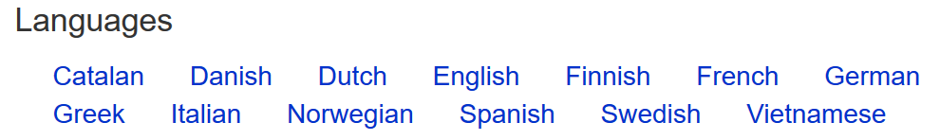
Notes:
This shows how translations appear in the RDA Registry.
The RDA Registry is a service for developers of RDA applications. The content of the Registry is automatically generated from the RDA Reference data in GitHub.
A developer can choose which language to display by selecting from a list of available translations of RDA Reference.
For example, choosing Vietnamese displays the translation of RDA entities (known as classes in the Registry).

Slide 17
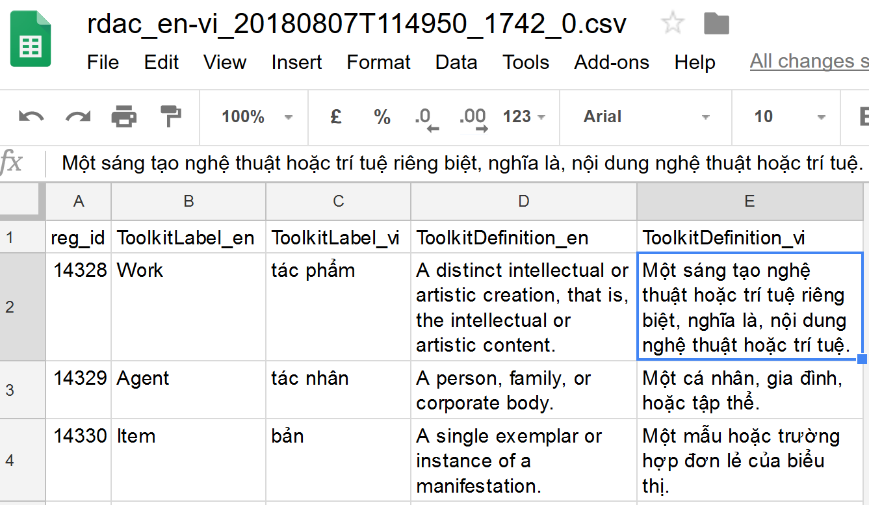
Update translation in Google sheets: Vietnamese
Notes:
The shows part of the spreadsheet tool that is used to translated RDA Reference.
The data for a specific set of elements or a vocabulary encoding scheme is exported into a spreadsheet that can be edited using readily-available tools such as Google Sheets.
The data can be exported at any time, under the control of the translator.
The spreadsheet contains the English text and the parallel language text.
A translator can edit the parallel text. When finished, the spreadsheet is imported back into the Open Metadata Registry.
This allows translators to work according to their own schedule and in their own environment.
This method has been used successfully for the past three years for the translation of RDA Reference in up to 18 languages.

Slide 18
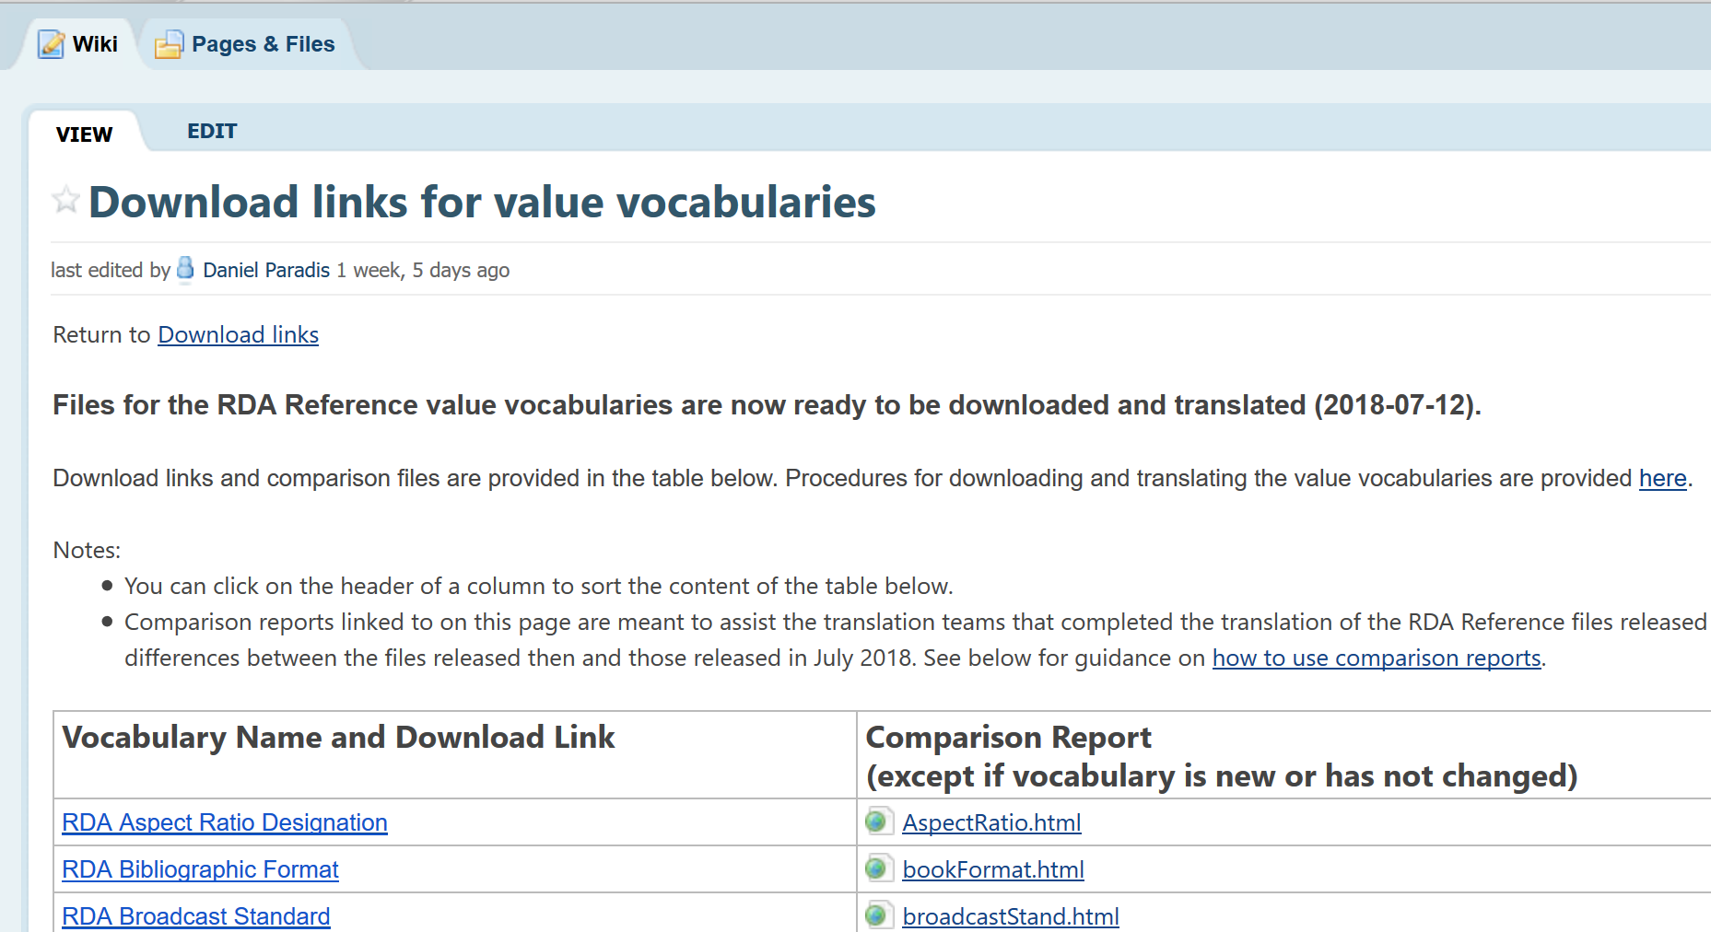
Notes:
Of course, the new Toolkit cannot be fully translated until development of the beta version is complete.
However, the new content of RDA Reference is being made available for translation as soon as it is ready.
This screenshot from the RDA Translators wiki shows that most of the vocabulary encoding schemes are available for translation now.
The RDA elements will be available for translation before the end of 2018.

Slide 19
Thank you!
If you are interested in translating RDA Reference or the whole RDA Toolkit, please contact the RSC Translations Liaison Officer:
Daniel Paradis transwgchair@rdatoolkit.org
Or talk to me during the seminar or IFLA 2018

