Slide 1
RDA Orientation Workshop UK 2019
Gordon Dunsire, RDA Technical Team Liaison Officer
Edinburgh, 21 November 2019; Birmingham 11 December 2019

Slide 2
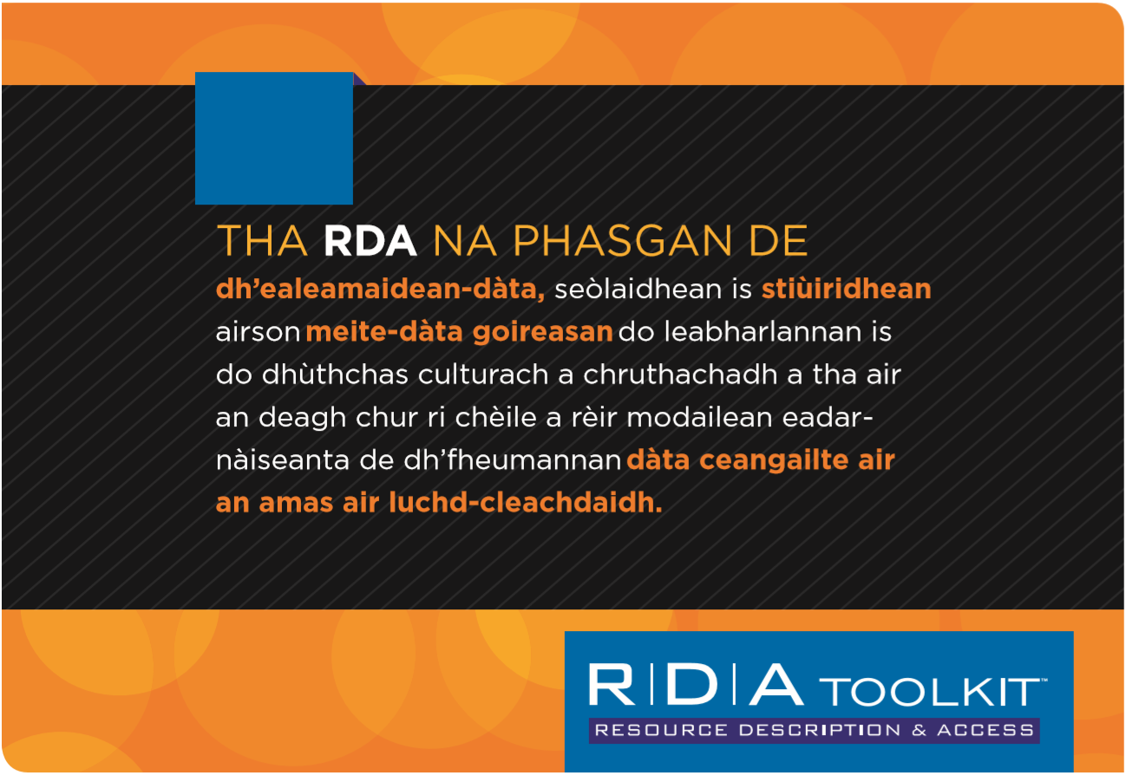
Notes:
RDA is intended for international use.
This is a Scottish Gaelic translation of the RDA ‘strapline’.

Slide 3
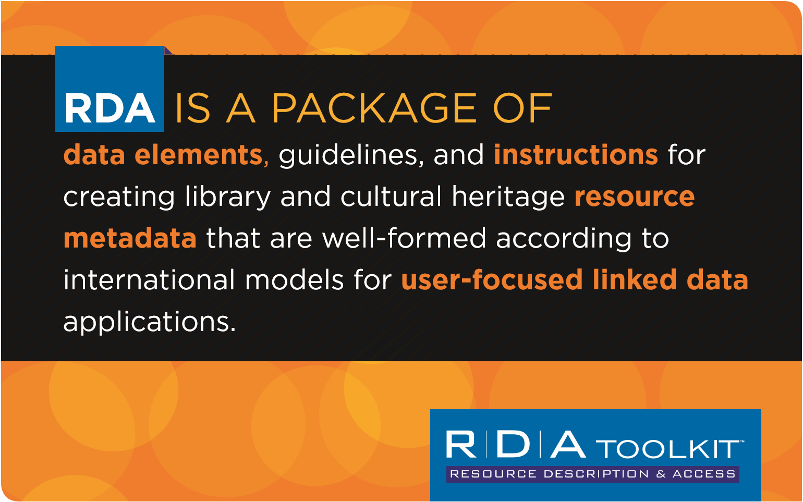
Notes:
And this is the English translation.

Slide 4
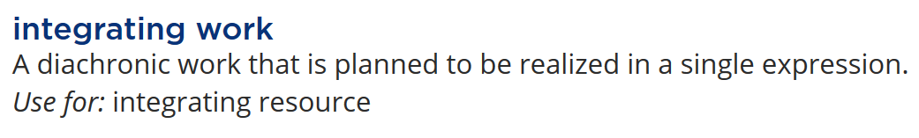
New RDA Toolkit (beta)
Continues evolution from book (AACR3) to kit
A kit of tools for metadata engineering
Construction; maintenance; re-cycling
Notes:
The new RDA Toolkit can be described, using the new RDA, as an integrating work.
The new layout is the result of a continuing evolution from presenting the standard as a book.
The new layout reflects RDA as a set of tools for the construction, maintenance, and re-use of metadata.

Slide 5
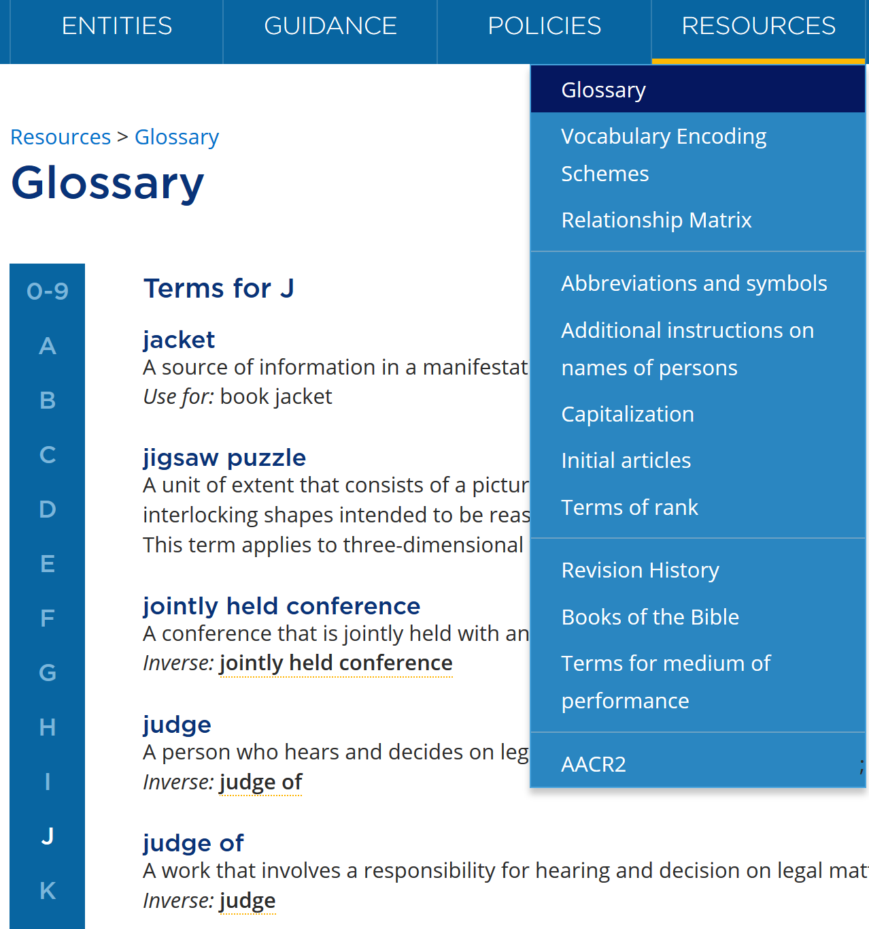
Glossary entries for all controlled terms
Element labels
Value terms
Instruction terms
Notes:
The Glossary is an important tool for understanding the new RDA Toolkit.
There is greater use of standard terminology, to assist translation and other forms of internationalization.

Slide 6
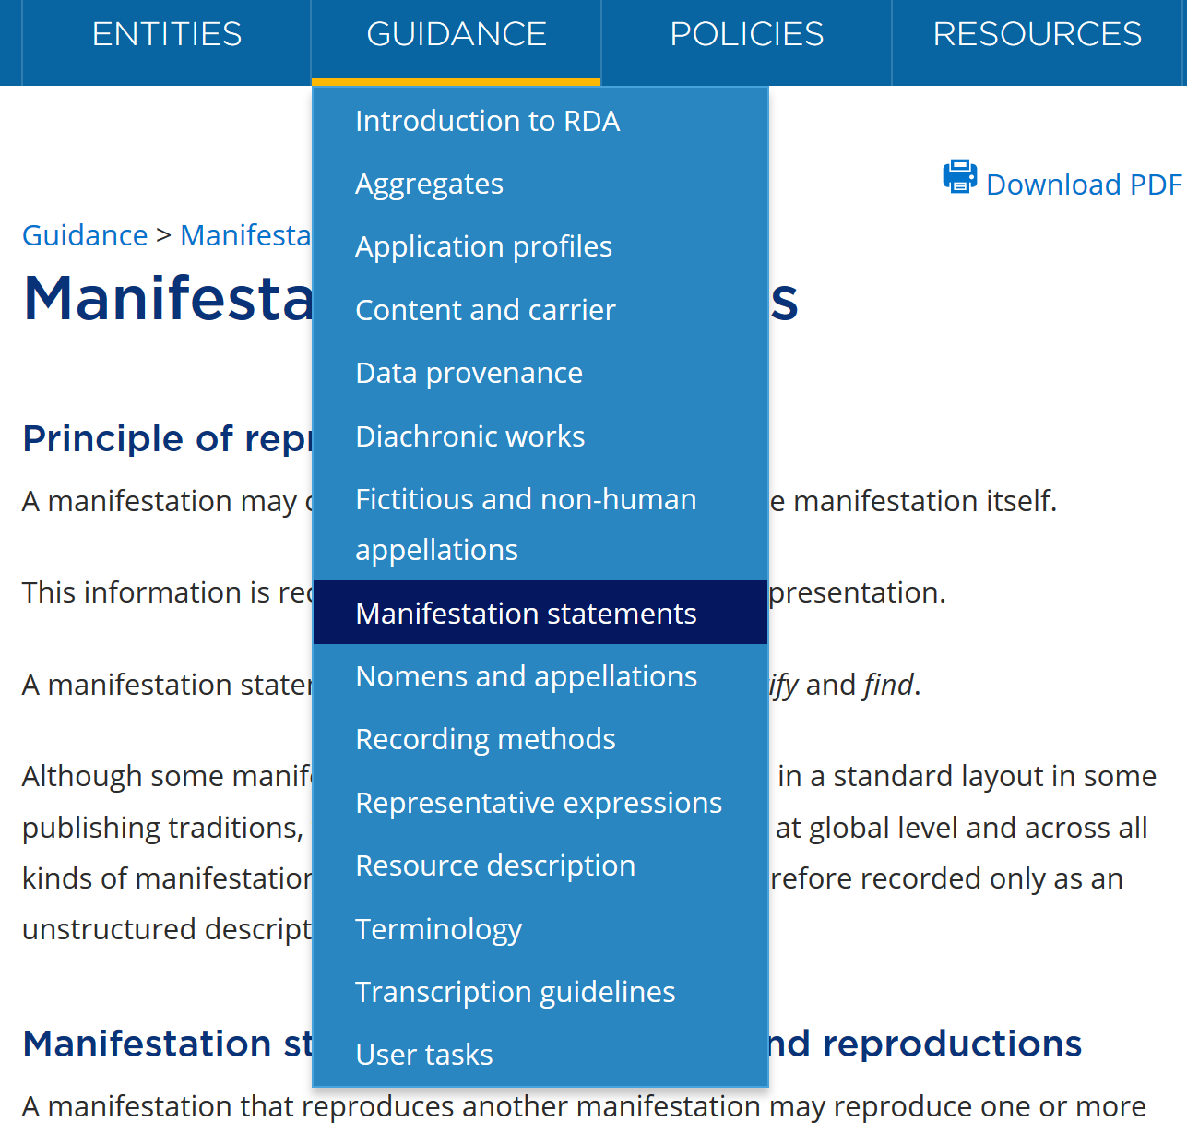
Notes:
One of the new features that is useful for the practical description of manifestations is the manifestation statement attribute.
The new Toolkit Guidance menu contains useful background and general information about many of the new features.

Slide 7
LRM-E4-A4 Manifestation statements
A statement appearing in the manifestation and
deemed to be significant for users to understand
how the resource represents itself.
… normally transcribed from a source … in a
manifestation. Transcription conventions are
codified by each implementation.
Principle of representation
User task: Identify
Notes:
The LRM attribute for Manifestation statement supports the principle of representation from IFLA’s International Cataloguing Principles – how a resource (manifestation) describes itself.
The data is usually transcribed from an exemplar of the manifestation, and supports only the user task Identify.

Slide 8
RDA Manifestation statement elements
Broad level of granularity:
Covers wide range of layouts on manifestation
One level of hierarchy:
All specific statements are sub-types
Manifestation statement
> Manifestation title and responsibility statement
> Manifestation edition statement
> Manifestation identifier statement
> …
Notes:
The RDA implementation of Manifestation statement keeps specific kinds of statement at a broad level of granularity in order to cover a wide range of ways in which the data is presented on the manifestation.
The specific kinds of statement do not have internal structure; there is only one level of hierarchy, and the specific manifestation statements are all sub-types of the general element. Internal structure is not required to support the user task Identify, and in many cases can be counter-productive. For example, it may be difficult to make a useful transcription of just the place(s) of publication.
These are some of the new RDA elements for manifestation statements. They use a labelling pattern for consistency and to distinguish them from the current hybrid transcription/recording elements, which are being retained to accommodate current practice.

Slide 9
RDA Manifestation statement
Recording method: unstructured description (only)
Transcribed from manifestation being described:
Basic transcription rules (WYSIWYG, machine-capture)
Normalized transcription rules (capitalization, punctuation, etc.)
Other transcription rules (specialized communities)
Notes:
A manifestation statement can only be an unstructured description because there is no control over the terminology, layout, or completeness of how a manifestation describes itself.
RDA provides specific sets of transcription rules. The basic set is designed for minimum intermediation by humans (what is seen on the manifestation) or machines (optical character recognition). The normalized set accommodates additional rules on punctuation, etc. that are similar to those in the original RDA Toolkit.
Other transcription rules are also accommodated.

Slide 10
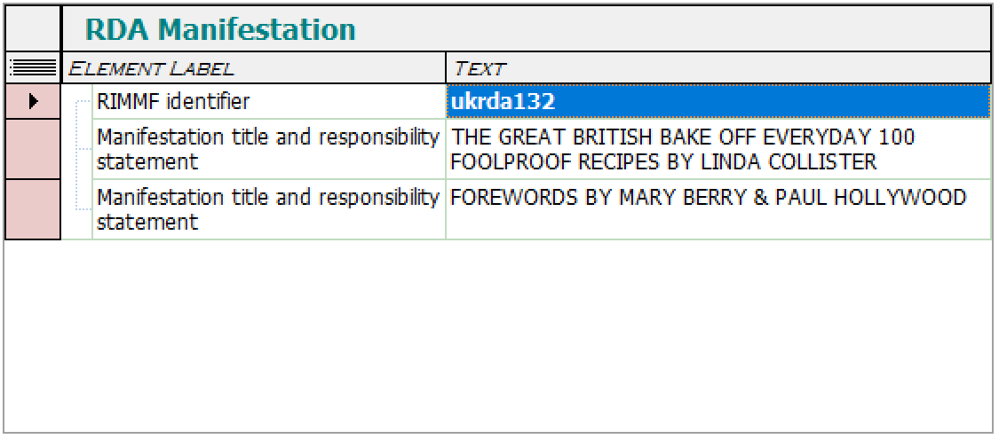
WYSYWYG (basic) transcription
Not intolerable to most end-users …
Notes:
In this example from RIMMF4, the same manifestation statement has been transcribed using basic rules.
The presentation of statements with un-normalized capitalization and punctuation is now routinely encountered by users of social media and online catalogues such as Amazon and E-bay.

Slide 11
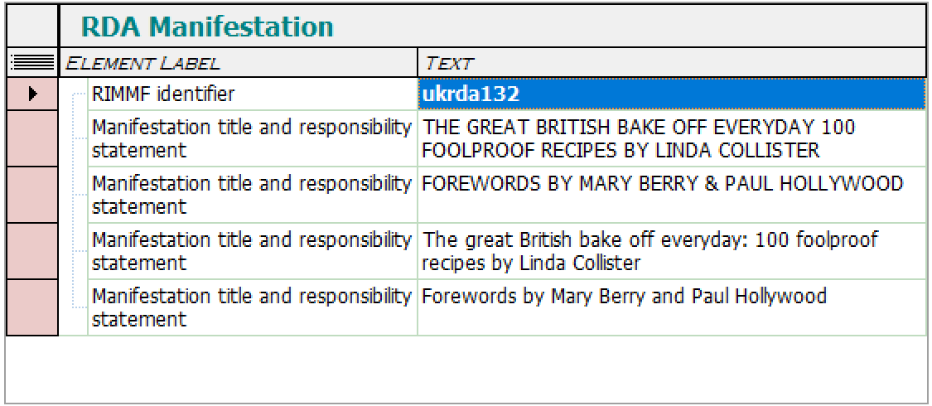
Normal(ized) transcription
Prettier … but takes longer to record
Notes:
This RIMMF4 description adds another value for the same element using basic transcription, and then adds the same statements using normalized transcription rules.
The presence of duplicate information in a single metadata description set is normal in the new RDA. For example, it might be the result of merging data from different sources.

Slide 12
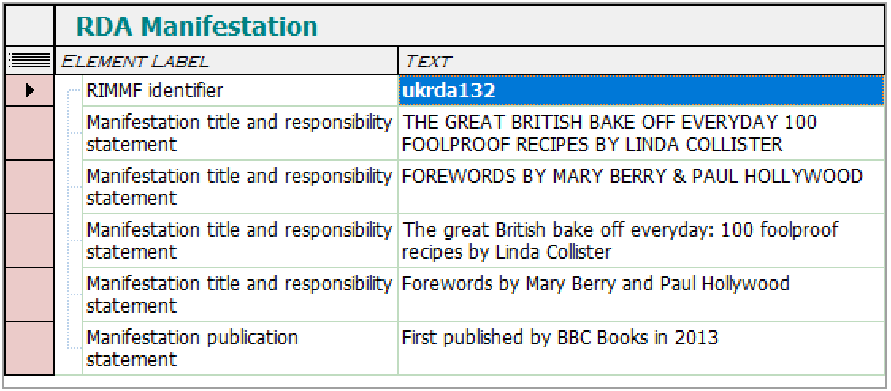
Functional description (cf Amazon)
Now add access points for related entities
Notes:
A description set might be entirely based on manifestation statements.
This approach is familiar to users of Amazon and other online catalogues.
When sufficient statements have been transcribed and recorded, a typical next step is to add access points based on the statements.

Slide 13
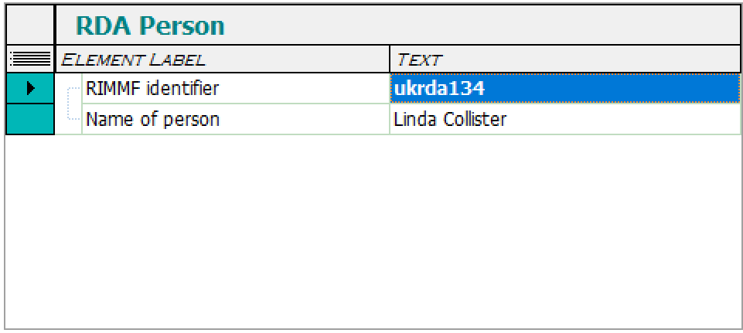
Names/titles used in manifestations
Unstructured (subjective control)
Notes:
The minimum description of any RDA entity must contain at least one appellation element to allow a human cataloguer or other user to reference it.
An appellation may be a name in the form that is found on a manifestation.

Slide 14
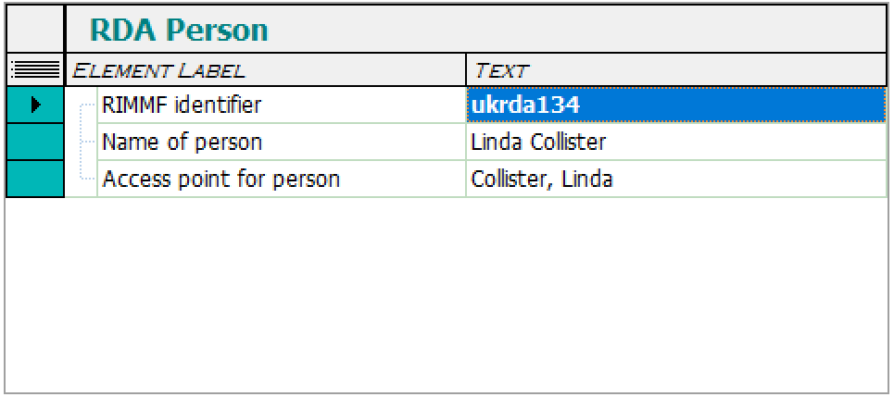
Access point for browse …
Structured (authority control)
Notes:
An access point usually manipulates other data values.
For a person, inversion of family name and given names is a typical method for deriving an access point.

Slide 15
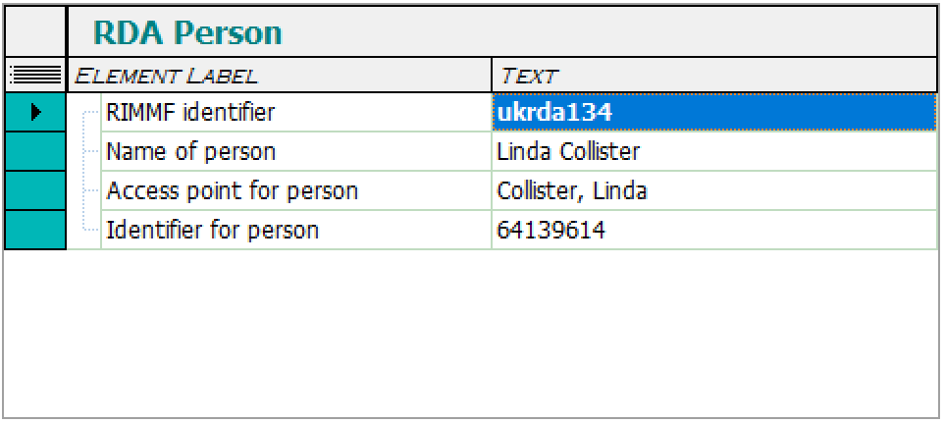
Identifier taken from a system
Not generally human-readable [VIAF]
Notes:
An identifier for an entity can be taken from an external source.
In this RIMMF4 example, the source is VIAF: Virtual International Authority File. This is the “local” VIAF identifier.
Another source of identifiers is the data storage and retrieval system that is used by an application.
This includes RIMMF itself, so the RIMMF identifier can also be used as an identifier for the entity.
Note that identifiers are generally not easily read or quoted by humans; the shorter the identifier, the easier it is likely to be rememberd and recognized.

Slide 16
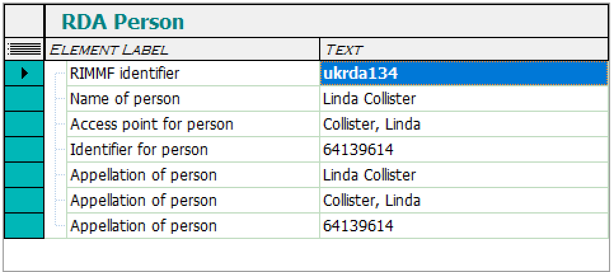
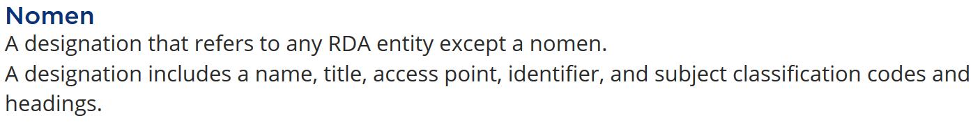
Types of appellation
Nomens!
Notes:
A name or title, an access point, and an identifier for an RDA entity are all types of appellation that may be associated with a Nomen entity.
A nomen is just the string of characters, etc. that comprises the appellation.
It is useful to record a separate nomen in authority control applications. A nomen allows a description set to be recorded for the appellation itself, such as language, script, derivation, context of usage, and relationships to other nomens.
The three kinds of appellation align with the recording methods for unstructured description (name or title), structured description (access point), and identifier.
A metadata description set that used specific kinds of appellation element can be “dumbed up” for interoperability.

Slide 17
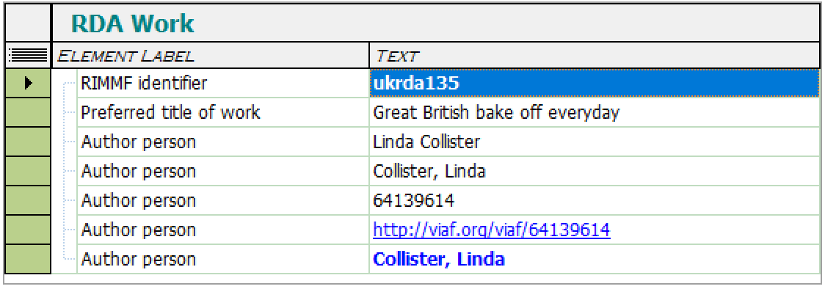
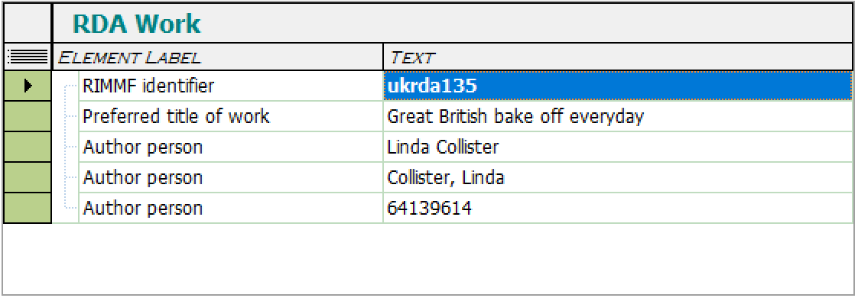
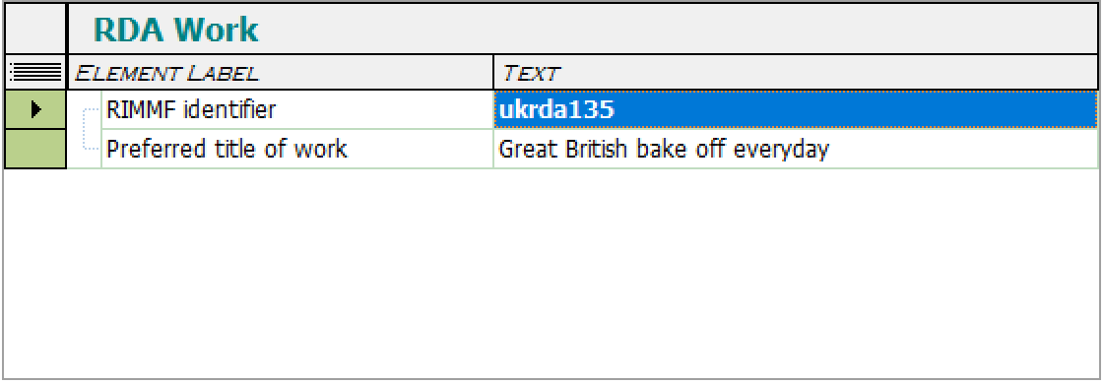
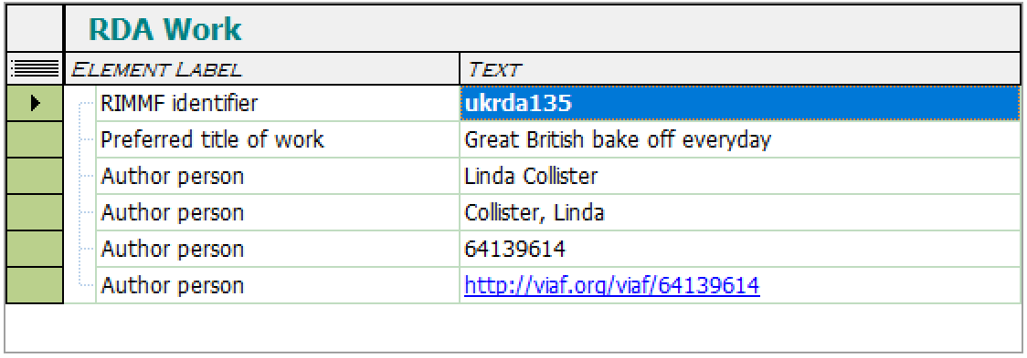
Relating entities
Notes:
An appellation of an entity can be used as the value of relationship element.

Slide 18
Value of related entity …
Any nomen can be used
=> Implementation scenario?
Notes:
In this RIMMF4 example, the author relationship is recorded three times, each using a different recording method and appellation of the related person entity.
The recording method is usually specified in a policy statement or application profile, and generally follows one of RDA’s new implementation scenarios.

Slide 19
Linked open data scenario
IRI recording method
Notes:
This allows the IRI of a related entity to be used as the value of a relationship.
In this RIMMF4 example, there is only one “author” related to the work, but it can be recorded with four distinct values. All of the values refer to the same person entity.

Slide 20
RIMMF is an RDBMS scenario
With linked open data output
Notes:
These RIMMF4 examples show that RIMMF4 uses an relational database management system implementation scenario.
In this scenario, each entity has its own metadata description set. Entities are related with local identifiers.
In fact, when a related RIMMF4 entity is displayed, the RIMMF identifier is used to link to the related entity, but the access point is displayed (in bold).
Note that the displayed value is identical to a structured description of the related entity appellation, but the underlying data is not.

Slide 21
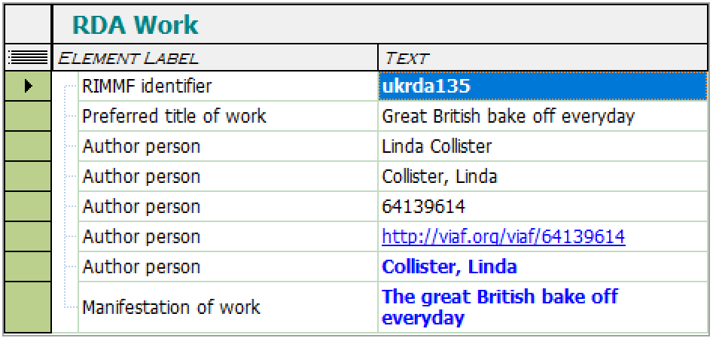
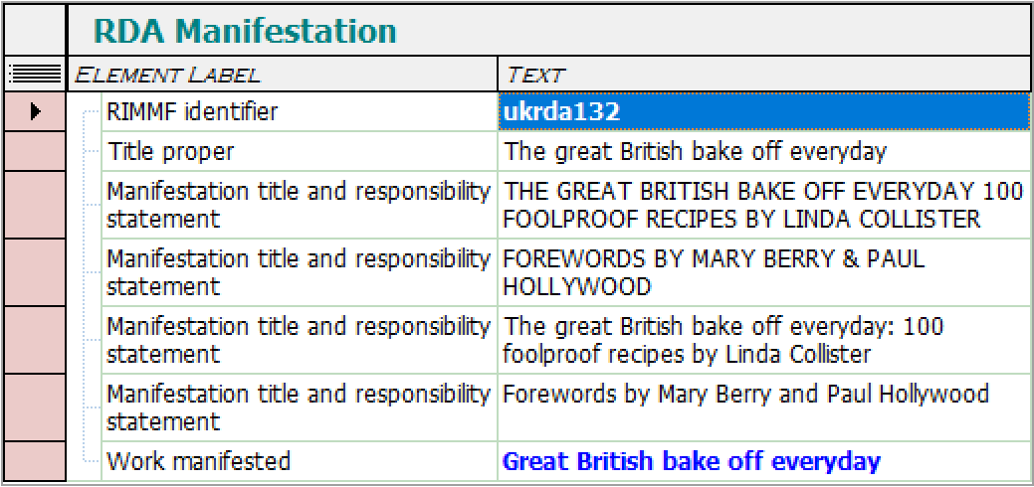
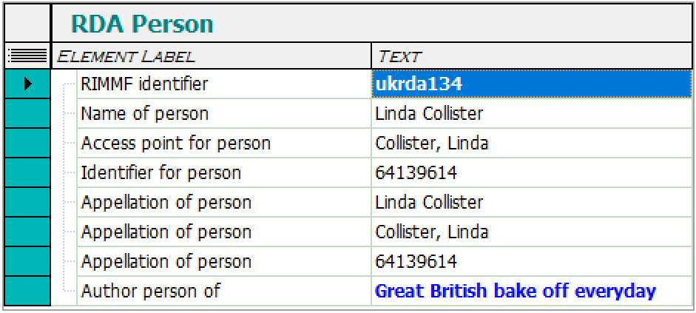
Notes:
The RIMMF4 examples are a simple set of linked metadata description sets.

Slide 22
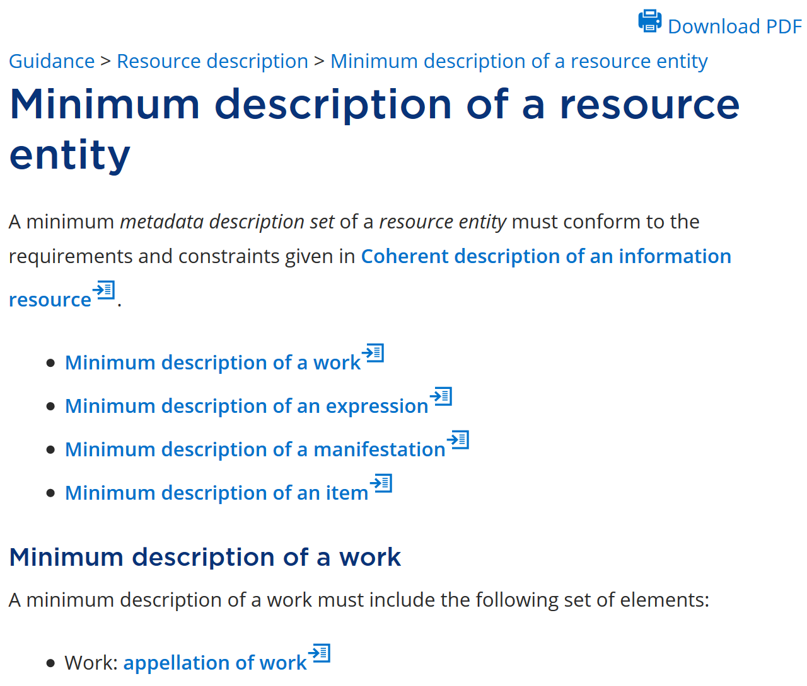
Notes:
All of these examples conform to the new RDA requirements for a minimum description of an RDA entity.

Slide 23
Application profile
Selects:
Element
Recording method
Instruction/option
Sequences: elements and entities
=> Workflow
Status: mandatory? Repeatable?
Spreadsheet
RIMMF templates (01, 02 …)
User-supplied documentation
Notes:
An application profile is a specification of the elements, recording methods, and instructions to be used in a specific application.
A proile may also specify if an element is mandatory or repeatable.
An application profile is typically laid out as a spreadsheet that can be adapted as a data entry form.
RIMMF4 has experimented with layering data entry via a set of templates. These are numbered to provide a potential workflow for data entry.
RDA can accommodate application profiles as user-supplied documentation.

Slide 24
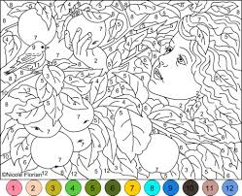

Cataloguing by numbers?
Notes:
Another metaphor for the use of the new RDA Toolkit is a paint-by-numbers kit.
RDA Toolkit provides a complete range of colours, and the blank, numbered canvas specifies which tools to use where.

Slide 25
Aggregate
RDA: A manifestation that embodies an aggregating work and one or more expressions of one or more works that realize the plan for aggregation.
AW: Work plan for
Great British bake off everyday
W2: Donoso. Paseo
W2: Donoso. Paseo
W1: Collister. Great British …
W2: Berry. Foreword
realizes
realizes
AE: Expression of the plan …
E1: Main text
E2:Foreword
E2:Text in
E2:Text in
embodies
embodies
aggregated by
The great British bake off everyday
(BBC Books, 2013)
Notes:
It is straightforward to implement the LRM model for aggregates in RDA.
This is the RDA label and definition for “aggregate manifestation”.
The example also shows that it is not necessary to record every distinct Work and Expression. There is no need to describe the aggregating work or expression for many applications, if the individual expressions are recorded. Conversely, it may be sufficient to describe the aggregating work and expression and ignore all of the numerous individual poems.
It does not matter if different agencies and applications record different components at different times; when the data are brought together, they will be coherent, although some redundancy or duplication will be expected.
The LRM provides a specific shortcut relationship between the aggregating expression and the expressions that are aggregated. It is not a type of whole/part relationship. This is a new RDA relationship element, labelled “aggregated by” (with inverse “aggregates”).
The terminology will be confusing until we become familiar with the new RDA Toolkit.

Slide 26
Next?
AW: Work plan for
Great British bake off everyday
W2: Donoso. Paseo
W2: Donoso. Paseo
W1: Collister. Great British …
W2: Berry. Foreword
realizes
realizes
AE: Expression of the plan …
E1: Main text
E2:Foreword
E2:Text in
E2:Text in
embodies
embodies
aggregated by
The great British bake off everyday
(BBC Books, 2013)
Notes:
The parts of the complete aggregate description that are filled here are likely to be sufficient for most library collections and users.

Slide 27
Thank you!
RDA Steering Committee
http://www.rda-rsc.org/
RDA presentations
http://www.rda-rsc.org/node/560
RDA Toolkit
https://www.rdatoolkit.org/

