Slide 1
The new RDA: resource description in libraries and beyond
Gordon Dunsire, Chair, RSC
Presented at “Metadata: Create, Share and Enrich”,
CILIP Cataloguing & Indexing Group Conference 2018,
Edinburgh, Scotland, 5-7 September 2018

Slide 2
RDA
“RDA is a package of data elements, guidelines, and instructions for creating library and cultural heritage resource metadata that are well-formed according to international models for user-focussed linked data applications.”
RDA Toolkit provides the user-focussed elements, guidelines, and instructions.
RDA Registry provides the infrastructure for well-formed, linked, RDA data applications.
Notes:
The RDA data ecosystem is summed up in this sentence introducing the RDA Board’s announcement of RDA’s strategic directions.
The RDA package is delivered by an infrastructure of two interacting services.
The human-facing components, including the guidelines and instructions, are the Toolkit.
The data-facing components are contained in the Registry.
Applying the data capture and storage techniques in RDA Toolkit to the data architecture in the RDA Registry produces well-formed data for RDA applications.

Slide 3
RDA Registry
Linked data representations of RDA Reference
Entities (classes)
Relationships and attributes (properties)
Controlled terminologies (concepts)
+ Translations
+ Maps (e.g. to ISBD, MARC Relators, MARC 21)
Open license (BY)
Notes:
The RDA Registry represents RDA Reference in Resource Description Framework, the data format of linked open data and the Semantic Web.
RDA Reference consists of the RDA entities, represented as classes, and their relationship and attribute elements, represented as properties.
The controlled terminologies in RDA vocabulary encoding schemes are represented as concepts.
RDA Reference also includes all of the translations of these data, and machine-actionable maps from RDA to related standards.
All of the data in the Registry is freely available on an open license that requires only attribution if it is used in another application.

Slide 4
Registry data in Toolkit
3R Project
Basic structure of all element “pages” generated from Registry
Toolkit releases
Element definition and scope
Element reference
Related elements
Glossary
Vocabulary encoding schemes
Relationship matrix
Notes:
During the 3R Project, the Registry data was used to generate the basic structure of every element page in the new Toolkit.
Registry data will be used in future releases of the new Toolkit to update basic element data, and the entire Glossary, Vocabulary encoding schemes reference, and Relationship matrix.

Slide 5
Impact of internationalization
Different cataloguing practices
Different authority files and vocabularies
No “one way” of describing an entity
Many ways, many choices
New elements for access points
Notes:
The new Toolkit has been designed for use across the world, in many countries with cataloguing traditions and practices that are different from the “Anglo-American” approach.
For example, there is wide variation in the construction of access points and authority files.
There are many vocabulary encoding schemes that can be used in place of those specified by RDA.
The new Toolkit introduces specific elements for access points to provide an over-arching framework for accommodating “local” practices.

Slide 6
Impact of other communities
Special library materials
New elements and vocabularies
Archive and museum communities
Collections, curation, provenance
LRM is compatible with CIDOC CRM
Linked data communities
IRI recording method, vocabulary notation
Notes:
The 3R Project has introduced several improvements to support the work of specialized communities.

Slide 7
Entities
WEMI = aspects of a “resource” (ISBD)
Agent (PFC), Place, Timespan associated with an information resource
Nomen associated with any other entity
All entities and their elements given equal presentation
But varying depth of coverage, relative to resource description
Notes:
RDA has retained all of its existing elements, and added the new entities of the LRM.
The new Toolkit presents the instructions and guidance for each entity and its elements in the same way.
The depth of coverage provided for each entity is reflected in the number and granularity of its elements; these vary to meet the general needs of resource description.

Slide 8
Elements
Unit of focus in new Toolkit
e.g. “performer” has a “page” all to itself
Standard structure and layout
No distinction between attribute and relationship elements
All elements assigned a single entity “domain”
But attributes do not have a “range” of an entity
And no inverse elements
New entities  more relationships  more inverses
Many more elements
Notes:
While the original Toolkit focussed on two pairs of entities (work/expression, and manifestation/item), the new Toolkit uses the much finer granularity of an individual element.
Each element has a page of guidance and instructions, using a standard layout.
Like the LRM, then new Toolkit blurs the distinction between attribute elements and relationship elements.
Many former attribute elements have become relationships as a result of the new entities; for example, Date of birth is now a relationship between a Person and a Timespan.
With many new entities, and relationships requiring inverses, the number of RDA elements has increased.

Slide 9
The numbers
13 entities
1700+ elements
Work | 388 |  | Agent | 175
Expression | 291 |  | Person | 85
Manifestation | 282 |  | Collective Agent | 34
Item | 70 |  | Corporate Body | 84
Place | 45 |  | Family | 46
Timespan | 54 |  | Nomen | 169
RDA Entity | 27

Slide 10
Recording methods
Extended to all elements
Confined to relationships in original Toolkit
Linked data “method” now explicit
4 methods = “4-fold path”
Unstructured description
Structured description
Identifier
IRI

Slide 11
Instructions
There are no rules!
Most instructions are now optional
Accommodates local practice in a global framework
Instructions assigned to recording methods
Much more choice
Flexibility ☺
How to choose? ☹

Slide 12
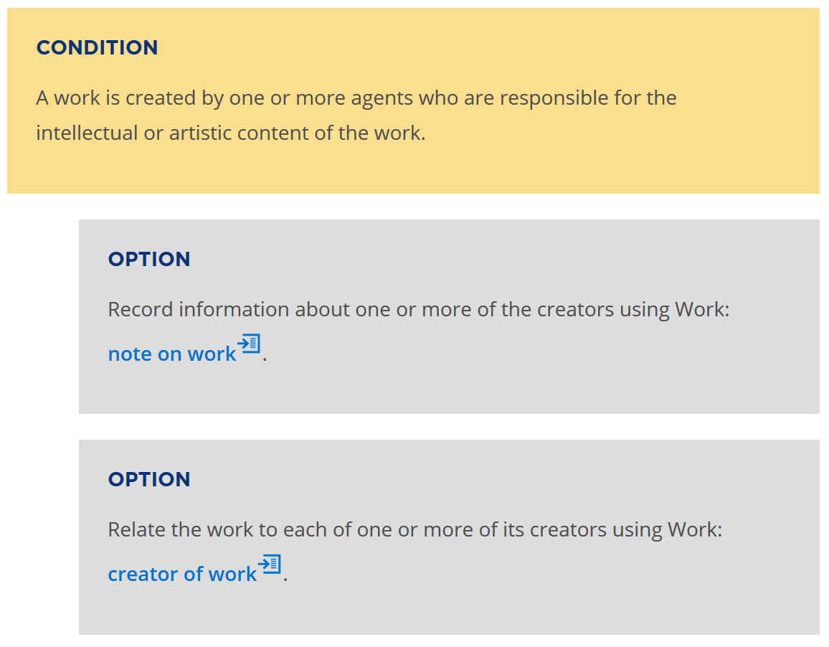
Notes:
Optional instructions are presented in a standard format and are linked to the conditions for which they can be applied.

Slide 13
Application profile
What elements must be recorded?
What elements should be recorded?
What elements may be repeated?
What vocabularies are used?
What recording methods are used?
Multiple ways: bookmarks, policy statements, workflows, external documents
Notes:
An application profile specifies the components of a well-formed set of metadata to be used in a specific application.
The profile effectively “picks and mixes” the elements from one or more ontologies or element sets.
An RDA application profile selects which RDA elements to use, which vocabularies to use, and which recording methods to use for a specific application.
The new RDA Toolkit provides a range of mechanisms for specifying a profile.
Bookmarks and notes can be used for simple, “personal” profiles.
User-generated documentation can be used for institution-wide applications.
Policy statements are applicable across multiple institutional subscriptions.
External documents that link to Toolkit instructions are suitable for widespread use.

Slide 14
Nomens and recording
methods
RDA Entity
has appellation
Nomen
has title proper
has nomen string
M1
N1
“My title”
has title proper
has identifier …
has nomen string
M1
N2
“0123-4567”
has identifier …
Notes:
Nomen is a new LRM entity for RDA, and represents the class of strings (names, titles, etc.) used to label and identify any other entity. The high-level relationship between RDA Entity and Nomen is "has appellation". This essentially says "All things have names". The current RDA relationships between an entity and an identifying label are refinements of the high-level relationships. So "[has] title proper" is a refinement of the "has appellation" relationship between a Manifestation and a Nomen.
The Nomen entity is always associated with the string of characters, symbols, etc. that constitutes the "name" or other label by which the entity is known or called. The "has nomen string" relationship associates the Nomen with its string. The chain of relationships "has title proper" + "has nomen string" can be short-cut to give the current RDA model of "appellation" attributes.
Similarly, the RDA "[has] identifier for …" attributes are also refinements of "has appellation". Note that the nomen string is this example may look like an ISSN, but it could be some other kind of identifier. More information about the Nomen is needed; this is one reason for treating such string labels as an entity or class that can have other attributes and relationships.

Slide 15
Identifying an entity
An entity is identified with a label by humans
= Record at least one appellation element
has name of RDA entity
“Name of entity”
RDA
Entity
[IRI]
has access point for RDA entity
“Access point for entity”
“Identifier for entity”
has identifier for RDA entity
Notes:
A description of any entity, as itself, must include at least on human-readable label that identifies or refers to the entity.

Slide 16
Using appellation data
Unstructured description
Keyword index: “entity”; “name”
“Name of entity”
Structured description
Authority index: “Entity, access point for”
“Access point for entity”
Identifier
Local application links: “EntityID”
“Identifier for entity”
IRI for entity
IRI
Global linked data
Notes:
The data recorded in each type of appellation element have a specific scope of use in applications.
This allows RDA applications to be more efficient and effective.

Slide 17
Well-formed description
Coherent
Compliance with LRM/RDA ontology
LRM retains FRBR relationships and cardinality restrictions (with clarification)
Notes:
A well-formed RDA description is coherent if it complies with the RDA ontology, as represented in the RDA Regisry. The RDA ontology is now compatible with the ontology of the LRM.
In particular, the LRM retains the cardinality restrictions between the FRBR entities. The scope of the Item entity is further clarified: all characteristics that are common to all items that exemplify a manifestation are recorded as characteristics of the manifestation, even if there is only one item (for example, a manuscript).

Slide 18
FRBR cardinality
Work
1 and only 1
At least 1
Expression
At least 1
At least 1
Manifestation
1 and only 1
At least 1
Item
Notes:
FRBR restricts the number of “primary” entities - Work, Expression, Manifestation, and Item – that are related in the description of a single information resource.
A “1 and only 1” restriction “locks” a pair of entities.

Slide 19
Minimal configuration (M)
Manifestation
“Title, access point, or identifier”
has appellation
of manifestation
Notes:
Putting together the requirement for at least one appellation element and the cardinality restrictions results in a minimal configuration for a Work, Expression, Manifestation, or Item that is the focus of a description.
For a manifestation, a minimal description consists only of a single appellation element.

Slide 20
Minimal configuration (E)
Expression
“Title, access point, or identifier”
has appellation
of expression
“Title, access point, or identifier
of related manifestation”
has manifestation
of expression
Manifestation
“Title, access point, or identifier
of related work”
has work
expressed
Work
Notes:
If an expression is the focus of a description, then the expression requires an appellation element, and relationships to one work and at least one manifestation.
The related entities can be identified by a human-readable appellation or a machine-readable IRI, or both.

Slide 21
Minimal configuration (I)
Item
“Title, access point, or identifier”
has appellation
of item
“Title, access point, or identifier
of related manifestation”
has manifestation
exemplified
Manifestation
Notes:
For an item, the minimal requirement is for an appellation, typically a barcode as Identifier for item, and a related manifestation identified by a human-readable appellation or machine-readable IRI or both.

Slide 22
Effective description
Choice of which resource entity to describe is governed by an application profile.
A well-formed description must conform to an appropriate minimal configuration.
Choice of which additional elements to record, and the recording method, is governed by an application profile.
Or cataloguer’s judgement
Notes:
A minimal description is usually not adequate to meet the needs of an application.
An application profile can specify what entities should be the focus of description, and what elements should be included in the description, in addition to those required for a minimal description.
Where an application profile is not available, cataloguer’s judgement can be applied.

Slide 23
Effective manifestation description
Manifestation
“Title, access point, or identifier”
“Other characteristics
of manifestation”
Expression
“Title, access point, or identifier
of related expression”
Agent
“Title, access point, or identifier
of related agent”
Place
“Title, access point, or identifier
of related place”
Timespan
Notes:
This is a template for an effective description of a manifestation, covering a wide range of applications.
The manifestation itself is identified by an appellation element and described with a selection of manifestation elements.
Then links to related entities such as expression, agent, place, and timespan are added using appellation elements or IRIs.

Slide 24
Aggregate
A manifestation that embodies an aggregating work and one or more expressions of one or more works that realize the plan for aggregation.
AW: Work plan for
Selected poetry of Lord Byron
W1: She walks in beauty
W2: To Belshazzar
realizes
realizes
E1: Text in
English
E2:Text in
English
AE: Expression of the plan …
embodies
embodies
Selected poetry
of Lord Byron
(Modern Library, 2001)
Notes:
This is the basic model of an aggregate in the LRM and RDA.
An aggregate (manifestation) embodies more than one expression of one or more distinct works, as well as the plan for aggregating them (the plan of the aggregating work). That plan selects which expressions to embody, their sequence, and other aspects of their layout in the manifestation.
The aggregating work is only the plan, and it does not have a whole-part relationship with the aggregated works. The aggregating expression does not "contain" the aggregated expressions, and does not have a whole-part relationship with them.

Slide 25
Serial work
Work
1 and only 1
1 and only 1
Expression
1 and only 1
1 and only 1
Manifestation
The WEM “lock”
Notes:
This diagram shows the additional cardinality restrictions that apply to serial works.
A serial work is realized by only one expression embodied in only one manifestation. Any change in any of these entities results in a new serial work; for example, a serial published in two different carrier types is modelled as two separate serial works.
This is known as the WEM lock.

Slide 26
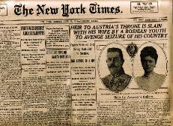



The New York times (print)
The New York times (CD-Rom)
The New York times (online)
Work
The New York times (print)
The New York times (CD-Rom)
The New York times (online)
Expression
Manifestation
Notes:
This example shows three “editions” of the New York Times, each issued on a different carrier type.
Following the LRM, these are described as three separate serial works. This allows each description to maintain accuracy. For example if the CD-Rom edition ceases, a user will not assume that a later issue is available in that format; if the content of the print and online editions diverges, the user will not assume that either format will contain the information required.

Slide 27
DiachronicW
1
transformed into
DiachronicW
2
DiachronicE
1
DiachronicE
2
aggregated by
aggregated by
IssueW
1A
IssueE
1A
IssueE
1B
IssueW
1B
precedes
precedes
IssueW
2A
IssueE
2A
IssueE
2B
IssueW
2B
AggregateM
AggregateM
Notes:
In this diagram, a serial work is transformed into a new, separate serial work.
Each work has an expression that aggregates the expressions of its issues.
Each work realized by an expression of an issue is related to the next issue in the sequence of enumeration.
The diagram does not indicate the structure of the aggregate manifestations. For example, both serial works may be embodied as a single online resource.
A serial work is one of the most complex information resources that is found in most library collections.

Slide 28
Work groups
A set of works that are identified as a whole
has appellation of work group
“Appellation of work group”
Work
“Authorized access point for work group”
has authorized access point
for work group
“Identifier for work group”
has identifier for work group
Notes:
This diagram shows how to collocate serial works in the same “family”.
Any set of works may be assigned a common appellation with the same nomen string.
RDA provides three sub-types of appellation element for a “work group appellation” that can be assigned to each work in the group. Only a single nomen string is required, so there is no provision for variant access points, or unstructured description; the method only works for authorized access points or an associated identifier. The general appellation element is provided as a catch-all, and as a data gathering mechanism.
This approach is already used by the ISSN Network: an ISSN-L functions as an identifier for work group, so all editions of the New York Times can be collocated in an information retrieval application.

Slide 29
Data provenance
Who made the metadata statement?
When was it stated?
Where did the values come from?
What standards were applied?
The trick: treat each statement or set as a work
Then apply RDA …
Notes:
Another significant innovation in the new RDA Toolkit is explicit provision for recording the provenance of RDA metadata.
This has become important for applications which mix metadata from multiple sources, including publishers and special collections communities. Applications can benefit from knowing the source of metadata, what standards (if any) were used, and so on.
Modelling data provenance in RDA is easy: each metadata statement (for example the value of a single element) or set of metadata statements (a “record” created or curated by a single source) is treated as a work in its own right.
Such a work can then be described using any of the appropriate RDA elements.
For example, the creator of work of a metadata statement is typically a cataloguer. A standard applied to the metadata statement is another work that can be related to the “metadata work”, and so on.

Slide 30
The new RDA Toolkit
A package of data elements, guidelines, and instructions ...
A package that meets the resource description and access needs of the 21st century

Slide 31
Thank you!
RDA Steering Committee
http://www.rda-rsc.org/
RDA presentations
http://www.rda-rsc.org/node/560
RDA Toolkit
https://www.rdatoolkit.org/

