Slide 1
RDA methods, scenarios, tools
Gordon Dunsire
Presented to RDA Day 2023
Birmingham, England, 8 September 2023
Notes:
The RDA Toolkit contains a comprehensive set of tools for creating and maintaining bibliographic and cultural heritage metadata in a wide range of information environments and applications.
This presentation gives a brief overview of how these tools interact to meet the needs of specific applications.

Slide 2
RDA Implementation scenarios
RDA Toolkit supports four different scenarios for processing metadata:
A: Linked open data
B: Relational or object-oriented data
C: Bibliographic/authority data
D: Flat file data
The main difference is how the metadata is structured and processed in an application:
How descriptions of different things are linked in a catalogue
How descriptions are manipulated to meet user functions
Notes:
The Toolkit supports four basic scenarios for storing, linking, and processing metadata.
Scenario A is for linked open data encoded in Resource Description Framework (RDF) for use in the Semantic Web. The focus is on relating metadata for different entities. This is the finest level of granularity of metadata.
Scenario B is for relational or object-oriented data in a relational database management system (RDBMS) or an object-oriented database (OOD). This scenario can support a similar fine level of granularity as Scenario A.
Scenario C is for applications that focus on descriptive metadata for an information resource as a whole, with controlled access headings for persons, places, and other entities that are related to the resource. The granularity of the metadata is broader than Scenarios A and B.
Scenario D is for applications that focus only on descriptive metadata for a resource, with no specific links between descriptions for different resources or related entities. This is the broadest level of granularity of metadata.

Slide 3
RDA recording methods
RDA Toolkit provides four different methods for recording the same information about some thing in a description:
1: unstructured description (e.g. name/title, note)
2: structured description (e.g. access point, controlled term)
3: identifier [string]
4: IRI [thing]
Data is linked in each implementation scenario with a recording method:
A: Linked open data => IRI
B: Relational or object-oriented data => identifier
C: Bibliographic/authority data => structured description
D: Flat file data => unstructured description
Notes:
The Toolkit also accommodates a wide range of methods for controlling the content of a single piece of metadata. Four recording methods are supported.
Method 1 is for unstructured content with minimal intermediation by a cataloguer. The content is generally determined by other agents, or without applying international standards.
Method 2 is for structured content, with intermediation that follows national or international content standards.
Method 3 is restricted to identifiers of related content.
Method 4 is further restricted to linked open data identifiers of related content.
The four recording methods can be roughly aligned with how the four implementation scenarios relate content within a description and between descriptions.

Slide 4
Application profiles
Only some RDA elements, options, and recording methods are relevant for any particular implementation or application
An application profile specifies which ones to use, plus other stuff like controlled vocabularies (authority files and value vocabularies)
It is very difficult to use RDA Toolkit without a profile (or policy statements, etc.)
Notes:
It follows, therefore, that the Toolkit does not intend that all of the RDA tools are applied to a specific information environment or service. The Toolkit is optimized for use in conjunction with an application profile that specifies the elements, entities, and recording methods that are to be used in describing and relating the items held in a library or other cultural heritage collection. An application profile may also specific which optional instruction to apply, and the source of controlled content such as a value vocabulary or dataset.
It is difficult to use the Toolkit without an application profile because it requires knowledge of all of the options and their impact on metadata services.
RDA Toolkit is like a general set of tools for car maintenance. The set includes spanners, wrenches, etc. that are not suitable for any specific make of car. To maintain the car, you need a manual that tells you what tools to select, and how to apply them. The manual is the equivalent of an application profile.

Slide 5
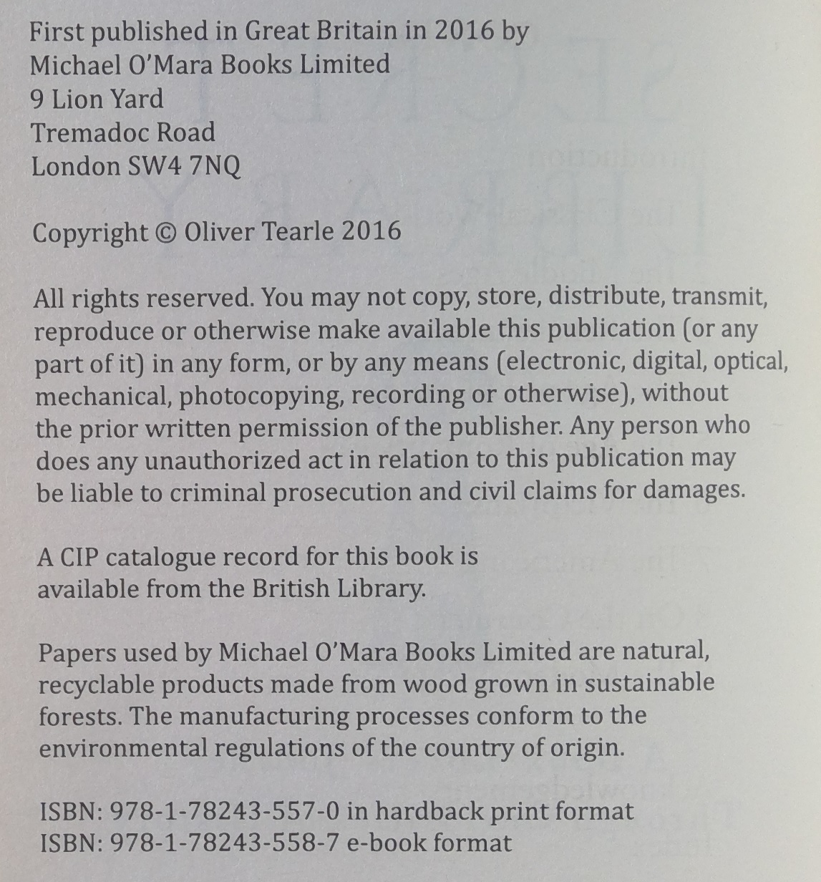
Notes:
This example is used to illustrate the range of descriptions that result from applying different recording methods in different implementation scenarios.
This is the title page and verso that provide the basis of description. These are not the only potential sources of information, and a real description will usually take into account external sources as well as the item itself.
Data processing of metadata values in operational information retrieval systems must also be taken into account when selecting which elements and recording methods to apply.
We can categorize the RDA elements in four groups with distinct sets of processing utilities.

Slide 6
Manifestation statements
IS = Implementation scenario
Element | Value | IS
manifestation title and responsibility statement | “The secret library, a book-lover’s journey through curiosities of history, Oliver Tearle” | All
manifestation publication statement | “First published in Great Britain in 2016 by Michael O’Mara Books Limited … London” | All
manifestation identifier statement | “ISBN 978-1-78243-557-0 in hardback print format, ISBN 978-1-78243-558-7 e-book format” | All
Data processing for access:
All values are unstructured strings that can be parsed to extract uncontrolled keywords:
“book-lover”; “curiosities”; “history”; “journey”; “library”; “Oliver”; “secret”; “Tearle”; etc.
Notes:
The manifestation statement elements support all implementation scenarios because they reflect how the manifestation describes itself (the “principle of representation” from International Cataloguing Principles). The content is transcribed with minimal intermediation, and can only be an unstructured description. The primary utility of a manifestation statement element is metadata display to support the identify task.
The example provides three different RDA manifestation statements.
An unstructured description can only be processed for a keyword index. The words are not controlled, so retrieval depends on the user knowing or guessing, say, the title or author name.

Slide 7
Notes
Element | Value | IS
note on manifestation | “Includes an index.” | All
note on manifestation | “Also available in e-book format.” | All
Data processing for access:
All values are unstructured strings that can be parsed to extract semi-controlled keywords:
“includes”; “index”
“available”; “e-book”; “format”
Notes:
The RDA note elements have similar processing utility to manifestation statement elements. The main difference is that the content is mediated by the cataloguer, and can be controlled within a specific information environment.
The two notes created for the example might be standard within a cataloguing community, so there is some consistency in the keywords that can be extracted.
Such consistency can improve information retrieval, if the user knows the terminology or is prompted from a display, such as “Enter ‘index’ to restrict your results”.

Slide 8
Attributes
Element | Value | IS
carrier type | http://rdaregistry.info/termList/RDACarrierType/1049 | A
 | “1049” | B
 | “volume” | C
 | “book” | D
Data processing for description and access:
A: De-reference IRI to obtain preferred term, definition, etc.
B: Look-up values table to obtain term, definition, etc.
C: Use controlled term in index; display term as graphic, etc.
D: Use uncontrolled term in index; display uncontrolled term
Notes:
The RDA attribute elements allow all four recording methods, each of which supports a different implementation scenario.
For the example, all four methods are applied to a single attribute element. Only one method will be applied in a specific implementation.
The data processing requirements and utility vary for each scenario.
In a linked open data implementation, the IRI that is recorded must be de-referenced in the Semantic Web to obtain human-readable information for further processing.
In a relational database implementation, the identifier that is recorded must be looked-up in the local database to obtain human-readable information for further processing.
In a bibliographic/authority implementation, the controlled term can be displayed directly or indirectly, or used in a controlled index.
In a flat-file implementation, the uncontrolled term is displayed as is.

Slide 9
Relationships
Element | Value | IS
place of publication | http://www.wikidata.org/entity/Q84 | A
 | “Q84” | B
 | “London (England)” | C
 | “London” | D
Data processing for description and access:
A: De-reference IRI to obtain preferred name, description, etc.
B: Look-up values table to obtain name, description, etc.
C: Use controlled term in index; display term on map, etc.
D: Use uncontrolled term in index; display uncontrolled term
Notes:
RDA relationship element content is processed in the same way as for attribute elements, but the utility is different.
Processing the content for linked open data or relational data provides additional metadata for a related entity which may, or may not, be relevant to the application. Further processing determines the utility in an information retrieval system.
A controlled term can be displayed directly or linked to an augmented display, or used in a controlled index.
An uncontrolled term can be displayed directly or used in an uncontrolled index.

Slide 10
Scenario A: linked open data
Element | Value
manifestation statement of title and responsibility | “The secret library, a book-lovers’ journey through curiosities of history, Oliver Tearle”
note on manifestation | “Includes index.”
identifier of manifestation | “9781782435570"
publisher corporate body | http://viaf.org/viaf/14908555
place of publication | http://www.wikidata.org/entity/Q84
date of publication | http://www.wikidata.org/entity/Q25245
carrier type | http://rdaregistry.info/termList/RDACarrierType/1049
work manifested | http://viaf.org/viaf/720154801932256310009
related person of manifestation | http://viaf.org/viaf/168386789
Notes:
This is the example with RDA element values for linked open data.
The manifestation statement and note content can be displayed directly to users, processed for display, or processed for keyword indexes.
The attribute and relationship content are all IRIs that must be processed for information retrieval and display.
[The identifier element and other RDA appellation elements have pre-determined recording method and implementation scenarios which are not discussed in this presentation. They can be mixed with other scenarios for display, as in this case.]

Slide 11
Scenario B: relational data
Element | Value
manifestation statement of title and responsibility | “The secret library, a book-lovers’ journey through curiosities of history, Oliver Tearle”
note on manifestation | “Includes index.”
identifier of manifestation | “9781782435570"
publisher corporate body | 14908555
place of publication | Q84
date of publication | Q25245
carrier type | 1049
work manifested | 720154801932256310009
related person of manifestation | 168386789
Notes:
This is the example with RDA element values for relational data.
The manifestation statement and note content can be displayed directly to users, processed for display, or processed for keyword indexes.
The attribute and relationship content are identifiers that must be processed for information retrieval and display.
The identifiers are “stringified” IRIs that have been previously de-referenced and cached for local look-up. The cache may become out-of-date if it is not maintained.

Slide 12
Scenario C: bibliographic/authority data
Element | Value
manifestation statement of title and responsibility | “The secret library, a book-lovers’ journey through curiosities of history, Oliver Tearle”
note on manifestation | “Includes index.”
identifier of manifestation | “9781782435570"
publisher corporate body | “Michael O’Mara Books Limited”
place of publication | “London (England)”
date of publication | “2016”
carrier type | “volume”
work manifested | “Tearle, Oliver. Secret library”
related person of manifestation | “Tearle, Oliver”
Notes:
This is the example with RDA element values for bibliographic/authority data.
The manifestation statement and note content can be displayed directly to users, processed for display, or processed for keyword indexes.
The attribute and relationship content are controlled values that can be displayed directly or processed for enhanced display or controlled indexes.

Slide 13
Scenario D: flat file data
Element | Value
manifestation statement of title and responsibility | “The secret library, a book-lovers’ journey through curiosities of history, Oliver Tearle”
note on manifestation | “Includes index.”
identifier of manifestation | “9781782435570"
publisher corporate body | “Michael O’Mara Books”
place of publication | “London”
date of publication | “2016”
carrier type | “book”
work manifested | “The secret library”
related person of manifestation | “Oliver Tearle”
Notes:
This is the example with RDA element values for flat-file data.
All element can be displayed directly to users or processed for keyword indexes.

Slide 14
Summary
RDA Toolkit supports a wide-range of metadata implementations. An application profile is necessary to select the correct tools and methods for a specific implementation.
Factors that influence a profile include:
Representation vs Context (description vs relationships)
Cost vs Benefit (data processing: hardware, systems, skills)
Open vs Closed (data gathering and sharing)
The internal coherency of the Toolkit provides a basis for interoperability of metadata between different profiles and applications.
Notes:
The example shows the range of metadata recording and processing methods that are supported by RDA Toolkit. An application profile is required for the selection of elements and recording methods for a specific implementation.
An implementation includes the functional requirements of the information system, economic factors such as data processing availability and skill sets, and collaborative requirements for data gathering and sharing.
The interoperability of RDA data is supported by the consistency of the Toolkit’s entity-focused elements and element hierarchies, irrespective of a specific implementation. As the example shows, the same elements underpin a range of content values.

Slide 15
Thank you!
Presentation, with notes:
http://www.gordondunsire.com/pubs/pres/RDAMST.pptx
RDA Toolkit Guidance:
Application profiles
Manifestation statements
RDA implementation scenarios
Recording methods

