Slide 1
Accommodating local cataloguing traditions in a global context
Gordon Dunsire, Chair, RSC & Ebe Kartus, RSC Wider Community Engagement Officer
Presented at “Diversity of Data: RDA in the international context”, 23 August 2018
National Library of Malaysia, Kuala Lumpur, Malaysia

Slide 2
RDA data
“RDA is a package of data elements, guidelines, and instructions for creating library and cultural heritage resource metadata that are well-formed according to international models for user-focussed linked data applications.”
Notes:
The RDA data ecosystem is summed up in this sentence introducing the RDA Board’s announcement of RDA’s strategic directions.

Slide 3
International models
IFLA LRM: Library Reference Model
Distillation of 20 years of international development
RDF: Resource Description Framework
Linked open data; Semantic Web
Content and encoding standards (pre-LRM)
MARC 21, ISBD, ISSN
Notes:
RDA is based on international models for bibliographic and other information.
The most important model is the new IFLA Library Reference Model. It replaces the models that the original RDA Toolkit was based on, and it is the cumulation of 20 years of thinking by international cataloguing experts.
RDA also uses the Resource Description Framework (RDF) data model developed for linked open data and the Semantic web by technical experts.
RDA also tries to be compatible with other international content and data encoding standards. We expect those standards to develop as a result of the LRM.

Slide 4
International communities
Full translations of RDA Toolkit
Open translations of RDA Reference
Flexible maintenance and production infrastructure aimed at international use
Notes:
RDA supports international communities by providing complete translations of the RDA Toolkit.
Translations of the RDA Reference components of the Toolkit are openly and freely available for use by local communities. These data are encoded in RDF.
A new production infrastructure has been developed for the RDA Toolkit. This is much more flexible than before, and it is intended to be used in an international environment.

Slide 5
Library & cultural heritage applications
RDA Board strategy to develop RDA for international library and cultural heritage communities.
National Institutions for library, archive, and museum resources have common metadata requirements.
Notes:
The RDA Board strategies for the development of RDA include its use by international library and other cultural heritage communities.
The Board is aware that national institutions for cultural heritage, including library, archive, and museum collections, have many common requirements for metadata.

Slide 6
User-focussed applications
“Local” applications
Focus on specific entities and characteristics of interest
Re-use of metadata curated locally
Integrated finding aids
“Global” data environment
Quality and trust; coherent semantics
Notes:
RDA is designed to create and maintain data for user-focussed applications.
Local applications, from big to small, can focus on entities and characteristics that support local interests.
Metadata that are curated and maintained in local applications can be re-used for other applications. For example, data from many libraries, archives, and museums can be used in integrated finding aids such as union catalogues.
Metadata can be shared at global level because the underlying semantics of RDA entities and elements are coherent. This supports the recognition and assessment of quality metadata from trusted national sources in a “sea” of metadata from dubious sources, including “fake news”.

Slide 7
Acting locally,
thinking globally
RDA has many features that accommodate local data requirements in a global application framework
External data can be integrated with local data with assured levels of quality, utility, and coherency
Notes:
RDA is designed so that metadata can be created to meet the interests of local communities within a global framework for interoperability.
Correct application of the RDA Toolkit results in metadata that can integrated with external sources of data created using other standards, or no standards at all. Applications can process the mix of data within specific levels of quality, utility, and coherency.

Slide 8
Extensibility
RDA is an implementation and extension of the LRM
RDA is designed for further extension to meet local application requirements
For example, a substitute vocabulary
All RDA entities, elements, and concepts can be refined by a local community
Notes:
RDA is designed for extension to meet local requirements.
RDA itself is an implementation of the LRM that extends the high-level entities and elements to more specific levels for practical applications.
The extension mechanisms can be applied to RDA to meet even more specific requirements of local communities.
For example, a local controlled terminology can be used in place of the vocabularies supplied with the Toolkit.

Slide 9
Modular Toolkit structure
Each element has its own “page” of instructions
Finer granularity improves flexibility for local applications
Notes:
The modular structure of the Toolkit, based on individual elements, provides a fine granularity or set of “building blocks” that can be used in flexible ways by local applications.

Slide 10
Options and profiles
Most RDA instructions are optional
Anglo-American and other national and international approaches are not adopted at “universal” or global level
RDA must be used with an application profile to select elements and recording methods for a local application
Notes:
The new RDA Toolkit has many more optional instructions.
The Anglo-American, or any other specific national or international way of creating and using metadata must be optional. There is no global agreement on a top-down, one-size-fits-all “universal bibliographic control” system.
RDA must therefore be used with an indication of which elements and recording methods are to be used in any specific local application. This is known as an application profile.

Slide 11
Application profile
Method developed by Dublin Core community to specify data elements used by an application
Which elements are mandatory and desirable?
Which elements are repeatable?
How are the elements gathered into functional data “records”?
What controlled terminologies are used?
Notes:
The concept of an application profile was developed by the Dublin Core metadata community to mix-and-match specific data elements from one or more schemas.
This mechanism can be used for RDA data.
An RDA application profile indicates which elements are mandatory or desirable, whether they are repeatable or single-use, how the elements form regular data sets that are equivalent to traditional catalogue records, and what controlled terminologies to use.

Slide 12
RDA application profile
Toolkit note attached to an element
Local individual user
Institutional document with link to an element
Local institutional user
Policy statements attached to an instruction
National and international user
External document with link to an instruction
All levels
Notes:
The new RDA Toolkit provides several ways of specifying an application profile.
An individual user can simply attach a note to a selected element.
An institution can provide a workflow or similar document that links to the elements that are to be used. These documents are stored within the Toolkit and can be made available to all users of an institutional subscription.
The existing RDA policy statements are another form of application profile. These are usually intended for use by multiple institutions within a local region or country.
Documentation that is maintained and published outside of the Toolkit can link to specific elements and specific optional instructions. This type of application profile may be used at all levels, from the individual Toolkit user to multiple national institutions with a common interest.

Slide 13
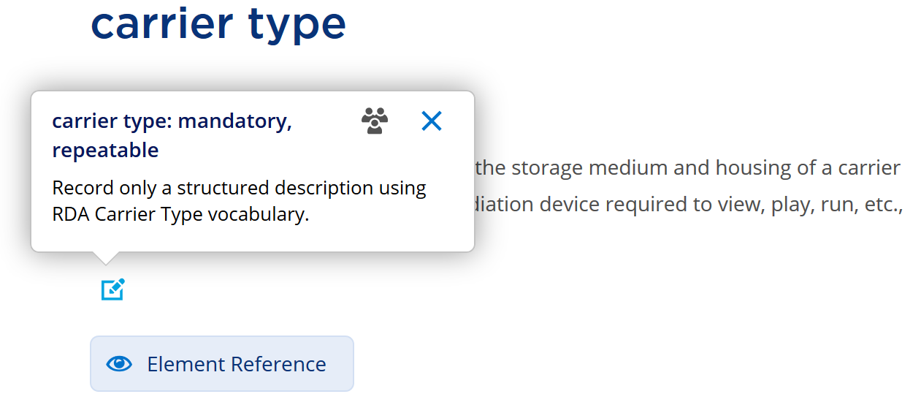
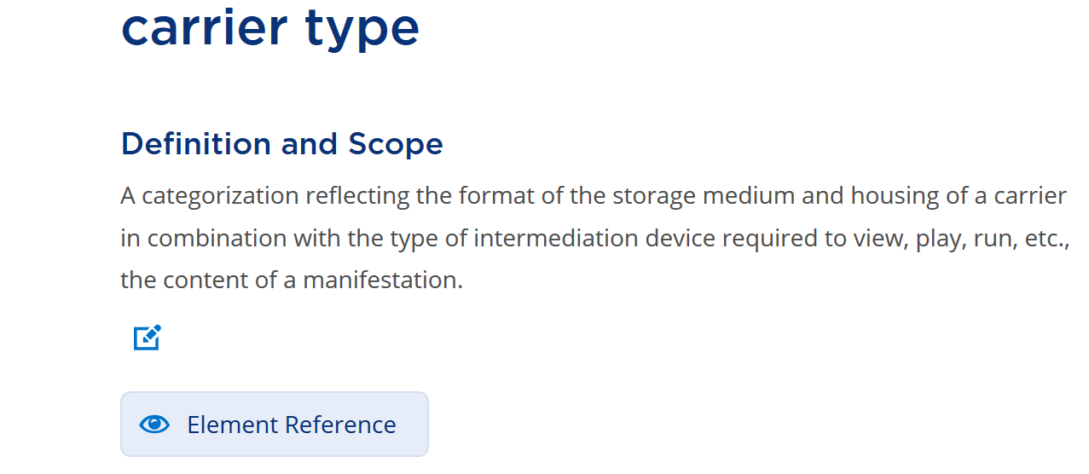
Example: Toolkit note
Notes:
This is a screen-shot from the new RDA Toolkit to show the simplest method for specifying an application profile.
This is a note created by an individual user and attached to a specific element. The note is displayed as a “pop-up” when a user requires it.

Slide 14
From local to global
governance
RDA Steering Committee
Europe Region
Latin America & Caribbean Region
North America Region
Africa Region
Oceania Region
Asia Region
Wider Community Engagement Officer

Slide 15
Notes:
RDA is now used across the world.
It is an international framework that allows cataloguing and other metadata services to meet the needs of the local community in an assured global environment.

Slide 16
Thank you!

