Slide 1
RDA, linked data, and update on development
Gordon Dunsire
Presented to The Kiviathon,
Kansalliskirjasto (National Library of Finland),
Helsinki, 17-18 November 2016

Slide 2
RDA data
“RDA is a package of data elements, guidelines, and instructions for creating library and cultural heritage resource metadata that are well-formed according to international models for user-focussed linked data applications.”
RDA Toolkit provides the user-focussed elements, guidelines, and instructions.
RDA Registry provides the infrastructure for well-formed, linked, RDA data applications. Open Metadata Registry (OMR) provides linked data representation of RDA elements.
Notes:
The RDA data ecosystem is summed up in this sentence introducing the RDA Board’s announcement of RDA’s strategic directions.
The RDA package is delivered by an infrastructure of two interacting services.
The human-facing components, including the guidelines and instructions, are the Toolkit.
The data-facing components are contained in the Registry.
Applying the data capture and storage techniques in RDA Toolkit to the data architecture in the RDA Registry produces well-formed data for RDA applications.

Slide 3
Development contexts (2-3 years)
Governance transition to international representation
Strategic communities: international, cultural heritage, linked data
IFLA Library Reference Model (LRM) and other international standards (IFLA, ISSN, …)
Toolkit review and re-organization (3R Project)

Slide 4
FRBR-LRM and RDA
LRM is “a high-level conceptual model … intended as a guide or basis on which to elaborate cataloguing rules”
RDA guidance, instructions, elements
“operates at a greater level of generality than FRBRoo, which seeks to be comparable in terms of generality with CIDOC CRM”
RDA cultural heritage communities
“this model is developed very much with semantic web technologies in mind”
RDA linked data communities

Slide 5
LRM highest-level Res model
LRM
Res
LRM
Res
is associated with
For example:
Person
Work
Place
etc.
Res sub-entity
(has) category
“Note”
(has) note

Slide 6
LRM Place and Timespan
LRM
Res
LRM
Place
is associated with
LRM
Timespan

Slide 7
LRM Nomen model
LRM
Res
has appellation
LRM
Nomen
(has) nomen string
“Name”
{shortcut}
Things have names:
The basis of authority control

Slide 8
LRM Agent model
LRM
Agent
All agents are humans
is category of
LRM
Collective Agent
is category of
RDA
*Person
RDA
Family
RDA
Corporate Body

Slide 9
LRM creation model
Products of human discourse
RDA
Work
was created by
RDA
Expression
LRM
Agent
RDA
Manifestation
was
modified by
RDA
Item

Slide 10
LRM aggregations model
Agent
Work
Work
Work
Expression
Expression
Expression
Manifestation
Manifestation

Slide 11
LRM and RDA
All* RDA entities are compatible refinements of LRM
* except Person
RDA refines LRM relationships as element sub-types (RDF sub-properties)
LRM encourages trend from attributes (strings) to relationships (things)
RDA "4-fold path" accommodates strings and things

Slide 12
Semantic refinement
Coarse/General
is associated with
Res1
Res2
has creator
has artist
Fine/Specific
is associated with
Res1
Res2
is derivative (E)
is adapted as (E)
is adapted as graphic novel (E)

Slide 13
Translations and multilingual RDA
The RDA Translations policy requires translations of RDA Reference:
Element set and value vocabulary labels, definitions, and scope notes
Linked data version of RDA Reference is available from the Open Metadata Registry, RDA Registry, and GitHub (open license allows commercial use)

Slide 14
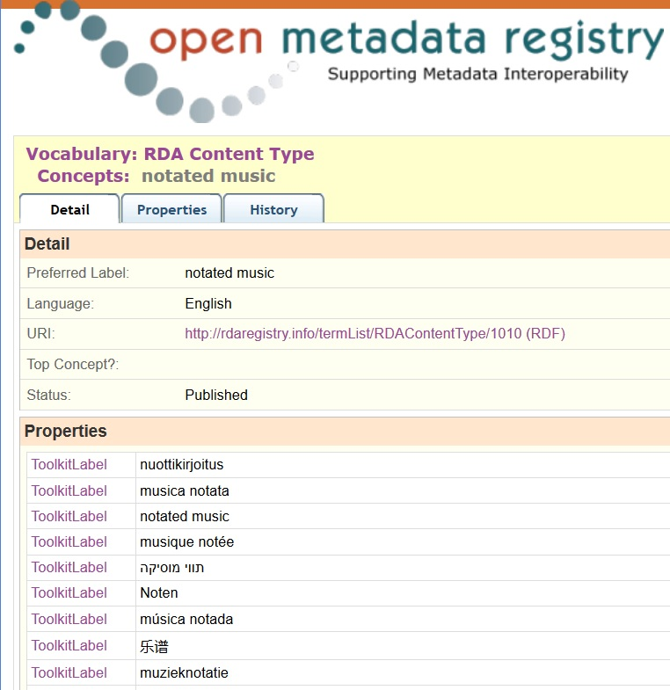
Semantic
Web

Slide 15
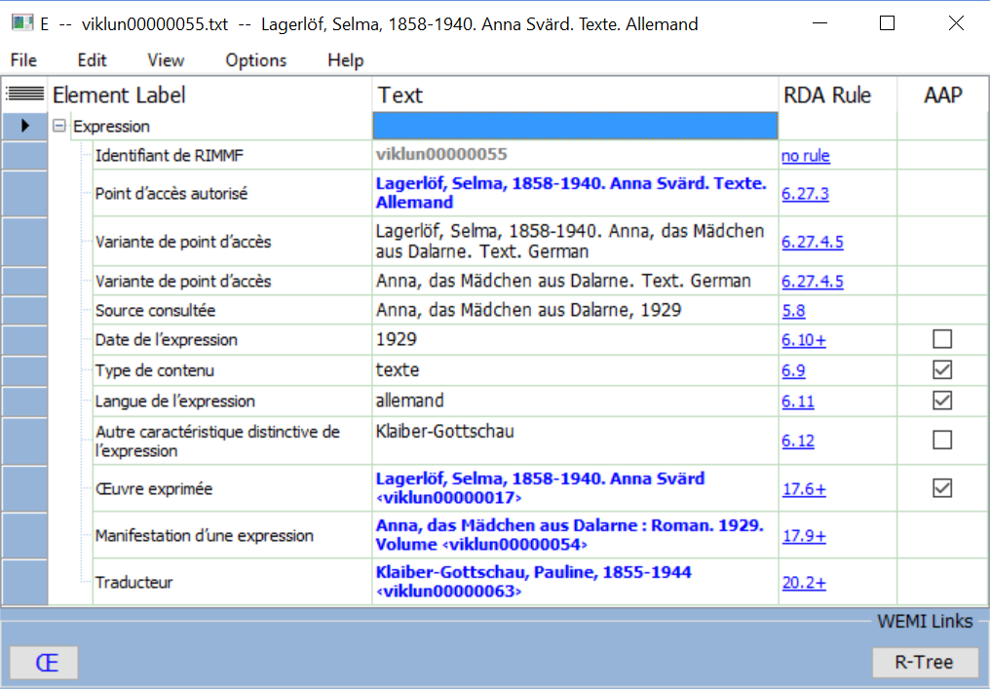
Global data
Swedish work
German translation
French cataloguer

Slide 16
Relationship data
RDA instructions accommodate related entities
identified by:
* Unstructured description
* Structured description (aggregate of attribute values)
* Access point (structured description) or Identifier
* URI (identifier for global linked data)
RDA "4-fold path":
Data stored in relationship object property (URI) or
datatype property with plain literal (unstructured) or
typed literal with syntax encoding scheme (structured)

Slide 17
2-fold
ontology
Unconstrained
(no domain, no range)
sub-property of
Canonical
(no range)
sub-property of
Object property
(entity range)
Datatype property
(literal range)

Slide 18
4-fold path in linked data
Literals
"Unstructured description"
Datatype property
(literal range)
"Structured description"
(has) range
"Identifier"
Object property
(entity range)
URI
(has) range

Slide 19
Local vocabularies
Translations!
Local terms in RDA vocabularies:
Extensions and refinements
(narrower/broader, equivalent)
Ex: Synonyms,
localized terms
Local vocabularies with similar semantics:
Substitutions in local Application Profile
Ex: Gender
Semantic coherency maintained
between OWL object and datatype properties and RDFS properties

Slide 20
RDA RDF property family
Domain | Property | Range
 | Unconstrained | 
 | Canonical RDA (Toolkit) | 
 | Object property | Thing
 | Datatype property | String
subPropertyOf
Unconstrained properties generalize RDA
for non-FRBR/LRM models

Slide 21
The challenges for linked data (beyond RDA)
Building the global from the local is essential
But the global infrastructure needs coordination
Who, when, how?
Triples store(s) for data
Maps between element sets
Maps between value vocabularies
Data triple maintenance services
Linked data catalogues

Slide 22
Thank you!
rscchair@rdatoolkit.org
RSC website
http://www.rda-rsc.org/
RDA Toolkit
http://www.rdatoolkit.org/
RDA Registry
http://www.rdaregistry.info/
RDA data, Jane-athons, etc.
http://www.rballs.info/

