Slide 1
RDA in a linked data world
Gordon Dunsire
Presented at CILIP RDA: Resource Description and Access Executive Briefing 2014, 12 June 2014, London

Slide 2
Overview
Linked data 101
RDA entities and relationships
RDA and linked data

Slide 3
Linked data
links 2 specific things
Of interest to
Of interest to
purchased
Libraries
Publishers
Archives
owned
Booksellers
Museums
autographed
Item
is
donated
by
Person
borrowed
Of interest to
conserved
The Crowd
photocopied
The Cloud
Semantic Web

Slide 4
Linked data
goes both ways
Entity
relationship
Entity
purchaser
owner
autographer
Person
is
donor
of
Item
borrower
conserver
photocopier

Slide 5
Linked data
needs identities
Which person?
Which item?
purchaser
“Jane Smith,
the author of
‘Paper’, OUP, 2001”
“The one in
the Reference
section”
owner
autographer
Person
is
donor
of
Item
“Smith, Jane, 1975-”
borrower
“0123-456-789”
conserver
{URI}
{URI}
photocopier
Uniform
Resource
Identifier
For humans
{URI}
Global
For machines

Slide 6
RDA entities
Based on modern international models
Work, Expression, Manifestation, Item, Person, Corporate Body (FRBR)
Family (FRAD)
Work-Expression-Manifestation-Item are discrete components of a resource. This avoids duplication of data
E.g. Work creator and Expression language are linked to, not copied in, multiple Manifestation descriptions such as a printed book and e-book

Slide 7
Distinct
FRBR/FRAD Entities
Work
One and
only one
Person
Expression
Family
Agent
Manifestation
Corporate Body
One or
more
Item
Primary/high-level relationships

Slide 8
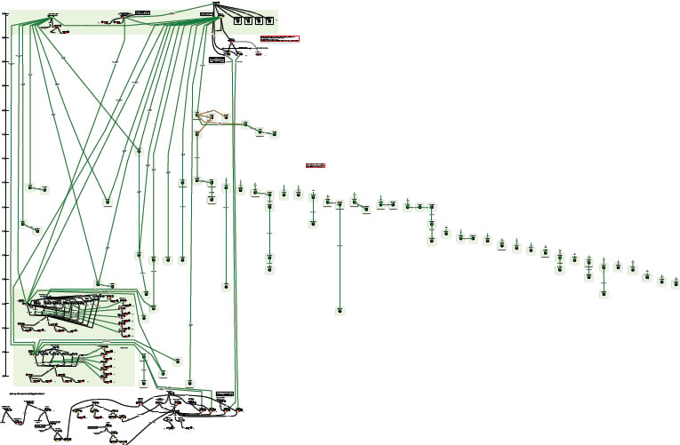
Complexity of relationships: Moby Dick
Printed editions
Diagram using FRBR entities and relationships
Films?
Gregory Peck?
Captain Ahab?
Led Zeppelin?
Whales in fiction?
“OrsonWhales” mash-up (YouTube)
Ronald J. Murray: From Moby Dick to mash-ups
http://www.slideshare.net/RonMurray/from-mobydick-to-mashups

Slide 9
RDA Entity relationships
Work
Person
Expression
Family
Manifestation
Corporate Body
Item
pov: Description -> Access

Slide 10
pov: Access -> Item
Work
Person
Expression
Family
Manifestation
Corporate Body
User
Item
content

Slide 11
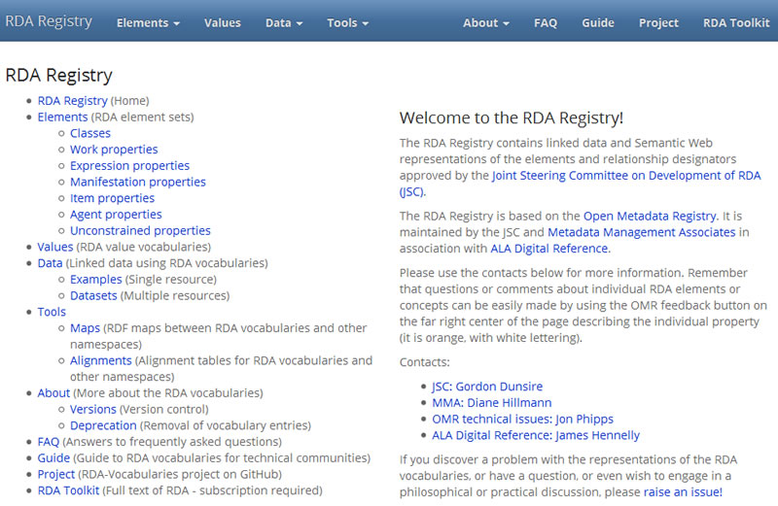
rdaregistry.info

Slide 12
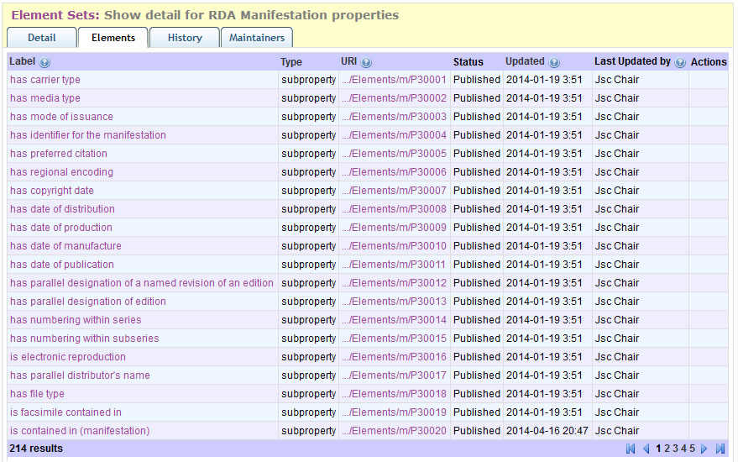
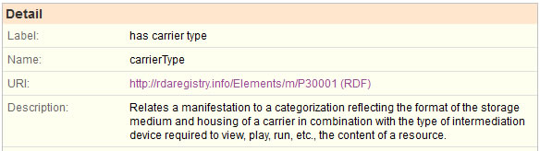
Web view of RDA elements (for humans)
Open Metadata Registry: http://metadataregistry.org

Slide 13
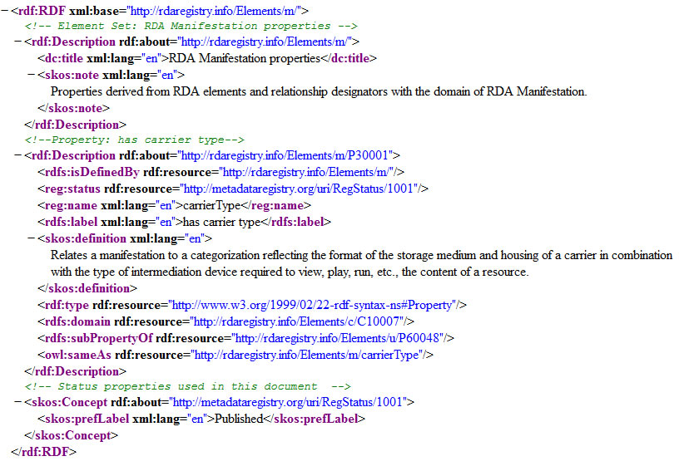
Machine view of RDA elements

Slide 14
RDA and linked data
RDA Entity | Relationships | To link | To text
Work | 235 | 200 | 35
Expression | 235 | 190 | 45
Manifestation | 210 | 50 | 160
Item | 50 | 40 | 10
Agent | 225 | 175 | 50
*Totals are
approximate
A set of linkable entities rich enough to represent the complexity of and support access to global cultural heritage content.
A set of textual relationships rich enough to describe all types of content and carrier.

Slide 15
Thank you!
jscchair@rdatoolkit.org
gordon@gordondunsire.com

