Slide 1
RDA and linked data applications: Registries, namespaces, maps, and profiles
Gordon Dunsire
Presented to RDA: Resource Description and Access – status and perspectives,
IFLA Satellite Meeting, 13 August 2014, Frankfurt-am-Main, Germany

Slide 2
RDA and linked data
May 2007: “London” meeting at British Library
RDA and Semantic Web communities
Aug 2011: First RDA value vocabularies published
Apr 2012: “Five years on” seminar at BL
Jan 2014: Full RDA element set published in new RDA Registry
Layered on top of Open Metadata Registry

Slide 3
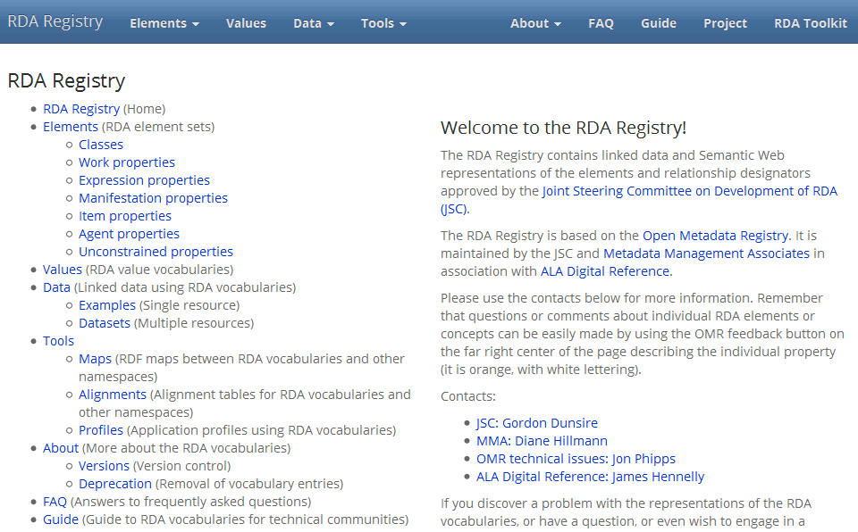

Slide 4
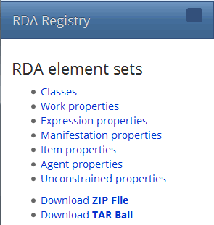
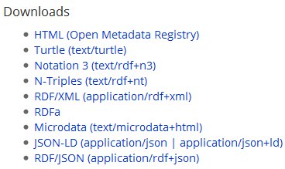
Multiple linked data formats

Slide 5

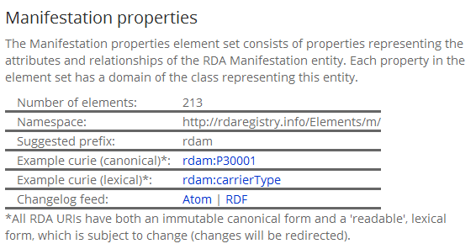
Technical stuff

Slide 6
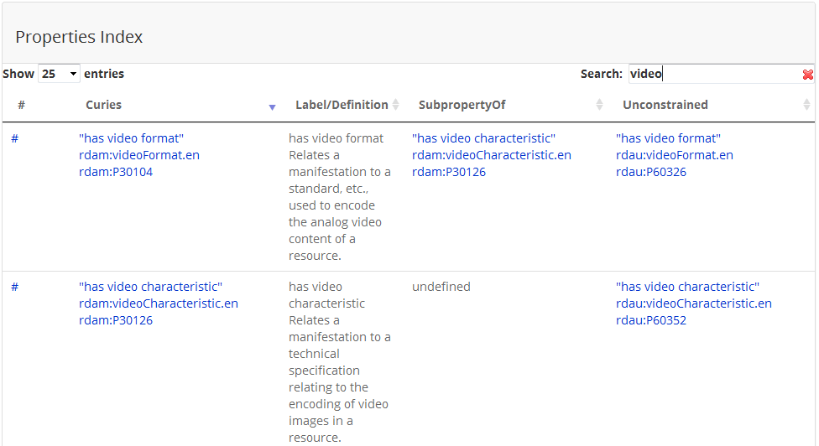
Element search

Slide 7

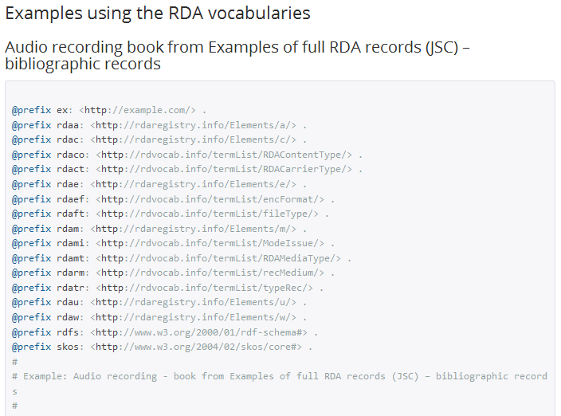
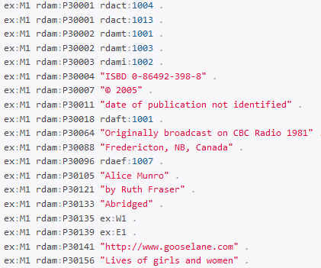


Slide 8
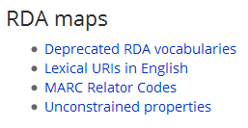
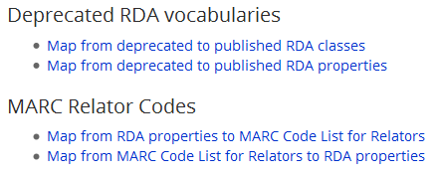
Development
Namespace
rdvocab.info
Operational
Namespace
rdaregistry.info
id.loc.gov

Slide 9
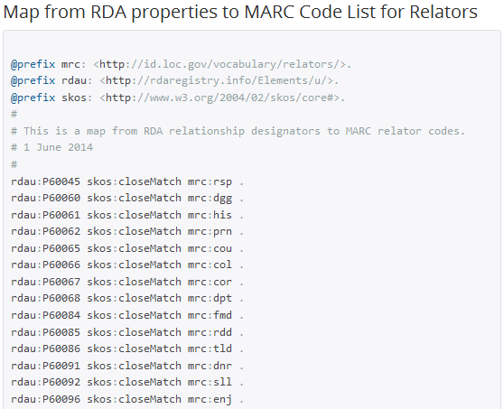
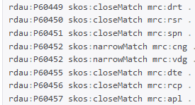

Slide 10
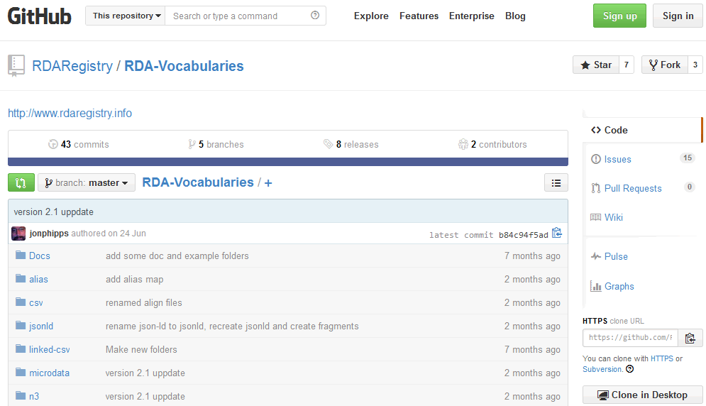
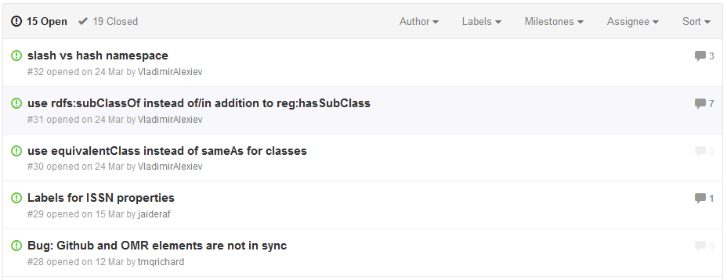

Slide 11
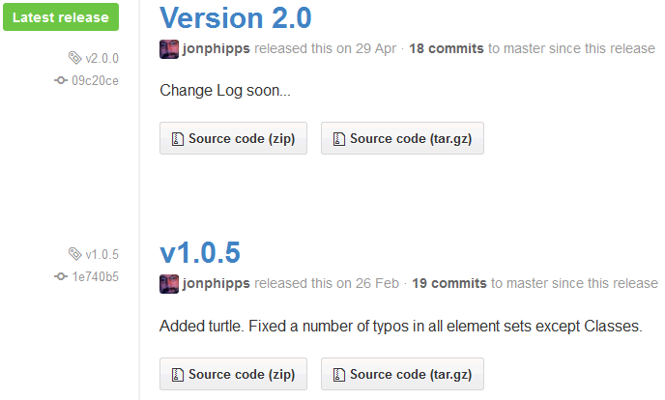
Old versions
available

Slide 12
Language-free URIs
“Opaque” URIs
E.g. http://rdaregistry.info/Elements/m/P30001
Not http://rdaregistry.info/Elements/m/carrierType
Or …/Elements/m/typeDeSupportMateriel
Readable by machines, not humans
But “difficult to remember” (cf. 338##$a !)
RDA Registry provides “lexical” URIs
Based on language-dependent element labels

Slide 13
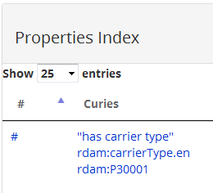
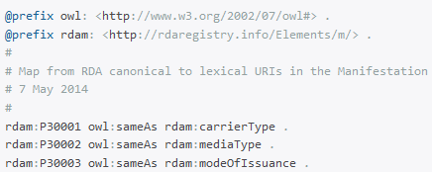
English lexical URI
(label-dependent)
Canonical URI
(immutable)
Map between
Canonical and
Lexical URIs

Slide 14
RDA Registry and translations
Data from RDA translations will be added to the RDA Registry
Element and value labels, definitions, scope notes
Registry accommodates Unicode scripts
First testing later in 2014 with German
First partners in RDA development namespace
Some RDA translations limited to “Registry” text
Registry accommodates lexical URIs in any language

Slide 15
RDA and non-FRBR linked data
RDA elements are tied to RDA entities
Machine assignment of what type of thing (entity) is described or related in data triples
Registry has “unconstrained” versions of elements
Used for interoperability with non-FRBR elements
E.g. ISBD (draft linked data map for approval in Lyon)
Bridge between FRBR/RDA and other (hybrid) data

Slide 16
RDA and linked data
RDA Entity | Relationships | To link | To text
Work | 235 | 200 | 35
Expression | 235 | 190 | 45
Manifestation | 210 | 50 | 160
Item | 50 | 40 | 10
Agent | 225 | 175 | 50
*Totals are
approximate
A set of linkable entities rich enough to represent the complexity of and support access to global cultural heritage content.
A set of textual relationships rich enough to describe all types of content and carrier.

Slide 17
Thank you!
rdaregistry.info

