Slide 1
The IFLA Library Reference Model and RDA
Gordon Dunsire, RDA Technical Team Liaison Officer
Presented at Segundo Coloquio sobre RDA en América Latina y el Caribe, Biblioteca Nacional de Chile,
21 October, 2019, Santiago de Chile, Chile

Slide 2
Overview
Library Reference Model
Integration with RDA
Manifestation statements
Representative expression
Nomen
Aggregates

Slide 3
Is LRM suitable for RDA?
LRM “a high-level conceptual model … intended as a guide or basis on which to elaborate cataloguing rules”
RDA guidance, instructions, elements
“operates at a greater level of generality than FRBRoo, which seeks to be comparable in terms of generality with CIDOC CRM”
RDA cultural heritage communities
LRM “this model is developed very much with semantic web technologies in mind”
RDA linked data communities
Notes:
There are several features of the LRM that make it suitable for use as the conceptual model behind RDA.
In particular, it supports the RDA Board strategy for improving the utility of RDA for international, cultural heritage, and linked data communities.

Slide 4
LRM entities
Retained:
Work, Expression, Manifestation, Item, Person**
Added:
Agent, Collective Agent, Nomen, Place, Time-span
+ Res (super-class of other entities)
Notes:
The LRM retains the main “resource” entities from FRBR: Work, Expression, Manifestation, and Item.
The Person entity is also retained, but the definition is now confined to real human beings, and excludes bibliographic identities, fictional and legendary beings, and so on.
The LRM introduces several new entities, and an entity super-type labelled “Res”.
Res allows broad attributes and relationships to be cascaded down to, or inherited by, all other LRM entities.

Slide 5
LRM and RDA entities
Res
is sub-class of
RDA Entity = Any RDA Thing
Covers all other types of entity
RDA
Entity
has appellation*
Nomen
W
is created by
E
Agent
Place
is sub-class
of
is associated with
M
Collective
Agent
Time-span
I
is modified by
P**
F
C
Notes:
In RDA, the super-entity "RDA Entity" is used in place of Res for all other RDA entities. RDA Entity is a sub-type (sub-class in RDF) of Res.
This RDF graph shows new RDA entities taken from the LRM: Nomen, Place, Time-span, Collective Agent, and Agent. Current RDA entities are labelled only with their initials. The graph also shows the high-level relationships between the new and current entities.
* The “appellation” relationship does not normally apply to Nomen itself: Nomens do not have nomens.
** The only RDA entity which does not fit without significant modification is Person because of the narrower definition used by the LRM.
The integrated semantic structure of the LRM and RDA entities allows the RDA relationships to be refinements of the high-level LRM relationships, as element sub-types (sub-properties in RDF).

Slide 6
LRM and RDA elements
Most RDA elements are sub-types of LRM elements
Many RDA attribute elements become relationship elements
New entities: “date of birth” relates a Person to a Timespan
LRM Res attributes added to all RDA entities
E.g. category of person; note on place
Notes:
Some current RDA elements are not compatible with the LRM and have been removed.
All of the remaining elements are narrower in scope than the LRM elements, and therefore can be mapped as sub-types of an LRM element.
The new LRM entities allow many RDA attribute elements to become relationship elements for greater flexibility and utility.
The LRM assigns attribute elements to the Res entity, with the intention that they apply to all sub-classes of Res; that is, to all other entities. Similar attribute elements have been assigned to each RDA entity to implement this intention.

Slide 7
LRM-E4-A4 Manifestation statements
A statement appearing in the manifestation and
deemed to be significant for users to understand
how the resource represents itself.
… normally transcribed from a source … in a
manifestation. Transcription conventions are
codified by each implementation.
Principle of representation
User task: Identify
Notes:
The LRM attribute for Manifestation statement supports the principle of representation from IFLA’s International Cataloguing Principles – how a resource (manifestation) describes itself.
The data is usually transcribed from an exemplar of the manifestation, and supports only the user task Identify.

Slide 8
RDA Manifestation statement elements
Broad level of granularity:
Covers wide range of layouts on manifestation
One level of hierarchy:
All specific statements are sub-types
Manifestation statement
> Manifestation title and responsibility statement
> Manifestation edition statement
> Manifestation identifier statement
> …
Notes:
The RDA implementation of Manifestation statement keeps specific kinds of statement at a broad level of granularity in order to cover a wide range of ways in which the data is presented on the manifestation.
The specific kinds of statement do not have internal structure; there is only one level of hierarchy, and the specific manifestation statements are all sub-types of the general element. Internal structure is not required to support the user task Identify, and in many cases can be counter-productive. For example, it may be difficult to make a useful transcription of just the place(s) of publication.
These are some of the new RDA elements for manifestation statements. They use a labelling pattern for consistency and to distinguish them from the current hybrid transcription/recording elements, which are being retained to accommodate current practice.

Slide 9
RDA Manifestation statement
Recording method: unstructured description (only)
Transcribed from manifestation being described:
Basic transcription rules (WYSIWYG, machine-capture)
Normalized transcription rules (capitalization, punctuation, etc.)
Other transcription rules (specialized communities)
Notes:
A manifestation statement can only be an unstructured description because there is no control over the terminology, layout, or completeness of how a manifestation describes itself.
RDA provides specific sets of transcription rules. The basic set is designed for minimum intermediation by humans (what is seen on the manifestation) or machines (optical character recognition). The normalized set accommodates additional rules on punctuation, etc. that are similar to those in the original RDA Toolkit.
Other transcription rules are also accommodated.

Slide 10
LRM-E4-A2 Representative expression attribute
An attribute which is deemed essential in characterizing the work and whose values are taken from a representative or canonical expression of the work.
Value of Expression element is recorded for a corresponding Work element
Notes:
The LRM introduces a generic attribute for the Work entity that allows a work to be characterized by one or more values taken from a specified expression of the work.

Slide 11
RDA representative expression elements
Small set of Expression elements that are cloned as Work elements
E.g. Expression: language of expression
Work: language of representative expression
E.g.Work: medium of performance of choreographic content of representative expression
[Longest label in RDA!]
Notes:
RDA has selected a small set of Expression elements that are useful for characterizing the work that is realized by an expression. The new Toolkit includes new Work elements that correspond to the Expression elements. The basic definitions and scope notes are the same.
Some of the Work representative expression elements alleviate problems caused by the LRM’s relocation of FRBR Work elements to LRM Expression, such as ‘medium of performance’.

Slide 12
Representative expression relationship element
(has) representative expression
Work
Expression
language (re) = “Serbian”
date (re) = “1978”
script = (re) “Cyrillic”
language = “Serbian”
date = “1978”
script = “Cyrillic”
Main utility:
construction of access points
distinct description of similar works
Notes:
In this example, three values from a specified representative expression are used to characterize the work that is realized.
The main utility is to provide qualifiers for constructing a unique access point for a work, and to distinguish works which otherwise have ambiguous descriptions

Slide 13
Nomen
A designation that refers to any RDA entity
Except a nomen
Includes a name, title, access point, identifier, and subject classification codes and headings
Treats a string of characters as a “thing” that can be described in itself
e.g. context of use, date of usage
Useful for authority control
RDA specifies three types of nomen corresponding to “string” recording methods:
Unstructured (description) name or title
Structured (description) access point
Identifier
Notes:
The LRM adds an entity for Nomen. A nomen is a name, label, identifier, or other designation that is used to refer to another entity.
This allows the designation to be independently described. LRM and RDA provide elements for Nomen that are useful for the maintenance of access points and identifiers found in name authority files.
RDA specifically accommodates three types of nomen that correspond to the three recording methods for string values. This is achieved by providing specific elements for name or title, access point, and identifier for each RDA entity except Nomen itself. These elements are all sub-types of the general “appellation” element that links a nomen to its referent entity.
Nomen has some unusual characteristics that require special orientation and training. Nomen is only likely to be used in authority control and special bibliographies; most metadata applications will use the value of a nomen without recording it as a separate entity.

Slide 14
Model for aggregates
2011: IFLA Working Group on Aggregates report
Do not implement before consolidation of FR models [2017]
LRM: “An aggregate is defined as a manifestation embodying multiple expressions … every aggregate manifestation also embodies an expression of the aggregating work”
Notes:
The development of the treatment of aggregates in RDA was set aside until the consolidation of IFLA’s Functional Requirements family of models for bibliographic description. This followed a recommendation of the IFLA Working Group on Aggregates that could not reach consensus without clarification and development of related aspects of the other models.
The delay lasted six years, although the RSC was able to see final drafts of the consolidated model, the IFLA Library Reference Model (LRM), well in advance of approval and publication in 2017 as a standard of the International Federation of Library Associations and Institutions (IFLA).
The LRM confirms the basic model proposed by the Working Group on Aggregates: aggregation is a characteristic the Manifestation entity.
The LRM specifically rejects the use of a whole/part relationship between the aggregated content and its component expressions.
Instead, the LRM refers to an aggregating work and its expression.

Slide 15
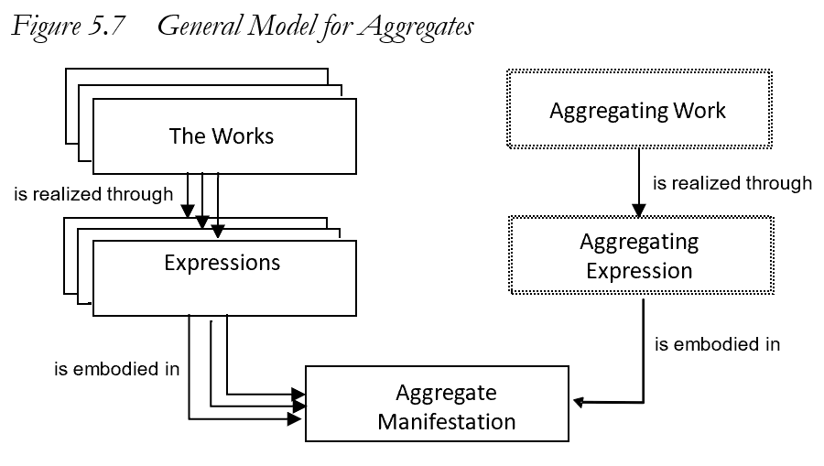
An aggregating work is a plan for aggregation
An aggregating expression realizes the plan by packaging the expressions that are aggregated
No whole/part relationships
Notes:
This is the general model for aggregates, taken from the LRM.
An aggregate manifestation embodies multiple expressions of one or more works plus a single expression of a single aggregating work.
Essentially, the aggregating work and its expression are the content of the aggregate manifestation that selects, organizes, and incorporates the content of the expressions that are aggregated in the manifestation.
There is no whole/part relationship between the Work entities or the Expression entities, and no corresponding whole/part structure in the Manifestation entity.

Slide 16
Aggregate
RDA: A manifestation that embodies an aggregating work and one or more expressions of one or more works that realize the plan for aggregation.
AW: Work plan for
Panorama del cuento chileno
W2: Donoso. Paseo
W1: Edwards. El regalo
W2: Donoso. Paseo
W2: Donoso. Paseo
realizes
realizes
AE: Expression of the plan …
E1: Text in
Spanish
E2:Text in
Spanish
E2:Text in
Spanish
E2:Text in
Spanish
embodies
embodies
aggregated by
Panorama del cuento chileno
(Banda Oriental, 1981)
Notes:
It is straightforward to implement this model in RDA.
This is the RDA label and definition for “aggregate manifestation”.
The example also shows that it is not necessary to record every distinct Work and Expression. There is no need to describe the aggregating work or expression for many applications, if the individual expressions are recorded. Conversely, it may be sufficient to describe the aggregating work and expression and ignore all of the numerous individual poems.
It does not matter if different agencies and applications record different components at different times; when the data are brought together, they will be coherent, although some redundancy or duplication will be expected.
The LRM provides a specific relationship between the aggregating expression and the expressions that are aggregated. It is not a type of whole/part relationship. This is a new RDA relationship element, labelled “aggregated by” (with inverse “aggregates”).
The terminology will be confusing until we become familiar with the new RDA Toolkit.

Slide 17
3 types of aggregation
Collection of expressions
e.g. 3 novels of Jane Austen
Augmentation
e.g. Emma, with introduction and commentary
Parallel expressions of the same work
e.g. Emma in English and French
An aggregate may consist of more than one type
Notes:
The LRM identifies three distinct categories of aggregate that are based on the relationships between the expressions selected by the aggregating work and expression.
In a collection aggregate, the expressions realize works that are intended by their creators to stand alone.
In an augmentation aggregate, one of the expressions realizes a work that is intended by its creator to stand alone, and the other expressions realize works that are intended to augment the stand alone work.
In a parallel aggregate, all of the expressions realize the same work in translations or different scripts.
It is possible for an aggregate to combine different types. For example, an anthology of poems with a commentary and translation of each poem is a combination of all three types.

Slide 18
Conclusion
RDA is a full implementation of the LRM
The LRM provides semantic coherency for all RDA metadata whatever options are chosen for an application
All RDA metadata are interoperable at a specified level

Slide 19
Thank you!
RDA Steering Committee
http://www.rda-rsc.org/
RDA presentations
http://www.rda-rsc.org/node/560
RDA Toolkit
https://www.rdatoolkit.org/

