Slide 1
What does RDA linked data look like and how does it benefit users?
Gordon Dunsire
Presented to RDA Forum, ALA Annual, Orlando, USA, June 25, 2016

Slide 2
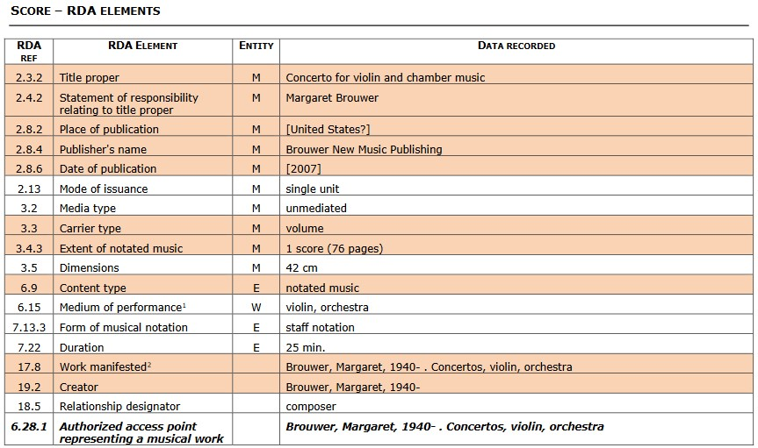
Toolkit full example: flat file (no links)

Slide 3
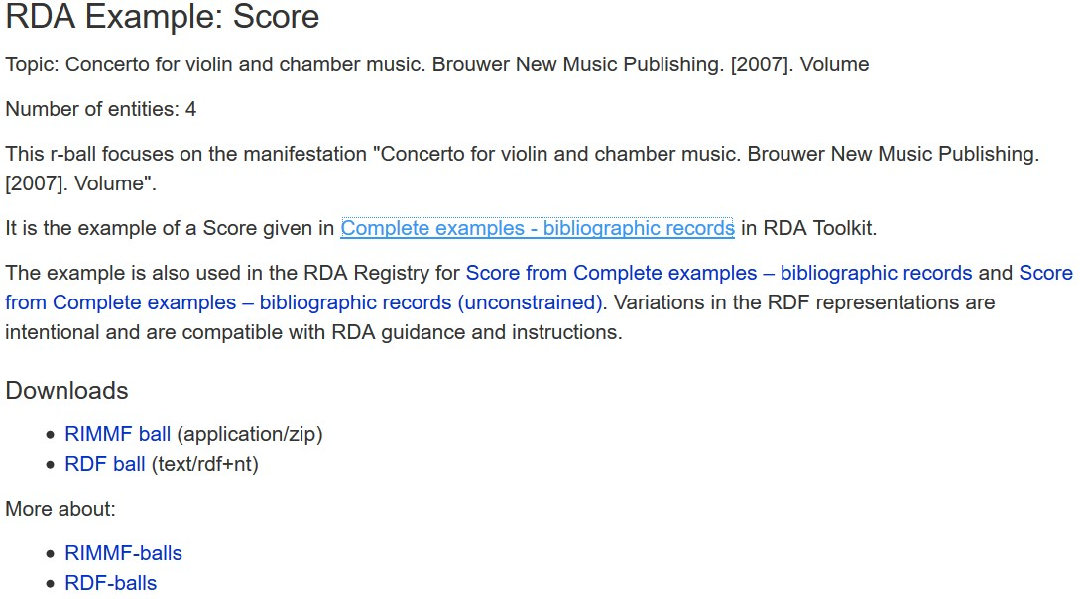
Toolkit full example: r-balls (linked data)

Slide 4
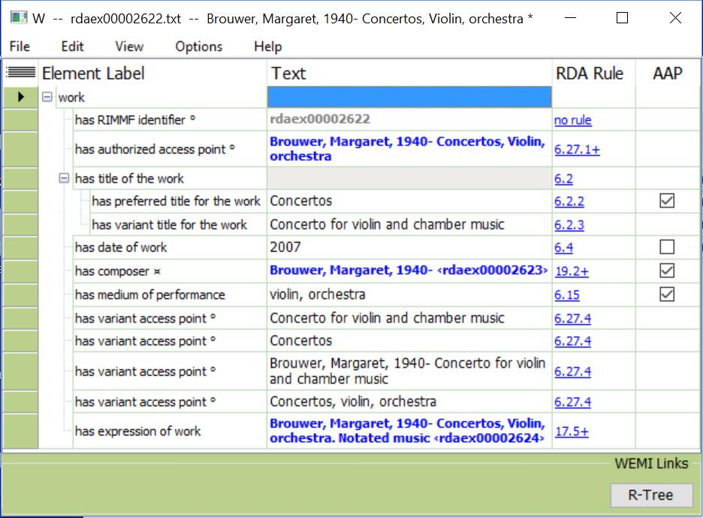
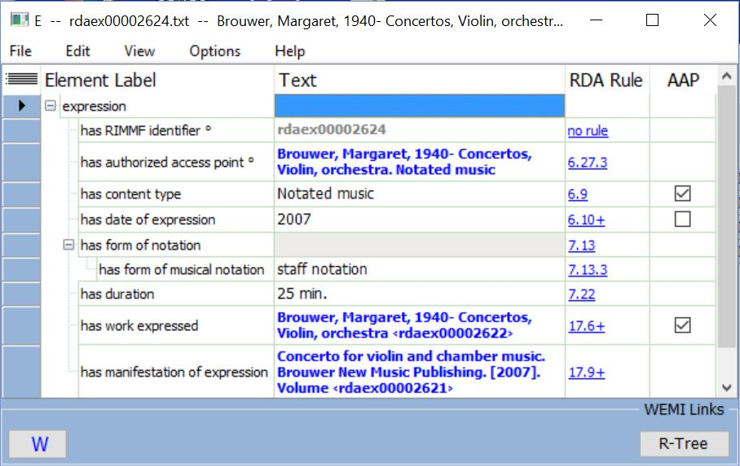
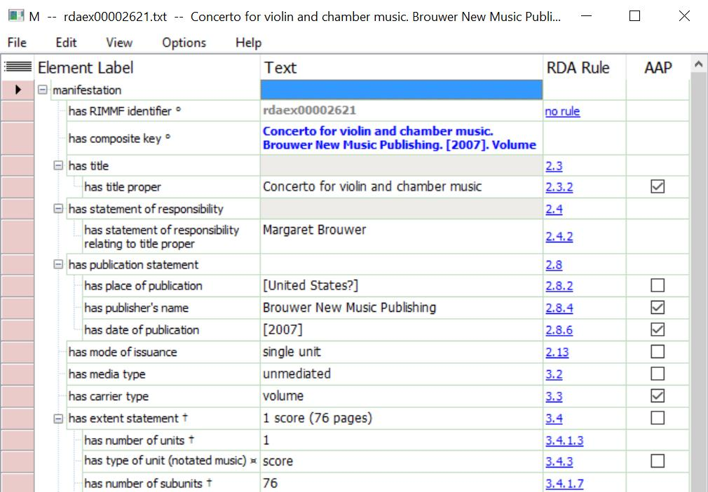
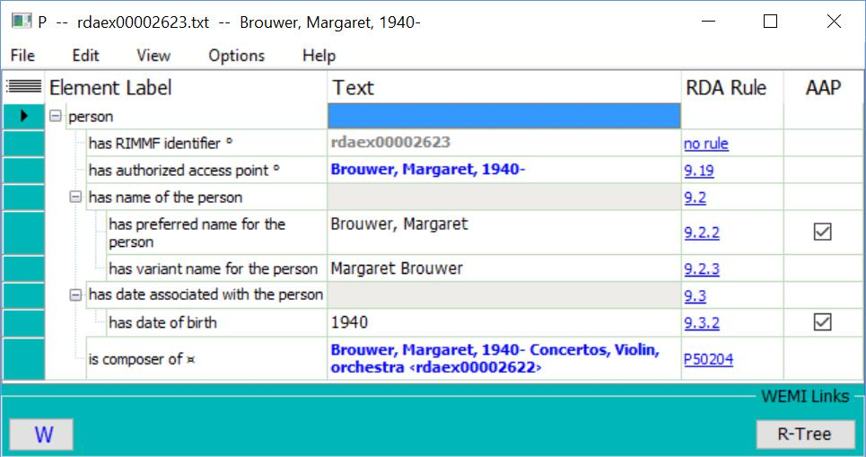
Toolkit full example: RIMMF (linked data)

Slide 5
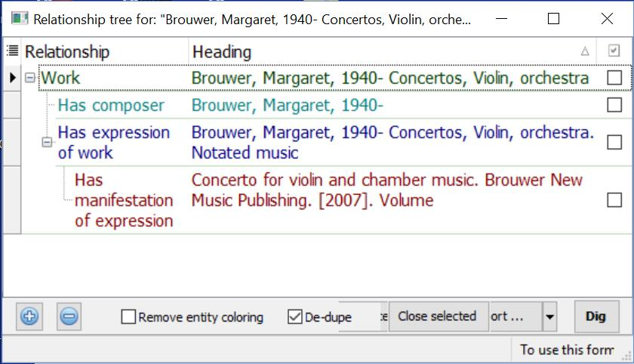
Toolkit full example: RIMMF (linked view)

Slide 6
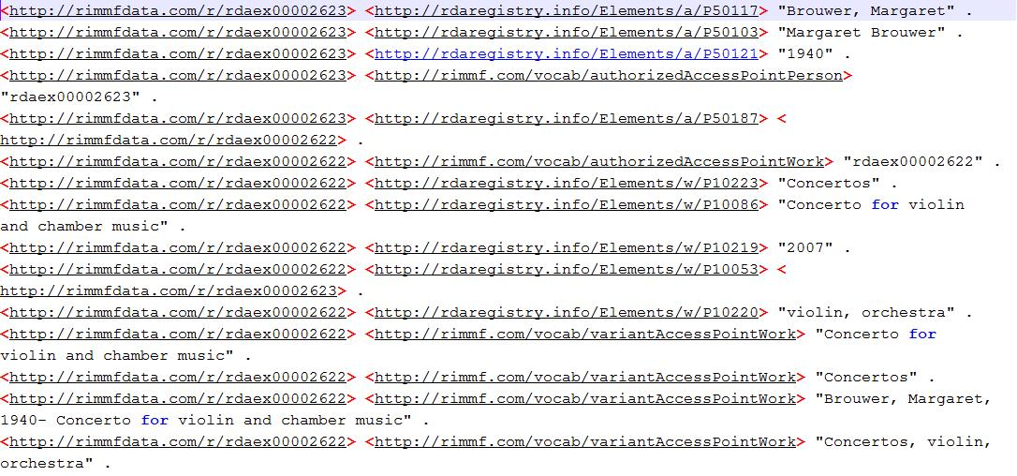
Toolkit full example: RIMMF RDF

Slide 7
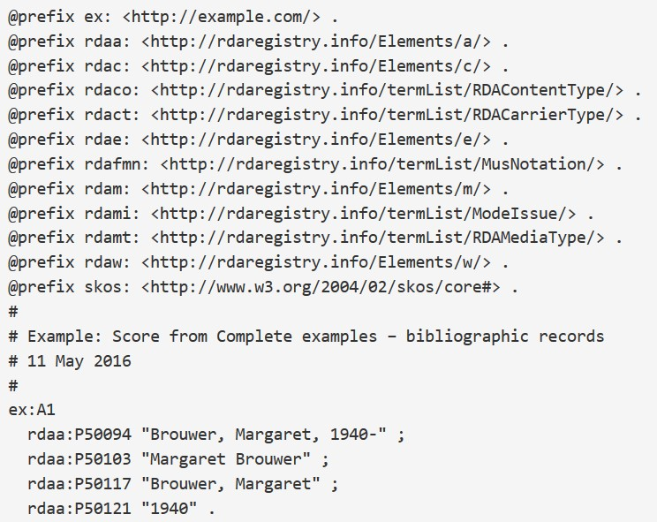
Toolkit full example: RDF turtle (semantic linked data)

Slide 8
Work linked data cluster
rdaw:P10002
"Brouwer, Margaret, 1940- . Concertos, violin, orchestra"
rdaw:P10086
"Concerto for violin and chamber music"
Work:1
rdae:P20231
"Concertos"@en
rdaw:P10223
"violin, orchestra"@en
rdaw:P10220
Expression:1
Agent:1
rdaw:P10053

Slide 9
Expression linked data cluster
Work:1
rdae:P20219
rdae:P20231
"25 min."
Expression:1
rdaco:1010
rdam:P30139
rdae:P20001
"notated music"@en
skos:prefLabel
rdafmn:1007
rdae:P20064
Manifestation:1
"staff notation"@en
skos:prefLabel

Slide 10
Manifestation linked data cluster
"Concerto for violin and chamber music"
Expression:1
"Margaret Brouwer"
rdam:P30139
"Brouwer New Music Publishing"
Manifestation:1
"[United States?]"
"2004"
"42 cm"
rdam:P30135
Work:1
rdact:1049
"volume"@en
rdamt:1007
"unmediated"@en
rdami:1001
"single unit"@en

Slide 11
Agent linked data cluster
rdaa:P50094
"Brouwer, Margaret, 1940-"
rdaa:P50103
"Margaret Brouwer"
Agent:1
"Brouwer, Margaret"
rdaa:P50117
"1940"
rdaa:P50121

Slide 12
Multilingual labels, etc.
skos:prefLabel
"notated music"@en
Expression:1
"Noten"@de
rdaco:1010
"música notada"@es
rdae:P20001
"musique notée"@fr
"乐谱"@zh

Slide 13
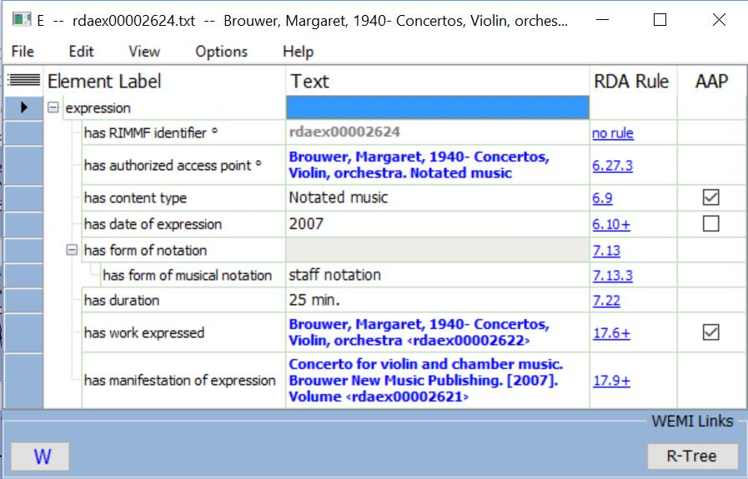
RIMMF in English

Slide 14
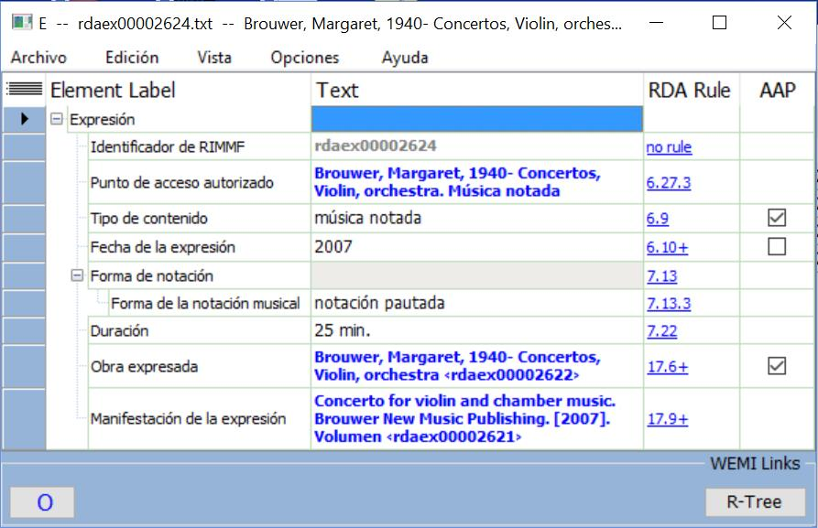
RIMMF in Spanish

Slide 15
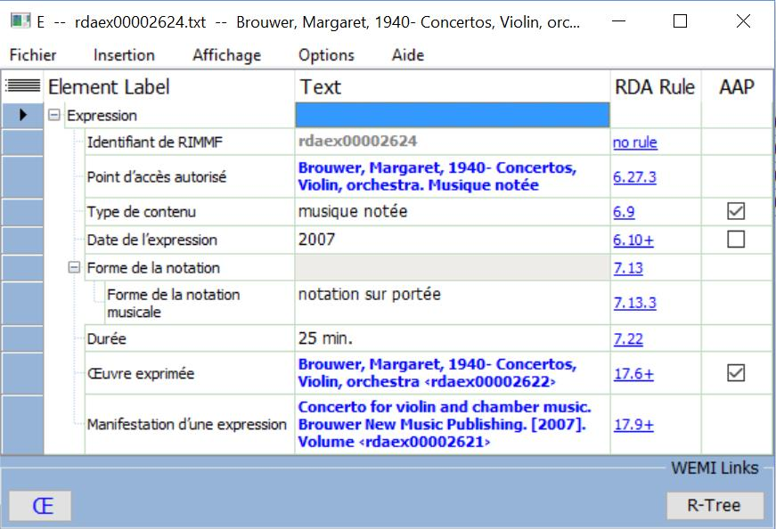
RIMMF in French

Slide 16
Manifestation linked data cluster in RDA/RDF
rdam:P30156
"Concerto for violin and chamber music"
Expression:1
rdam:P30105
"Margaret Brouwer"
rdam:P30139
rdam:P30176
"Brouwer New Music Publishing"
Manifestation:1
"[United States?]"
rdam:P30088
"2004"
rdam:P30011
"42 cm"
rdam:P30135
rdam:P30169
Work:1
rdact:1049
skos:prefLabel
"volume"@en
rdam:P30001
rdamt:1007
skos:prefLabel
"unmediated"@en
rdam:P30002
rdami:1001
skos:prefLabel
"single unit"@en
rdam:P30003

Slide 17
Manifestation linked data cluster in Dublin Core
dct:title
"Concerto for violin and chamber music"
Resource:1
dc:creator
"Margaret Brouwer"
dc:publisher
"Brouwer New Music Publishing"
Resource:1
"[United States?]"
"2004"
dct:issued
"42 cm"
dct:extent
Resource:1
rdact:1049
rdfs:label
"volume"@en
dct:medium
rdamt:1007
rdfs:label
"unmediated"@en
dct:medium
rdami:1001
rdfs:label
"single unit"@en
dct:medium

Slide 18
Transformation from RDA to DC loses information
DC Terms agents (creator, publisher) expect things, not strings
Original DC agents (creator, publisher) do not expect things or strings – can be used for strings
No place for place!
RDA Content type
RDA Media type
DC Medium
RDA Mode of issuance

Slide 19
A record?
“LabelW1”
W1
P1
“LabelP1”
“DescriptionP1”
“DescriptionW1”
E1
P2
“LabelP2”
“Description…”
“DescriptionE1”
M1
I1
C1
“LabelC1”
“Description…”
“LabelM1”
F1
“LabelF1”
“Description…”
“DescriptionM1”
“LabelI1”
W2
E2
M2
I2
P3
W3
E3
M3
I3
“LabelW3”
“DescriptionW3”
Notes:
We can look at a typical simple case.
* This is the WEMI stack for a single resource; there is an Item, and therefore a Manifestation, Expression, and Work.
* The Work has two attribute values, for a label such as the Preferred title or Authorized access point and for a descriptive element such as Intended audience.
* The Manifestation and Item have label attributes; the Expression and Manifestation have descriptive attributes.
* Is this set of values the record for the resource?
* The Work is related to a Person such as its creator. In linked data applications, the entity is identified with a URI.
* The Expression is related to a different Person such as a translator, the Manifestation to a Corporate Body such as a publisher, and the Item to a Family such as a donor. The Work is also related to another Work such as an abridgment, and the Expression is related to yet another Work such as a review.
* Do we extend the set of values to include the identifiers of the related entities?
* Each of the related entities has its own label, and related WEMI entities are components of other WEMI stacks.
* Do we extend the record to include the labels of related entities?
* Each of the related entities has its own descriptive attributes.
* Do we extend the record to include other information about related entities?
* Each of the related entities may be related to other entities, such as the Person who is producer of the manuscript that abridges the original Work. Where does the record end?

Slide 20
RDA benefits for users
User's choice of language of labels and controlled terminologies
User's ability to expand or contract the detail displayed
Choice of flat-file, related description and authority data, and graphical display of data
Fine granularity supporting interoperability with all coarser-grained schema

Slide 21
Thank you!
rscchair@rdatoolkit.org
RSC website
http://www.rda-rsc.org/
RDA Toolkit
http://www.rdatoolkit.org/
RDA Registry
http://www.rdaregistry.info/
RDA data, Jane-athons, etc.
http://www.rballs.info/

Slide 22
Example data sources
RDA Toolkit
http://www.rdatoolkit.org/sites/default/files/rsc_rda_complete_examples_bibliographic_april2016.pdf
RDA Registry
http://www.rdaregistry.info/Examples/exRSCFullScore.html
R-Balls
http://rballs.info/topics/m/rdaex/rdaexScore.html

