Slide 1
RDA linked data update
Gordon Dunsire, RDA Technical Team Liaison Officer
Presented at RDA Linked Data Forum, ALA Midwinter
January 28, 2019, Seattle, USA

Slide 2
3R releases
Last full release of RDA Vocabularies before 3R Project is Release 2.7.3 (October 2017)
April 2017 Toolkit + translations
16 “pre-release” versions of RDA Vocabularies released on GitHub:
Release 3.0.0 – Release 3.0.15
This is a pre-release to support the 3R Project. The content is not stable, and should be used with caution

Slide 3
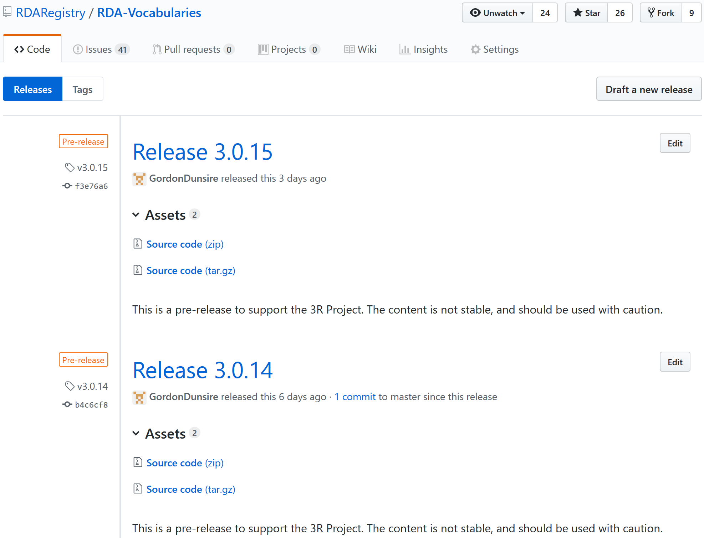

Slide 4
Next full release
Next full release of RDA Vocabularies is imminent:
Version 3.1.0
Indicates that the element sets are “stable”
No further large-scale changes are envisaged
Updates to support Toolkit releases will continue
Typos, translations, feedback
Element sets will become available to translators
Value vocabularies available since May 2018

Slide 5
Registry data in 3R
Basic structure of all element “pages” generated from Registry linked data
Standard sections and headings
Common instructions for every element included as boilerplate
Initial set-up of beta Toolkit before incorporating instructions
Break-out of Agent elements to Collective Agent, Corporate Body, Family, and Person
Notes:
During the 3R Project, the Registry data was used to generate the basic structure of every element page in the new Toolkit.
Registry data will be used in future releases of the new Toolkit to update basic element data, and the entire Glossary, Vocabulary encoding schemes reference, and Relationship matrix.

Slide 6
Data flow
Toolkit data extraction
(database, program)
GitHub
Release
(zip)
RDA Content Management System
RDA Toolkit

Slide 7
Registry data in Toolkit
Element page
Definition and scope; Element reference; Related elements
Resources
Glossary
Vocabulary encoding schemes
Relationship matrix
Notes:
During the 3R Project, the Registry data was used to generate the basic structure of every element page in the new Toolkit.
Registry data will be used in future releases of the new Toolkit to update basic element data, and the entire Glossary, Vocabulary encoding schemes reference, and Relationship matrix.

Slide 8
Element page structure
Definition and Scope
Element Reference
Prerecording
Recording
Recording an unstructured description
Recording a structured description
Recording an identifier
Recording an IRI
Instructions
RDA Reference
Related Elements
Notes:
This is an outline of the element page structure.
The RDA Reference data are displayed in the sections highlighted in gray.
All of these sections use content that has already been translated in the Open Metadata Registry.
The guidance and instructions are displayed in the sections highlighted in orange.
The content of these sections is translated in the Content Management System using Trados.
This allows translators to focus their work on specific areas of Toolkit content.

Slide 9
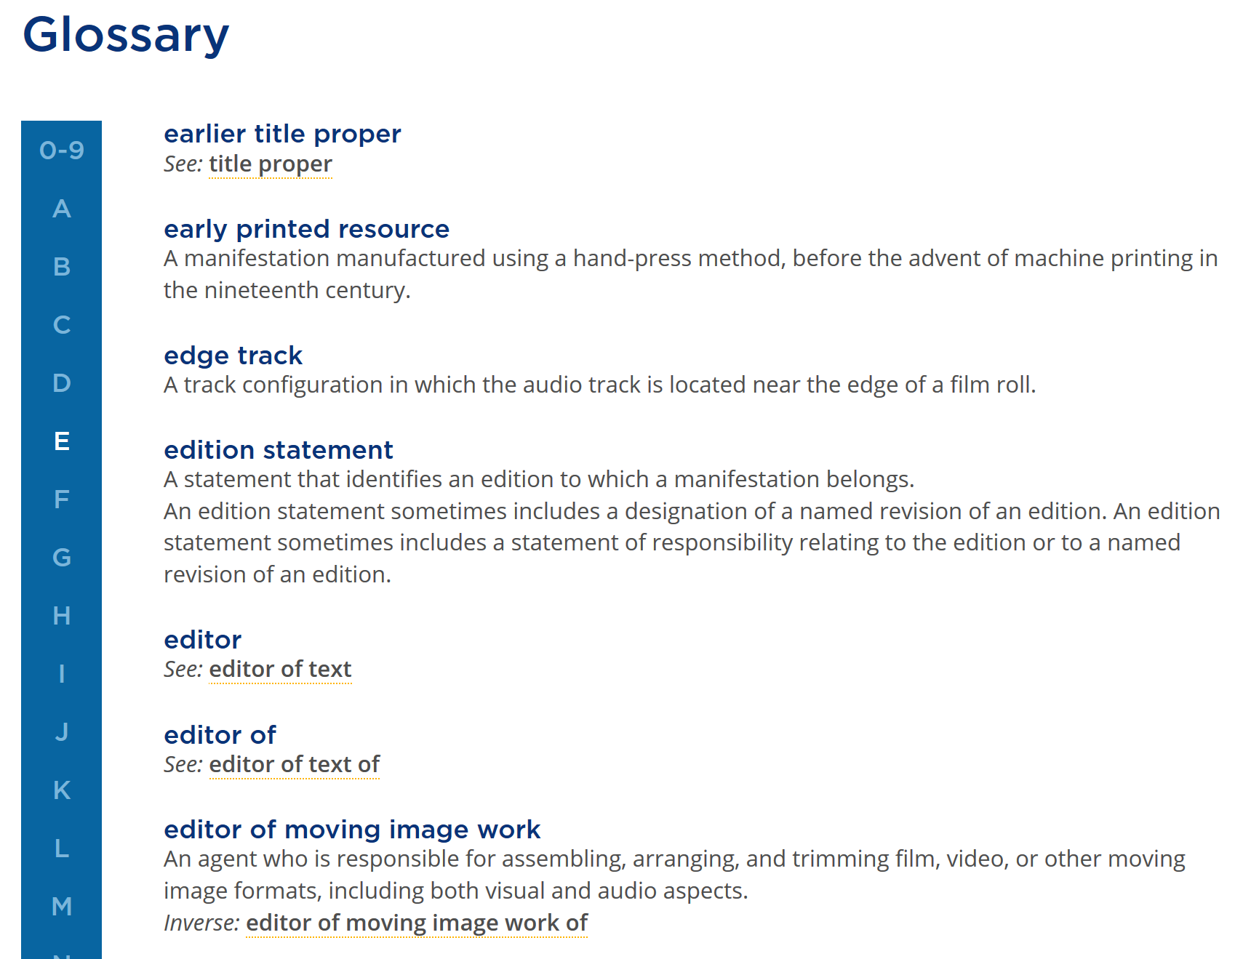

Slide 10
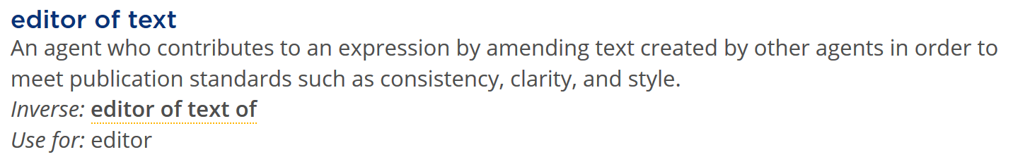
Glossary linked data
skos:label (Toolkit label) - canonical property
skos:definition (Toolkit definition) - canonical property
owl:inverse - object property
skos:altLabel - canonical property

Slide 11
Break-out of Agent roles
has author
Work
Agent
is sub-class of
Collective Agent
is sub-class of
Corporate Body
Family
Person

Slide 12
Break-out of Agent roles
Work
has author agent
Agent
Collective Agent
has author
collective agent
Corporate Body
has author
corporate body
Family
has author family
Person
has author person

Slide 13
Break-out advantages
Context of instructions
All Person relationships in Person entity chapter
Application profiles
Selection of explicit elements for persons, etc.
Consistency
Many agent elements already explicit (appellations, etc.)
Gender-inflected translations
Person break-down to male/female

Slide 14
Data provenance
Single metadata statement or set of statements is treated as a Work
Metadata work can be described using RDA
Who is the author?
When was it created?
Where did the value come from?

Slide 15
Metadata reification
has identifier for work
Work
“2049-3630”
ISSN International
Register
has source consulted

Slide 16
The numbers
13 entities
2900+ elements
Work | 587 |  | Agent | 183
Expression | 531 |  | Person | 237
Manifestation | 394 |  | Collective Agent | 187
Item | 136 |  | Corporate Body | 236
Place | 51 |  | Family | 198
Timespan | 57 |  | Nomen | 165
RDA Entity | 29
Notes:
This table shows the number of elements assigned to each entity.
RDA entity reflects the basic elements available for every entity.

Slide 17
RSC Technical Working Group
One of only two permanent (standing) RSC working groups
New RDA governance structure
Will be “revived” following stabilization of 3R content
Wider international representation
Call for participation in April/May 2019

Slide 18
Thank you

