Slide 1
RDA internationalization and application profiles: applying the global to the local
Gordon Dunsire
Presented to the CC:DA meeting, ALA Annual, Orlando, USA, June 25, 2016

Slide 2
Overview
Internationalization developments
Local choice in global RDA
Introduction to application profiles
Basic application profiles for RDA
Local terms and vocabularies
Local refinements

Slide 3
RSC Governance
JSC 2015
Edinburgh
RSC 2016
Frankfurt
CILIP
British Library
UK
Deutsche Nationalbibliothek
Europe
Now
Notes:
Changes to the structure of the RDA Steering Committee have already been made.
The representation of the UK’s Chartered Institute of Library and Information Professionals (CILIP) and of the British Library were merged to form a temporary United Kingdom community prior to the JSC meeting in Edinburgh in November 2015.
Transition to a Europe regional community will involve an additional merger with the DNB representation. This may take place on or before the next RSC meeting, scheduled to be held in Frankfurt, Germany, in November 2016.

Slide 4
User feedback
Hackathons: Jane-athons
Clarity
Consistency
Simplicity
RSC
RDA
Translation teams

Slide 5
FRBR-LRM and RDA
RDA refines LRM relationships as element sub-types (RDF sub-properties)
Any Thing:
Covers all other types of thing
Res
has appellation
Nomen
is created by
W
E
Agent
M
is type of
Place
I
Collective
agent
is associated with
is modified by
Timespan
P
F
C

Slide 6
Refinements
Coarse/General
is associated with
Res1
Res2
has creator
has artist
Fine/Specific
is associated with
Res1
Res2
is derivative (E)
is adapted as (E)
is adapted as graphic novel (E)

Slide 7
Attributes => Relationships
has manifestation
statement
Publication statement
Transcribed
has place of publication
Nomen
Place
has publisher’s name
M
C
Nomen
Recorded
Timespan
Nomen
has date of publication

Slide 8
RDA Reference
RDA element sets and value vocabularies
Linked data representations will be used to derive Toolkit data: Glossary, Relationship designators, and relevant instruction content
RDA Glossary in process of review:
To improve consistency and completeness
To consolidate sub-vocabularies
To publish all value vocabularies in OMR
Everything in Glossary should be in OMR

Slide 9
RDA Terms
Value vocabulary for specialized terms used in instructions, requiring Glossary definitions
Possibility of linking to IFLA's Multilingual Dictionary of Cataloguing (25+ languages)
Will support extension of RDA to archives and museums communities

Slide 10


RDA policy statements
Local choice of variation in general instructions

Slide 11
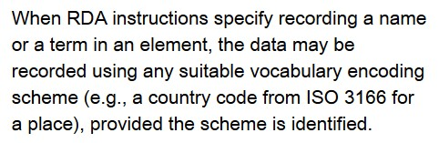
Local choice of data value vocabulary
Local option for vocabularies and terms
Vocabulary encoding scheme (VES)

Slide 12
Local choice of data value
Aggregated values (e.g. publication statement)
Components: place, name, date
"date: name (place)"?
"place (date : name)"?
"place : name, date"?
Syntax/string encoding scheme (SES)

Slide 13
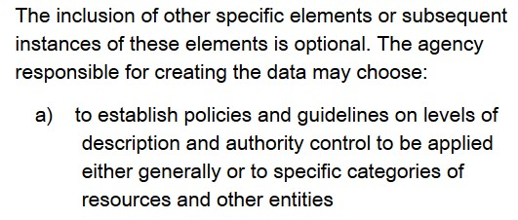
Local choice of element
Core elements are not mandatory:
"… a minimum … should include …"
Application profile (AP)

Slide 14
Application profile
Specifies each element that is used in an application, how it is aggregated into logical units of information, and if it is:
mandatory or optional
repeatable
associated with a VES
associated with an SES or datatype

Slide 15
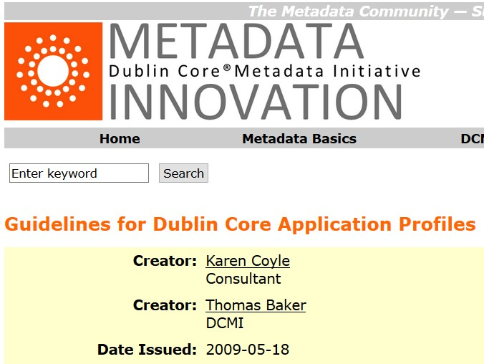
DC Application profile
"a generic construct for designing metadata records that does not require the use of metadata terms defined by DCMI"

Slide 16
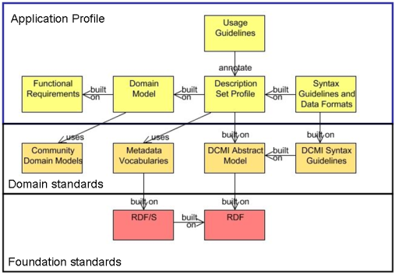
Singapore framework
RDA
Reference
RDA + Policy
statements
FRBR-LRM

Slide 17
Local Application Profile
Selects set of RDA elements for the application
Identifies locally refined elements for the application
Assigns local mandatory and repeatability status to each element
Assigns local vocabularies
Assigns local syntax encoding and datatypes

Slide 18
Very basic RDA AP: core Expression
Element | Range | Value string | String type | SES | VES | Min | Max
content type | non-literal | Yes | plain |  | RDA Content Type | 1
identifier for the expression | literal | Yes | typed | [RDA Identifier] |  | (1)
language of expression | non-literal | Yes | plain |  | ISO 639-3
scale | non-literal | Yes | typed | [RDA Scale]
Min: 1 = Mandatory
Max: 1 = Non-repeatable

Slide 19
Other basic RDA APs
Based on "core for" and "core if" conditions
Often focused on a content category
E.g. music, cartography, rare materials

Slide 20
Local AP for Expression (example)
Element | Range | Value string | String type | SES | VES | Min | Max
content type | non-literal | Yes | plain |  | Local Content Type | 1 | 1
scale | non-literal | Yes | typed | Local Scale |  | 1
Content type uses a local VES, is mandatory, and is non-repeatable
Scale uses a local SES (e.g. "1 to 25000"), is mandatory, and is repeatable

Slide 21
Semantic coherency
Element/property | Domain | Range
Unconstrained | - | -
Constrained (FRBR) | RDA/FRBR entity | -
Associated VES | RDA/FRBR entity | VES
Local | Entity sub-type | Local VES
Sub-property
ladder
Sub-classes

Slide 22
4-fold path for relating entities
Unstructured description:
"The capital city of Scotland"
Structured description/access point:
"Edinburgh (City of Edinburgh, Scotland)"
Strings
Identifier:
"N 55° 57' 7''/W 3° 11' 47''"
URI:
tgn:7009546
Thing

Slide 23
Accommodating the paths
Range of a property = type of object in a triple
Only two types of object: thing, or string
OWL (Web Ontology Language) provides two types of property:
ObjectProperty: expects a thing as the object
DatatypeProperty: expect a string as the object

Slide 24
4 paths, 2 types
Property type | Expected object | Path
Datatype | Literal | Unstructured
+ SES | Literal (typed) | Structured
+ data type | Literal (typed) | Identifier
Object | URI | URI

Slide 25
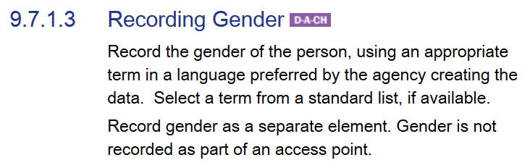
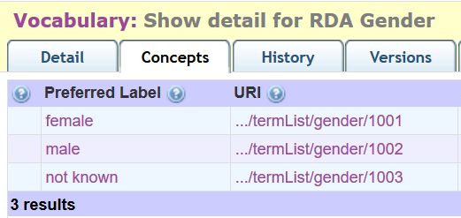
Local vocabularies
Vocabulary removed
from “global” RDA
becomes a “local” vocabulary
Notes:
RDA is being developed to support refinements and extensions to RDA elements and vocabularies for local applications.
An example is “audio belt”, proposed by the Library of Congress as a new RDA Carrier type.
This was implemented as a local RDA refinement of a basic resource category in the RDA/ONIX Framework ontology.
The new type is included in the vocabulary, and the nature of the refinement is given in a machine-readable map in the RDA Registry.

Slide 26
Local AP for gender
Element | Range | Value string | String type | SES | VES | Min | Max
gender | non-literal | Yes | typed |  | ALA Gender |  | 1
Gender uses a local VES (ALA), is not mandatory, and is non-repeatable

Slide 27
Another gender issue
Gender distinctions in roles (relationship designators) have largely disappeared in Anglophone countries: "actor" is gender-neutral
But this is not the case in many other languages: "acteur" is male; "actrice" is female
Translations make a compromise and use the male form, but this looks strange to metadata users

Slide 28
Local refinements to vocabulary terms
RDA
actor
Person
Sub-property
Sub-class
Local
acteur
actrice
Male
Female
Range

Slide 29
Conclusion
Accommodating the local in the global
Accommodating national practice in an international framework
Presenting global data in local applications
Focusing on the individual in the crowd

Slide 30
Questions?
rscchair@rdatoolkit.org
RSC website
http://www.rda-rsc.org/
RDA Toolkit
http://www.rdatoolkit.org/
RDA Registry
http://www.rdaregistry.info/
RDA data, Jane-athons, etc.
http://www.rballs.info/

