Slide 1
RDA in a non-MARC environment
Gordon Dunsire
Presented at 22nd Annual Conference and Exhibition of the Special Libraries Association/Arabian Gulf Chapter, Kuwait, 19 April 2016

Slide 2
RDA: resource description and access
“RDA is a package of data elements, guidelines, and instructions for creating library and cultural heritage resource metadata that are well-formed according to international models for user-focussed linked data applications.”
RDA Board, 2015
http://www.rda-rsc.org/node/235
Notes:
The RDA Board, formerly the Committee of Principals for RDA, made this statement as part of an announcement affirming commitment to the internationalisation of RDA: resource description and access.

Slide 3
RDA in Resource Description Format
RDA controlled terminologies represented as RDF value vocabularies
Example: RDA carrier type vocabulary
Entities, attributes, and relationships represented as RDF element sets
Entities represented in RDF as classes
Attributes and relationships represented in RDF as properties (“predicates”)
Example: RDA manifestation properties

Slide 4
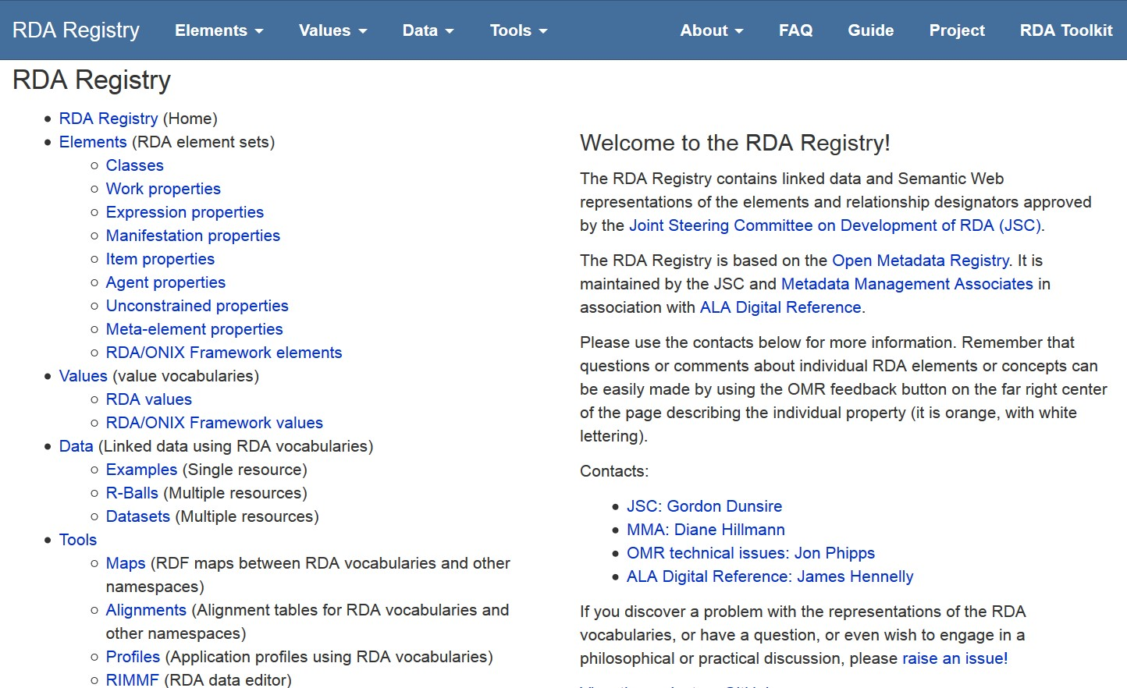
RDA Registry: rdaregistry.info
RDA Reference
Elements, attributes, relationships
Values
Other Glossary terms
Translations and partial translations
Notes:
The RDA Registry provides access to linked data versions of the RDA element sets and value vocabularies.
The Registry also provides access to tools for creating and editing RDA data and making it interoperate with non-RDA and non-FRBR applications.

Slide 5
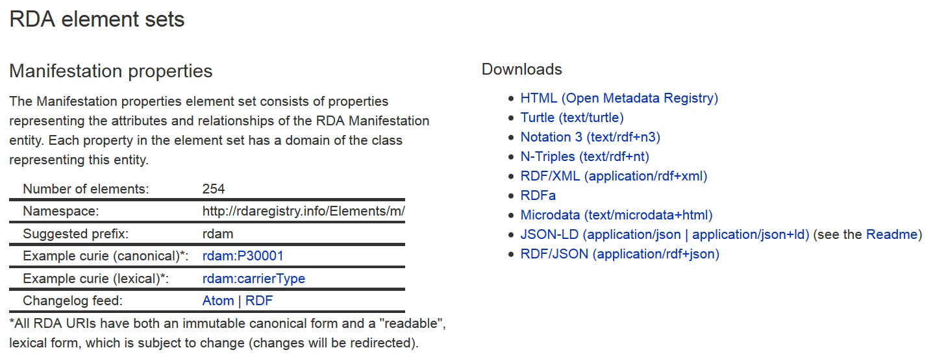
Except HTML for humans
RDF linked data serializations
Formal or canonical URI is “opaque”
- not intended for human readability
Lexical URI is intended for human readability
in different languages
Notes:
RDA URIs are opaque and do not hint at their meaning or semantics. This avoids issues of language and changes of label.
RDA has developed lexical URIs that can be “read” more easily by developers. These can be in any language; the lexical URIs are automatically linked to the canonical URI.
Each RDA element set and value vocabulary can be freely downloaded in different versions or serializations of RDF.
Human-readable versions are available in the Open Metadata Registry

Slide 6
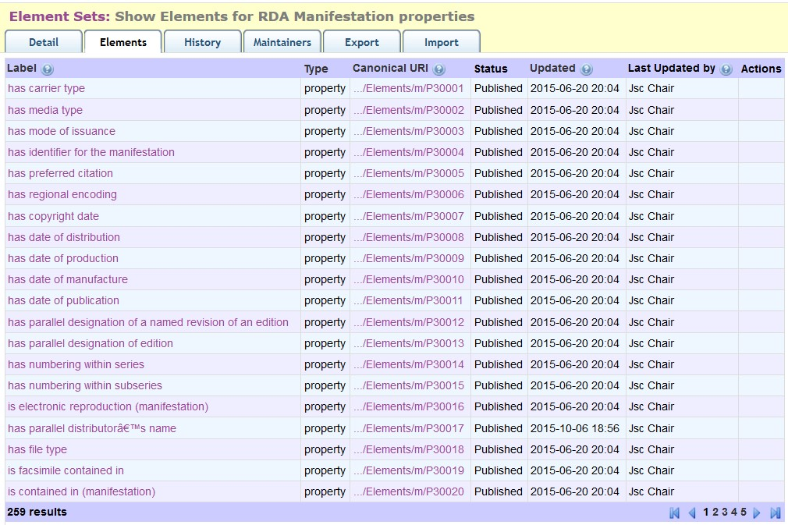
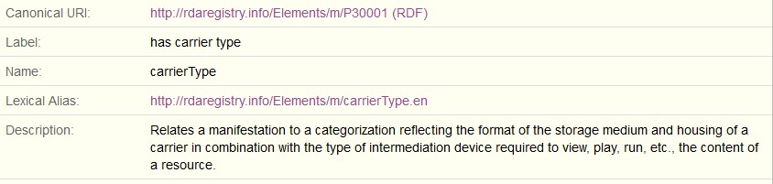
Open Metadata Registry (http://metadataregistry.org)
Web view
Fine granularity audit trail
Notes:
This is a partial screen-shot of the first page of the Manifestation element set in the OMR.
The interface provides standard browse and search facilities.
Clicking on an element reveals more data about the element.
The OMR maintains an audit trail at the level of each transaction on each element, dated and attributed.

Slide 7
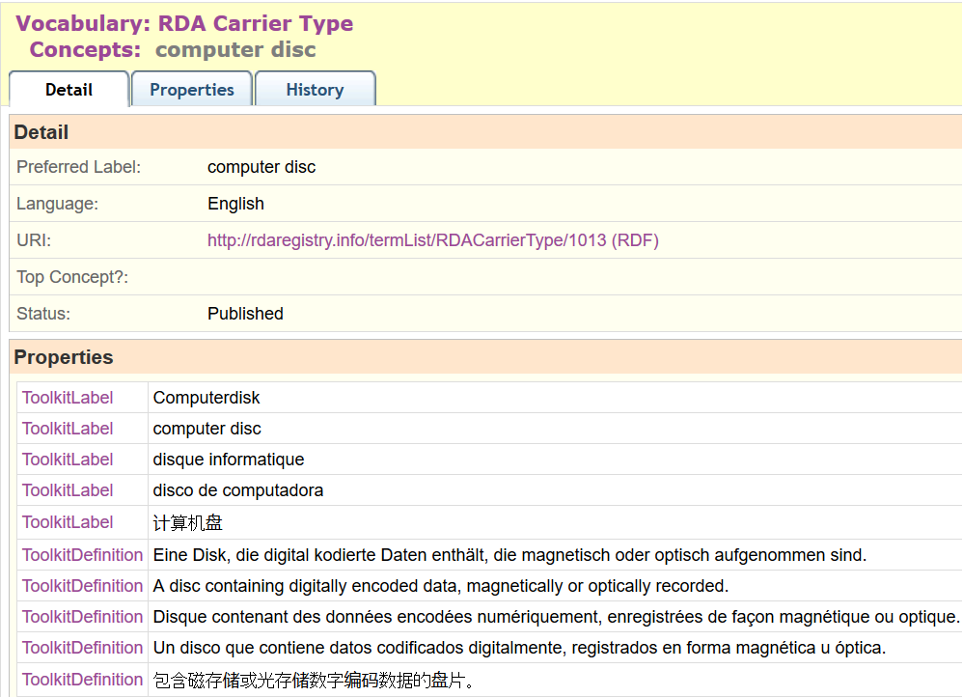
Multilingual linked data
French
German
Spanish
Chinese
[Arabic]
…
Notes:
This is a partial screen-shot of the OMR view of the RDA Media type “microform”.
The term label, definition, and scope note in multiple languages are linked to the URI for the term. This basic feature of RDF, the separation of strings (labels, etc.) from things (URIs), is fully exploited by the RDA Registry.
Value vocabularies are represented using SKOS (Simple Knowledge Organization System) elements. SKOS allows one preferred label per language, and as many definitions and notes as are required. RDA uses SKOS elements for broader, narrower, and term or concept equivalence to represent semantic hierarchies and maps.
The RDA Toolkit is currently available in French, German, and Spanish, with Finnish and Italian translations scheduled for the next series of updates. A separate translation is published in China. The RDA Translations Policy requires all full translations of the Toolkit to be represented in linked data format in the Registry.
Partial translations covering the RDA Reference data of element sets and value vocabularies will also be added to the Registry.

Slide 8
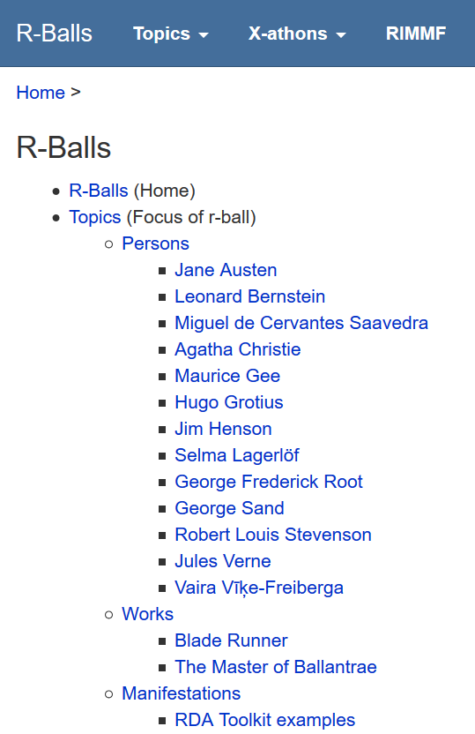
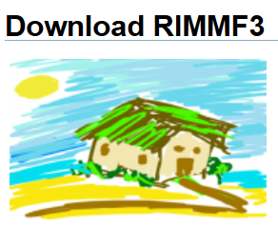
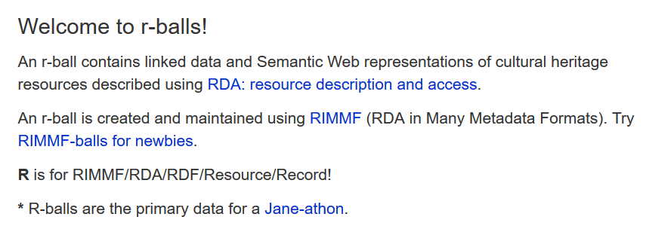
http://rballs.info
RDA data: r-balls

Slide 9
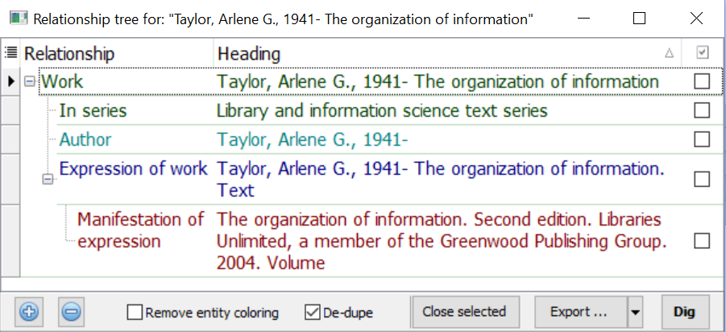

Slide 10
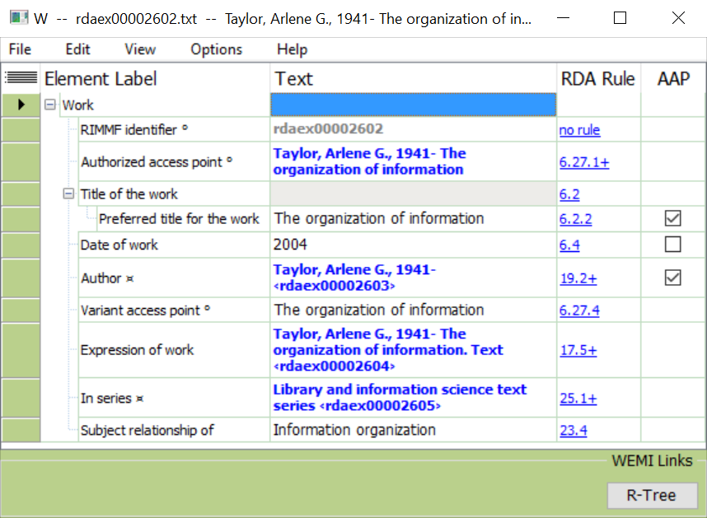
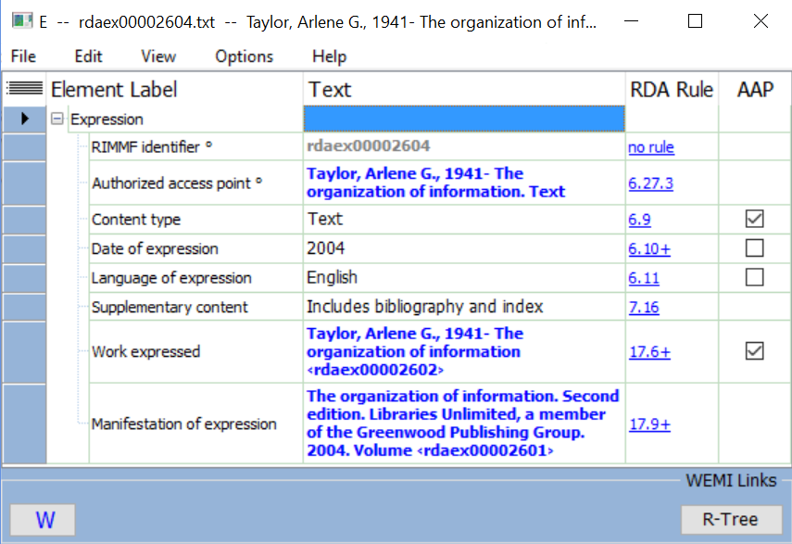
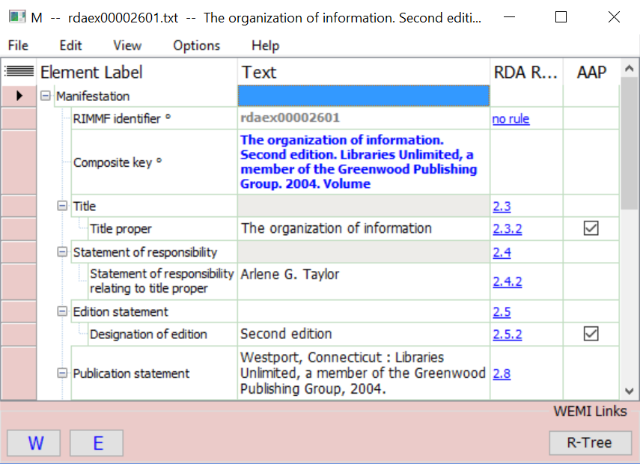

Slide 11
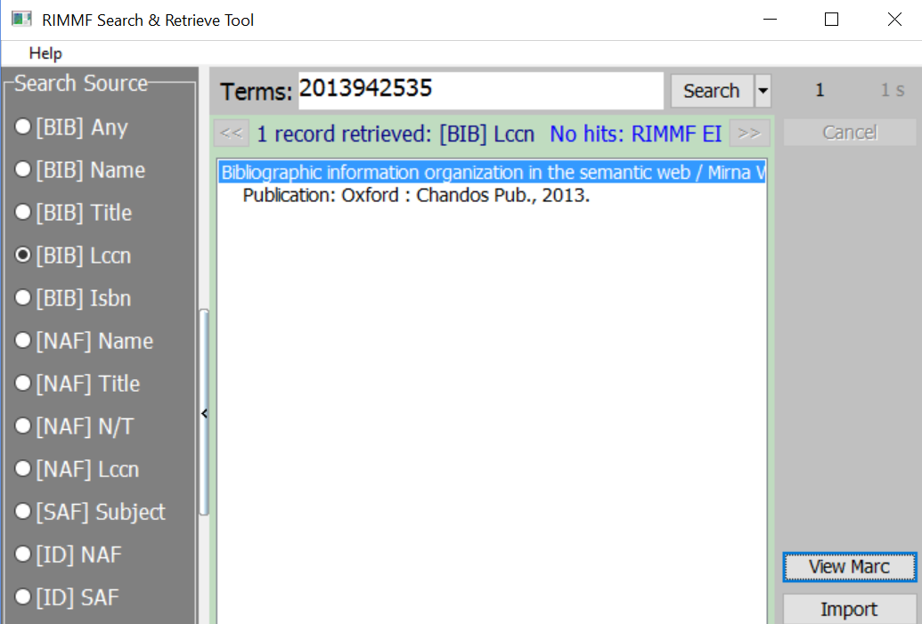
RIMMF import from Library of Congress MARC21 catalogue

Slide 12
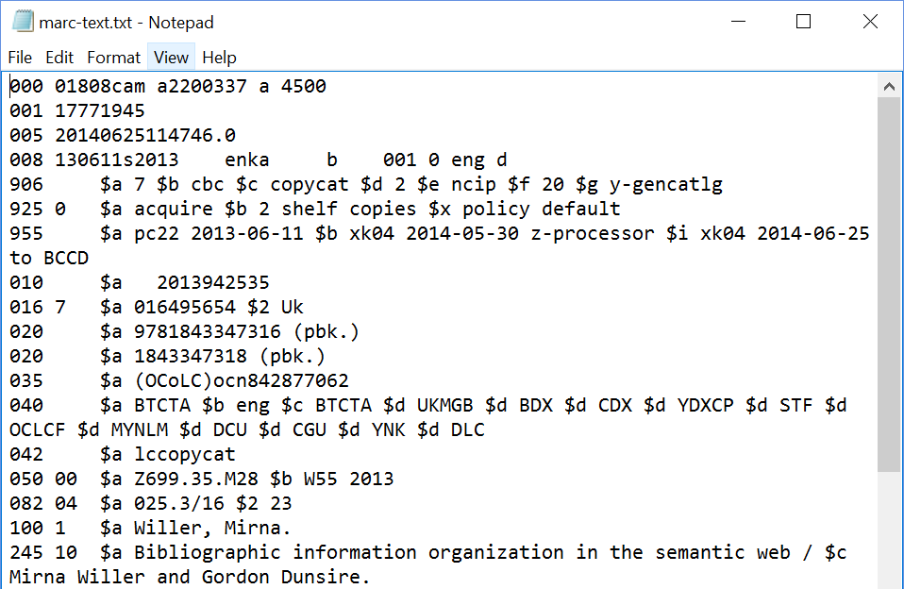
MARC21 record

Slide 13
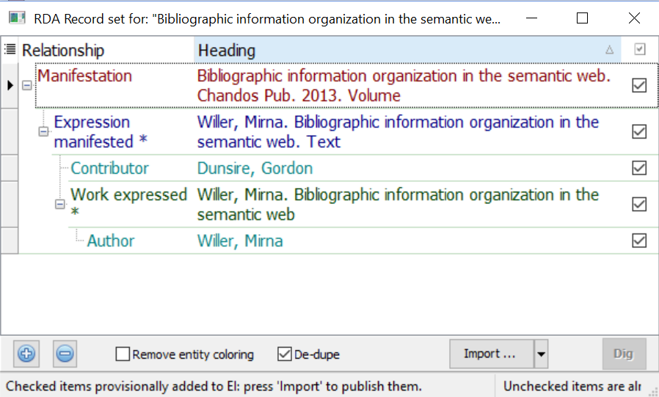
RIMMF FRBRizes MARC21 record to RDA data set

Slide 14
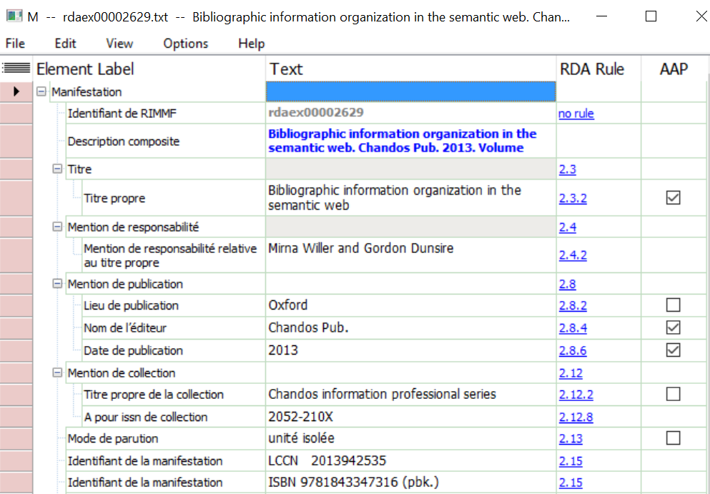
RIMMF interface switched to French translation of Registry

Slide 15
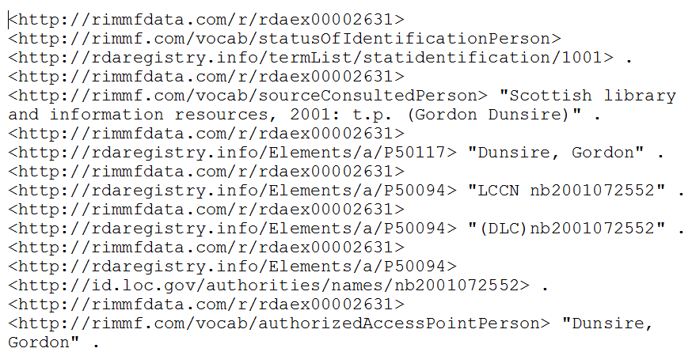
RIMMF exports linked data: RDF N-triples

Slide 16
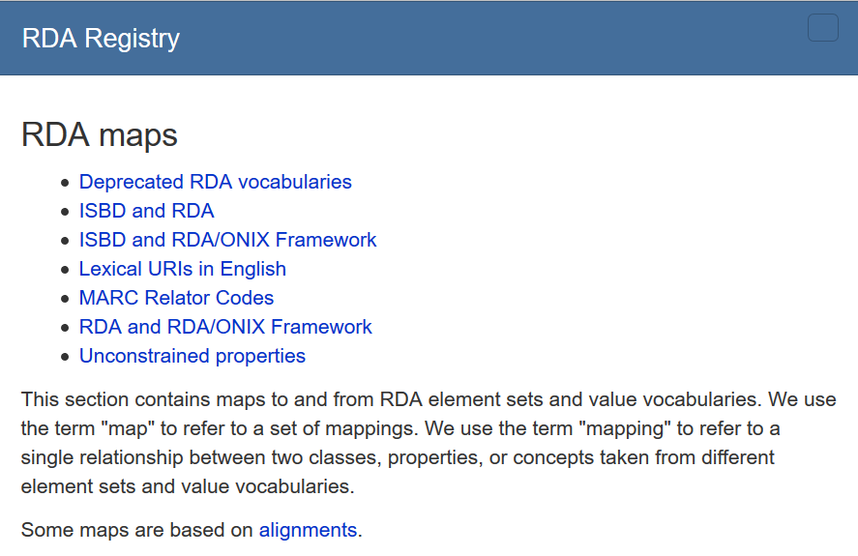
Multi-schema linked data
Linking RDA to:
ISBD
MARC21
RDA/ONIX Framework
…

Slide 17
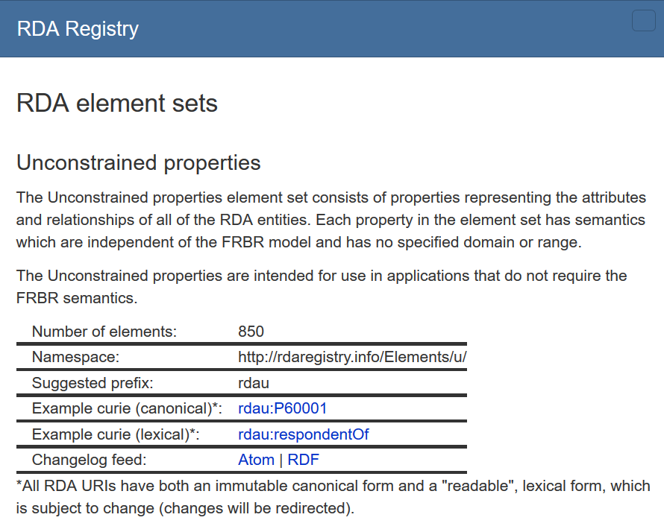
Unconstrained linked data
Example: Contributor
Relates a resource to an agent contributing to a resource.
Remove FRBR model to
“dumb-down”
semantics to common level of granularity
“resources” and “agents”

Slide 18
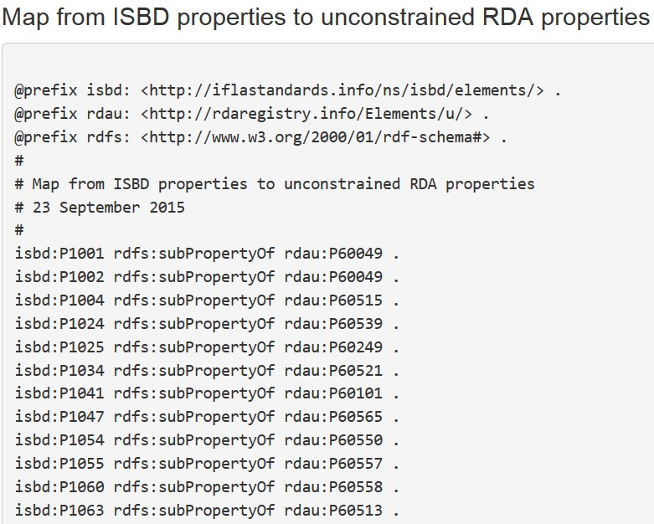
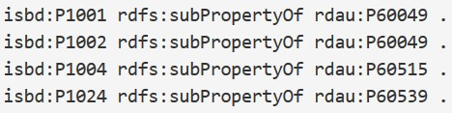
Beyond RDA data: ISBD
[Linked data cloud, not RDF graph]
Unconstrained
(No entity
Specified)
RDAU
ISBDU
RDA
ISBD
Work
Expression
Manifestation
Item
Resource
Notes:
The RDA Registry contains an element set that is not tied to the RDA entities. The “unconstrained” elements parallel the RDA elements but have general definitions, so they can be used by applications that do not require the finer granularity and semantics of RDA and FRBR.
This allows RDA data to interoperate with data from another community. For example, there is an agreed alignment between ISBD (International Standard Bibliographic Description) elements and RDA elements. The alignment is the basis of a set of linked data maps between ISBD and RDA data.
The diagram shows the maps between the RDA and ISBD element sets and their unconstrained versions. The maps preserve semantic coherence by removing the information about RDA’s WEMI entities and ISBD’s Resource entity; the semantic relationship between these entities is not simple and direct.
The diagram is part of the “linked data cloud” of RDF maps, and is not itself an RDF graph. For example, the map between ISBD and the unconstrained RDA elements represented by a single line is an RDF graph, the first part of which is shown.

Slide 19
Does BIBFRAME fit here?
Semantic map of manifestation carrier type
element
dc:
format
dct:
format
schema:
encoding
rdau:
P60050
m21:
M338__b
rdam:
P30002
isbd:
P1003
rdam:
P30001

Slide 20
Thank you!
rscchair@rdatoolkit.org
http://www.rda-rsc.org/ [RDA Steering Committee]
http://www.rdaregistry.info/
http://metadataregistry.org/
http://www.marcofquality.com/wiki/rimmf3/

