Slide 1
RDA Governance and strategy
Gordon Dunsire
[based on a presentation by Simon Berney-Edwards]
Presented to EURIG 2017, Florence, Italy

Slide 2
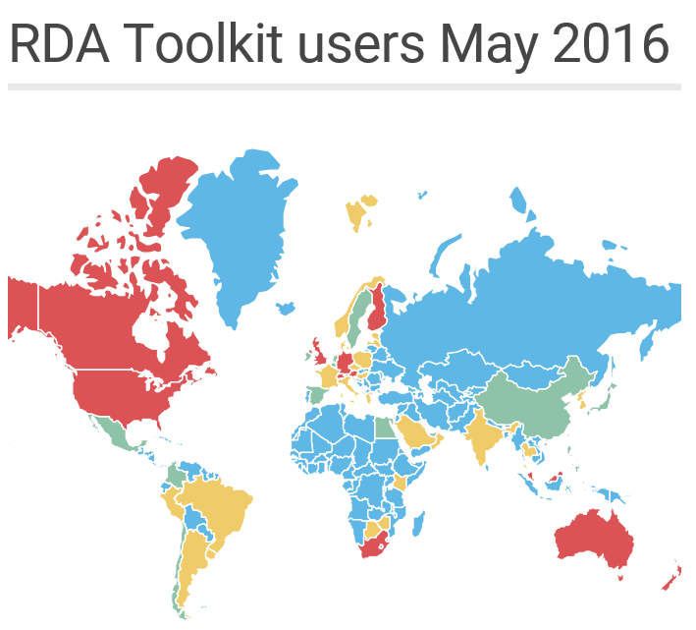
0
1-10
11-100
101 +

Slide 3
The journey so far….
Initial review
Discussions in the regions
CoP agree vision, strategy and need for Governance Review
Launch new governance model branding
First set of Board and RSC appointments
Stakeholder consultation
CoP approve overall Governance model
Board approve selection and transition requirements
2013
2014
2015
2016

Slide 4
Governance Model Overview
RDA Board
RDA Steering Committee
Permanent Working Groups
Task and Finish Working Groups
RDA Board Working Groups
Co-Publishers / Fund Trustees
Task and Finish Working Groups

Slide 5

RDA Steering Committee
Steering Committee Secretary
Examples Editor
Technical Team Liaison Officer
Translations Team Liaison Officer
Wider Community Engagement Officer
Translations Working Group
Africa
ALA Publishing Rep
6 x Regional Representatives
Chair of RDA Steering Committee
Technical Working Group
Latin America and The Caribbean
North America
Asia
Europe
Oceania
Chair of RDA Board
Task and Finish working groups
Aggregates
Capitalisation
Music
Places
RDA/ONIX
Relationship Designators
Fictitious Entities
Archives

Slide 6
Selection process
Who? | Selection Process
RSC Chair | Application and Selection
Examples Editor
Technical Liaison Officer
Translations Team Liaison Officer
Wider Community Engagement Officer
Regional Representatives | Appointed by Regional Body*
Secretary | Post-holder
Chair of RDA Board
ALA Publishing Representative
* Regional representatives will be nominated by the body selected by the RDA Board to represent the region and ratified by the RSC Chair.
Must serve for a minimum of two years
Must work for an institution that has implemented RDA
Must have expert knowledge of RDA

Slide 7
Rotating RSC Roles
Role | 2016 | 2017 | 2018 | 2019 | 2020 | 2021 | 2022 | 2023 | 2024 | 2025
Chair of RSC
Wider Community Engagement Officer
Technical Team Liaison Officer
Examples Editor
Translations Team Liaison Officer
Gordon Dunsire: 2014-18
4 years: 2019-22
4 years: 2023-26
VACANT: 2017-20
4 years: 2021-24
4 yrs...
VACANCY FROZEN until 3R completion: 2017-21
4 years: 2022-25
Kate James: 2015-18
4 years: 2019-22
4 years: 2023-26
Daniel Paradis: 2017-2019
4 years: 2020-23
4 years: 2024-27
Selection process

Slide 8
RSC Core roles
Role | 2016 | 2017 | 2018 | 2019
Secretary
ALA Publishing Rep
Chair of RDA Board
Judy Kuhagen
Recruit
Linda Barnhart
James Hennelly
Simon Berney-Edwards
Current Chair of RDA Board

Slide 9
Regional Representatives
Role | 2016 | 2017 | 2018 | 2019
Africa
Asia
Europe
Latin America and the Caribbean
North America
Oceania
Work with key stakeholders in the region to identify a suitable representative body
Work with key stakeholders in the region to identify a suitable representative body
Transition to EURIG
EURIG (DNB rep until 2018)
Work with key stakeholders in the region to identify a suitable representative body
CC:DA / CCC / LoC Reps
Transition timescale TBC
Develop new network
New North American RDA Community (ask for a current rep until 2019)
ACOC Rep
Transition timescale TBC
Develop new network
New Oceania RDA Community (ACOC rep until 2019)

Slide 10
RSC+ (plus)
One-year "experiment" to evolve responsibilities in new governance structure
RSC + Chairs of working groups
Will take part in 2 RSC executive meetings (May: Chicago; October: Madrid)
And all 3R Project discussions
Project wiki
Act as liaisons with communities and groups

Slide 11
RDA administration
Policy documents updated
New FAQ web page
New section of website with selected presentations, etc.

Slide 12
Thank you!
rscchair@rdatoolkit.org
http://access.rdatoolkit.org/
http://www.rdaregistry.info/
http://www.rda-rsc.org/

