Slide 1
RDA: international linked data for cultural heritage resources
Gordon Dunsire
Presented to ALCTS/LITA session, ALA Annual, Orlando, USA, June 25, 2016

Slide 2
RDA data
“RDA is a package of data elements, guidelines, and instructions for creating library and cultural heritage resource metadata that are well-formed according to international models for user-focussed linked data applications.”
RDA Toolkit provides the user-focussed elements, guidelines, and instructions.
RDA Registry provides the infrastructure for well-formed, linked, RDA data applications. Open Metadata Registry (OMR) provides linked data representation of RDA elements.
Notes:
The RDA data ecosystem is summed up in this sentence introducing the RDA Board’s announcement of RDA’s strategic directions.
The RDA package is delivered by an infrastructure of two interacting services.
The human-facing components, including the guidelines and instructions, are the Toolkit.
The data-facing components are contained in the Registry.
Applying the data capture and storage techniques in RDA Toolkit to the data architecture in the RDA Registry produces well-formed data for RDA applications.

Slide 3
Contexts (2-3 years)
Governance transition from Anglo-American to international communities
FRBR Library Reference Model and other international standards (IFLA, ISSN, …)
Toolkit review and re-organization

Slide 4
FRBR-LRM and RDA
LRM is “a high-level conceptual model … intended as a guide or basis on which to elaborate cataloguing rules”
RDA guidance, instructions, elements
“operates at a greater level of generality than FRBRoo, which seeks to be comparable in terms of generality with CIDOC CRM”
RDA cultural heritage communities
“this model is developed very much with semantic web technologies in mind”
RDA linked data communities

Slide 5
RDA refines LRM relationships as element sub-types (RDF sub-properties)
FRBR-LRM and RDA entities
Any Thing:
Covers all other types of thing
Res
has appellation
Nomen
is created by
W
E
Agent
M
is type of
Place
I
Collective
agent
is associated with
is modified by
Timespan
P
F
C

Slide 6
Refinement
Coarse/General
is associated with
Res1
Res2
has creator
has artist
Fine/Specific
is associated with
Res1
Res2
is derivative (E)
is adapted as (E)
is adapted as graphic novel (E)

Slide 7
Translations and multilingual RDA
The RDA Translations policy requires translations of RDA Reference:
Element set and value vocabulary labels, definitions, and scope notes
Linked data version of RDA Reference is available from the OMR and RDA Registry

Slide 8
Translations of RDA
RDA
Translations Policy
In process (in RDA Toolkit):
Finnish
Italian
Translations in
RDA Registry:
German
French
Spanish
Chinese
In process (for RDA Reference):
Arabic
Dutch
Swedish
Chinese
+ …

Slide 9
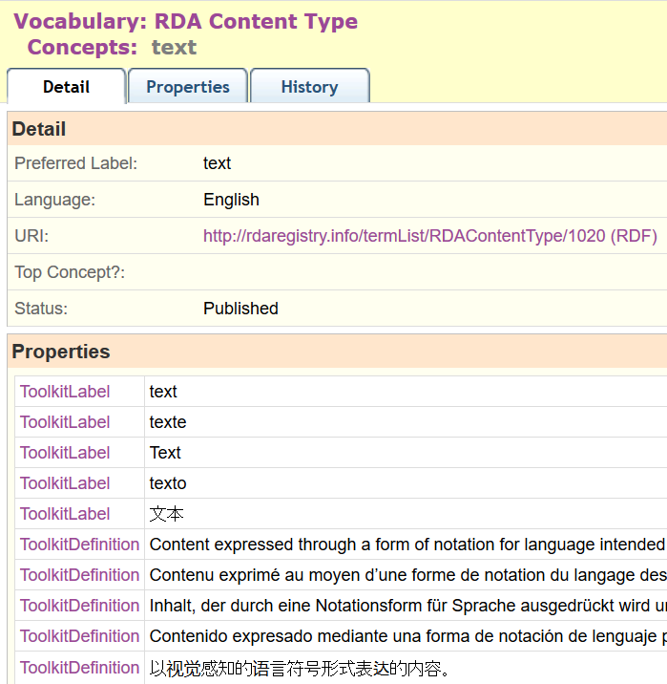
Semantic
Web

Slide 10
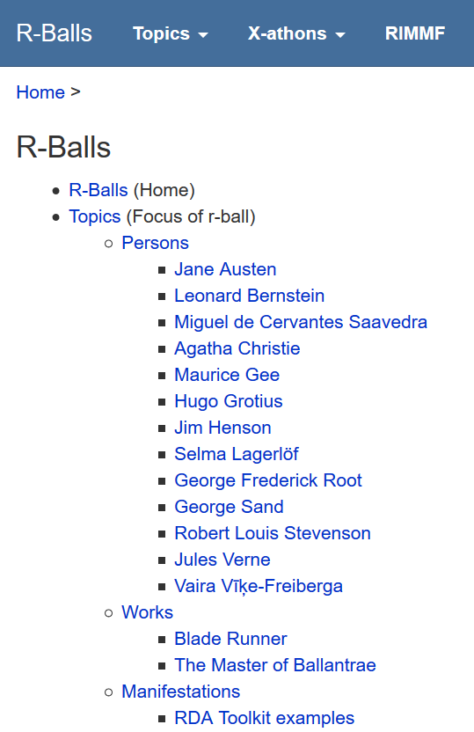
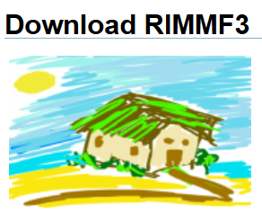
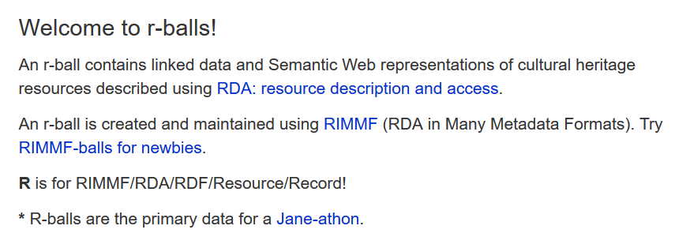
http://rballs.info
RDA data: r-balls

Slide 11
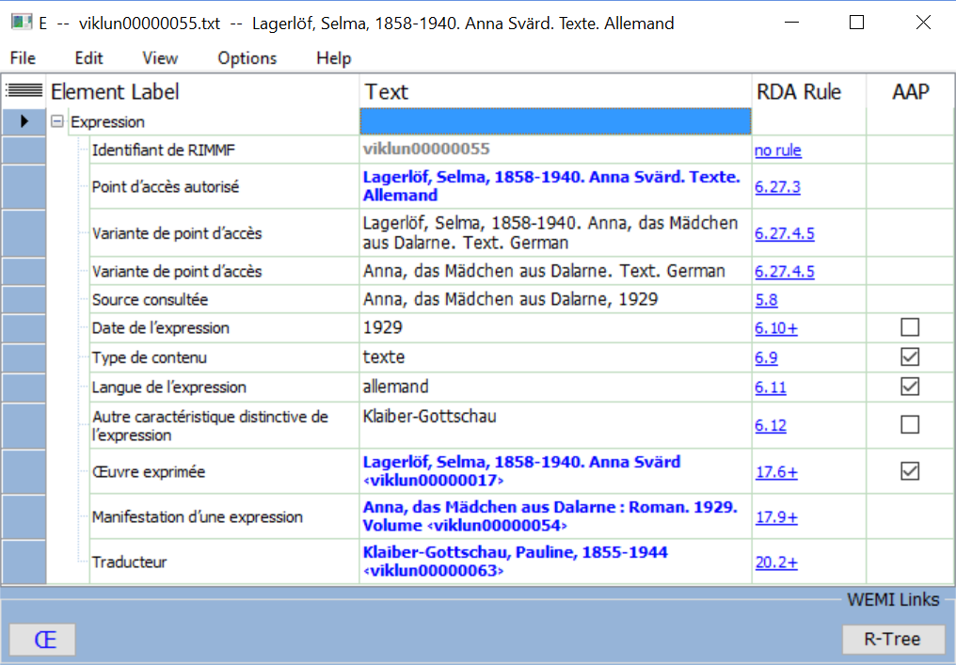
Global data
Swedish work
German translation
French cataloguer

Slide 12
RDA linked data projects in Europe
National Libraries:
British Library
Bibliothèque national de France
Biblioteca Nacional de España
Kungliga biblioteket (Sweden)

Slide 13
Global fun with RDA: the jane-athons
Jane-athon: A hackathon for RDA data using RIMMF
ALA Midwinter 2015: topic: Jane Austen and her works
Wellington (New Zealand)
Edinburgh (Scotland)
Madrid (Spain)
Stockholm (Sweden)
USA (x5)
Paris (France)
London (England)
Riga (Latvia)
The Hague (The Netherlands)
Frankfurt (Germany)
Helsinki (Finland)

Slide 14
The challenge
Building the global from the local is essential
But the global infrastructure needs coordination
Who, when, how?
Triples store(s) for data
Maps between element sets
Maps between value vocabularies
Data triple maintenance services
Linked data catalogues

Slide 15
Thank you!
rscchair@rdatoolkit.org
RSC website
http://www.rda-rsc.org/
RDA Toolkit
http://www.rdatoolkit.org/
RDA Registry
http://www.rdaregistry.info/
RDA data, Jane-athons, etc.
http://www.rballs.info/

