Slide 1
RDA progress on governance and strategy
Gordon Dunsire
Chair, RDA Steering Committee
Presented to RDA Forum, ALA Midwinter 2016, 9 January 2016, Boston, USA

Slide 2
Progress on RDA governance
November 6, 2015: Change of name
Committee of Principals
For RDA
(CoP)
RDA Board
Joint Steering Committee
For Development of RDA
(JSC)
RDA
Steering Committee
(RSC)
http://www.rda-rsc.org/
Notes:
The Committee of Principals and Joint Steering Committee changed names in November 2015.

Slide 3
Notes:
These changes have been applied to the Steering Committee’s website.
The website now accommodates web pages for the RDA Board.

Slide 4
RDA Steering Committee - Europe
JSC 2015
Edinburgh
RSC 2016
Frankfurt
CILIP
British Library
UK
Deutsche Nationalbibliothek
Europe
Notes:
Changes to the structure of the RDA Steering Committee have already been made.
The representation of the UK’s Chartered Institute of Library and Information Professionals (CILIP) and of the British Library were merged to form a temporary United Kingdom community prior to the JSC meeting in Edinburgh in November 2015.
Transition to a Europe regional community will involve an additional merger with the DNB representation. This may take place on or before the next RSC meeting, scheduled to be held in Frankfurt, Germany, in November 2016.

Slide 5
RDA Steering Committee
North America
Europe
Asia
Chair of RDA Board
Latin America
& the Caribbean
Africa
Oceania
ALA Publishing
Chair
Technical Team Liaison
Secretary
Translations Team Liaison
Examples Editor
Wider Community Engagement
Notes:
This is the final structure of the RSC.
Members marked in blue are already in place.
Members marked in gray have clear transition paths.
The other members are in preliminary stages of transition planning.

Slide 6
RDA Working Groups
Standing
Working Groups→
Technical
Translations
Aggregates
Music
←Task and Finish
Working Groups
Archives
Places
Capitalization Instructions
Rare materials
Fictitious Entities
RDA/ONIX Framework
Relationship Designators
Notes:
Working groups marked in green are active.
A new Rare Materials Working Group is about to be implemented.
This has taken priority over the new Archives Working Group, which is in the preliminary stages of planning.

Slide 7
Progress on RDA strategy
3 targets:
International communities
Cultural heritage communities
Linked data communities
RDA is a package of data elements, guidelines, and instructions for creating library and cultural heritage resource metadata that are well-formed according to international models for user-focussed linked data applications.

Slide 8
Contexts (next 2-3 years)
Governance transition
FRBR Library Reference Model
International standards (IFLA, ISSN, …)
Toolkit review and re-organization

Slide 9
Some specific activities
International integration
Local refinement of elements and values
Base ontologies and models
Provenance

Slide 10
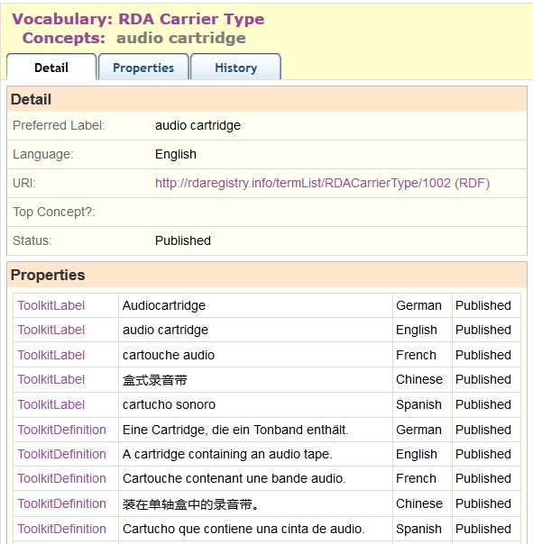
International
integration
RDA
Translations Policy
Translations in
RDA Registry:
German
French
Spanish
Chinese
Notes:
The new RDA Translations Policy requires Toolkit translations of RDA Reference (the labels and definitions of RDA entities, elements, and vocabularies) to be added to the RDA Registry, and encourages the addition of translations from outside the Toolkit.
As a result, the value vocabularies in the RDA Registry are now available in Chinese, French, German, and Spanish (as well as English).
This examples demonstrates how a single linked data URI for an RDA carrier type can be associated with multiple labels and definitions in different languages.
This allows applications to automatically interoperate data from national agencies using different languages.

Slide 11
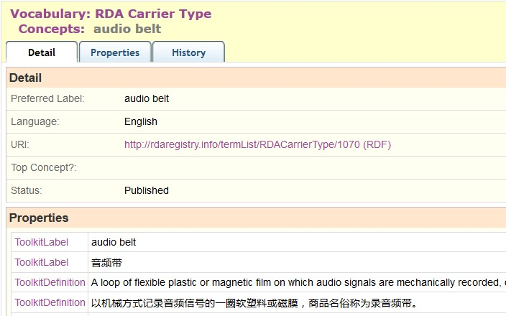
Local
refinement
“audio belt”: refinement to Carrier type
via RDA/ONIX Framework
Notes:
RDA is being developed to support refinements and extensions to RDA elements and vocabularies for local applications.
An example is “audio belt”, proposed by the Library of Congress as a new RDA Carrier type.
This was implemented as a local RDA refinement of a basic resource category in the RDA/ONIX Framework ontology.
The new type is included in the vocabulary, and the nature of the refinement is given in a machine-readable map in the RDA Registry.

Slide 12
Base
ontologies
RDA/ONIX Framework: basis for
all RDA carrier and content types
http://rdaregistry.info/Elements/rof/C10004
reg:hasSubClass <http://rdaregistry.info/Elements/rof/C10009> ;
reg:lexicalAlias "http://rdaregistry.info/Elements/rof/CarrierCategory"@en ;
reg:name "CarrierCategory"@en ;
reg:status <http://metadataregistry.org/uri/RegStatus/1001> ;
a owl:Class ;
rdfs:isDefinedBy <http://rdaregistry.info/rof/Elements/> ;
rdfs:label "Carrier category"@en ;
rdfs:subClassOf <http://rdaregistry.info/Elements/rof/C10006> ;
skos:definition "A class of resources defined in terms of specific values for one or more attributes of the means and methods by which content is conveyed."@en .
Under investigation:
FRBR-LRM = FRBRoo < CIDOC CRM
Notes:
The Framework ontology is the basis for all of the RDA carrier and content types that determine the clear distinction between content and carrier.
It is available in machine-readable linked data format, as the example shows.
The RDA Steering Committee and working groups are investigating the impact of changes to the FRBR model and associated ontology. The new FRBR Library Reference Model is compatible with the object-oriented FRBR extension to the CIDOC Conceptual Reference Model developed for the museum community. This may support the development of RDA for the cultural heritage communities.

Slide 13
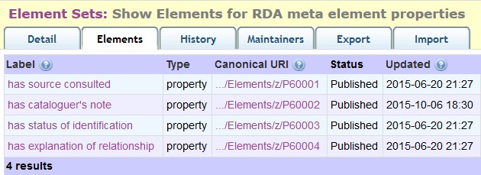
Provenance
RDA meta-elements:
data about metadata
In process:
Clarification of Note elements
(about the data vs additional data)
Expansion to all or most RDA elements
Notes:
The treatment of provenance data, or data about the metadata, has always been problematic in RDA. It is problematic in general, for all metadata communities.
Some of the RDA elements for provenance – providing information about the value recorded in an element – have been published in the RDA Registry. Work is being undertaken to distinguish between note elements that provide additional data for the value of the associated element, and those that are about the value of the associated element – that is, provenance.
The application of provenance elements to all or most RDA elements is also under investigation.

Slide 14
Engagement
Membership of RSC Working Groups
RDA Development Forum
Community representation on RDA Steering Committee
Community representation on RDA Board
Email and issue discussion on RDA-L and RDA Vocabularies Github project
Jane-athons!
Notes:
The RDA strategy depends on the active participation of the RDA communities and their individual members.
There are many ways of participating and engaging in the RDA process, to suit all interests and capabilities.

Slide 15
Thank you
jschair@rdatoolkit.org
RSC website
http://www.rda-rsc.org/
RDA Toolkit
http://www.rdatoolkit.org/
RDA Registry
http://www.rdaregistry.info/
RDA data, Jane-athons, etc.
http://www.rballs.info/

