Slide 1
RDA for linked data
Gordon Dunsire
Presented to CILIP Linked Data Executive Briefing
24 November 2015, London

Slide 2
RDA: resource description and access
“RDA is a package of data elements, guidelines, and instructions for creating library and cultural heritage resource metadata that are well-formed according to international models for user-focussed linked data applications.”
RDA Board, 2015
http://www.rda-rsc.org/node/235
Co-published by CILIP
Notes:
The RDA Board, formerly the Committee of Principals for RDA, made this statement as part of an announcement affirming commitment to the internationalisation of RDA: resource description and access.

Slide 3
International models
FRBR (IFLA)
FRBR/FRAD/FRSAD → FRBR-LRM (Library Reference Model)
FRBRoo ← CIDOC-CRM (Conceptual Reference Model)
Resource Description Framework (RDF)
←Dublin Core Abstract Model (DCMI)
Notes:
RDA is based on international data models.
The Functional Requirements for Bibliographic Records (FRBR) models, developed by the International Federation of Library Associations and Services (IFLA), identify the basic entities and relationships required to meet user tasks in library resource discovery. The three original models are being consolidated into a single Library Reference Model. The new model will be compatible with an extension of the object-oriented model developed for museum data, the Conceptual Reference Model.
Data produced using the RDA instructions is intended to be well-formed according to the Dublin Core Abstract Model (DCAM) developed by the Dublin Core Metadata Initiative. The model has subsequently been instantiated in Resource Description Framework (RDF), the basis of linked data and the Semantic Web.

Slide 4
RDA entities
FRBR Work-Expression-Manifestation-Item
Discrete components of a resource; avoids duplication of data
E.g. Work creator and Expression language are linked to, not copied in, multiple Manifestation descriptions
E.g. printed book, digitized book, and e-book
FRBR Person, Family, and Corporate Body
Agents related to a resource
FRBR-LRM introduces new entities for Place, Timespan, and Nomen (name) [expected 2016]
Notes:
RDA entities correspond to two groups of FRBR entities.
The first group includes Work, Expression, Manifestation, and Item entities. They represent layers of abstraction, and therefore commonality of data, from the individual item to the abstract conception behind its creation. Data for a Work entity can be linked to multiple Expressions, including translations. Each Expression can be linked to multiple Manifestations, including different print and digital formats, and each Manifestation may have multiple Items.
The second group includes three types of human entity that can be related to the WEMI aspects of a resource. For example, a Person can create a Work, or translate an Expression; a Corporate Body can publish a Manifestation; a Family can donate an Item to a rare books collection.
The Library Reference Model is likely to introduce new entities for Place and Timespan, to cover relationships such as date and place of birth of a Person. The entity Nomen will support linked data for names, titles, access points, and identifiers. The final version of the LRM is expected to be available later in 2016.

Slide 5
Distinct RDA Entities
Work
One and
only one
Person
Expression
Family
Agent
Manifestation
Corporate Body
One or
more
Item
Primary/high-level relationships
Notes:
This is the basic high-level diagram of the current RDA entities and their relationships.
The cardinality of the WEMI relationships ensures coherency while minimising duplication by creating Expression/Work and Item/Manifestation data pairs.
Any type of agent entity can be related to any aspect of a resource.
The broad, high-level relationships are refined by specific RDA elements.

Slide 6
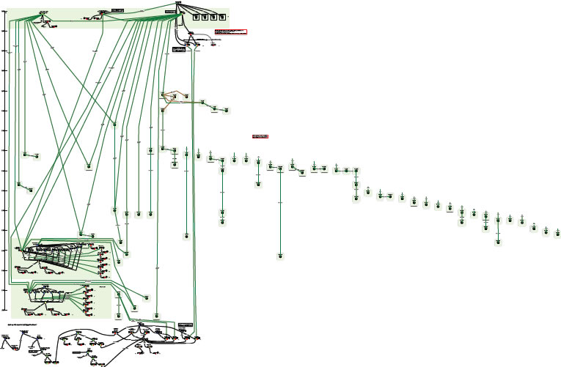
Complexity of relationships: Moby Dick
Printed editions
Diagram using FRBR entities and relationships
Films?
Gregory Peck?
Captain Ahab?
Led Zeppelin?
Whales in fiction?
“OrsonWhales” mash-up (YouTube)
Ronald J. Murray: From Moby Dick to mash-ups
http://www.slideshare.net/RonMurray/from-mobydick-to-mashups
Notes:
RDA data is designed to reflect the complexity of relationships found in library and cultural heritage resources.
This is an example of a paper exercise to draw the relationships between the various printed editions of Herman Melville’s novel “Moby Dick”.
The complex sub-graph at the bottom represents a multimedia mash-up of Moby Dick with Orson Welles (who acted in the film of Moby Dick).
This diagram can be readily extended.
We could add the film starring Gregory Peck as Captain Ahab, and other film and tv adaptations, in multiple formats and editions. And the various recordings of the instrumental “Moby Dick” (for solo drummer!) by Led Zeppelin, and all the other recordings by the group, in multiple formats and editions. And so on.

Slide 7
RDA Entity relationships
Work
Person
Expression
Family
Manifestation
Corporate Body
Item
pov: Description -> Access
Notes:
RDA supports the complexity of the library environment by providing relationships to refine and multiply the basic entity diagram.
Each entity can be related to every other entity, including multiple instances of itself.
This RDF diagram shows relationships from the point-of-view of describing resources to provide access to them. The direction of the relationships is from item-in-hand to access points (the RDA cataloguer’s point of view).

Slide 8
pov: Access -> Item
Work
Person
Expression
Family
Manifestation
Corporate Body
User
Item
content
Notes:
In linked data terms, the same graph with relationships reversed provides the user with access to a specific item with the required content.
The number of links or relationships between the user and the item is not a significant factor when data triples are processed using the web of machines.
It is the quality of the links, reflected in finer granularity and complexity of semantic relationships, that drives rich applications for users.

Slide 9
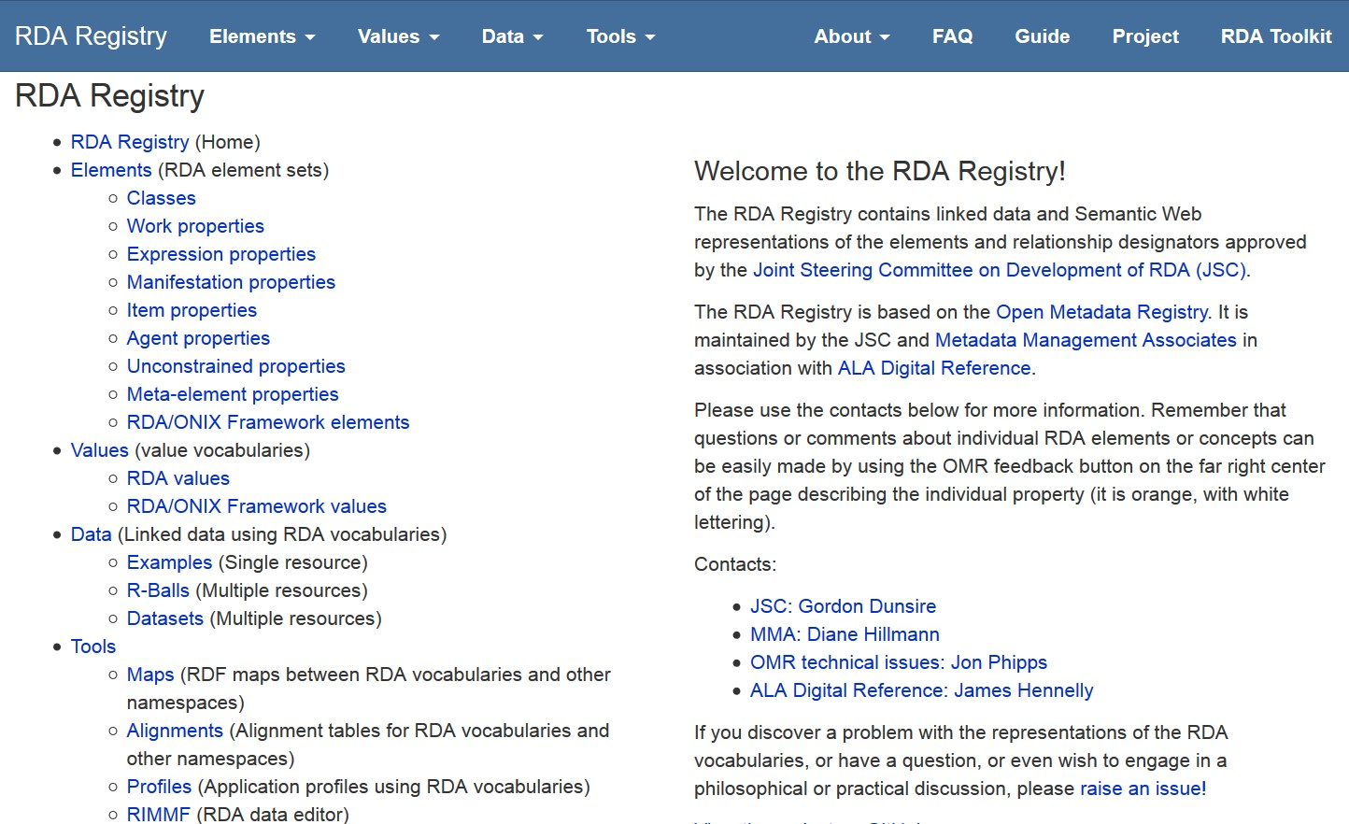
rdaregistry.info
Notes:
The RDA Registry provides access to linked data versions of the RDA element sets and value vocabularies.
The Registry also provides access to tools for creating and editing RDA data and making it interoperate with non-RDA and non-FRBR applications.

Slide 10
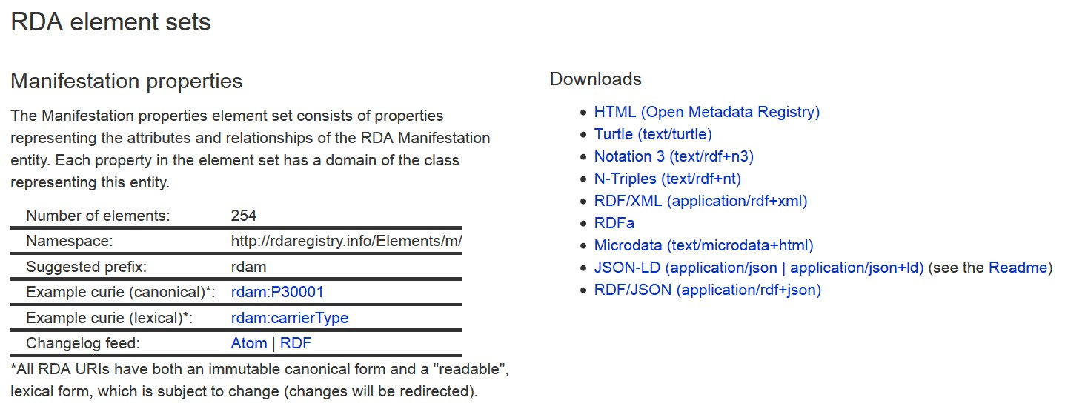
Except HTML for humans
RDF linked data serializations
Formal or canonical URI is “opaque”
- not intended for human readability
Lexical URI is intended for human readability
in different languages
Notes:
RDA URIs are opaque and do not hint at their meaning or semantics. This avoids issues of language and changes of label.
RDA has developed lexical URIs that can be “read” more easily by developers. These can be in any language; the lexical URIs are automatically linked to the canonical URI.
Each RDA element set and value vocabulary can be freely downloaded in different versions or serializations of RDF.
Human-readable versions are available in the Open Metadata Registry

Slide 11
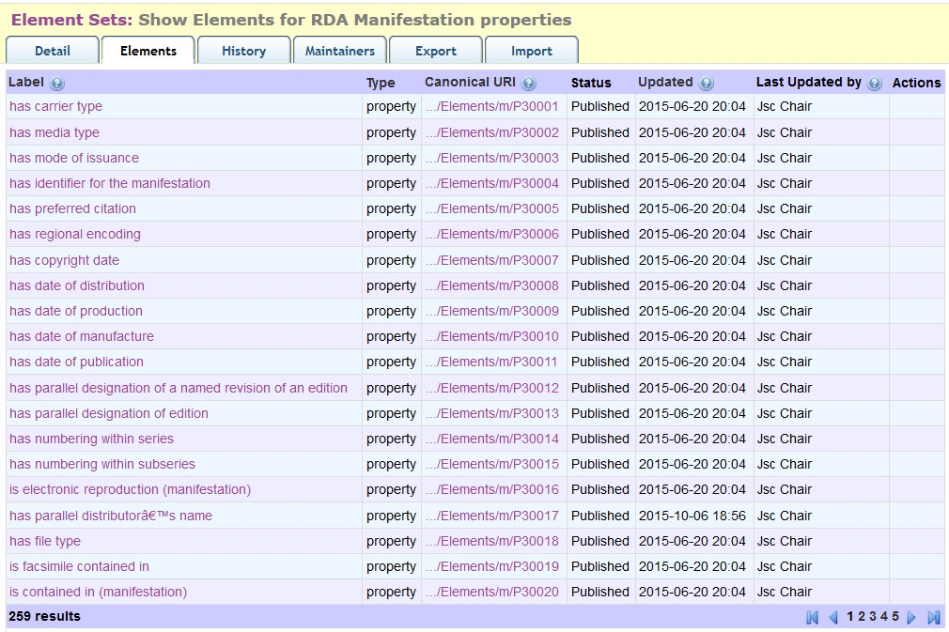
Open Metadata Registry (http://metadataregistry.org)
Web view of RDA elements
Fine granularity audit trail
Notes:
This is a partial screen-shot of the first page of the Manifestation element set in the OMR.
The interface provides standard browse and search facilities.
Clicking on an element reveals more data about the element.
The OMR maintains an audit trail at the level of each transaction on each element, dated and attributed.

Slide 12
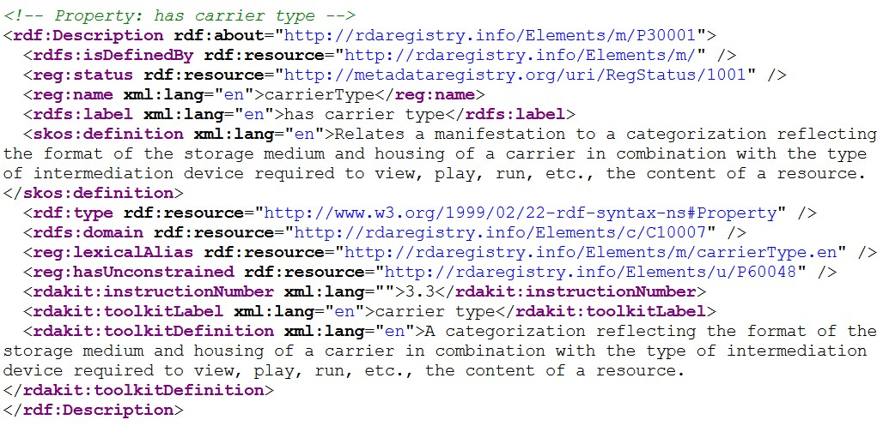
Machine views of RDA elements
<http://rdaregistry.info/Elements/m/P30001>
reg:hasUnconstrained <http://rdaregistry.info/Elements/u/P60048> ;
reg:lexicalAlias <http://rdaregistry.info/Elements/m/carrierType.en> ;
reg:name "carrierType"@en ;
reg:status <http://metadataregistry.org/uri/RegStatus/1001> ;
rdakit:instructionNumber "3.3" ;
rdakit:toolkitDefinition "A categorization reflecting the format of the storage medium and housing of a carrier in combination with the type of intermediation device required to view, play, run, etc., the content of a resource."@en ;
rdakit:toolkitLabel "carrier type"@en ;
a rdf:Property ;
rdfs:domain <http://rdaregistry.info/Elements/c/C10007> ;
rdfs:isDefinedBy <http://rdaregistry.info/Elements/m/> ;
rdfs:label "has carrier type"@en ;
skos:definition "Relates a manifestation to a categorization reflecting the format of the storage medium and housing of a carrier in combination with the type of intermediation device required to view, play, run, etc., the content of a resource."@en .
Notes:
This is a set of RDF triples about the RDA element “carrier type”, presented in RDF/XML syntax. It is an extract from the full set of triples for the Manifestation element set.
The same extract is also shown in Terse Triple Language (ttl or turtle) syntax.

Slide 13
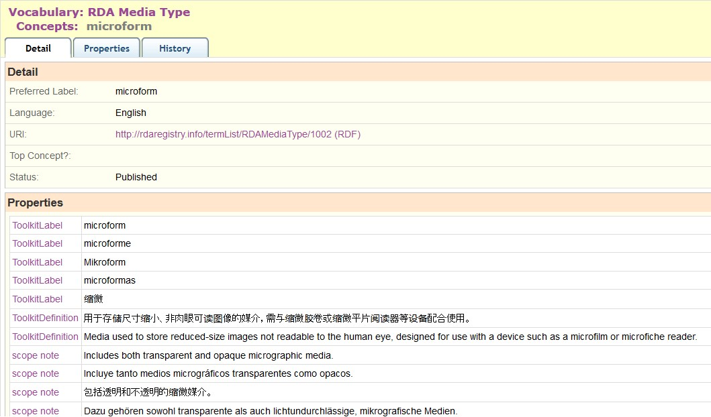
Multilingual views
French
German
Spanish
Chinese
…
Notes:
This is a partial screen-shot of the OMR view of the RDA Media type “microform”.
The term label, definition, and scope note in multiple languages are linked to the URI for the term. This basic feature of RDF, the separation of strings (labels, etc.) from things (URIs), is fully exploited by the RDA Registry.
Value vocabularies are represented using SKOS (Simple Knowledge Organization System) elements. SKOS allows one preferred label per language, and as many definitions and notes as are required. RDA uses SKOS elements for broader, narrower, and term or concept equivalence to represent semantic hierarchies and maps.
The RDA Toolkit is currently available in French, German, and Spanish, with Finnish and Italian translations scheduled for the next series of updates. A separate translation is published in China. The RDA Translations Policy requires all full translations of the Toolkit to be represented in linked data format in the Registry.
Partial translations covering the RDA Reference data of element sets and value vocabularies will also be added to the Registry.

Slide 14
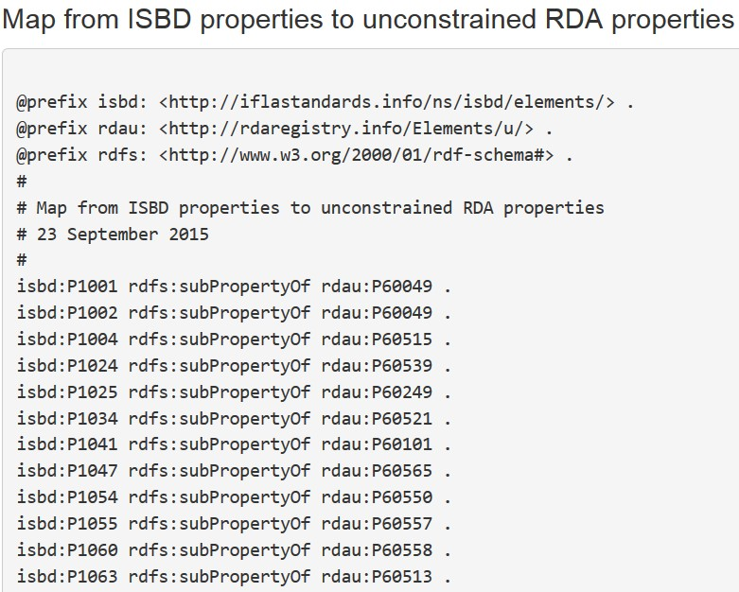
Data beyond RDA: ISBD
[Linked data cloud, not RDF graph]
Unconstrained
(No entity
Specified)
RDAU
ISBDU
RDA
ISBD
Work
Expression
Manifestation
Item
Resource
Notes:
The RDA Registry contains an element set that is not tied to the RDA entities. The “unconstrained” elements parallel the RDA elements but have general definitions, so they can be used by applications that do not require the finer granularity and semantics of RDA and FRBR.
This allows RDA data to interoperate with data from another community. For example, there is an agreed alignment between ISBD (International Standard Bibliographic Description) elements and RDA elements. The alignment is the basis of a set of linked data maps between ISBD and RDA data.
The diagram shows the maps between the RDA and ISBD element sets and their unconstrained versions. The maps preserve semantic coherence by removing the information about RDA’s WEMI entities and ISBD’s Resource entity; the semantic relationship between these entities is not simple and direct.
The diagram is part of the “linked data cloud” of RDF maps, and is not itself an RDF graph. For example, the map between ISBD and the unconstrained RDA elements represented by a single line is an RDF graph, the first part of which is shown.

Slide 15
Thank you!
rscchair@rdatoolkit.org
http://www.rda-rsc.org/

