Slide 1
RDA linked data vocabularies data management and use workflow
Gordon Dunsire
Presented to RDA Linked Data Forum, ALA Annual, Chicago, USA, 26 June 2017
Notes:
This is a brief presentation showing how data for the RDA linked data vocabularies are managed and re-used.
For further information about the topics mentioned in the presentation, see the RDA Registry at http://www.rdaregistry.info

Slide 2
RDA Reference data flow
Atomic audit trail
Deprecation policy
Entities, element sets, value vocabularies
Semantic versioning:
Application roll-back
RDA editors:
Secretary
Translators
Open Metadata Registry
RDA/RDF
Developers
RDA Vocabularies
(GitHub)
Developers
RDA Toolkit
content
RIMMF3
data editor
RDA
Vocabulary
Server
RDA Registry
Cataloguers
Trainers;
Prototypers
Applications
Developers
Notes:
This diagram shows the basic flow of RDA Reference data through the RDA content management infrastructure.
RDA Reference is the content of labels, definitions, and scope notes of RDA entities, element sets and value vocabularies.
Editors of RDA Reference, including translators, maintain the content in the Open Metadata Registry in linked data format.
From there, the content flows via software processes to various RDA products and services aimed at different audiences.
Further information can be found in the RDA Registry at http://www.rdaregistry.info/rgAbout/rdaref/dataflow/ and in the appendix of
RSC/Chair/17 - RDA Toolkit Glossary and RDA Reference (http://www.rda-rsc.org/sites/all/files/RSC-Chair-17-fix.pdf).

Slide 3
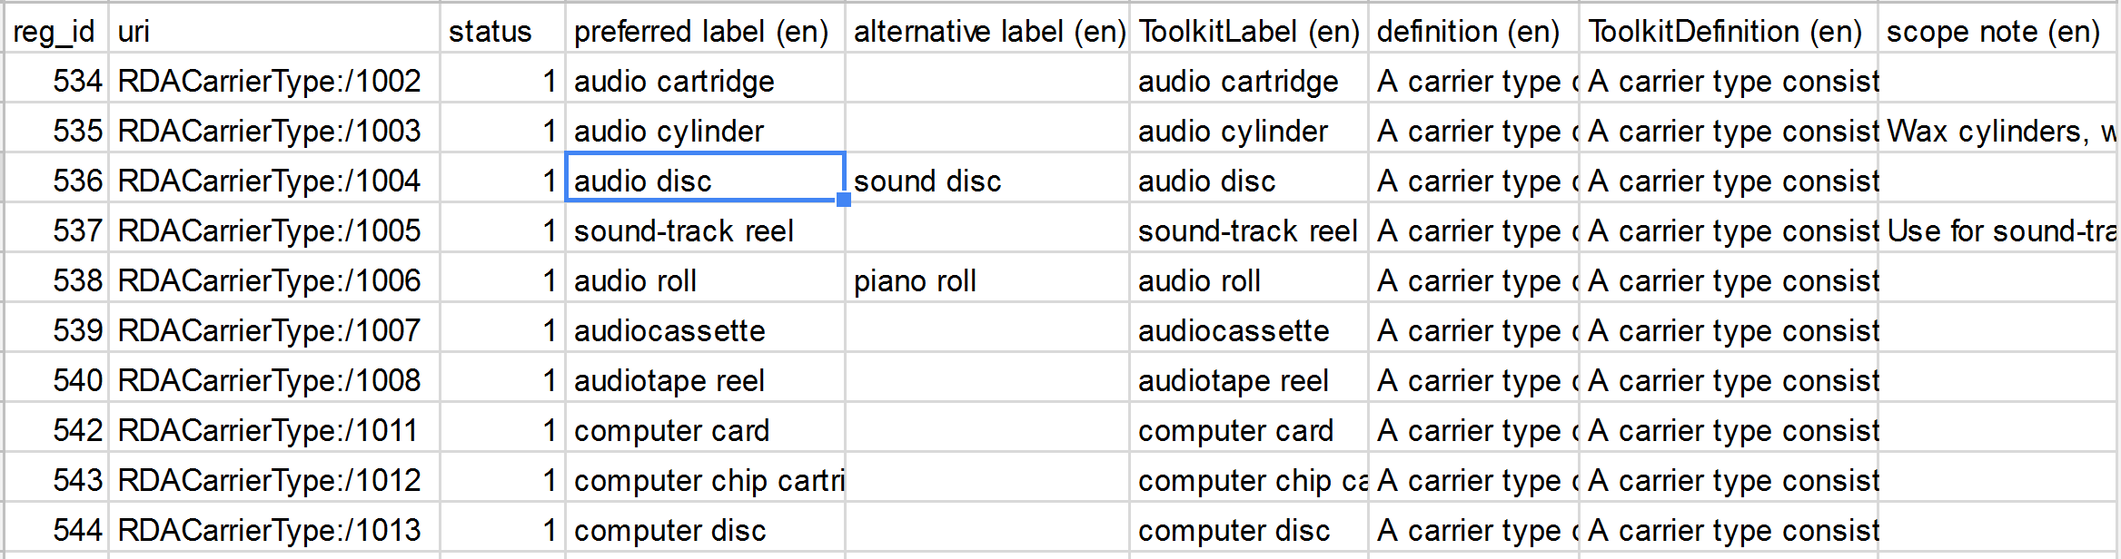
OMR data import spreadsheet
Notes:
Bulk changes to RDA Reference are made on a spreadsheet that is then imported into the OMR.
This is part of the spreadsheet for the RDA Carrier Type value vocabulary.
The remaining slides show how the preferred label "audio disc" appears as it moves through the infrastructure.
The OMR also has an interface for making changes to single elements or concepts.

Slide 4
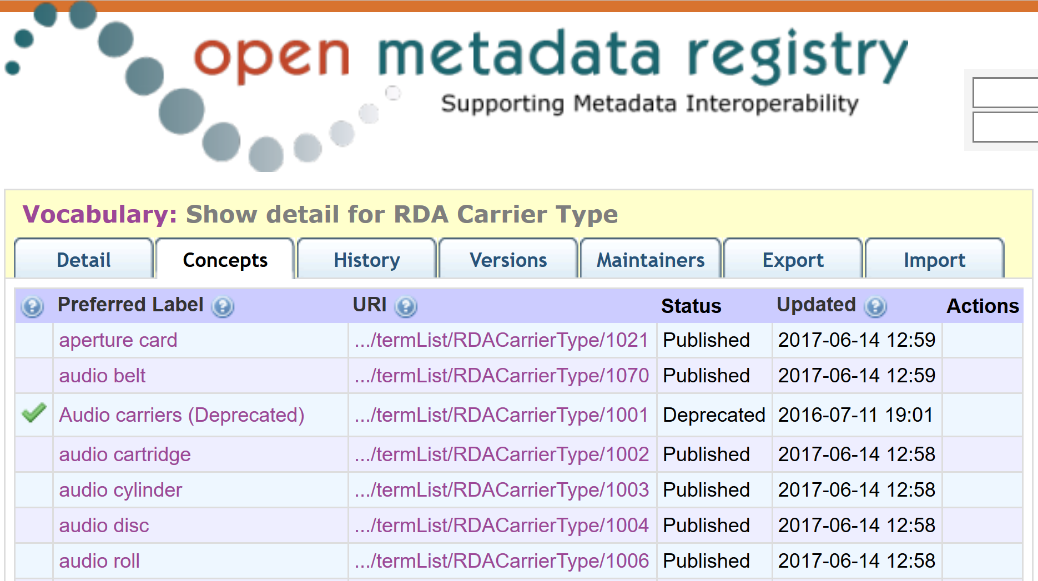
OMR vocabulary display (HTML)
Notes:
This is part of the HTML webpage for the value vocabulary.

Slide 5
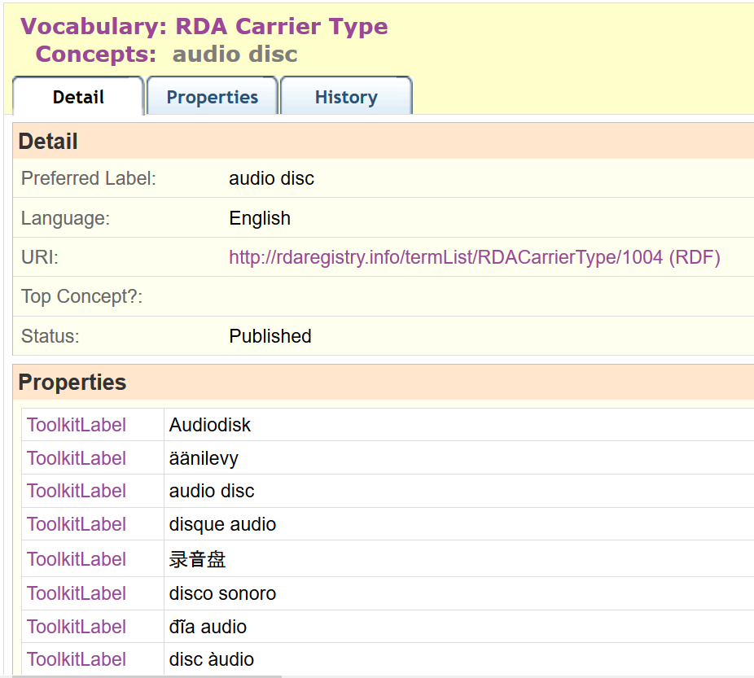
OMR concept display (HTML)
Notes:
This is part of the detail webpage for "audio disc".
It shows translations in multiple languages, linked to the URI of the vocabulary concept.

Slide 6
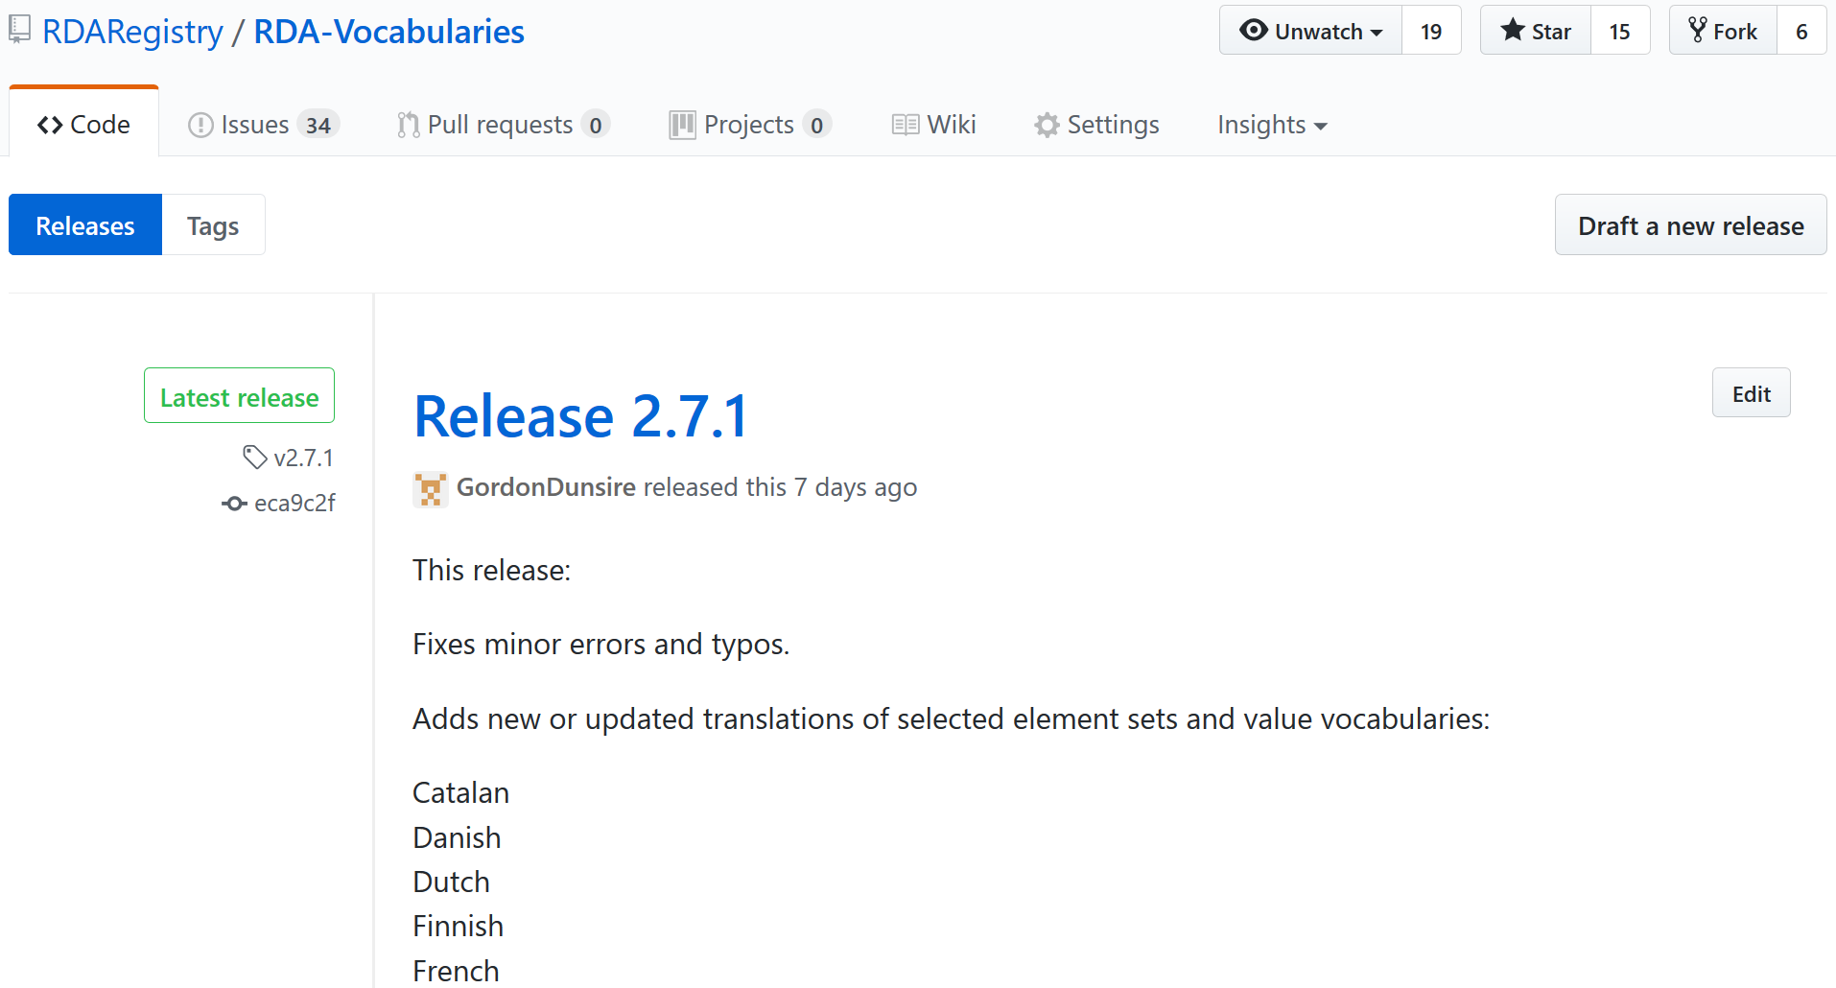
RDA Vocabularies release (GitHub)
Notes:
The RDA Reference content in the OMR is updated ad hoc.
From time to time the cumulative changes are released as versions of RDA Vocabularies in a variety of RDF linked data formats.
The GitHub platform is used for version control and distribution. RDA releases use a semantic version numbering system.

Slide 7
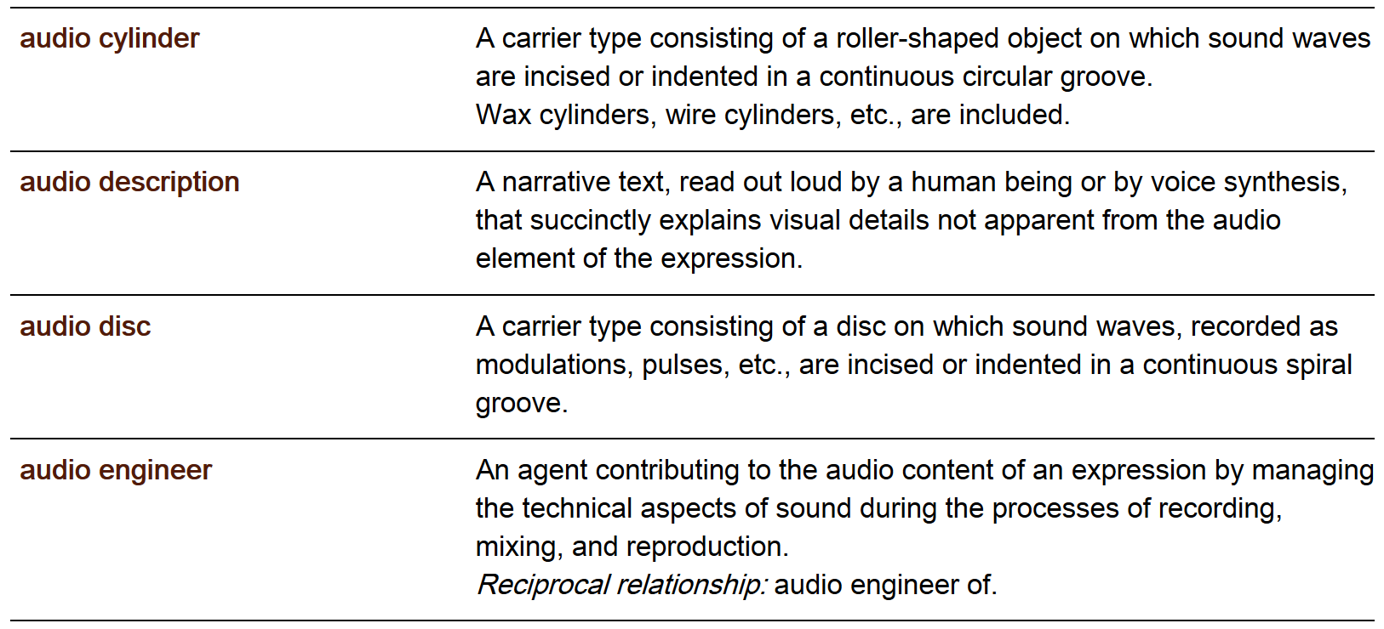
RDA Toolkit Glossary entry
Notes:
RDA Vocabularies data in RDF/XML format is extracted and formatted using XLST scripts.
The whole of the RDA Toolkit Glossary is generated in this way.

Slide 8
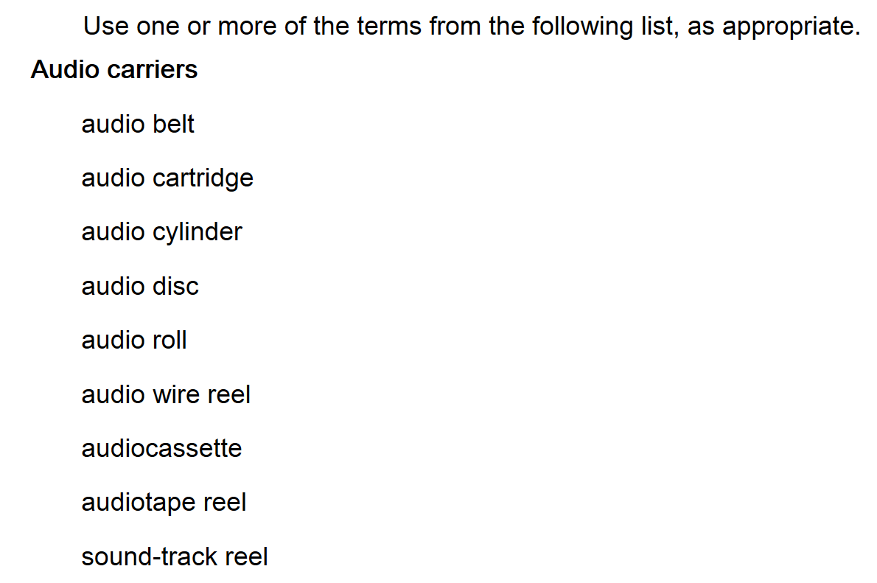
Vocabulary RDA Toolkit in instructions
Notes:
Value vocabulary terms for listing with the RDA Toolkit instructions are also extracted and formatted using XSLT.

Slide 9
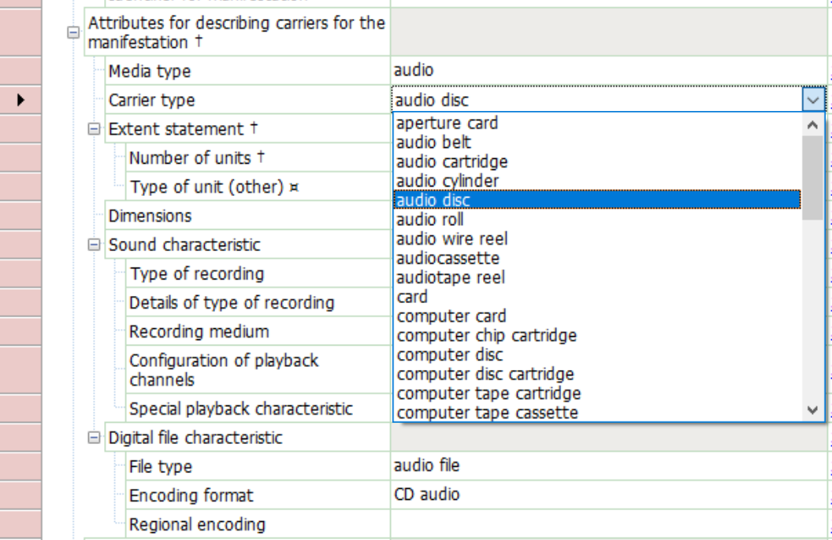
RIMMF pick-list in data input form
Notes:
RIMMF, the RDA data editor, also extracts content from RDA Vocabularies.
This is part of the data form for a manifestation that offers a pop-down list of terms for the RDA element Carrier type.

Slide 10
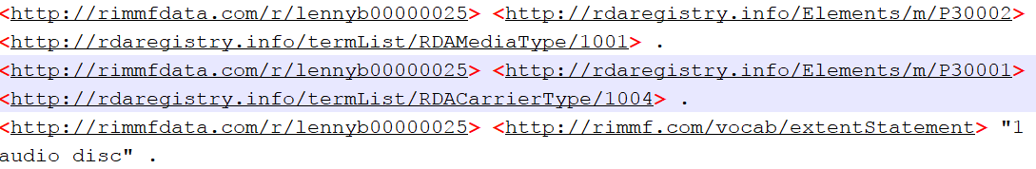
RIMMF linked data output (RDF)
Taken from r-ball from the Lenny-a-thon
Notes:
RIMMF can export RDA data as RDF linked data.
This is part of the r-ball from the RDA hackathon ("jane-athon") for Leonard Bernstein, exported in a linked data format. It shows the URI for "audio disc".

