Slide 1
RDA data capture and storage
Gordon Dunsire
Chair, RDA Steering Committee
Presented to Committee on Cataloging: Description and Access II (CC:DA) - ALCTS CaMMS
ALA Midwinter 2016, 11 January 2016, Boston, Mass.
Notes:
This presentation complements the presentation on RDA progress on governance and strategy, given to the RDA Forum, 9 January 2016.

Slide 2
Overview
RDA for data management: a continuous process of development
From here to the future, and what is on the way
Notes:
This presentation looks at the methods and techniques specified by RDA to support the creation and management of data for applications in the library environment. That environment, an ecosystem of international cultural heritage information and its users, continues to evolve under the impact of global digital networks.
The presentation analyses the current RDA guidance and instructions for data capture and storage and outlines the RDA Steering Committee’s plans for their development to support strategic aims and anticipated changes in the underlying FRBR model.

Slide 3
RDA data
RDA is a package of data elements, guidelines, and instructions for creating library and cultural heritage resource metadata that are well-formed according to international models for user-focussed linked data applications.
RDA Toolkit provides the user-focussed elements, guidelines, and instructions.
RDA Registry provides the infrastructure for well-formed, linked, RDA data applications.
Notes:
The RDA data ecosystem is summed up in this sentence introducing the RDA Board’s announcement of RDA’s strategic directions.
The RDA package is delivered by an infrastructure of two interacting services.
The human-facing components, including the guidelines and instructions, are the Toolkit.
The data-facing components are contained in the Registry.
Applying the data capture and storage techniques in RDA Toolkit to the data architecture in the RDA Registry produces well-formed data for RDA applications.

Slide 4
Recording relationships in RDA
RDA offers a choice of techniques for recording relationships between entities. The number of options varies depending on the type of entity:
4 techniques for relationships between works, expressions, manifestations, and items
3 techniques for primary relationships between works, expressions, manifestations, and items
2 techniques for relationships between persons, families, and corporate bodies.
Notes:
RDA supports a range of options for storing data about related entities.
Guidance and instructions on the various techniques appear in several places.

Slide 5
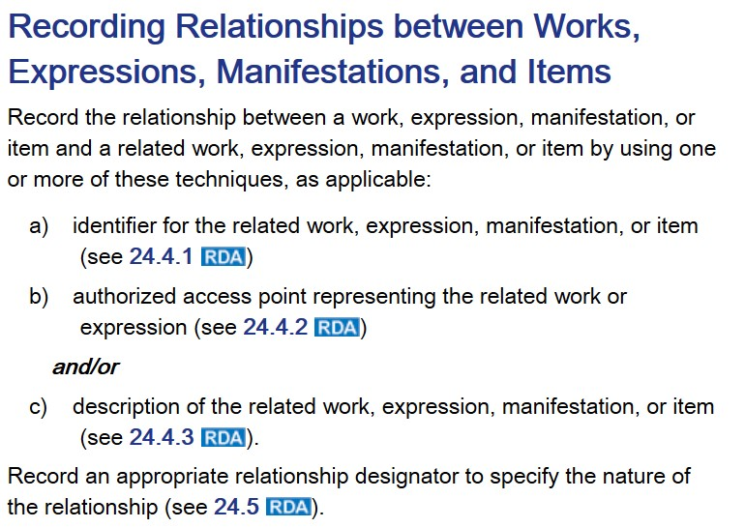
The 4-fold path
a: Identifier
b: AAP
c: Description
c1: Structured
c2: Unstructured
b:Excludes
manifestation
and
item
Notes:
RDA provides three techniques for recording relationships between the Work, Expression, Manifestation, and Item entities. They are not mutually exclusive and techniques can be mixed and used in parallel.
The use of an authorized access point (AAP) is not applicable to Manifestation and Item entities.
The use of a description offers an additional choice between two types of description.
The result is a set of four different methods for recording data about the related entity.

Slide 6
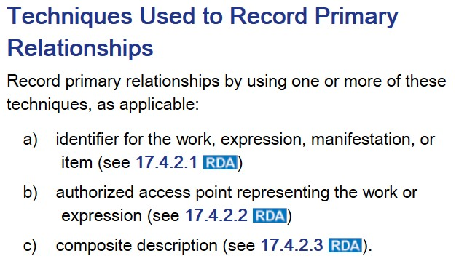
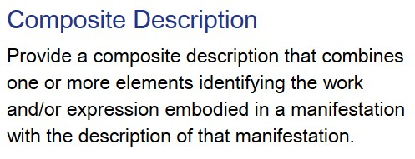
The 3-fold path
a: Identifier
b: AAP
c: Description
c1: Structured
semi-structured?
Notes:
RDA provides three techniques for recording primary relationships between the Work, Expression, Manifestation, and Item entities: Identifiers, AAP (but only for Works and Expressions), and Composite descriptions. They are not mutually exclusive and techniques can be mixed and used in parallel.
A composite description contains data from elements that identify the Work and Expression entities and a description of the related Manifestation entity.
A composite description has overall structure, but the type of description of the Manifestation is not specified to be structured or unstructured.
Composite descriptions are problematic, because they mix data belonging to Work and Expression entities with the description of the related Manifestation entity. This kind of a description is appropriate for a flat file/single record scenario, but is not appropriate for any scenario that provides separate descriptions for different entities.

Slide 7
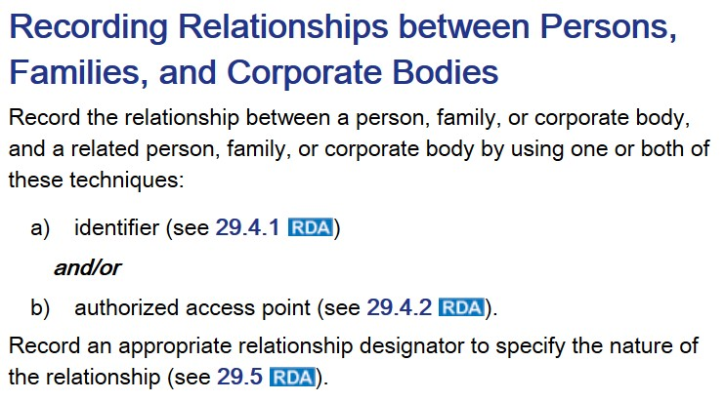
The 2-fold path
a: Identifier
b: AAP
Notes:
Relationships between Person, Family, and Corporate Body entities are recorded using only two of the techniques.

Slide 8
New FRBR-LRM entities
Collective
agent
Place
Nomen
Timespan
F
C
Encompasses:
Identifier
AAP
VAP
Structured description
Transcribed title, etc.
What techniques will apply
to new RDA entities?
a: Identifier
b: AAP
c1: Structured?
c2: Unstructured?
Notes:
The forthcoming FRBR-Library Reference model will introduce new entities for Place and Timespan (not confined to a subject role).
It will also add a general entity for groups of two or more persons: Collective Agent is a super-entity of Family and Corporate Body. Agent (already used in the RDA Registry) is in turn a super-entity of Person and Collective Agent.
What techniques should be used for relating these entities: all or part of the 4-fold path?
Another new entity in the model is Nomen. This entity is the appellation of something, and is related to every other entity in the model. A Title proper is the Nomen of a Manifestation, a name is the Nomen of a Person, and so on. A Nomen is any label that a thing is “called” by, including identifiers, access points, and structured descriptions.
Applying each of the paths results in a Nomen.

Slide 9
Structured description
A full or partial description of the related resource using the same data that would be recorded in RDA elements for a description of that related resource presented in an order specified by a recognized display standard.
[Example: ISBD display pattern]
Title proper : other title information / statement of responsibility
How full?
A complete ISBD record
with all of the data?
RDA : an introduction / by J. Smith
Title proper: “RDA”
Other title information: “an introduction”
Statement of responsibility: “by J. Smith”
Notes:
RDA defines a structured description as an aggregation of RDA elements. The values of the elements are concatenated in a pre-determined sequence. The definition assumes that the display standard will also specify delimiters in the form of punctuation and/or layout. The definition does not exclude embedded mark-up, such as HTML.
For example, a structured description of a Manifestation might consist of title and statement of responsibility elements. ISBD offers a set of display patterns for various combinations of such elements. One of the simplest patterns is shown here.
The structured description is derived by substituting the specific value for each element.
ISBD is not the only display standard that can be used. This example uses a generic format often found in OPACs; the values are delimited by the element label and a new display line, and no punctuation is added.
RDA allows for a “full” description. In theory, this might comprise all of the data for the entity being described, for example a complete ISBD record for a Manifestation.

Slide 10
Database implementation scenarios
0: Linked data
Fully linked (global)
1: Relational or
object database
Fully linked (local)
2: Bibliographic and
authority records
AAP/Identifier linked
3: Flat-file
Not linked
Notes:
RDA has always supported a range of implementation scenarios for RDA data.
Three “database implementation scenarios” were described in 2009; the term “database” is used with a broad meaning, and is not necessarily confined to computer database programs.
The simplest of these is a flat-file approach used in printed catalogues. Data for different entities is not explicitly linked and a “heading” is used to browse for related entities.
A more flexible approach separates the bibliographic Work, Expression, Manifestation, and Item entities from all other entities. Data for the other entities are managed in separate records under authority control. This scenario is common for library OPACs using MARC encoding formats. Bibliographic data are linked to other entity data by locally unique authorized access points or identifiers.
Data for information objects in special and non-library collections that do not use MARC are often accommodated in relational or object databases. In this scenario, data are fully de-duplicated and linked within the local database using machine-readable identifiers.
RDA now needs to develop its latent scenario for linked data using URIs – a special kind of global identifier.

Slide 11
Techniques for obtaining data
Categorization of elements?
Recorded elements
Sources | any (authoritative, recognized, etc.)
Tasks | all (Find, Identify, Select, Obtain, Explore)
Entities | all
is form of?
Transcribed elements
Sources | Manifestation (Item in hand)
Tasks | Identify
Entities | Manifestation
Notes:
RDA elements currently accommodate data obtained by two methods. Does this distinction allow a useful categorization of elements.
The general technique is to record the data after evaluating any relevant and accessible authoritative source of information, including the item in hand.
Recorded data elements are used in all RDA entities to support all FRBR-LRM user tasks.
A special technique is to transcribe the data as it appears in the most immediate source of information, the item in hand.
Note that data transcribed from secondary sources of information are assumed to be recorded in the first instance.
Transcribed data elements apply to the Manifestation entity only, in accordance with the semantic relationship with Item and FRBRoo’s Manifestation Singleton.
Is transcribed data a special case of recorded data?

Slide 12
Transcription
What you see is what you get?
Digital image
Optical Character Recognition transcription
EDINBURGH:
Printed for the Author,
And fold at his Mufic-fhop at the Harp and Hautboy,
M D C C L X I J.
Notes:
A transcription is similar to the idea of “What you see is what you get” from computer displays (WYSIWYG or wizzywig).
This is not quite as simple as it seems. Here is an extract from the digitized image of a book held in the National Library of Scotland.
The Library supplies a transcription derived from Optical Character Recognition software.
Note that the software treats small capital letters as lower-case, but it does recognize the long “s” and transcribes it as “f”.
Note also that layout is lost; here, the centre justification of each line is replaced with default left justification.

Slide 13
Transcription
What you see is what you get?
“User” transcription
EDINBURGH:
PRINTED FOR THE AUTHOR,
And fold at his Music-fhop at the Harp and Hautboy.
MDCCLXII.
Notes:
A user might “see” the digital image a bit differently.
Users have successfully contributed to crowd-sourcing projects for transcribing digitized text that cannot be accurately transcribed by OCR software.
What the user “sees” might depend on educational, cultural, or contextual factors. The tools available, for example keyboard characters and input forms, will also influence the transcription.
For example, a user unfamiliar with 19th century typography conventions might create a much more “literal” transcription, preserving the small capitals as upper-case, reading the long “s” as “f”, and auto-correcting the final “J” of the date.
I think the user would make this correction using knowledge of Roman numerals, and the possibility that there is an unintended smudge on the image.

Slide 14
Transcription
What you see is what you get?
Edinburgh: Printed for the author, and sold at his music-shop at the Harp and Hautboy, 1762
Notes:
To complicate matters further, the RDA instruction for publication statements mixes recording and transcription techniques.
WYSIWYG isn’t guaranteed: the general instructions for transcription at RDA 1.7 permit altering “what you see” in specific situations.
The result of applying the RDA instructions is really recording, not transcription.
RDA permits the transliteration of the date from Roman to Arabic numerals, making it impossible for simple pattern-matching between the OCR, user, and cataloguer transcriptions.
While the RDA instructions allow for a reasonably faithful transcription of the text, any transcription will require compromise, so only reproduction can deliver WYSIWYG as an outcome.
The only true WYSIWYG data is the digital image itself.

Slide 15
Transcription for “Identify” task
Digital image is:
Quickest and cheapest
Easiest for user with item/image in hand
21st century!
Web of machines!
App + Camera + Touch-screen + Image matching software service
Transcription string for item citation:
User must know transcription rules
Is OCR good enough?
Feedback capture = Crowdsourcing
Notes:
The user task best supported by transcription is Identify.
After all, the use case is to match an item-in-hand, carrying self-identifying content, to the description of another item (or the same item) from the same manifestation.
Of the approaches described using the example, the simple digital image is the quickest and cheapest to capture as data, as well as being the easiest for a user with an item in hand. For many users and cataloguers, in the 21st century of the web of machines, it should be easy to create a digital image from the item using an app running on a mobile smart device with built-in camera and touch-screen, and then use an online service to match the capture image against the “catalogue” image.
This approach does not cater for situations when the data must be stored and used as character strings rather than a digital image. But in these cases, the user must know the transcription rules (much harder for foreign languages and scripts!).
Is Optical Character Recognition good enough for the user task of Identify? There have been several successful attempts to improve the quality of OCR for newspapers and older books by capturing feedback from users and applying crowdsourcing techniques.

Slide 16
Recording for user tasks
If data is not transcribed, it is recorded
Recording excludes (more or less):
Typos
Deliberate errors
Fictitious entities
Some of the recorded data support the Find, Identify, Select, Obtain, or Explore user tasks
How can the data best be accommodated in RDA?
Notes:
Recorded data supports all user tasks, but the guidance and instructions on recording RDA data excludes information that is found in transcriptions.
This includes accidental typographic errors, and deliberate errors and the use of fictitious entities intended to conceal, for example, the name of the author or publisher.
Some of these data can be useful for all the FRBR LRM user tasks, but transcription is mainly confined to the Identify task. If the data is only transcribed, how can the information be accommodated in recorded elements?

Slide 17
N-fold path
Unstructured string.
Exact transcription (OCR or born digital).
Transcription using the RDA guidelines.
Data recorded from another source.
Structured string of delimited sub-values.
Access point.
Structured description.
Structured string.
Identifier
URI of entity, including Nomen.
URI/URL of digital image.
Notes:
There are different ways of representing the data capture techniques of the 4-fold paths and transcription and recording. This arrangement is in order of increasing structure and machine-actionability.
Transcription techniques apply to unstructured descriptions of manifestations.
Access points and structured descriptions are both structured strings aggregated from the values of component elements; some of those values are themselves unstructured descriptions.
Identifiers are a special case of structured string, as they usually have some internal structure and may be composed of a label and value.
All descriptions, whether structured or unstructured, may be treated as Nomen entities and assigned their own URIs.
A digital image of a description, for example a title page, might also be considered a Nomen for the entity described.

Slide 18
The path starts here
Paths are available for describing related entities
The same paths describe the entity in focus
Xox oxox oxo xoxo x oxo
Xox oxox: oxo xoxo.
/ xoxo. - x oxo xo xoxo. - Xo xox oxox; oxo xo oxo.
ID: xox-oxox
URI
Notes:
The 4-fold path offers techniques for describing entities related to the entity in focus.
The related entity can be described by an unstructured or structured string, or an identifier, or a linked data URI.
But the entity in focus may become a related entity if the focus moves to another entity.
This implies that the techniques of the 4-fold path may be used for all RDA data, not just related entities. Elements of the entity in focus can be described using unstructured or structured descriptions, including access points), and identifiers.
It just depends on a point-of-view (the focus). Each path or technique is appropriate for specific elements in a relative context. This allows RDA to support data capture in a wide variety of environments and applications, from a static focus on local items-in-hand to a dynamic focus on local and related remote entities.

Slide 19
Developing Toolkit guidance and instructions
Methods of recording RDA data
General guidance on techniques (4-fold path)
General instruction sets for specific entities and element categories (attribute, relationship)
Specific instructions for specific elements
Notes:
The guidance and instructions offered by RDA Toolkit cover the methods of recording RDA data.
RSC intends to develop RDA Toolkit to clarify and contextualize the techniques for capturing and recording RDA data in light of the FRBR Library Reference Model by extending the current approach of giving general guidance and instructions before instructions for specific RDA elements.
Guidance on the 4-fold path techniques is likely to precede general instructions for the application of the techniques to specific categories of entity and element. Not every path is suitable for every element.
These will be followed by the specific instructions for specific elements.
This approach will be applied to new LRM entities such as Place and Timespan, as well as the current RDA entities.
RSC expects a reduction in duplication of instructions for different entities and elements, and simpler pathways for workflows.

Slide 20
Developing RDA Registry for applications
Elements for storage of RDA (linked) data
Element domain = parent Entity (constrained)
Element range = type of path (not currently specified)
Sub-properties (sub-types) of each element have 2 types of range to accommodate 4-fold path: literal and object
Element range | Path
Literal | Unstructured
Literal (associated with construction encoding scheme) | Structured/AP/Identifier
Object | URI
Notes:
Elements for storing RDA data as linked data are published in the RDA Registry.
The constrained RDA element sets specify the “parent” entity of each element as its domain to indicate to which entity the element belongs.
The element sets do not indicate currently whether the element is expected to have a literal string or a URI of a linked entity as its value; the range is not specified so that any of the paths can be used.
Clarification of the 4-fold path techniques will allow the Registry to add new element sub-types, as RDF sub-properties, to accommodate the unstructured and structured descriptions as literals and URIs of linked entities as RDF objects. Literals containing structured data may be associated with a construction encoding scheme specifying the elements, sequence, delimiting punctuation, etc.
These element sub-types will, in general, be transparent to cataloguers. They are primarily intended for applications and systems using RDA data, and are likely to remain hidden behind the data entry forms.

Slide 21
New entities
New high-level
relationship elements
Res
Place
Timespan
Agent
W
E
Collective
agent
Nomen
M
I
P
F
C
New relationship designators
(cross-entity)
Notes:
The RDA instructions and elements will need to accommodate the new entities proposed in the FRBR Library Reference Model.
These include Place, Timespan, Nomen, Collective Agent, and Agent.
The “primary” relationships between Person, Family, and Corporate Body and the new Agent entities can be amended without breaking semantic consistency.
New high-level, “primary” relationship elements will be required. For example, Nomen is related to every other element by the “appellation” element.
New relationship designators to refine the new elements will also be required. Many of these will apply between different entities; there is already a demand for more cross-entity designators for the current RDA entities.
For clarity, the diagram shows only a small sample of relationship elements and designators.
The LRM Res entity is a super-entity of all other entities, used to simplify the modelling of relationships. It is unlikely to be required in RDA.

Slide 22
Toolkit Entity views
Proposed development to provide a focus for each RDA entity and its elements
Replaces out-of-date Element set views
Acts as a ready-reference to all elements and instructions associated with the entity
Notes:
RSC wishes to develop a set of Entity views in RDA Toolkit. Each view will focus on one RDA entity and its elements in isolation, in contrast to the embedding of entity information in the guidance and instructions.
This will be a re-purposing and re-modelling of the current Toolkit Element set views (ESVs) which are now significantly out-of-date.
The Toolkit entity view will be a ready reference device for accessing the elements, guidance, and instructions associated with each RDA entity.

Slide 23
Entity view: a dictionary/reference for RDA
Possible layout
Entity definition, etc.
Guidance and
instructions
Entity elements
Common elements
Specific elements
With n-fold path:
literal range + associated structure
object (Entity) range
Notes:
This is one possible layout for an entity view.
It follows the approach of starting with general information about the entity before moving to specifics.
Some elements will be common to many or all entities, for example the appellation and subject relationship elements: Entity has appellation Nomen; Entity is subject of Work.
Depending on the context of the entity and element, many elements will have more than one data capture and recording technique available.
The entity view is a complement to the guidance and instructions, and acts a data dictionary for entity and element definitions and scope notes, pointing to the relevant guidance and instructions for each element.

Slide 24
Re-organizing the Toolkit
Appendices and tabs
Vocabulary Encoding Schemes
Sharing, extending, linking (RDA and other communities)
RDA Reference (entities, elements, terms)
Glossary
How far beyond entities, elements, and vocabulary terms?
Translations
Policy statements and application profiles
Entity views, Relationship designators, etc.
Notes:
These anticipated developments suggest that now is a good time to review and improve the organization and layout of RDA Toolkit. The RDA Board has approved a project to carry out this work over the next 2-3 years in synchronization with the development of RDA discussed in this presentation. These are some of the components that will be taken into account.
Development of the RDA appendices and tabs has been ad hoc, and now is the time to review and consolidate these macro-structures for Toolkit layout.
RSC wishes to improve the functionality of the RDA vocabularies and Vocabulary encoding schemes by extending them to meet the needs of local RDA communities, and linking them to other library and cultural heritage vocabularies.
The Glossary is a one-size-fits-all dictionary for vocabulary terms, element names, and Toolkit terminology. Is this the best approach? How far should RDA go with definitions for professional cataloguing terminologies such as “access point”, etc.?
Is the current approach for adding translations, policy statements, and (in the future) application profiles sustainable and scalable?
Where is it best to accommodate the proposed entity views, larger numbers of relationship designators, and other new Toolkit content?

Slide 25
Some issues
Needs of international, cultural heritage, and linked data communities
Primary (WEMI) vs Secondary (PFC …) entities
Reciprocal relationships/links/designators
Elements other than those for access points?
Structure in descriptions
How much specification?
International communities use different structures
Nomen control (a kind of authority control?)
Relationship designators
Cross-entity, and many more (labels, definitions?)
Notes:
These discussions have raised several strategic issues for RDA.
RDA currently differentiates between the primary entities constituting a complete resource (WEMI) with secondary entities that act as access points to the resource, currently PFC but soon to be expanded with new FRBR-LRM entities. Is it useful for international, cultural heritage, and linked data communities for RDA to maintain this distinction? Should RDA provide elements other than those required for “classical” access point construction?
To what extent should RDA specify the elements the comprise a structured description, including access points? Different international communities use different sets of component elements in different sequences to compose access points. Would it be better to leave such specification to application profiles?
The management of Nomens, including access points, identifiers, and structured descriptions, is similar to authority control and there are many issues to resolve.
There will be many more relationship designators, with added complexity for cross-entity designators. How should these be labelled and described?

Slide 26
Thank you!
rscchair@rdatoolkit.org
http://access.rdatoolkit.org/
http://www.rdaregistry.info/
http://www.rda-rsc.org/

