Slide 1
RDA cataloguing and linked data
Gordon Dunsire, Chair, RSC
Presented at First Colloquium on RDA in Latin America
Mexico City, Mexico, 15 November 2018

Slide 2
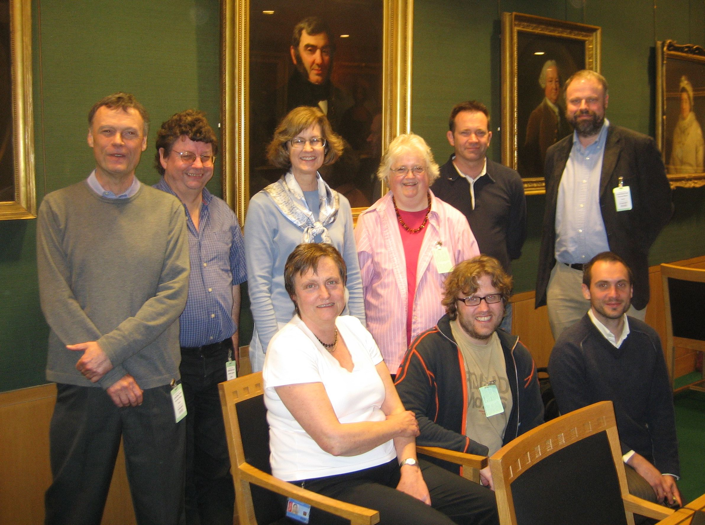

Slide 3
RDA and linked data
2006: DCMI, Colima, Mexico
2007: “London meeting” with linked data communities
Committee of Principals for RDA agrees to develop linked data representation of RDA
2014: v1.0.0 of RDA Vocabularies on GitHub
2015: RDA Board strategy includes linked data communities

Slide 4
RDF
Resource Description Framework (RDF)
Designed for machine-processing of metadata at global scale (Semantic Web)
24/7/365
Trillions of operations per second
Everything must be dis-ambiguated
Machines are dumb
A simple approach helps!
Require machine-readable identifiers

Slide 5
RDF triple
Simple, single, “atomic” statement in 3 parts
subject – predicate (property) – object
This slide – has title – “RDF triple”
Subject and predicate must be identified by a URI or IRI*
Unambiguous machine identification (a thing)
Object may be an IRI or a literal
Literal: human-readable string
* Internationalized resource identifier

Slide 6
RDF graph
Graphical representation of one or more triples
Subject IRI
Property IRI
Object IRI
Property IRI
Subject IRI
“Literal”
Property1
Object1
= Subject2
Property2
Subject1
Object2
Property3
“Literal”

Slide 7
RDA in RDF
RDA uses RDF to represent RDA Reference (entities, elements, and controlled vocabularies)
Provides data for RDA Toolkit (Glossary, element reference, navigation)
Available from RDA Registry for external applications
open license: CC0 BY

Slide 8
Toolkit element page
Definition and Scope
Element Reference
Prerecording
Recording
Recording an unstructured description
Recording a structured description
Recording an identifier
Recording an IRI
Instructions
RDA Reference
Related Elements
Notes:
This is an outline of the element page structure.
The RDA Reference data are displayed in the sections highlighted in gray.
All of these sections use content that has already been translated in the Open Metadata Registry.
The guidance and instructions are displayed in the sections highlighted in orange.
The content of these sections is translated in the Content Management System using Trados.
This allows translators to focus their work on specific areas of Toolkit content.

Slide 9
RDA Vocabularies
RDA Reference:
entities (classes), elements (properties), and terms (concepts)
Includes translations (12+ languages)
Published via GitHub and RDA Registry
open license: CC0 BY

Slide 10
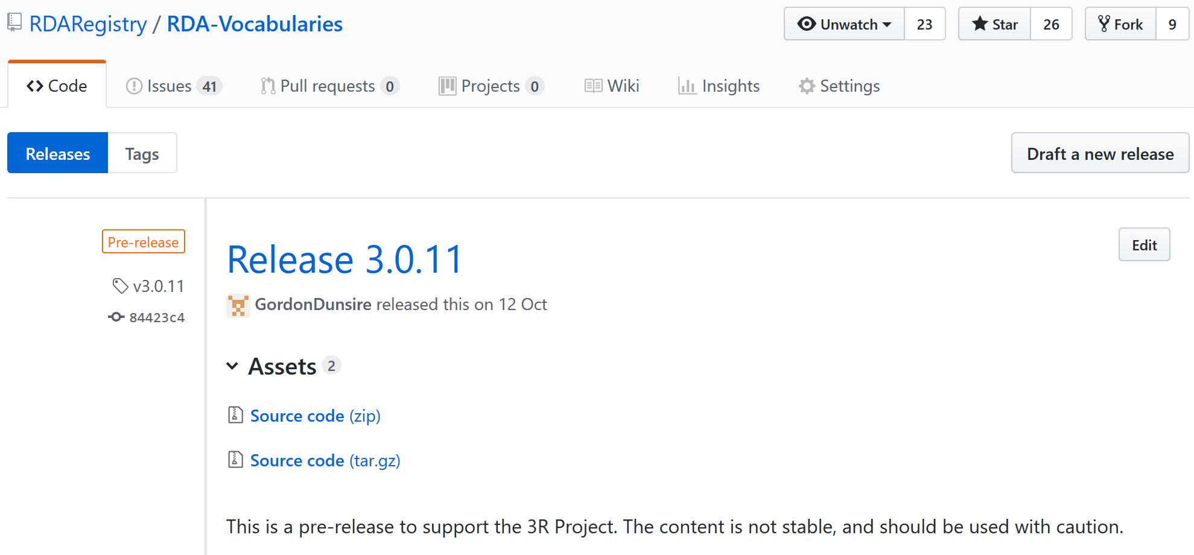
https://github.com/RDARegistry/RDA-Vocabularies/releases

Slide 11
RDA Releases
Semantic versioning
Break.Bend.Minor (n.n.n)
GitHub pre-releases used to test production infrastructure for new Toolkit
Warning: unstable!

Slide 12
RDA Releases
2.7.3: Original Toolkit (April 2017)
Pre-releases: 3.0.1 – 3.0.11
3 !!!: Breaks semantics of 2.7.3
Re-definition of Person entity (LRM)
3.1.0: real soon now (December 2018?)

Slide 13
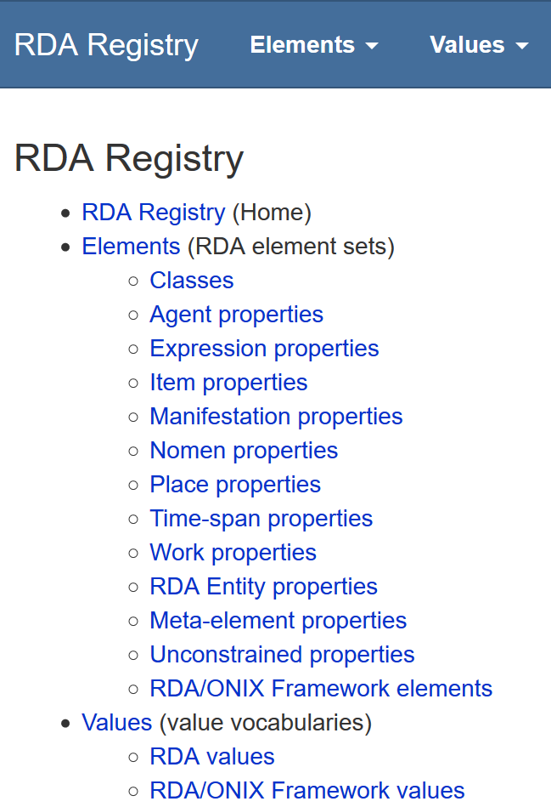


Slide 14
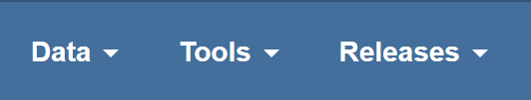
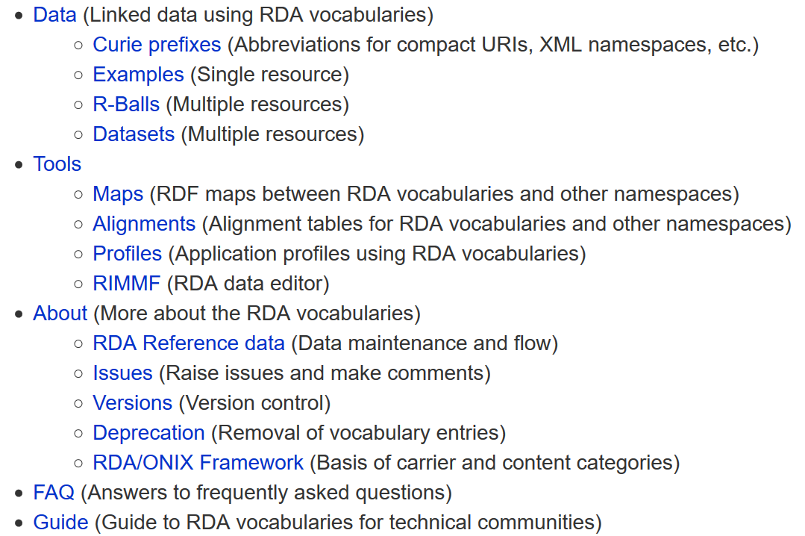

Slide 15
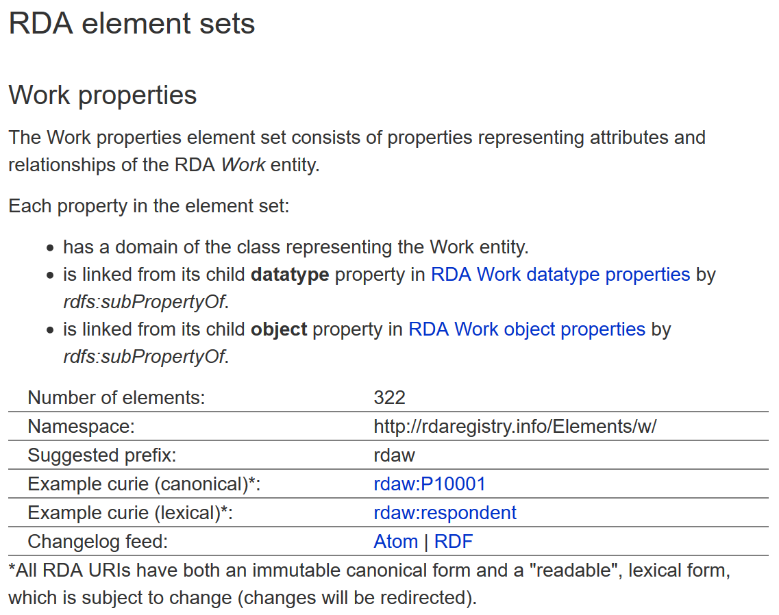
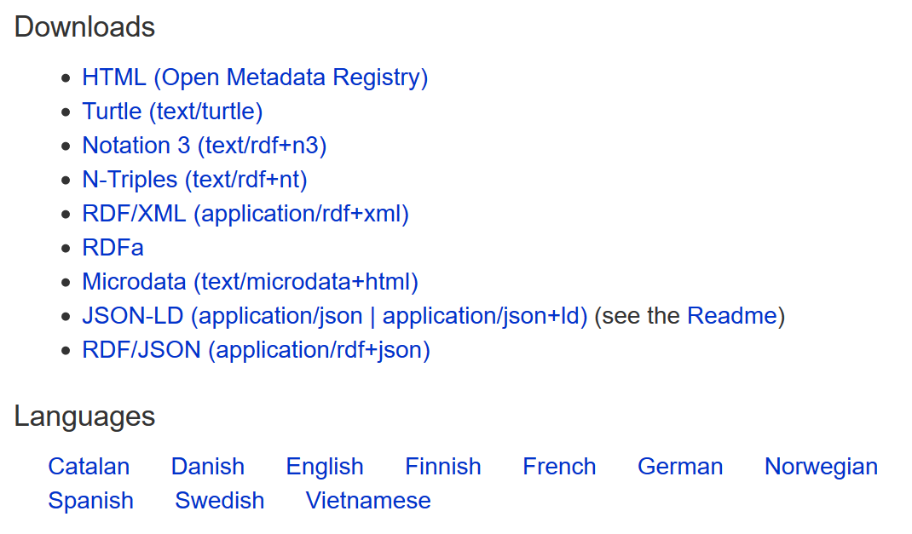

Slide 16
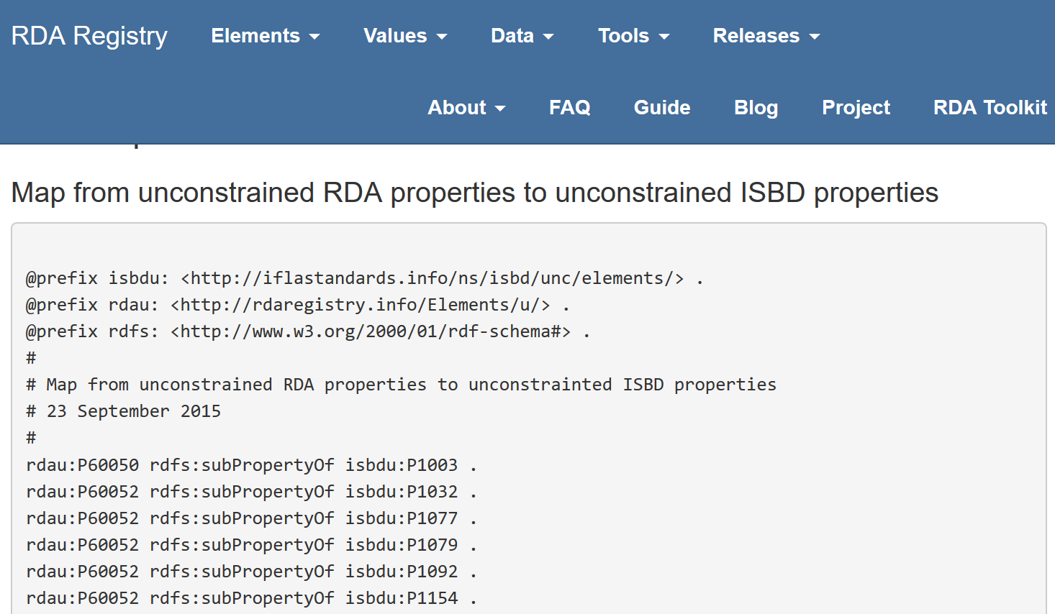
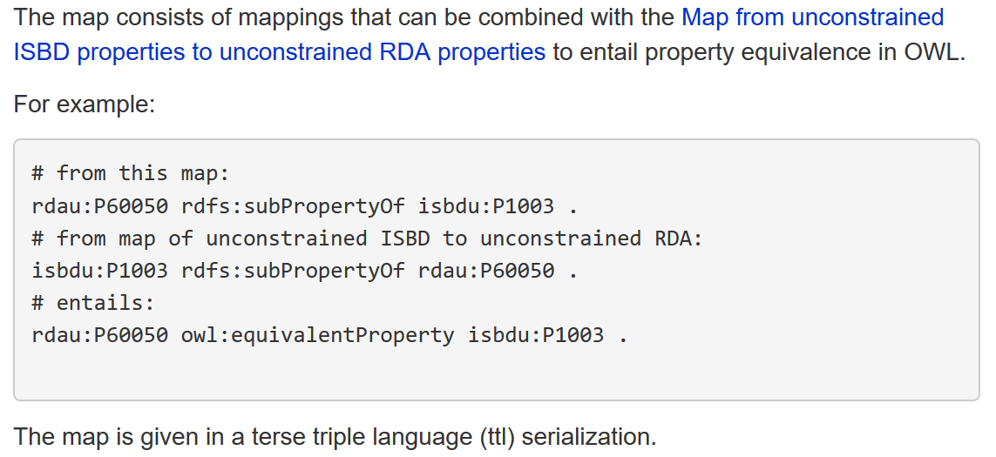

Slide 17
Property domain & range
Property domain specifies the expected entity (class) of a triple subject
Property range specifies the expected entity (class) of a triple object
No domain or range = no expectations

Slide 18
Recording methods
unconstrained property
(no domain, no range)
external property
(non-LRM)
subPropertyOf
"Unstructured description"
Datatype property
(literal range)
"Structured description"
canonical property
(no range)
subPropertyOf
"Identifier"
Object property
(entity range)
IRI

Slide 19
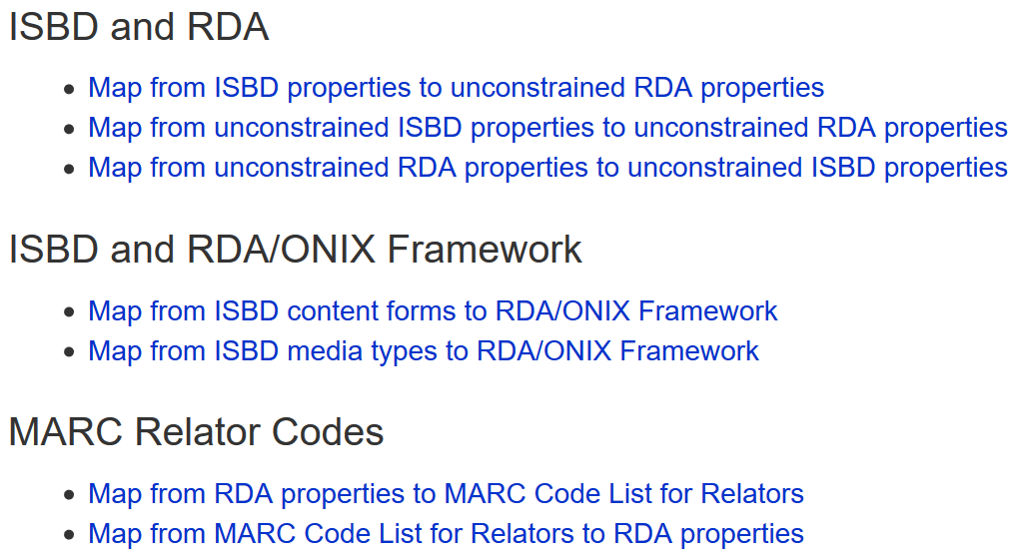
Maps to related linked data
New!: Dublin Core Terms

Slide 20
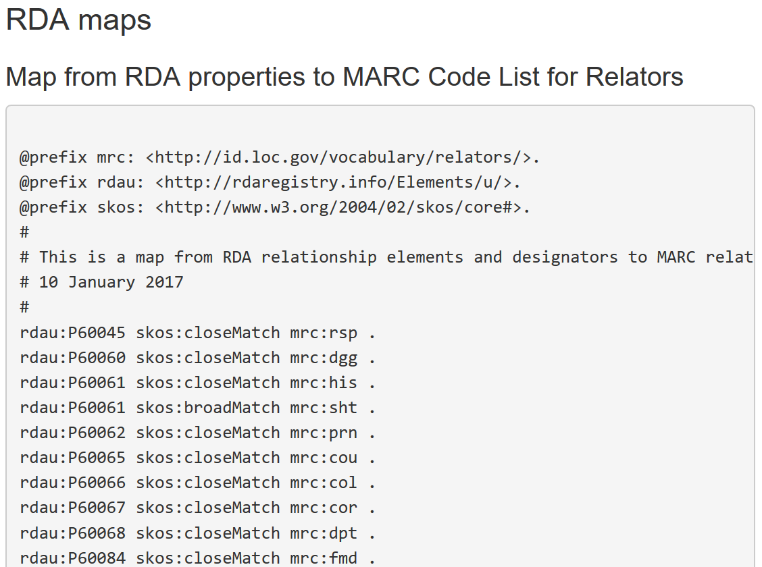

Slide 21
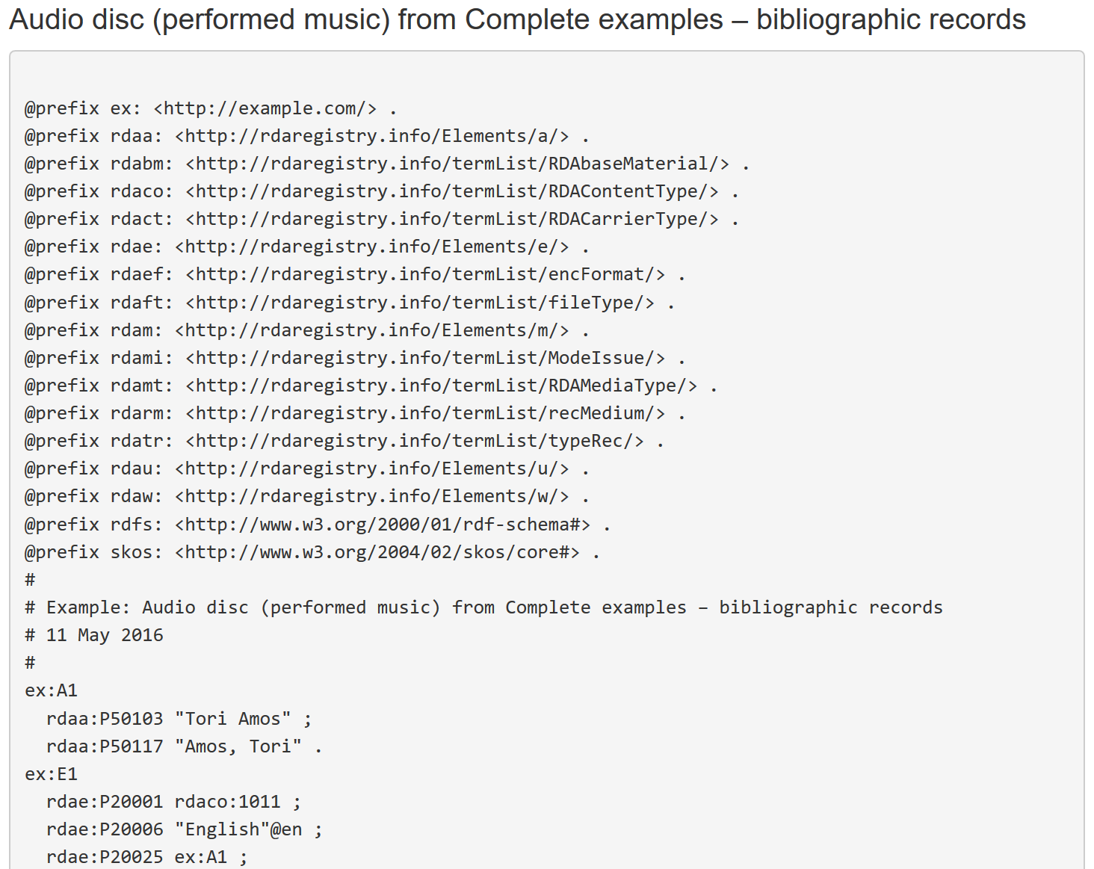
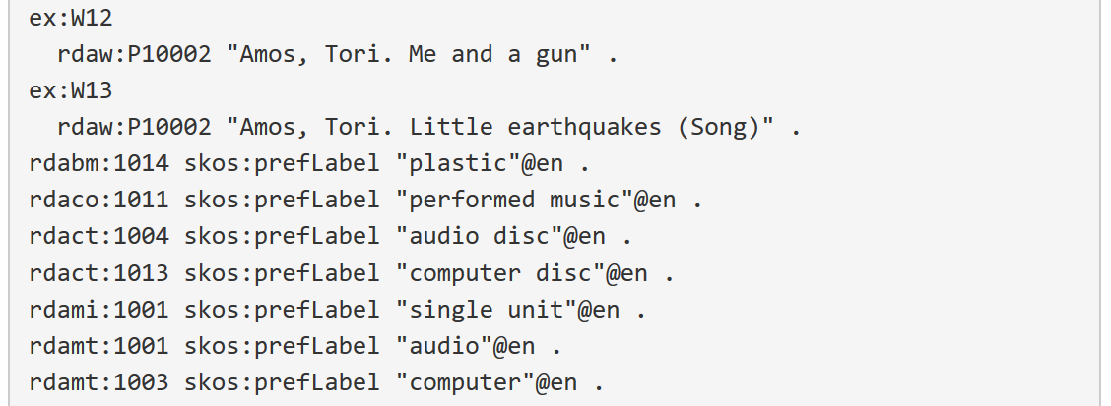

Slide 22
Conclusion
RDA provides a complete package for linked data applications
RDF elements
Content instructions
Maps to related standards
Extension mechanism for local applications

Slide 23
Muchas gracias!
RDA Registry
http://www.rdaregistry.info/
RDA Vocabularies
https://github.com/RDARegistry/RDA-Vocabularies
RDA Steering Committee
http://www.rda-rsc.org/
RDA Toolkit:
https://www.rdatoolkit.org/

