Slide 1
Where is RDA in the bibliographic universe?
Gordon Dunsire
Presented to Standard RDA – korzyści i problemy związane z jego wdrożeniem = RDA standard – benefits and problems related to its implementation, Warsaw, Poland, 14 October 2016

Slide 2
Where is RDA in the universe of
data?

Slide 3
RDA data
“RDA is a package of data elements, guidelines, and instructions for creating library and cultural heritage resource metadata that are well-formed according to international models for user-focussed linked data applications.”
[RDA Board announcement]
RDA Toolkit provides the user-focussed elements, guidelines, and instructions.
RDA Registry provides the infrastructure for well-formed, linked, RDA data applications. Open Metadata Registry (OMR) provides linked data representation of RDA elements.
Notes:
The RDA data ecosystem is summed up in this sentence introducing the RDA Board’s announcement of RDA’s strategic directions.
The RDA package is delivered by an infrastructure of two interacting services.
The human-facing components, including the guidelines and instructions, are the Toolkit.
The data-facing components are contained in the Registry.
Applying the data capture and storage techniques in RDA Toolkit to the data architecture in the RDA Registry produces well-formed data for RDA applications.

Slide 4
RDA Reference
RDA entities, relationships, designators, vocabulary encoding schemes + translations
Data used in RDA Toolkit Glossary, instructions, and appendices
  Also used in other RDA services
  Open CC0 license
New content management infrastructure for multiple services and languages

Slide 5
RDA Reference data maintenance and flow
RDA editors:
Secretary
Translators
Open Metadata Registry
RDA/RDF
Developers
RDA Vocabularies
(GitHub)
Developers
RDA Toolkit
Glossary
RIMMF3
RDA
Vocabulary
Server
RDA Registry
Cataloguers
Trainers
Applications
Developers

Slide 6
RDA Reference data in Toolkit
Expanded Glossary is a listing of all elements and concepts in RDA Reference
  Glossary data is re-used in instructions and appendices
New vocabulary encoding scheme for terminology used by RDA instructions
  Many terms included in previous Glossary
  Now managed as a separate vocabulary: RDA Terms

Slide 7
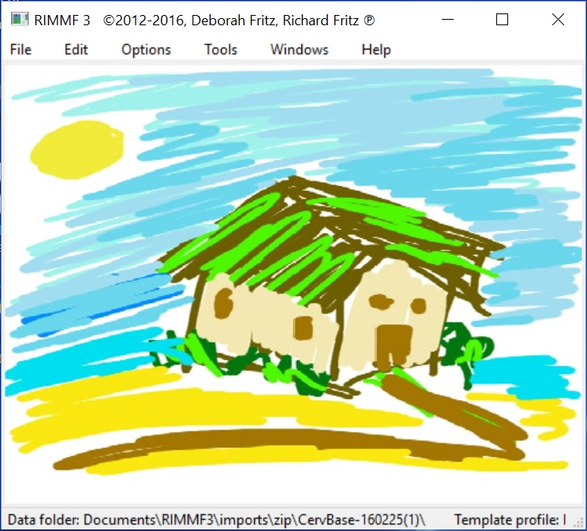
RIMMF: RDA in Many Metadata Formats
Developed as a training tool and prototype interface for RDA
RIMMF3 uses RDA linked data

Slide 8
Legacy data: MARC21 to RDA linked data
MARC21
RIMMF RDA
Semantic
Web
RDF linked data
MARC21
Legacy
systems

Slide 9
Where is RDA in the universe of
linked data?

Slide 10
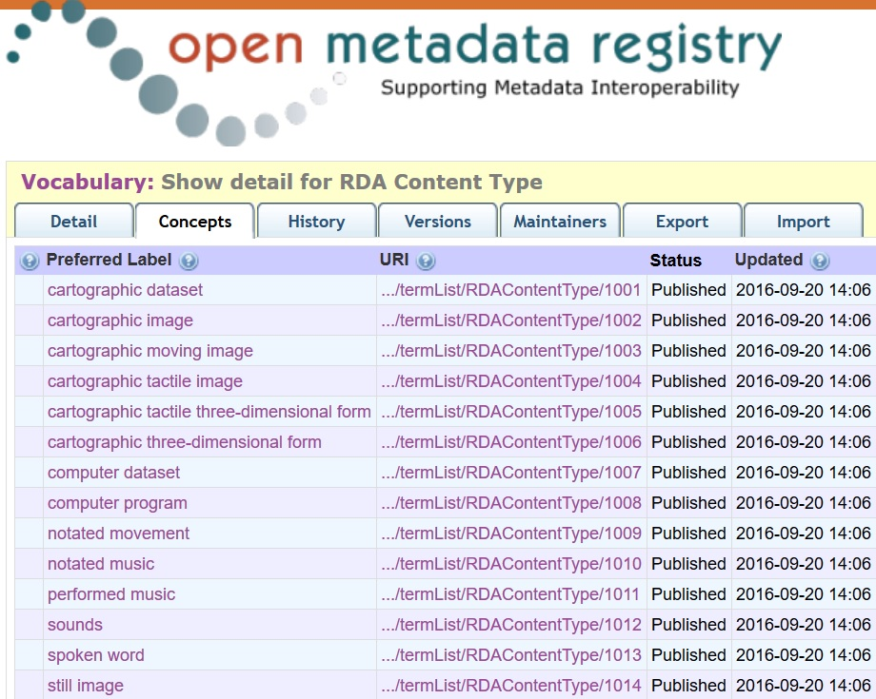

Slide 11
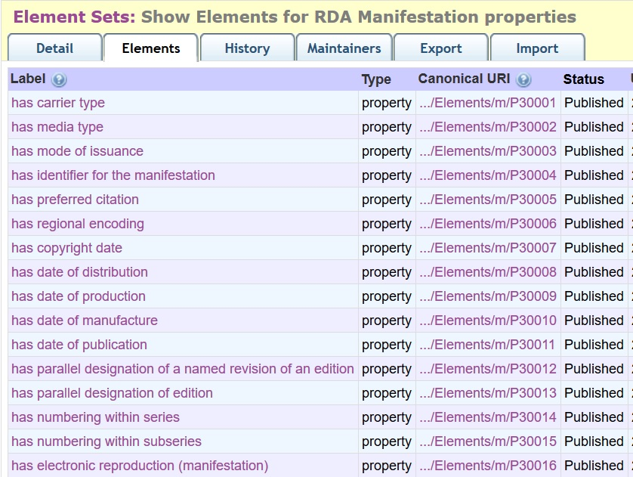
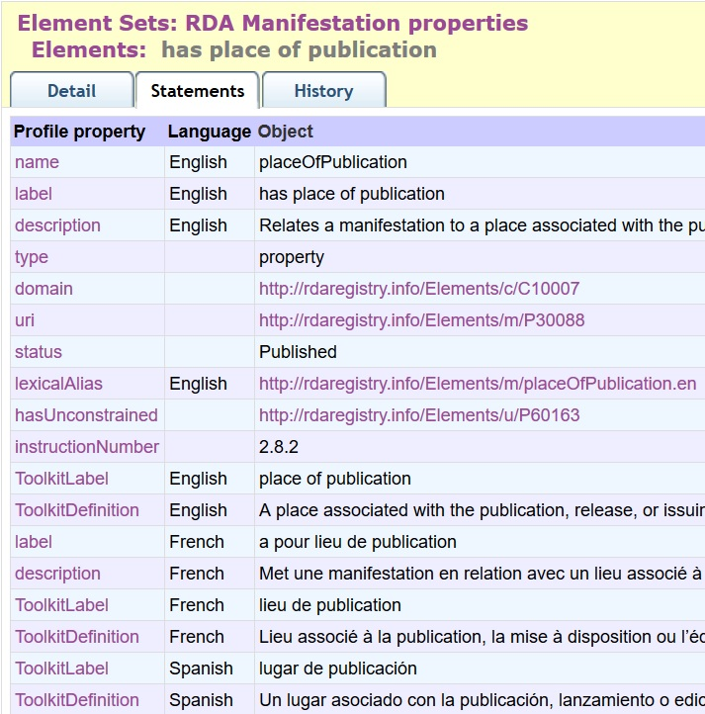

Slide 12
Local vocabularies
Translations!
Local terms in RDA vocabularies:
Extensions and refinements
(narrower/broader, equivalent)
E.g.: Synonyms,
localized terms
Local vocabularies with similar semantics:
Substitutions in local Application Profiles
Ex: Gender
Semantic coherency maintained
between OWL object and datatype properties and RDFS properties

Slide 13
RDA RDF property family
Domain | Property | Range
 | Unconstrained | 
 | Canonical RDA (Toolkit) | 
 | Object property | Thing
 | Datatype property | String
subPropertyOf
Unconstrained properties generalize RDA
for non-FRBR/LRM models

Slide 14
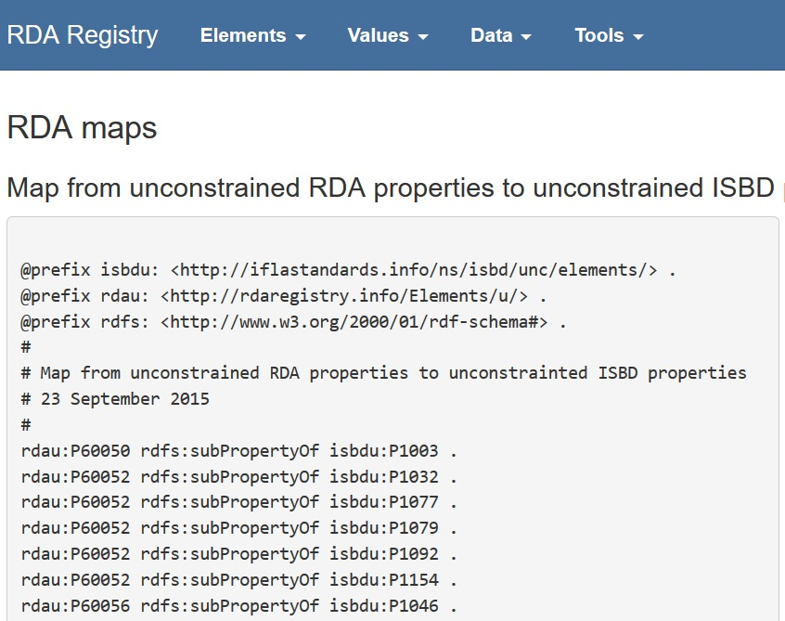
In development:
BIBFRAME (stable?)
Dublin Core
LRM (when published)
schema.org

Slide 15
Where is RDA in the universe of
language?

Slide 16
Full or partial translations of RDA
published or in development
Arabic
Catalan
Chinese
Danish
Dutch
Finnish
French
German
Greek
Hebrew
Icelandic
Italian
Latvian
Norwegian
Portuguese
Slovak
Slovene
Spanish
Swedish
Ukrainian
Vietnamese

Slide 17
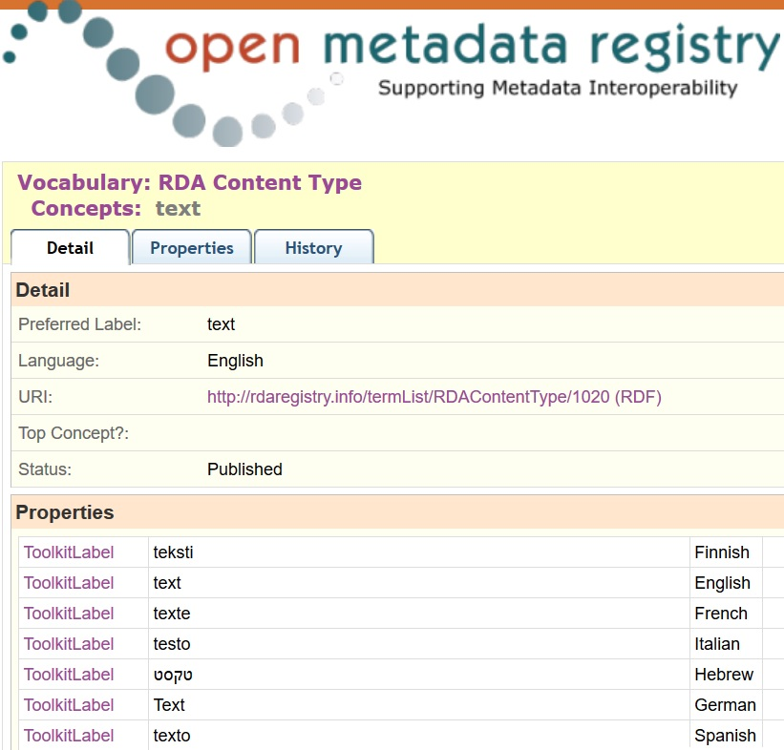
One URI
Many languages

Slide 18
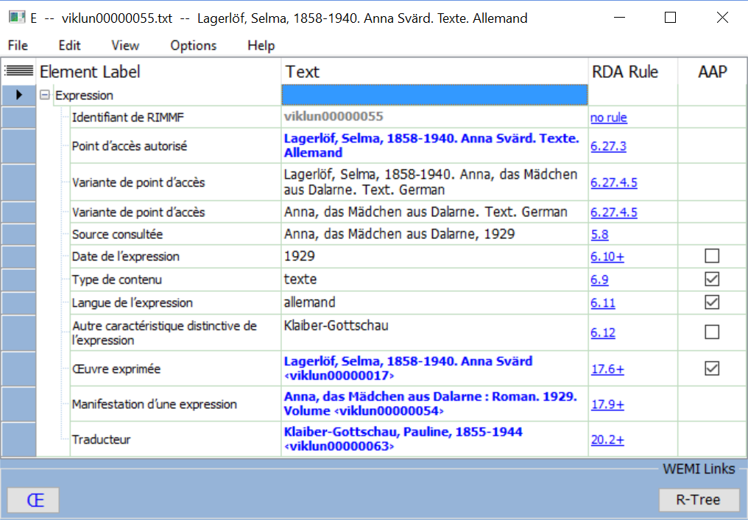
Multilingual global data: Example from RIMMF
Swedish work
German translation
French cataloguer

Slide 19
Where is RDA in the universe of
cultural heritage standards?

Slide 20
FRBR-LRM and RDA
LRM “a high-level conceptual model … intended as a guide or basis on which to elaborate cataloguing rules”
RDA guidance, instructions, elements
“operates at a greater level of generality than FRBRoo, which seeks to be comparable in terms of generality with CIDOC CRM”
RDA cultural heritage communities
LRM “this model is developed very much with semantic web technologies in mind”
RDA linked data communities

Slide 21
Impact of LRM
More entities (Nomen, Place, Time-span, Agent, Collective Agent)
Shift from attributes to relationships
RDA as a refinement of LRM high-level entities, attributes, and relationships

Slide 22
FRBR-LRM and RDA entities
Any Thing:
Covers all other types of thing
Res
has appellation
W
Nomen
E
is created by
Agent
Place
M
is type of
Collective
Agent
is associated with
I
Timespan
is modified by
is type of
P*
F
C

Slide 23
RDA refines LRM
Coarse/General/Global
Res1
is associated with
Res2
W
A
has creator
has artist
Fine/Specific/Local
is associated with
Res1
Res2
E
E
is derivative (E)
is adapted as (E)
is adapted as graphic novel (E)

Slide 24
From attributes to relationships
has manifestation
statement
Publication statement
Transcribed
has place of publication
Nomen
Place
has publisher’s name
M
C
Nomen
Recorded
Timespan
Nomen
has date of publication

Slide 25
The 4-fold path
The “4-fold path” supports catalogue cards, flat file schema, RDBMS, and linked data (RDA database implementation scenarios)
Describing a related entity:
Unstructured description
Structured description
Identifier
URI
General guidance and instructions:
Simple
Less duplication
Easier to translate

Slide 26
Example: Place of publication
Data source | Path | Value
Unmediated transcription | unstructured | "EDINBVRGH"
Mediated transcription | unstructured | "Edinburgh"
Authorized access point | structured | "Edinburgh (Scotland)"
Getty TGN ID | identifier | "7009546"
LCSH control number | identifier | "n79053770 "
DBPedia URI | URI | http://dbpedia.org/resource/Edinburgh
GeoNames URI | URI | http://sws.geonames.org/3333229/

Slide 27
RDA Working Groups
Standing
Working Groups→
Technical
Translations
Aggregates
Music
←Task and Finish
Working Groups
Archives
Places
Capitalization Instructions
Rare materials
Fictitious Entities
RDA/ONIX Framework
Relationship Designators
Notes:
Working groups marked in green are active.
A new Rare Materials Working Group is about to be implemented.
This has taken priority over the new Archives Working Group, which is in the preliminary stages of planning.

Slide 28
Protocols and liaisons
FRBR Review Group
Impact of LRM?
ISBD Review Group
Permanent UNIMARC Committee (in discussion)
PRESSoo Review Group (in discussion)
ISSN International Centre
Library of Congress NDMSO

Slide 29
Toolkit project
Review of design – user feedback
Manifest ☺ benefits of new infrastructure
  Re-use RDA Reference data
  Format Toolkit content to DITA standard
  Create Entity-based View
    Visualization and interaction
  Translations, local policy statements, etc.
Express ☺ benefits of LRM
Release of new design in 2018

Slide 30
Thank you!
rscchair@rdatoolkit.org
RDA Steering Committee
  http://www.rda-rsc.org/
RDA Toolkit
  http://www.rdatoolkit.org/
RDA Registry
  http://www.rdaregistry.info/
Open Metadata Registry
  http://metadataregistry.org/
RIMMF
  http://www.marcofquality.com/wiki/rimmf3/

