Slide 1
RDA and semantic data
Gordon Dunsire
Presented at Thematic Seminar on Resource Description and Access
Library and Archives Canada, Ottawa, 28 April 2016

Slide 2
RDA: resource description and access
“RDA is a package of data elements, guidelines, and instructions for creating library and cultural heritage resource metadata that are well-formed according to international models for user-focussed linked data applications.”
RDA Board, 2015
http://www.rda-rsc.org/node/235
Notes:
The RDA Board, formerly the Committee of Principals for RDA, made this statement as part of an announcement affirming commitment to the internationalisation of RDA: resource description and access.

Slide 3
International models
FRBR (IFLA)
FRBR/FRAD/FRSAD → FRBR-LRM (Library Reference Model)
FRBRoo ← CIDOC-CRM (Conceptual Reference Model)
Resource Description Framework (RDF)
←Dublin Core Abstract Model (DCMI)
Notes:
RDA is based on international data models.
The Functional Requirements for Bibliographic Records (FRBR) models, developed by the International Federation of Library Associations and Services (IFLA), identify the basic entities and relationships required to meet user tasks in library resource discovery. The three original models are being consolidated into a single Library Reference Model. The new model will be compatible with an extension of the object-oriented model developed for museum data, the Conceptual Reference Model.
Data produced using the RDA instructions is intended to be well-formed according to the Dublin Core Abstract Model (DCAM) developed by the Dublin Core Metadata Initiative. The model has subsequently been instantiated in Resource Description Framework (RDF), the basis of linked data and the Semantic Web.

Slide 4
Linked data and RDF
Resource Description Framework (RDF)
Designed for machine-processing of metadata at global scale (Semantic Web)
24/7/365
Trillions of operations per second
The cloud
Connecting the crowd
The universe of human discourse

Slide 5
RDF graph for manuscript
Parchment
material
“Requires ...”
treatment
title
This ms
“Ode to himself”
location
author
place of birth
Place X
Ben Jonson
coordinates
“abcxyz”
“Jonson, Ben”
normalised name
Notes:
RDF triples can be linked by chaining the object (secondary focus) of one triple to the subject (primary focus) of another triple by matching URIs. Triples can also be linked in clusters sharing the same primary focus.
Human-readable strings, enclosed in boxes, cannot be linked because they are not URIs. The literal objects of some triples therefore terminate chains of linked triples.
This is a small RDF graph about:
a manuscript,
Ben Jonson,
parchment,
Place X,
depending on your point of view (or primary focus).
It is part of what has been called the “one giant global graph” that potentially links all resources, and data about them, together. This graph has no centre, edge, up, or down; it is all about what is in focus (the “subject” of a triple).

Slide 6
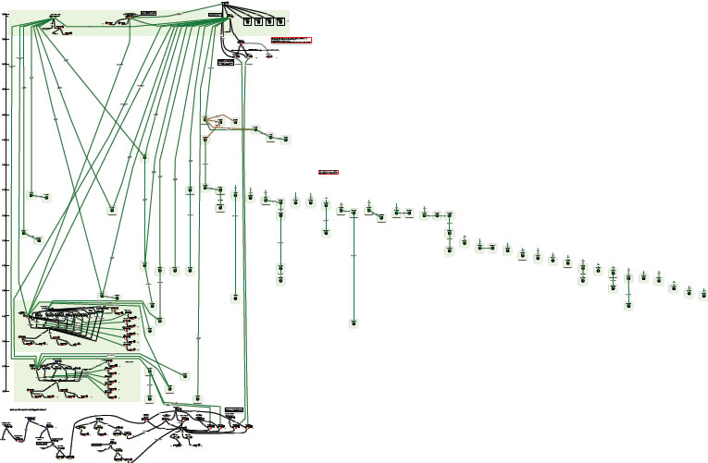
Complexity of relationships: Moby Dick
Printed editions
Diagram using FRBR entities and relationships
“OrsonWhales” mash-up (YouTube)
Ronald J. Murray: From Moby Dick to mash-ups
http://www.slideshare.net/RonMurray/from-mobydick-to-mashups
Notes:
RDA data is designed to reflect the complexity of relationships found in library and cultural heritage resources.
This is an example of a paper exercise to draw the relationships between the various printed editions of Herman Melville’s novel “Moby Dick”.
The complex sub-graph at the bottom represents a multimedia mash-up of Moby Dick with Orson Welles (who acted in the film of Moby Dick).
This diagram can be readily extended.
We could add the film starring Gregory Peck as Captain Ahab, and other film and tv adaptations, in multiple formats and editions. And the various recordings of the instrumental “Moby Dick” (for solo drummer!) by Led Zeppelin, and all the other recordings by the group, in multiple formats and editions. And so on.

Slide 7
RDA in Resource Description Format
RDA controlled terminologies represented as RDF value vocabularies
Example: RDA carrier type vocabulary
Entities, attributes, and relationships represented as RDF element sets
Entities represented in RDF as classes
Attributes and relationships represented in RDF as properties (“predicates”)
Example: RDA manifestation properties

Slide 8
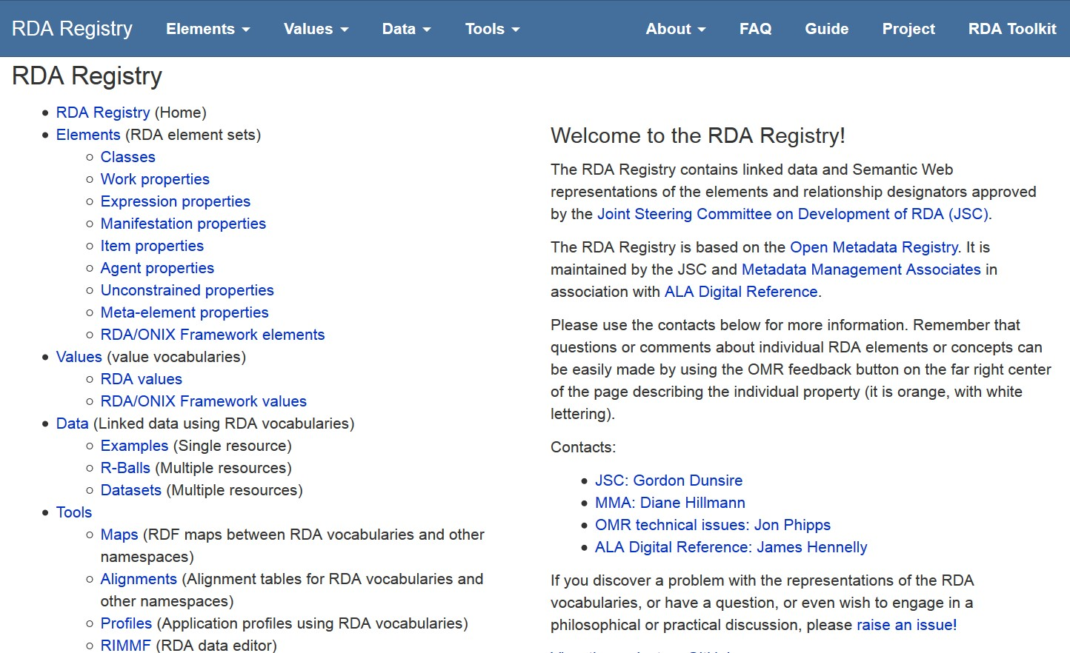
RDA Registry: rdaregistry.info
RDA Reference
Elements, attributes, relationships
Values
Other Glossary terms
Translations and partial translations
Notes:
The RDA Registry provides access to linked data versions of the RDA element sets and value vocabularies.
The Registry also provides access to tools for creating and editing RDA data and making it interoperate with non-RDA and non-FRBR applications.

Slide 9
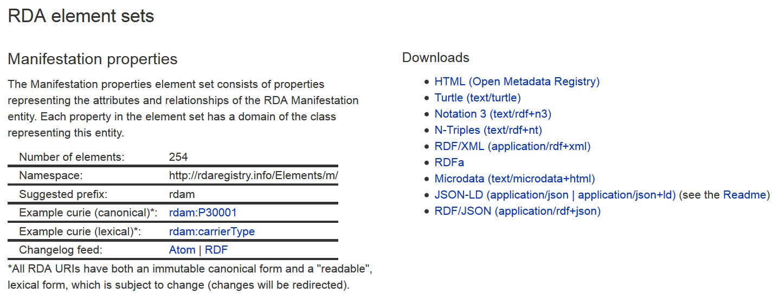
Except HTML for humans
RDF linked data serializations
Formal or canonical URI is “opaque”
- not intended for human readability
Lexical URI is intended for human readability
in different languages
Notes:
RDA URIs are opaque and do not hint at their meaning or semantics. This avoids issues of language and changes of label.
RDA has developed lexical URIs that can be “read” more easily by developers. These can be in any language; the lexical URIs are automatically linked to the canonical URI.
Each RDA element set and value vocabulary can be freely downloaded in different versions or serializations of RDF.
Human-readable versions are available in the Open Metadata Registry

Slide 10
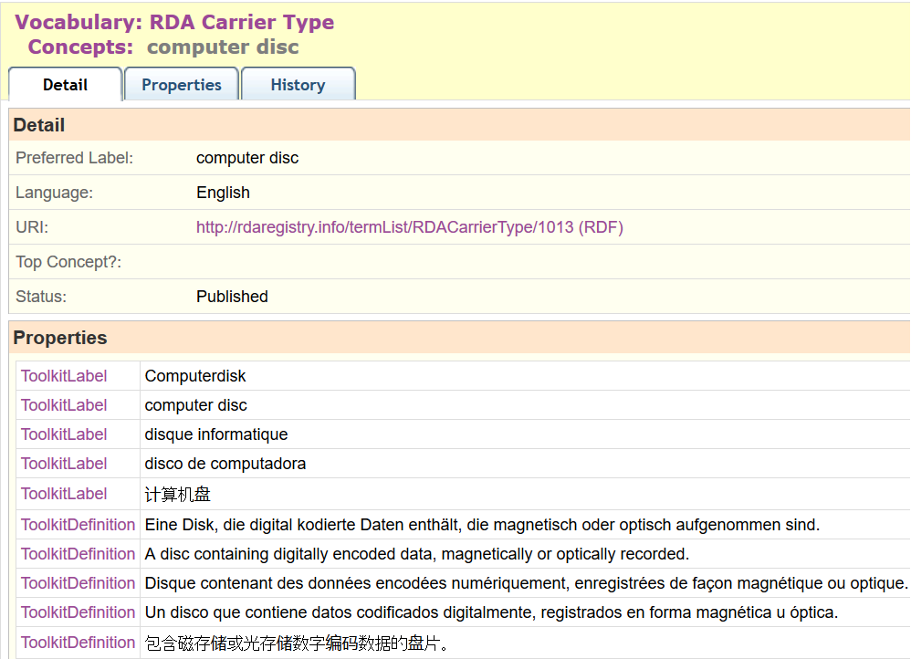
Multilingual linked data
RDF as global language
French
German
Spanish
Chinese
…
Notes:
This is a partial screen-shot of the OMR view of the RDA Media type “microform”.
The term label, definition, and scope note in multiple languages are linked to the URI for the term. This basic feature of RDF, the separation of strings (labels, etc.) from things (URIs), is fully exploited by the RDA Registry.
Value vocabularies are represented using SKOS (Simple Knowledge Organization System) elements. SKOS allows one preferred label per language, and as many definitions and notes as are required. RDA uses SKOS elements for broader, narrower, and term or concept equivalence to represent semantic hierarchies and maps.
The RDA Toolkit is currently available in French, German, and Spanish, with Finnish and Italian translations scheduled for the next series of updates. A separate translation is published in China. The RDA Translations Policy requires all full translations of the Toolkit to be represented in linked data format in the Registry.
Partial translations covering the RDA Reference data of element sets and value vocabularies will also be added to the Registry.

Slide 11
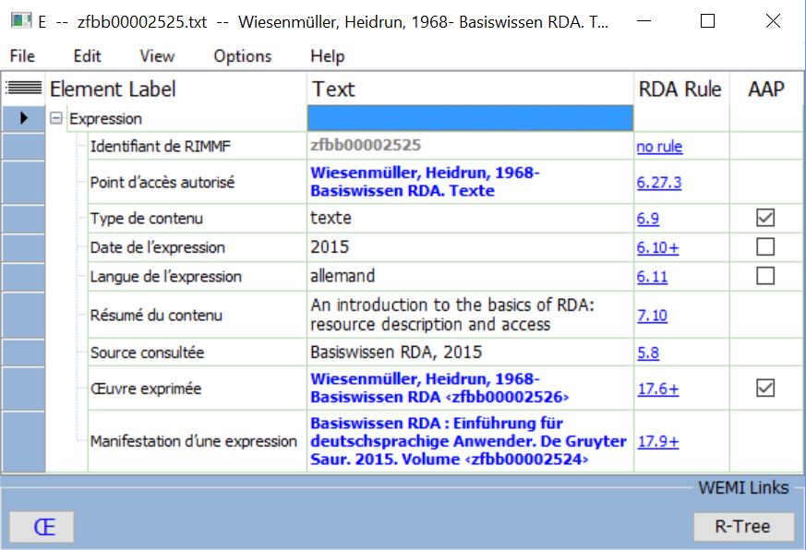
Polylingual data (RIMMF-ball
French cataloguer
German content
English agency

Slide 12
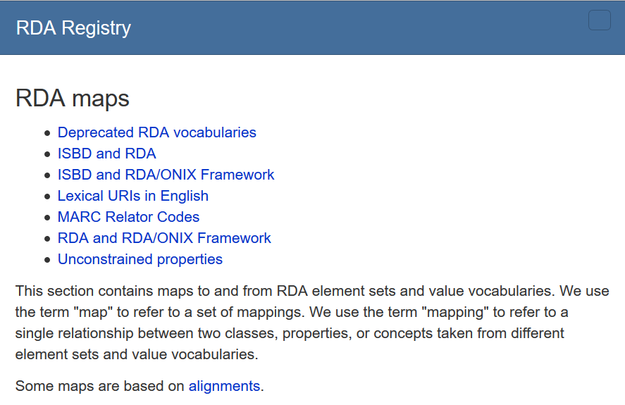
Multi-schema linked data
Many local dialects
Linking RDA to:
ISBD
MARC21
RDA/ONIX Framework
…

Slide 13
Conclusion
RDA supports fine-grained linked data compatible with the FRBR model
RDA supports extensions and refinements for cultural heritage data
RDA supports the multilingual Semantic Web
RDA supports linked data application developers

Slide 14
Thank you!
rscchair@rdatoolkit.org
http://www.rda-rsc.org/
http://www.rdaregistry.info/
http://metadataregistry.org/
http://www.marcofquality.com/wiki/rimmf3/

