Slide 1
RDA and Linked Data
Gordon Dunsire
Presented at Cita BNE - RDA and Linked Data, 15 April 2016, Madrid, Spain

Slide 2
Overview
Introduction: basic linked data
RDA Registry RDA Reference
Registry add-ons
  Unconstrained elements, maps, etc.

Slide 3
RDA: resource description and access
“RDA is a package of data elements, guidelines, and instructions for creating library and cultural heritage resource metadata that are well-formed according to international models for user-focussed linked data applications.”
  RDA Board, 2015
  http://www.rda-rsc.org/node/235
Notes:
The RDA Board, formerly the Committee of Principals for RDA, made this statement as part of an announcement affirming commitment to the internationalisation of RDA: resource description and access.

Slide 4
International models
FRBR (IFLA)
  FRBR/FRAD/FRSAD → FRBR-LRM (Library Reference Model)
  FRBRoo ← CIDOC-CRM (Conceptual Reference Model)
Resource Description Framework (RDF)
  ←Dublin Core Abstract Model (DCMI)
Notes:
RDA is based on international data models.
The Functional Requirements for Bibliographic Records (FRBR) models, developed by the International Federation of Library Associations and Services (IFLA), identify the basic entities and relationships required to meet user tasks in library resource discovery. The three original models are being consolidated into a single Library Reference Model. The new model will be compatible with an extension of the object-oriented model developed for museum data, the Conceptual Reference Model.
Data produced using the RDA instructions is intended to be well-formed according to the Dublin Core Abstract Model (DCAM) developed by the Dublin Core Metadata Initiative. The model has subsequently been instantiated in Resource Description Framework (RDF), the basis of linked data and the Semantic Web.

Slide 5
Linked data and RDF
Resource Description Framework (RDF)
Designed for machine-processing of metadata at global scale (Semantic Web)
  24/7/365
  Trillions of operations per second
Everything must be dis-ambiguated
  Machines are dumb
    A simple approach helps!
  Require machine-readable identifiers

Slide 6
RDF triple
Metadata expressed as “atomic” statements
  A simple, single, irreducible statement
    The title of this book is “RDA is fun!”
Constructed in 3 parts
  “Triple”
The title of this book is “RDA is fun!”
  Subject of the statement = Subject: This book
  Nature of the statement = Predicate: has title
  Value of the statement = Object: “RDA is fun!”
This book – has title – “RDA is fun!”
  Syntax: subject – predicate - object

Slide 7
Machine-readable identifiers
Uniform Resource Identifier (URI)
  Can be any unique combination of numbers and letters
  No intrinsic meaning; it is just an identifier
RDF requires the subject and predicate of triple to be URIs
  Object can be a URI, or a literal string (“RDA is fun!”)
URIs can be matched by machine to link triples together in chains and clusters

Slide 8
Manuscript example: RDF graph
Parchment
material
“Requires ...”
treatment
title
This ms
“Ode to himself”
location
author
Place X
birthplace
Ben Jonson
coordinates
“abcxyz”
“Jonson, Ben”
normalised name
Notes:
RDF triples can be linked by chaining the object (secondary focus) of one triple to the subject (primary focus) of another triple by matching URIs. Triples can also be linked in clusters sharing the same primary focus.
Human-readable strings, enclosed in boxes, cannot be linked because they are not URIs. The literal objects of some triples therefore terminate chains of linked triples.
This is a small RDF graph about:
a manuscript,
Ben Jonson,
parchment,
Place X,
depending on your point of view (or primary focus).
It is part of what has been called the “one giant global graph” that potentially links all resources, and data about them, together. This graph has no centre, edge, up, or down; it is all about what is in focus (the “subject” of a triple).

Slide 9
Linked data vocabularies
Each thing is globally identified by a URI
  A thing may be identified by more than one URI
  A URI must identify only one thing
Each thing is linked to, and humanly identified by, a label and/or definition.
  A thing may be identified by more than one label
  A label may identify more than one thing
Labels are fashionable, and at the mercy of convention and trend
Notes:
All linked data vocabularies exhibit the same characteristics.
RDF requires a one-to-one correspondence between a URI and the thing it identifies, but does not impose a one-and-only-one limit. A thing may therefore be identified by more than one URI. An RDF map between different URIs for the same thing is easy to create, once it is known that it is, indeed, the same thing. This usually requires human intervention.
To be useful for end-user applications, RDF data needs to contain human-readable labels and definitions for things, whether they are individuals, value concepts, or elements. RDF allows a thing to have any number of labels, definitions, and other strings linked to it. The nature of human language dictates that the same label may be used for distinct things. All of this is ambiguous data, and cannot be used for coherent semantic processing.
Labels are also vulnerable to fashion and trends. Jargon and slang are particularly rife in communities going through rapid change; the labels of cultural heritage things are unreliable indicators of meaning.

Slide 10
3 types of linked data vocabulary
Datasets (e.g. datos.bne.es)
  Individual things
  E.g. specific Person, Item, Place, etc.
Value vocabularies
  Concepts, terminologies
  E.g. subject headings, thesauri, etc.
Element sets
  Types of thing (classes); types of relationship between things
  E.g. Person, place of birth, supervisor, etc.
Notes:
The W3C Library Linked Data Incubator Group describes three categories of linked data vocabulary.* A vocabulary is a set of RDF triples.
Datasets are sets of triples about specific, individual things. Datasets are the linked data versions of catalogue records. Datasets can also represent cross-walks or maps between value vocabularies and between element sets from different communities.
Value vocabularies are sets of triples about controlled terminologies, subject headings, thesauri, and other knowledge organization schemes. Value vocabularies represent the semantics of the individual terms or concepts and the relationships between them. Value vocabularies are used in statements about individual things in datasets.
Element sets are sets of triples about the entities and relationships used to make statements about individual things in datasets. Elements sets represent the semantics of entities and their relationships, and are the linked data versions of models, schemas, and ontologies.
* http://www.w3.org/2005/Incubator/lld/XGR-lld-vocabdataset-20111025/

Slide 11
RDA in RDF
RDA controlled terminologies represented as RDF value vocabularies
  Example: RDA carrier type vocabulary
Entities, attributes, and relationships represented as RDF element sets
  Entities represented in RDF as classes
  Attributes and relationships represented in RDF as properties (“predicates”)

Slide 12
RDA entities
FRBR Work-Expression-Manifestation-Item
  Discrete components of a resource; avoids duplication of data
  E.g. Work creator and Expression language are linked to, not copied in, multiple Manifestation descriptions
    E.g. printed book, digitized book, and e-book
FRBR Person, Family, and Corporate Body
  Agents related to a resource
FRBR-LRM introduces new entities for Place, Timespan, and Nomen (name) [expected 2016]
Notes:
RDA entities correspond to two groups of FRBR entities.
The first group includes Work, Expression, Manifestation, and Item entities. They represent layers of abstraction, and therefore commonality of data, from the individual item to the abstract conception behind its creation. Data for a Work entity can be linked to multiple Expressions, including translations. Each Expression can be linked to multiple Manifestations, including different print and digital formats, and each Manifestation may have multiple Items.
The second group includes three types of human entity that can be related to the WEMI aspects of a resource. For example, a Person can create a Work, or translate an Expression; a Corporate Body can publish a Manifestation; a Family can donate an Item to a rare books collection.
The Library Reference Model is likely to introduce new entities for Place and Timespan, to cover relationships such as date and place of birth of a Person. The entity Nomen will support linked data for names, titles, access points, and identifiers. The final version of the LRM is expected to be available later in 2016.

Slide 13
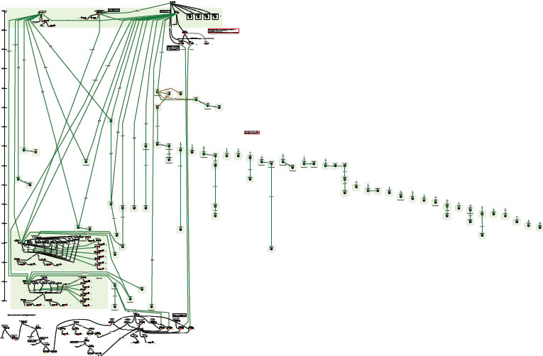
Complexity of relationships: Moby Dick
Printed editions
Diagram using FRBR entities and relationships
“OrsonWhales” mash-up (YouTube)
Ronald J. Murray: From Moby Dick to mash-ups
http://www.slideshare.net/RonMurray/from-mobydick-to-mashups
Notes:
RDA data is designed to reflect the complexity of relationships found in library and cultural heritage resources.
This is an example of a paper exercise to draw the relationships between the various printed editions of Herman Melville’s novel “Moby Dick”.
The complex sub-graph at the bottom represents a multimedia mash-up of Moby Dick with Orson Welles (who acted in the film of Moby Dick).
This diagram can be readily extended.
We could add the film starring Gregory Peck as Captain Ahab, and other film and tv adaptations, in multiple formats and editions. And the various recordings of the instrumental “Moby Dick” (for solo drummer!) by Led Zeppelin, and all the other recordings by the group, in multiple formats and editions. And so on.

Slide 14
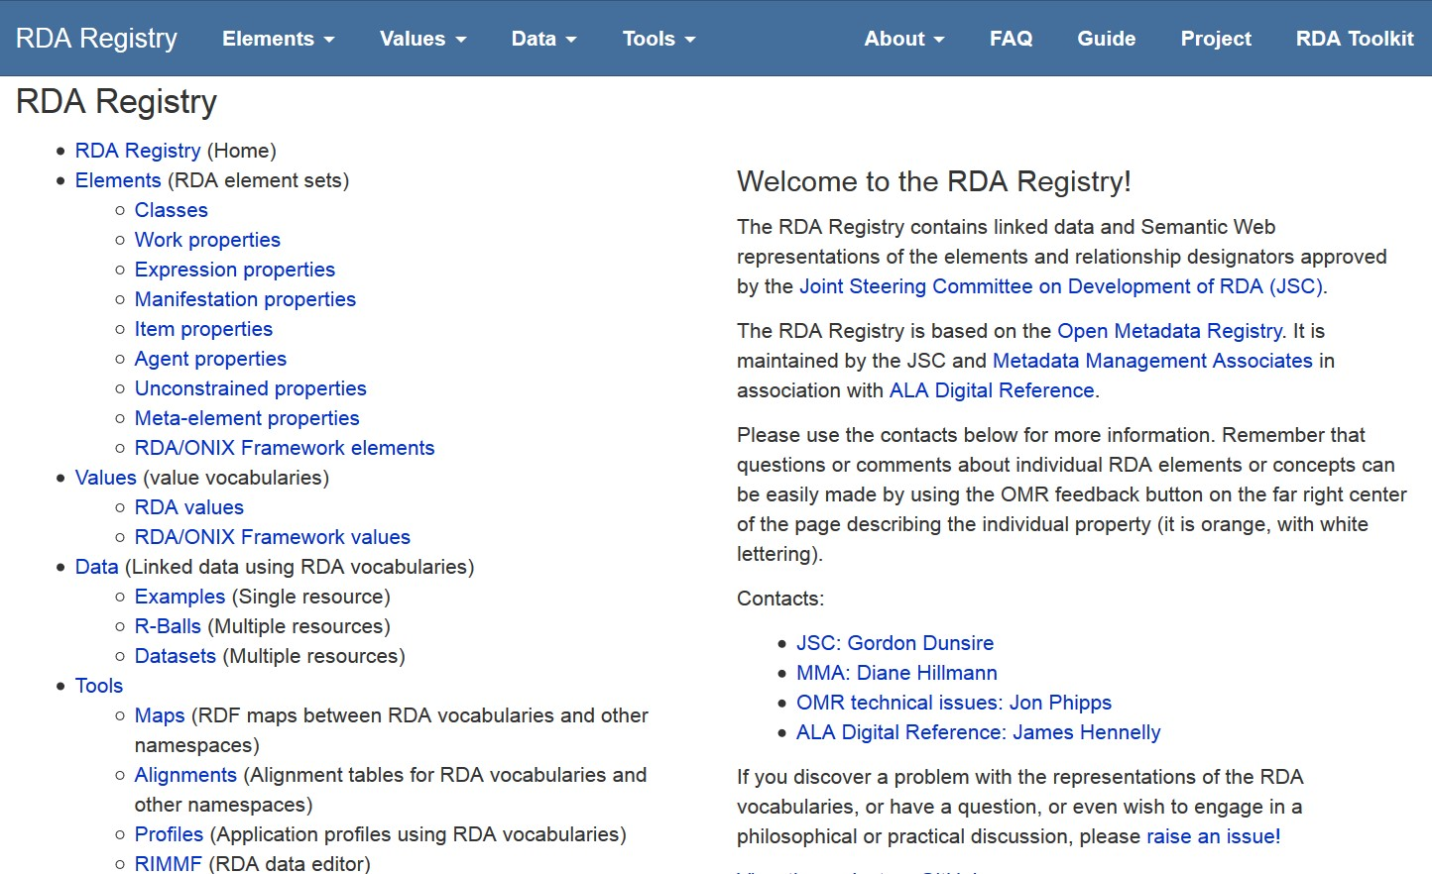
RDA Registry: rdaregistry.info
RDA Reference
Elements, attributes, relationships
Values
Other Glossary terms
Translations and partial translations
Notes:
The RDA Registry provides access to linked data versions of the RDA element sets and value vocabularies.
The Registry also provides access to tools for creating and editing RDA data and making it interoperate with non-RDA and non-FRBR applications.

Slide 15
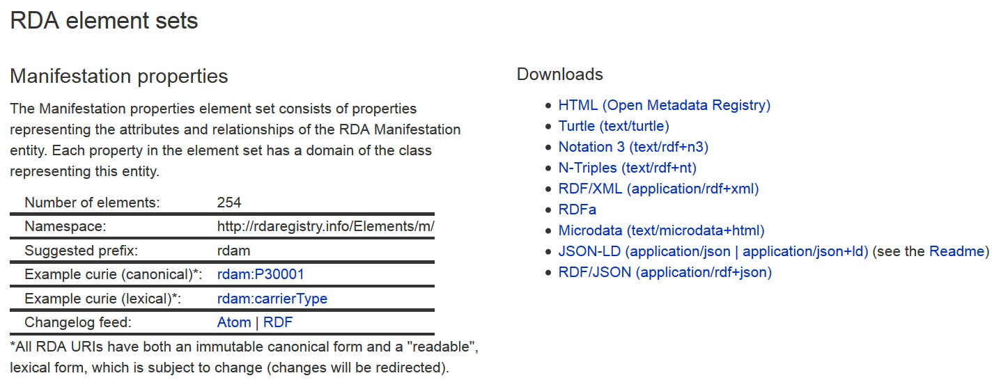
Except HTML for humans
RDF linked data serializations
Formal or canonical URI is “opaque”
- not intended for human readability
Lexical URI is intended for human readability
in different languages
Notes:
RDA URIs are opaque and do not hint at their meaning or semantics. This avoids issues of language and changes of label.
RDA has developed lexical URIs that can be “read” more easily by developers. These can be in any language; the lexical URIs are automatically linked to the canonical URI.
Each RDA element set and value vocabulary can be freely downloaded in different versions or serializations of RDF.
Human-readable versions are available in the Open Metadata Registry

Slide 16
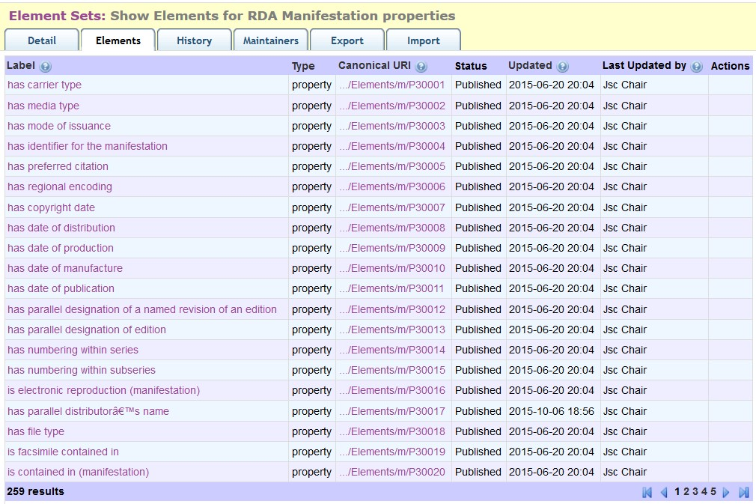
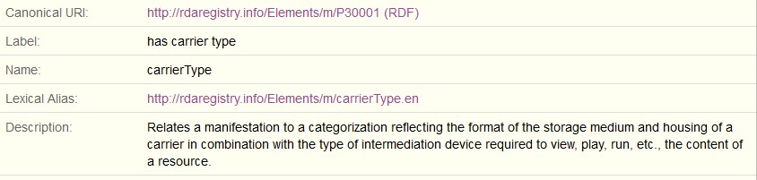
Open Metadata Registry (http://metadataregistry.org)
Web view of RDA/RDF
Fine granularity audit trail
Notes:
This is a partial screen-shot of the first page of the Manifestation element set in the OMR.
The interface provides standard browse and search facilities.
Clicking on an element reveals more data about the element.
The OMR maintains an audit trail at the level of each transaction on each element, dated and attributed.

Slide 17
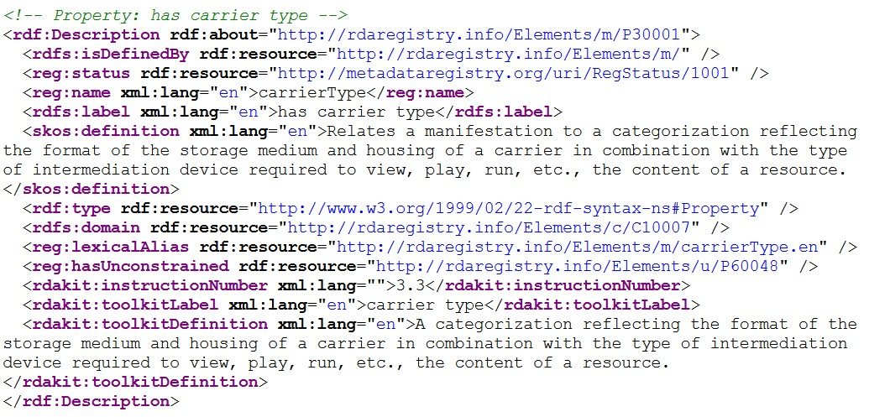
Machine views of RDA elements
<http://rdaregistry.info/Elements/m/P30001>
reg:hasUnconstrained <http://rdaregistry.info/Elements/u/P60048> ;
reg:lexicalAlias <http://rdaregistry.info/Elements/m/carrierType.en> ;
reg:name "carrierType"@en ;
reg:status <http://metadataregistry.org/uri/RegStatus/1001> ;
rdakit:instructionNumber "3.3" ;
rdakit:toolkitDefinition "A categorization reflecting the format of the storage medium and housing of a carrier in combination with the type of intermediation device required to view, play, run, etc., the content of a resource."@en ;
rdakit:toolkitLabel "carrier type"@en ;
a rdf:Property ;
rdfs:domain <http://rdaregistry.info/Elements/c/C10007> ;
rdfs:isDefinedBy <http://rdaregistry.info/Elements/m/> ;
rdfs:label "has carrier type"@en ;
skos:definition "Relates a manifestation to a categorization reflecting the format of the storage medium and housing of a carrier in combination with the type of intermediation device required to view, play, run, etc., the content of a resource."@en .
Notes:
This is a set of RDF triples about the RDA element “carrier type”, presented in RDF/XML syntax. It is an extract from the full set of triples for the Manifestation element set.
The same extract is also shown in Terse Triple Language (ttl or turtle) syntax.

Slide 18
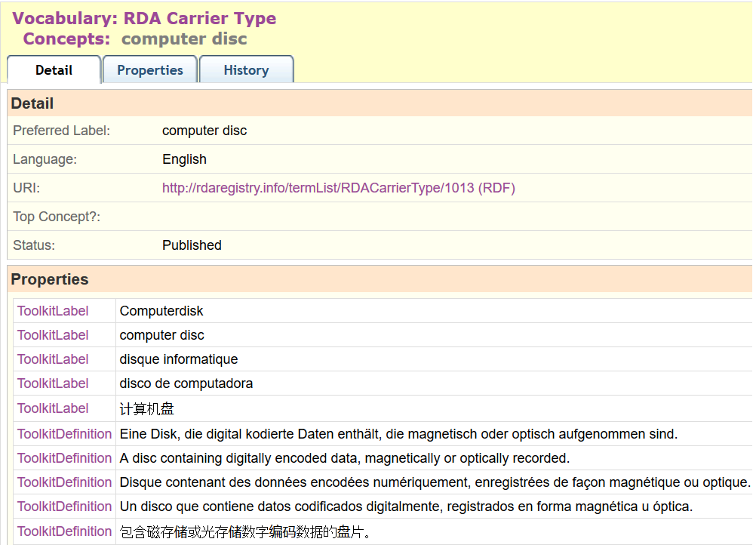
Multilingual linked data
French
German
Spanish
Chinese
…
Notes:
This is a partial screen-shot of the OMR view of the RDA Media type “microform”.
The term label, definition, and scope note in multiple languages are linked to the URI for the term. This basic feature of RDF, the separation of strings (labels, etc.) from things (URIs), is fully exploited by the RDA Registry.
Value vocabularies are represented using SKOS (Simple Knowledge Organization System) elements. SKOS allows one preferred label per language, and as many definitions and notes as are required. RDA uses SKOS elements for broader, narrower, and term or concept equivalence to represent semantic hierarchies and maps.
The RDA Toolkit is currently available in French, German, and Spanish, with Finnish and Italian translations scheduled for the next series of updates. A separate translation is published in China. The RDA Translations Policy requires all full translations of the Toolkit to be represented in linked data format in the Registry.
Partial translations covering the RDA Reference data of element sets and value vocabularies will also be added to the Registry.

Slide 19
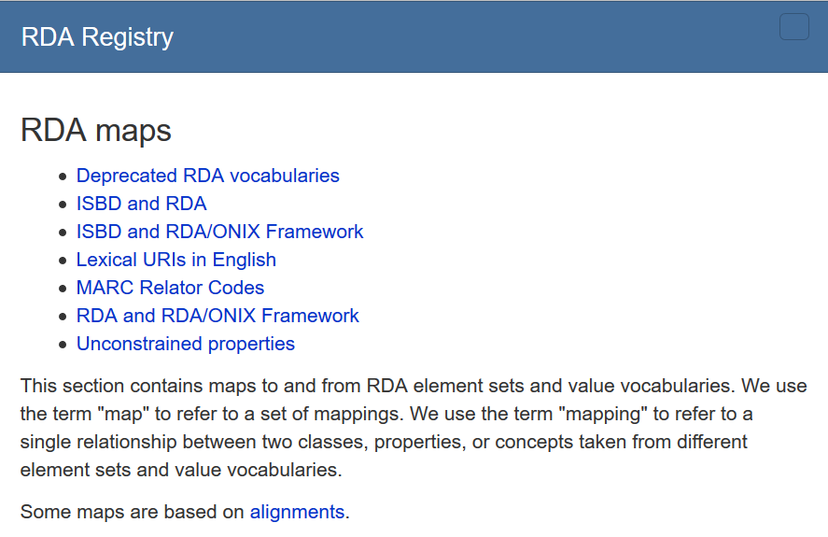
Multi-schema linked data
Linking RDA to:
ISBD
MARC21
RDA/ONIX Framework
…

Slide 20
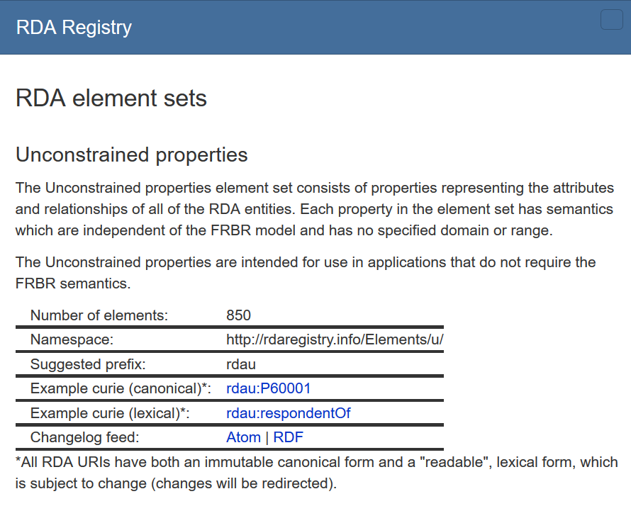
Unconstrained linked data
Example: Contributor
Relates a resource to an agent contributing to a resource.
Remove FRBR model to
“dumb-down”
semantics to common level of granularity
“resources” and “agents”

Slide 21
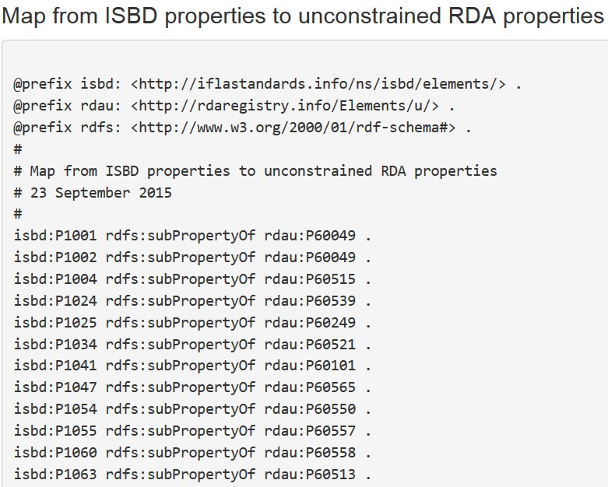
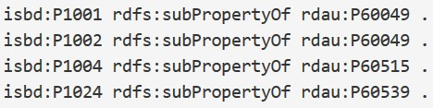
Beyond RDA data: ISBD
[Linked data cloud, not RDF graph]
Unconstrained
(No entity
Specified)
RDAU
ISBDU
RDA
ISBD
Work
Expression
Manifestation
Item
Resource
Notes:
The RDA Registry contains an element set that is not tied to the RDA entities. The “unconstrained” elements parallel the RDA elements but have general definitions, so they can be used by applications that do not require the finer granularity and semantics of RDA and FRBR.
This allows RDA data to interoperate with data from another community. For example, there is an agreed alignment between ISBD (International Standard Bibliographic Description) elements and RDA elements. The alignment is the basis of a set of linked data maps between ISBD and RDA data.
The diagram shows the maps between the RDA and ISBD element sets and their unconstrained versions. The maps preserve semantic coherence by removing the information about RDA’s WEMI entities and ISBD’s Resource entity; the semantic relationship between these entities is not simple and direct.
The diagram is part of the “linked data cloud” of RDF maps, and is not itself an RDF graph. For example, the map between ISBD and the unconstrained RDA elements represented by a single line is an RDF graph, the first part of which is shown.

Slide 22
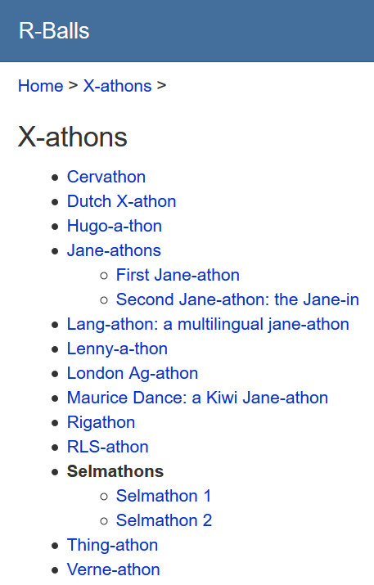
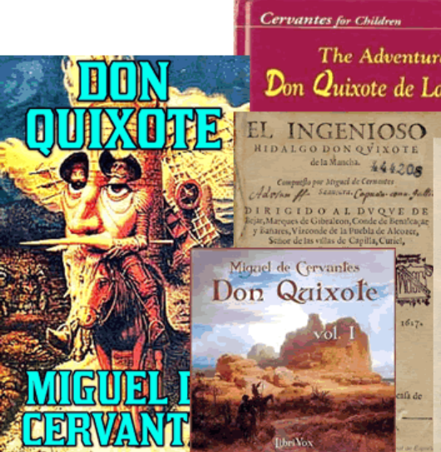
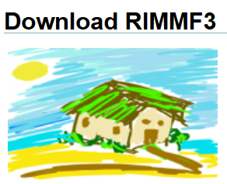
RDA linked data in action: Cervathon
Hackathon for RDA data
Using RIMMF software
With output format for linked data (RDA/RDF)

Slide 23
Conclusion
RDA supports fine-grained linked data compatible with the FRBR model
RDA supports extensions and refinements for cultural heritage data
RDA supports the multilingual Semantic Web
RDA supports linked data application developers
RDA is linked data fun!

Slide 24
Thank you!
rscchair@rdatoolkit.org
http://www.rda-rsc.org/

