Slide 1
RDA and Linked Data
by Gordon Dunsire
National Seminar,
National Library of Finland,
Helsinki, Finland, 25 March 2014

Slide 2
Based on RDA and the Semantic Web: Lectio magistralis in Library Science,
Florence University, Florence, Italy
4th March, 2014

Slide 3


Functional Requirements for
Bibliographic Records
User
tasks
Work
Expression
Manifestation
Item
Content attributes
Carrier attributes
AACR3
Item
JSC, 2005

Slide 4
Semantic Web (Berners-Lee)
Structured
collections
of information
Sets of inference rules
Automated reasoning
Web of linked data
Web of linked documents
Web of linked computing devices

Slide 5
ex:“is derivative work of”
ex:
“That work”
ex:“has derivative work”
ex:“has title”
“RDA and the Semantic Web”
ex:
“This work”
ex:“has author”
One giant global graph
“Gordon Dunsire”
ex:“has name”
ex:
Gordon Dunsire
ex:
“This work”
“G. J. Dunsire”
ex:“has author”
ex:“has alternate name”
ex:“is author of”
ex:
Scotland
ex:“has
country of birth”

Slide 6
Data vs Ontology
ex:
Gordon Dunsire
ex:
“This work”
Data triple
ex:“has author”
URI
ex:
hasAuthor
Ontology
triple
“has author”
ex:“has label”
“Property”
ex:“has type”

Slide 7
Inference rules: sub-property
ex:
Property1
“has author”@en
ex:“has label”
ex:
“is sub-
property
of”
ex:
Property2
“has creator”@en
ex:“has label”
ex:
“This work”
ex:“has author”
“Gordon Dunsire”
ex:
“This work”
ex:“has creator”
“Gordon Dunsire”

Slide 8
RDF vocabularies: DCT + RDFS
Dublin Core Terms + RDF Schema
rdfs:label
rdfs:label
“Creator”
“Agent”
dcterms:
creator
dcterms:
Agent
rdfs:range
“A resource that acts or has the power to act.”
rdfs:comment
Source of URIs

Slide 9
Inference rules: range
dcterms:
creator
dcterms:
agent
rdfs:range
ex:
Gordon Dunsire
ex:
“This work”
dcterms:creator
ex:
Gordon Dunsire
dcterms:
Agent
rdfs:type

Slide 10
Benefits expected from London 2007 meeting
The library community gets a metadata standard that is compatible with the Web Architecture and that is fully interoperable with other Semantic Web initiatives
The DCMI community gets a libraries application profile firmly based on the DCAM and FRBR (which will be a high profile exemplar for others to follow)
The Semantic Web community get a significant pool of well thought-out metadata terms to re-use
There is wider uptake of RDA

Slide 11
Activities 2007-
Development of an RDA Element Vocabulary
Development of an RDA DC Application Profile based on FRBR and FRAD
Disclosure of RDA Value Vocabularies using RDF/RDFS/SKOS

Slide 12
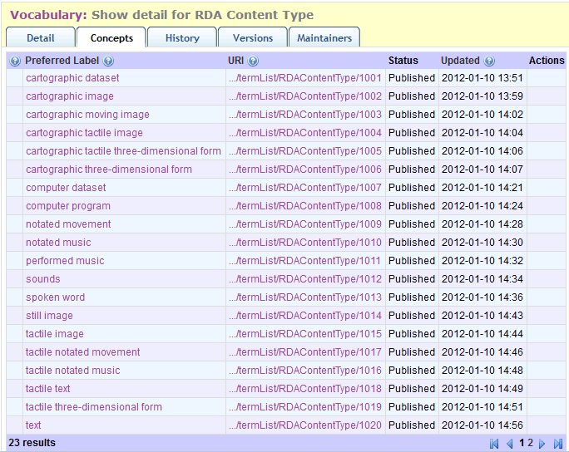
Opaque URI
(only for machines)
Compact URI = rdact:1010

Slide 13
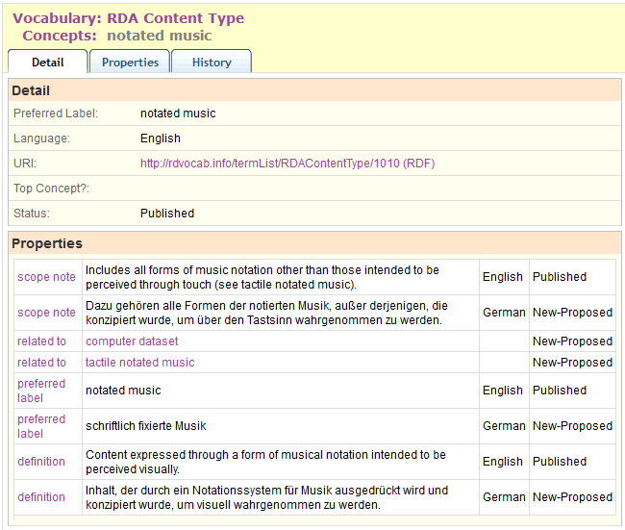

Slide 14
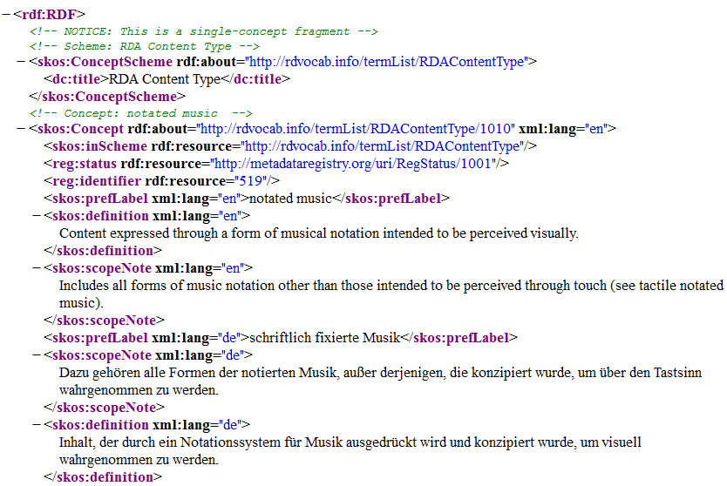
…

Slide 15
DCAM and RDA
Dublin Core Abstract Model
<indecs>
Basic RDA metadata structures
ex:
ExpressionURI
e.g vocabulary encoding scheme
rdae:
“has content
type”
rdfs:label
“notated music”@en
rdact:
1010
skos:inScheme
rdaterms:
RDAContentType

Slide 16
High-level metadata structures
Unconstrained
rdau:
“has title”
Constrained by FRBR (domain)
sP
rdfs:
“domain”
rdam:
“has title”
rdau:
“has title proper”
rdac:
“Manifestation”
sP
rdam:
“has title proper”
sP
rdfs:
“domain”
sP = rdfs:”sub-property of”

Slide 17
Relationship designators
rdau:
“has creator”
sP
rdaw:
“has creator”
rdau:
“has designer”
rdac:
“Work”
rdfs:
“domain”
sP
rdfs:
“range”
rdac:
“Agent”
sP
rdaw:
“has designer”
sP = rdfs:”sub-property of”

Slide 18
Link-ability
Domains
Relationships
Attributes
Entity | Properties | Range | No Range
Work | 235 | 200 | 35
Expression | 235 | 190 | 45
Manifestation | 210 | 50 | 160
Item | 50 | 40 | 10
Agent | 225 | 175 | 50
Triple clusters
Triple chains
Literals
Covering all media

Slide 19
Rich detail
rdaw:
“has related work”
rdaw:
“has accompanying work relationship with”
rdaw:
“is complemented by (work)”
rdaw:
“is screenplay (work)”
rdaw:
“is video screenplay (work)”
sub-property ladder

Slide 20
Interoperability
rdau:
“has creator”
???
dc:
“creator”
rdaw:
“has creator”
rdau:
“has performer”
dcterms:
“creator”
rdau:
“has actor”
rdau:
“has voice actor”

Slide 21
To do (from 2007 …)
Publish more RDA value vocabularies
Develop cross-entity elements
E.g. Work-Expression relationship designators
Develop Application Profile for RDA “core”
Develop RDF elements for aggregated statements (RDA, ISBD, MARC, …)
E.g. Place of publication -> Publication statement

Slide 22
To do (from now)
More machine-actionability (internal)
Extent
Place
RDA/ONIX Framework
Maps to related linked data elements (external)
RDA->MARC 21 relators ✓
ISBD->RDA [✓]
RDA-BIBFRAME [?]
RDA-FRBR [!]
What is an RDA record?

Slide 23
Achievements: 5+ years on
Rich set of elements and value vocabularies for “bibliographic control”
At global, “universal” level
“a metadata standard that is compatible with the Web Architecture and that is fully interoperable with other Semantic Web initiatives”
“a significant pool of well thought-out metadata terms to re-use”
Wider uptake of RDA? …

Slide 24
Thank you!
gordon@gordondunsire.com

