Slide 1
RDA and libraries
Gordon Dunsire
Presented at a College Development Network webinar, 13 June 2013

Slide 2
Overview
Introduction to RDA
What it means for our library users
What it means for our library management systems
The RDA environment
  Relationships with other catalogue standards such as MARC and ISBD and linked data

Slide 3
RDA
Resource Description and Access
A new standard for creating bibliographic metadata (catalogue record) content
  Based on the Anglo-American Cataloguing Rules (AACR)
    In development since 1841 (Panizzi’s rules for the British Museum)
  And Functional Requirements for Bibliographic Records (FRBR) and other more modern stuff
    1995-

Slide 4



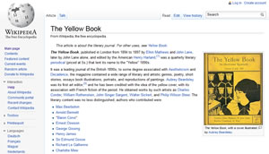



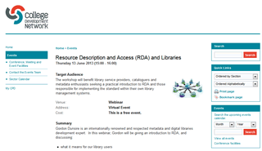


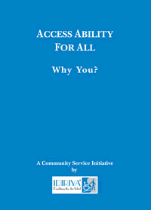

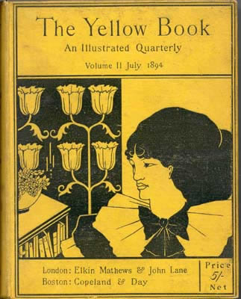


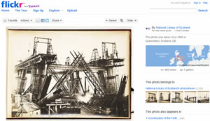
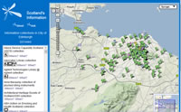

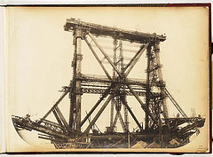
Impact of the global digital environment!
Why now?

Slide 5
Short-term impact of RDA on users:
Content of catalogue record
“Plain English” in prescriptive terminology
  Place of publication not identified instead of [S.l.]
More consistency in terminology
  wide screen, piano score, not drawn to scale, etc.
More detail and clarity in controlled vocabularies
  computer disc cartridge, online resource, etc., instead of [electronic]

Slide 6
Long-term impact on users:
Navigation of catalogue (1)
FRBR splits one record of a Resource into four records of a Work, an Expression, a Manifestation, and an Item (WEMI entities)
  “products of intellectual or artistic endeavour that are named or described in bibliographic records”
  From general/abstract to specific/concrete
Each entity attribute is associated with a user task
  Find, Identify, Obtain, Use (FISO)

Slide 7
FRBR navigation
Example
 FISO 
Work
Symphony no.1
Is realised through
Expression 1
Expression 2
LSO recording
Is embodied in
Manifestation 1.1
Manifestation 2.1
Manifestation 2.2
DVD-A
Is exemplified by
Item 1.1.1
Item 2.1.1
Item 2.2.1
Item 2.2.2
Copy on shelf
Notes:
7

Slide 8
Long-term impact of RDA on users:
Navigation of catalogue (2)
FRBR model includes relationships between entities
  Work A derived from Work B
Entities include agents (persons, corporate bodies, families)
  Manifestation A published by Agent B
RDA refines these relationships to provide an extensive list of roles and other designators
  Rich interconnections between resources

Slide 9
Short-term impact on systems
RDA does not specify any data carrier or format
MARC 21 has added tags, etc. for RDA elements
  Most current library systems can handle MARC 21
  Index maps need updated
  Display layouts may need tweaked
Many new controlled terms
  Pull-down lists; display maps

Slide 10
Long-term impact on systems
WEMI records reduce duplication, but require new workflows
  Attach a new Manifestation record to an existing Expression record
Publisher and machine-generated metadata part of the immediate RDA environment
  Extension of shared cataloguing infrastructure
Or will it be something completely different?

Slide 11
RDA environment
Alignment/interoperability with MARC 21 and International Standard Bibliographic Description (ISBD)
  Also ONIX (Publishing industry) content and carrier types via the RDA/ONIX Framework
Adoption beyond the Anglo-American axis
  Germany and other European countries, etc.
Translations into French and German
  Spanish on the way

Slide 12
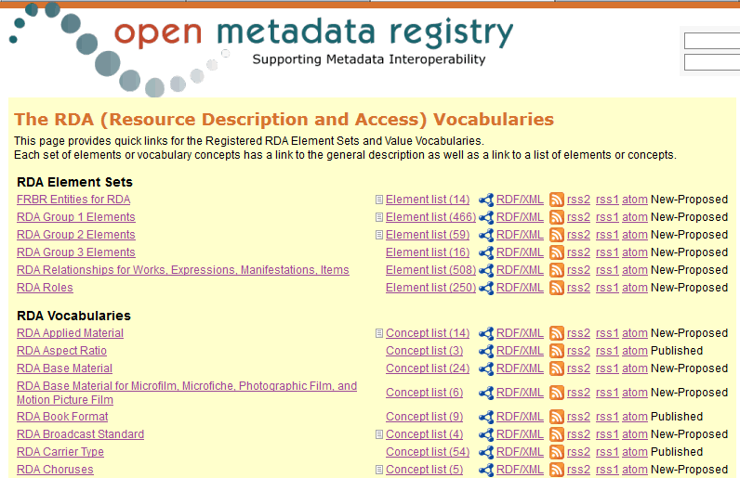
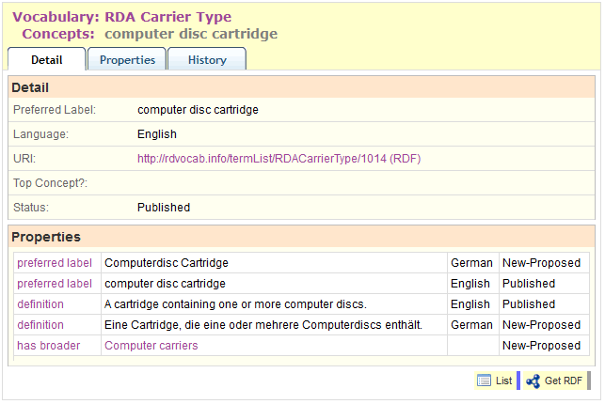
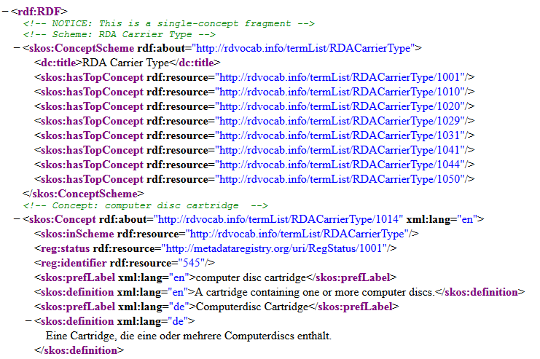
RDA and linked data
http://rdvocab.info/

Slide 13
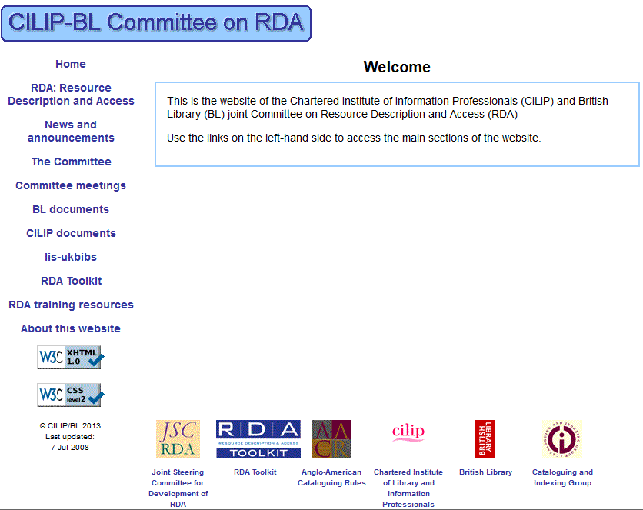
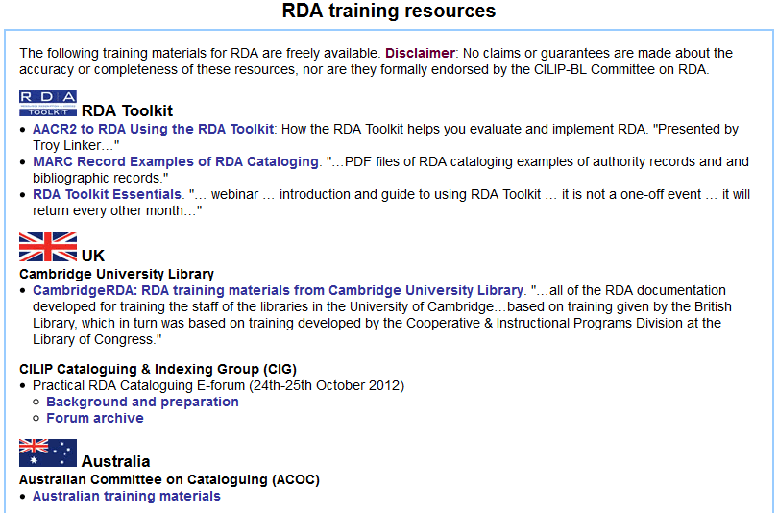
http://www.slainte.org.uk/aacr/

Slide 14
Thank you!
gordon@gordondunsire.com

