Slide 1
Quests, collections, and community knowledge: local perspectives on metadata
Gordon Dunsire
Presented to 11th Prato CIRN Conference October 13-15 2014, Monash Centre, Prato, Italy

Slide 2
Abstract
The presentation will journey from the personal view of a librarian on archival practice via a description of recent trends in metadata for global information retrieval to a discussion on the impact on local communities of knowledge. On the way it encounters the killer library assistant interview question, Heaney’s model of collections and their metadata, granularity, the Grail of cataloguing, Universal Bibliographic Control, entities and relationships and databases, a sense of place and time, dumbing-up and dumbing-down, and linked data and the Semantic Web. The result is a paradigm shift, from top to bottom, from control to chaos, from global to local. There is no favoured point of view except that of the community, but where in the cloud is the crowd? If there is no centre, where is the edge? How small can big data be? What does it really mean to be forgotten, and who has the right?

Slide 3
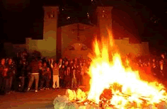
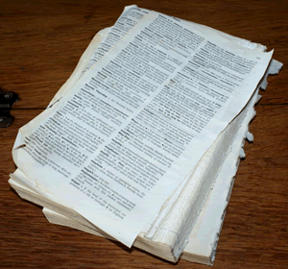
Killer questions
Why do you want to work in a library?
Because I like books! ☺
Sometimes we have to destroy books: what do you think about that?
Superseded
Updated
Erroneous
☹
Content vs Carrier

Slide 4
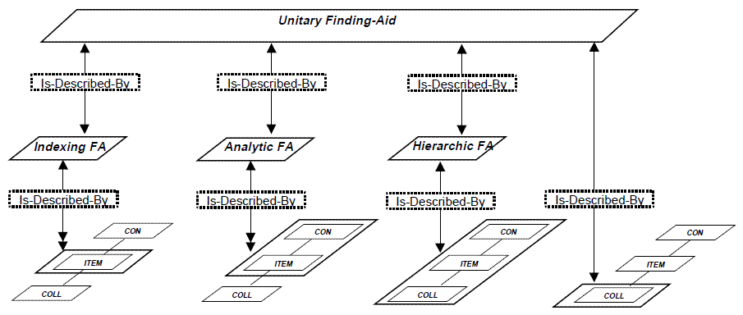
Heaney’s models
Michael Heaney (2000)
An Analytical Model of Collections and their Catalogues
Analytic Finding Aid (Library catalogue)
CONtent
ITEM
COLLection
Hierarchic Finding Aid (Archives)

Slide 5
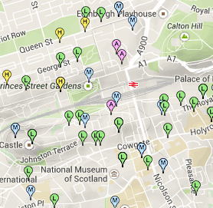
Collections and collectives
Database based on Heaney
Scottish Collections Network (SCONE)
Central Edinburgh:
National, special, and public collections
Libraries: 1 collective body
Archives: 2 collective bodies (disjoint)
Hierarchical dis-organization?

Slide 6
Granularity
coarse
Collection
aggregated by
aggregation
member of
Collection
part of
Item
Content:
contained by
fine
Item
Preface
Index
Chapter
Cultural heritage
Illustration
Paragraph
Library
Archive
Word
Collection
Fonds
Carrier:
Item or object (tangible)
Resource
Sub-fonds
Copy
…?

Slide 7

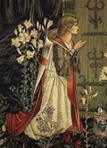
The (metadata) Grail
Item
describes
itself
Master
Catalogue
Record
Interpreted by professional intermediaries
Using arcane rules and processes
Representation
Title page, cover, introduction, etc.
(by author, publisher, etc.)

Slide 8
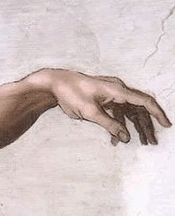
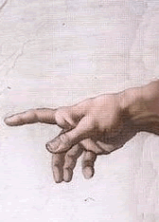
Universal Bibliographic Control
Agreed at international level with global scope
Top-down,
one size
fits all
One
record
structure
One
content
rules
One
encoding
format

Slide 9
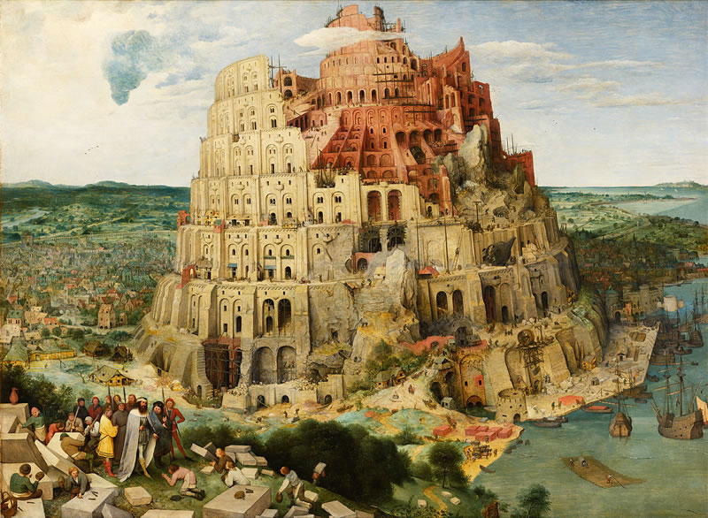
Digital technology:
All content on one carrier
Global is the connected local
Control structures crumble
Web is the fundamental structure
From record to data

Slide 10
Entities and relationships
Entity: type of thing being described
Person
Event
Item
Name of person
Common characteristics
Date of birth of person
Address of person
Relationships between entities
attends
Person
Event
is attended by

Slide 11
Place and time
Localization
Auxiliaries for library subject headings added to any topic: Education – Italy – 19th century
Actor
Product
Event
Place
Time(span)
Events in lifecycle of a resource and its metadata

Slide 12
Semantic Web (Berners-Lee)
Structured
collections
of information
Sets of inference rules
Automated reasoning
Web of linked data
Web of linked documents
Web of linked computing devices

Slide 13
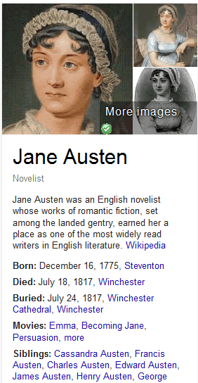
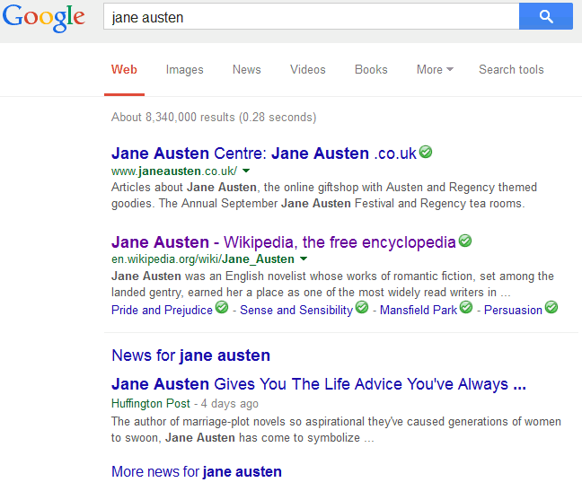
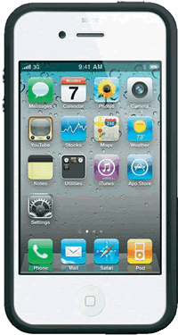
Semantic web
Web of data
Web of documents
Web of machines

Slide 14
Linked data
“This work has author Jane Austen”
Triple!
Subject – Predicate - Object
For machines
“For humans”
Work
Person
“Jane Austen”
has author
has name
“16 Dec 1775”
has title
has birth date
“Pride and prejudice”
Place
has location
Linked data chain
Linked data cluster
“England”

Slide 15
ex:“is derivative work of”
ex:
“That work”
ex:“has derivative work”
ex:“has title”
“Quests, collections, …”
ex:
“This work”
ex:“has author”
One giant global graph
“Gordon Dunsire”
ex:“has name”
ex:
Gordon Dunsire
ex:
“This work”
“G. J. Dunsire”
ex:“has author”
ex:“has alternate name”
ex:“is author of”
ex:
Scotland
ex:“has
country of birth”

Slide 16
Dumbing-up; dumbing-down
coarse
Semantic granularity of entities, characteristics and relationships
global
has creator
Agent
X
has author
has painter
Person
Family
has label
has name
has title
local
fine
No intrinsic smarting-up of data

Slide 17
Paradigm shift
From the (catalogue) record to the statement (triple)
A record is a specified set of statements
There is no perfect record
Statements from professionals, users, and machines are all in the mix
From a closed world to an open world

Slide 18
Semantic web principles
Anyone can say Anything about Any thing (AAA)
There is no test for truth, only the detection of contradictory statements.
Open World Assumption (OWA)
The absence of a statement is not a statement about absent data; the data may be stated elsewhere or at another time.

Slide 19
Provenance
Must be explicitly stated
Who said that?
Meta-metadata
Person
“16 Dec 1775”
has birth date
Person
has author
“9 Sep 1981”
has date
The cluster is
the context
Rules of
description
has rules

Slide 20
Aggregation
Context
A Collection
is part/sub-collection of;
is contained in
has part/sub-collection;
contains
A Fonds
is part/sub-collection of;
is contained in
has part/sub-collection;
contains
A Sub-fonds
is part/sub-collection of;
is contained in
has part/sub-collection;
contains
An Item
Digital
surrogate

Slide 21
No favoured point of view
There is no centre or edge
Start anywhere and follow the links
Everything can be connected to everything
Regions of dense or sparse links
6 degrees of Kevin Bacon
Link attractors:
Trust, coverage, availability

Slide 22
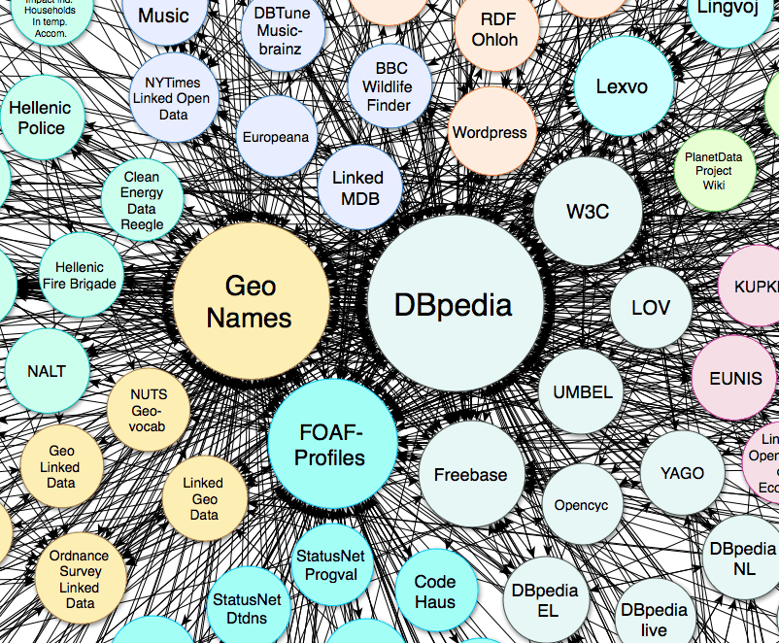
Collection-level entities in the LOD cloud

Slide 23
Missing links
X
?
To be forgotten (?) = 0 links
∞ degrees of Kevin Bacon!

Slide 24
Community issues
Don’t be dumb(ed-down)
Use local schema representing the local pov
Link the local to the global
Use semantic maps, not data cross-walks
There is no space in cyberspace:
Everything can fit in

Slide 25
The global is the local
The local is the global

Slide 26
Thank you!
gordon@gordondunsire.com
www.gordondunsire.com
Heaney’s model
http://www.ukoln.ac.uk/metadata/rslp/model/amcc-v31.pdf
Book spine view of: Leaflets of Memory (Philadelphia: E.H. Butler & Co., 1847)
Detail of: The Achievement of the Grail by Sir Edward Burne-Jones
Detail of: The Creation of Adam by Michelangelo
The Tower of Babel by Pieter Bruegel the Elder
Linking Open Data cloud diagram 2014, by Max Schmachtenberg, Christian Bizer, Anja Jentzsch and Richard Cyganiak. http://lod-cloud.net/

