Slide 1
RDA and practical linked open data
Gordon Dunsire
Presented to EURIG Conference: RDA towards Linked Data, 9 May 2017, Fiesole, Italy

Slide 2
LRM and RDA
Consolidation and extension of FRBR, FRAD, FRSAD; compatible with CIDOC-CRM (and linked data/RDF)
All* RDA entities are compatible refinements of LRM
* except Person (non-humans excluded)
RDA refines LRM attributes and relationships (strings and things) as RDF sub-properties.
RDA "4-fold path" extension accommodates strings and things

Slide 3
4-fold path for values of related entities*
Value | Type | Processing | Examples
Unstructured description | String | Keywords can be extracted | Transcription (manifestation statement); notes
Structured description | String | Sub-elements can be extracted | Aggregated statement with SES; preferred label from VES, KOS, authority file; constructed access point
Identifier | String |  | Identifier from named scheme; notation from VES, KOS, authority file
IRI | Thing
* And entity attributes

Slide 4
4-fold path in linked data
The “4-fold path” supports catalogue cards, flat file schema, RDBMS, and linked data (RDA database implementation scenarios)
unconstrained property
(no domain, no range)
external property
(non-FRBR)
subPropertyOf
"Unstructured description"
Datatype property
(literal range)
"Structured description"
SES/VES
canonical property
(no range)
range
subPropertyOf
"Identifier"
(local)
Object property
(entity range)
IRI
range

Slide 5
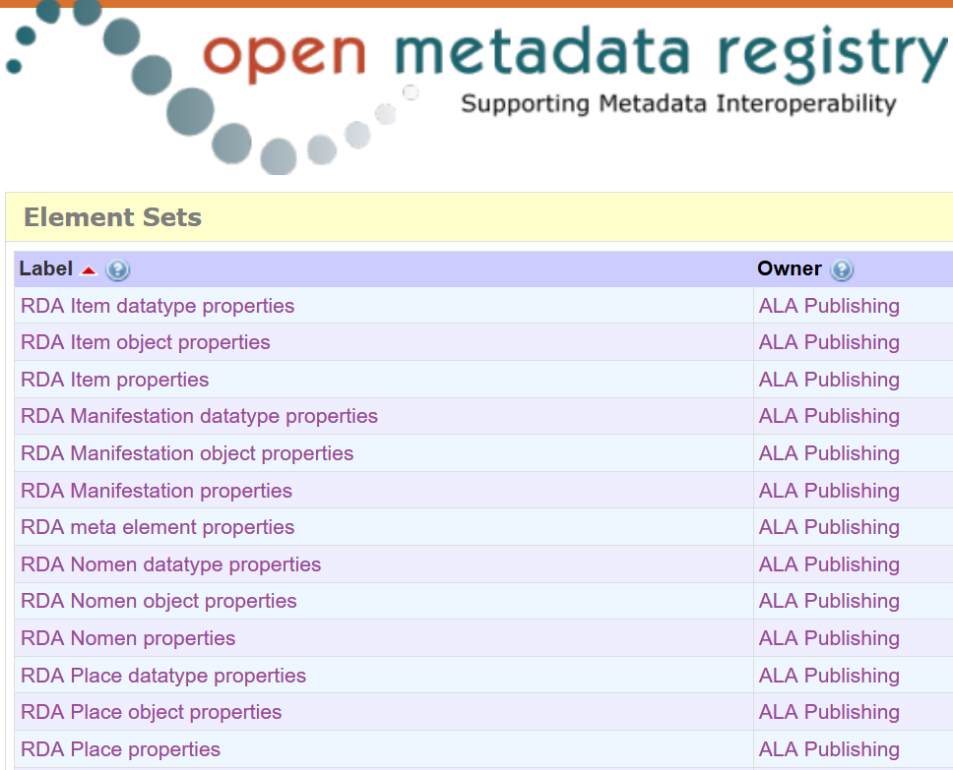

Slide 6
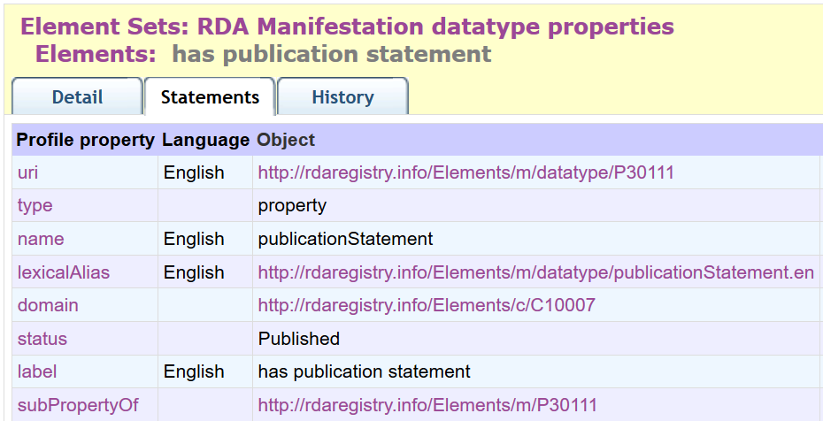
Canonical property

Slide 7
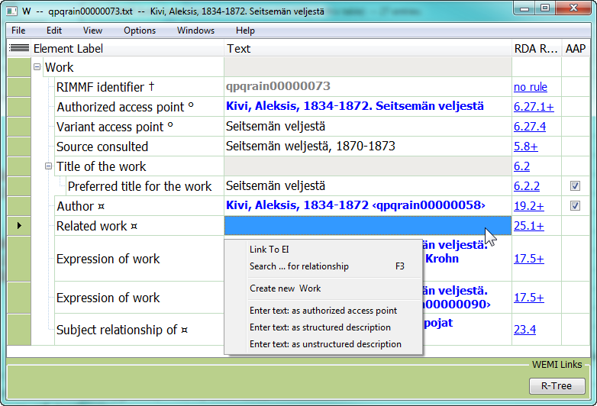

Slide 8
Practical applications
Property | Value | Notes | Path
Publication statement (ms) | London: MACMILLAN AND CO. AND NEW YORK. 1891 | Manifestation statement transcribed by machine | Unstructured
Publication statement | London ; New York : Macmillan and Co., 1891 | ISBD (SES) | Structured
Publication statement | 210 ##$aLondon$aNew York$cMacmillan and Co.$d1891 | UNIMARC (SES) | Structured
Place of publication | London (England) | RDA guidance | Structured
Place … | 7011781 | Getty TGN | Identifier
Place … | http://dbpedia.org/resource/London | DBPedia | IRI

Slide 9
Maps and inferences
RDA unconstrained properties map to non-FRBR/LRM properties; e.g. ISBD
Simple sub-property inferencing generates data at lowest common dumbness level
Losses: VES and SES; identifier and IRI distinction; all paths collapse to unstructured description

Slide 10
Strategic challenges
Building the global from the local is essential
But the global infrastructure needs coordination
Who, when, how?
Triples store(s) for data
Maps between element sets
Maps between value vocabularies
Data triple maintenance services
Linked data catalogues

Slide 11
Thank you!
rscchair@rdatoolkit.org
http://access.rdatoolkit.org/
http://www.rdaregistry.info/
http://www.rda-rsc.org/

