Slide 1
On building universal bibliographic control
Gordon Dunsire
Presented to COBISS 2014
19-20 November 2014,
Maribor, Slovenia

Slide 2
Overview
Failure of centralized, top-down standards
IFLA UBC Programme
Result is a mix of long-established and new standards for resource description
Overlap considerable, and inevitable
The resource remains the same
RDF supports interoperability at finest common level of dumbness
A matter of relative granularity
Infrastructure required to maintain maps
Protocols, version control, provenance

Slide 3
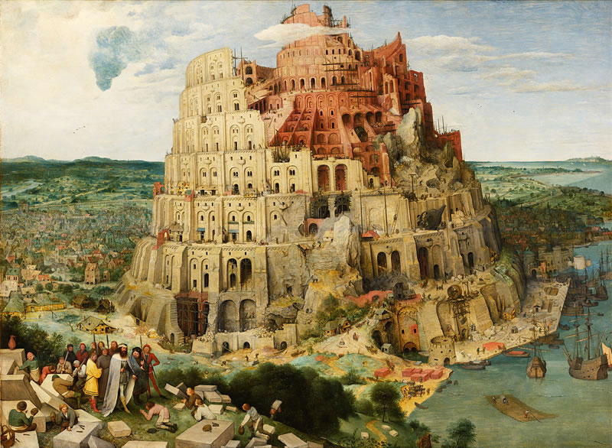
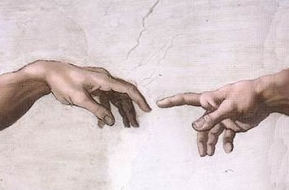
Universal
Bibliographic
Control
KOS++
Confusing
tongues?
RDF
BIBFRAME:
Bibliographic
Framework
FR: Functional
Requirements
ISBD: International Standard
Bibliographic Description
Say what
we mean
BibO:
Bibliographic
Ontology
DC: Dublin Core
RDA: Resource
Description
and Access
CRM: Conceptual
Reference Model
MARC21
schema.org
UNIMARC

Slide 4
Element sets (schema)
Map of
“Audience”
isbdu:
“has note on use or audience”
Unconstrained
versions
Value vocabularies (KOS)
isbd:
“has note on use or audience”
rdau:
“Intended audience”
rdfs:subPropertyOf
Broader/narrower/same?
dct:
“audience”
m21:
e
BBFC:
18?
“adult”
rdaw:
“Intended audience”
schema:
“audience”
MPAA:
NC-17?
pbcore:
adult
“adult”
m21:
“Target audience”
frbrer:
“has intended audience”
umarc:
m
“adult, general”
m21:
“Target audience of …”
umarc:
k
“adult, serious”

Slide 5
Granularities and overlaps
Property label in English | Granularity
RDA: has place of publication | Fine
ISBD: has place of publication, production, distribution | Medium
BIBFRAME: Place, name, and/or date information relating to the publication, printing, distribution, issue, release, or production instance | Coarse
Granularity of “Place”
Aggregation of “Place” +
other elements

Slide 6
Black box
?
!
The
magic
bibliographic
box
Input
Output
?
!
We do not need to know what goes on inside

Slide 7
Subject | Predicate/property | Object
This resource | has place of publication (RDA) | "Zagreb"
ex:Resource1 | rdam:P30088 | "Zagreb"
Schema Translator
?
!
La
boîte
bibliographique
magique
?
!
Subject | Predicate/property | Object
This resource | has place of publication, production, distribution (ISBD) | "Zagreb"
ex:Resource1 | isbdu:P1016 | "Zagreb"

Slide 8
Subject | Predicate/property | Object
This resource | has frequency of issue … (UNIMARC) | “daily"
ex:Resource1 | unimarc:U110__a1 | unimarccf:h
Term Translator
?
!
Magic
box
bibliografski
?
!
Subject | Predicate/property | Object
This resource | has frequency of issue … (UNIMARC) | “daily"
ex:Resource1 | unimarc:U110__a1 | rdaf:1010

Slide 9
Subject | Predicate | Object
ex:Resource1 | isbd:P1016 | “Zagreb"
ex:Resource1 | isbd:P1017 | "Hrvatsko knjižničarsko društvo"
ex:Resource1 | isbd:P1018 | “2012”
Statement Maker
?
!
?
!
神奇的书目中
Subject | Predicate | Object
ex:Resource1 | isbd:P1162 | "Zagreb : Hrvatsko knjižničarsko društvo, 2012"

Slide 10
Subject | Predicate | Object
ex:Resource1 | isbd:P1162 | "Zagreb : Hrvatsko knjižničarsko društvo, 2012"
Statement Breaker
!
?
La
magio
bibliografiaj
skatolo
!
?
Subject | Predicate | Object
ex:Resource1 | isbd:P1016 | “Zagreb"
ex:Resource1 | isbd:P1017 | "Hrvatsko knjižničarsko društvo"
ex:Resource1 | isbd:P1018 | “2012”

Slide 11
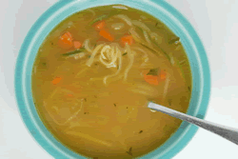
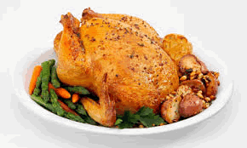
Soup of triples
Record maker
!
?
?
Y
blwch
llyfryddol
hud
!
Reconstituted
ingredient

Slide 12
Record breaker
!
?
Magikoa
kutxa
bibliografia
!
?

Slide 13
Magic?
Act locally
!
?
!
?
!
!
?
?
?
!
!
?
!
?
?
!
Think globally
Or Technique?

Slide 14
Management infrastructure
What happens if an element or concept changes?
Protocol for change notification and re-mapping
Who are the parties to such a protocol?
Registry of ownership and provenance
Self-governing or third party arbitration?
How reliable is the map?
Version control? Meta-metadata? Provenance!

Slide 15
Acknowledgements
Google Translate
translate.google.com
Michaelangelo, Creation of Adam, Sistine Chapel, 1511-1512
Pieter Bruegel the Elder, The Tower of Babel, 1563
Chicken and chicken soup: Good cooks everywhere!

