Slide 1
A Bibliographic Roadmap miscellany
Vocabularies in space, time, and nets
Gordon Dunsire
Presented to NISO BibRM Group
20 November 2015

Slide 2
Overview
Multilingual vocabularies: vocabularies in space
Describing change: vocabularies in time
Semantic maps: vocabularies in nets

Slide 3
Types of vocabulary
Vocabulary | Definition* | In scope
Dataset | Set of triples about individuals or things. | No
Value vocabulary | Set of triples about values for use in datasets. | Yes
Element set | Set of triples about properties and classes for use in datasets. | Yes
*http://www.w3.org/2005/Incubator/lld/XGR-lld-vocabdataset-20111025/

Slide 4
Multilingual vocabularies
Vocabularies in space

Slide 5
Multilingual vocabularies
Direct translations of element set (class and property) and value concept labels, definitions, notations, etc.
  Use RDF separation of machine-readable identifier (URI) from human-readable (translatable!) data (literal).
  One URI + multiple labels in multiple languages
Linking vocabularies developed independently in different languages involves Semantic maps

Slide 6
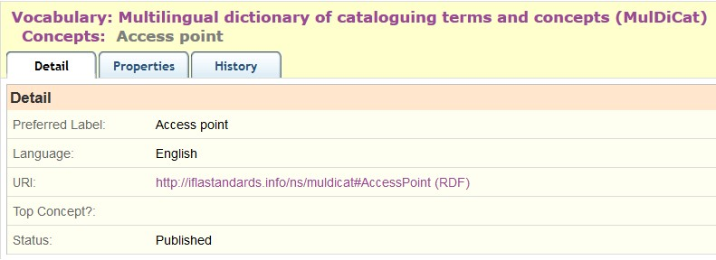
http://metadataregistry.org/concept/show/id/4675.html

Slide 7
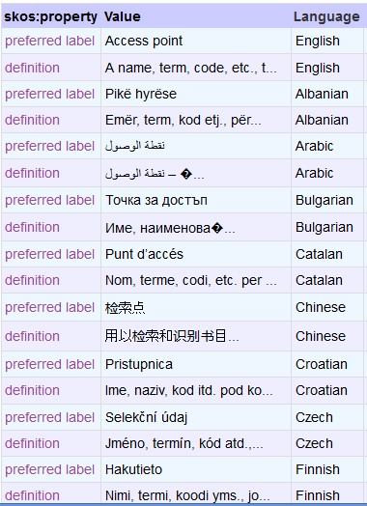
1 URI
25 languages
http://metadataregistry.org/concept/show/id/4675.html

Slide 8
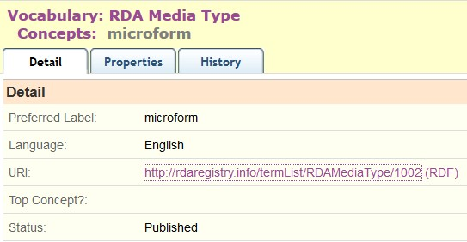

Slide 9
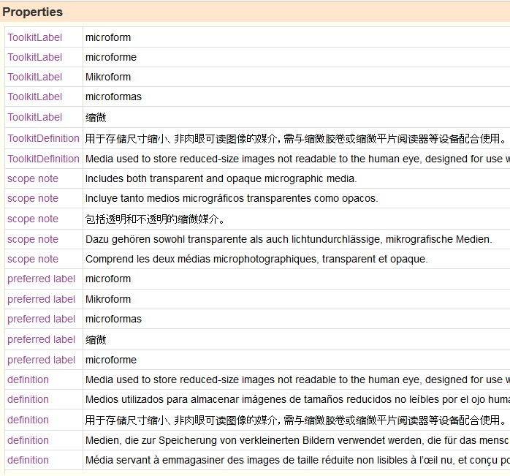

Slide 11
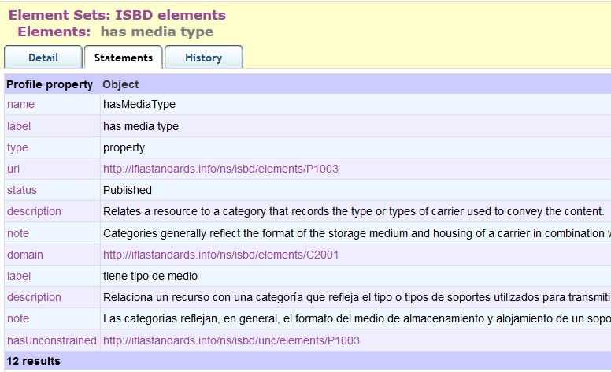
Spanish translation of English property

Slide 12
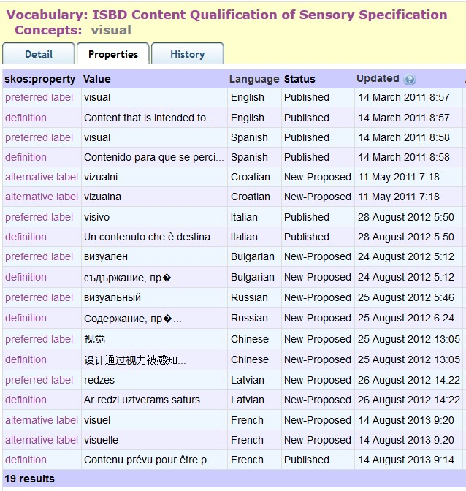

Slide 13
Inflected
Languages
vs
1 x
preference

Slide 14
Inflected
Languages
vs
1 x
preference
Avoid
Inflected
Labels
(adjectives)

Slide 15
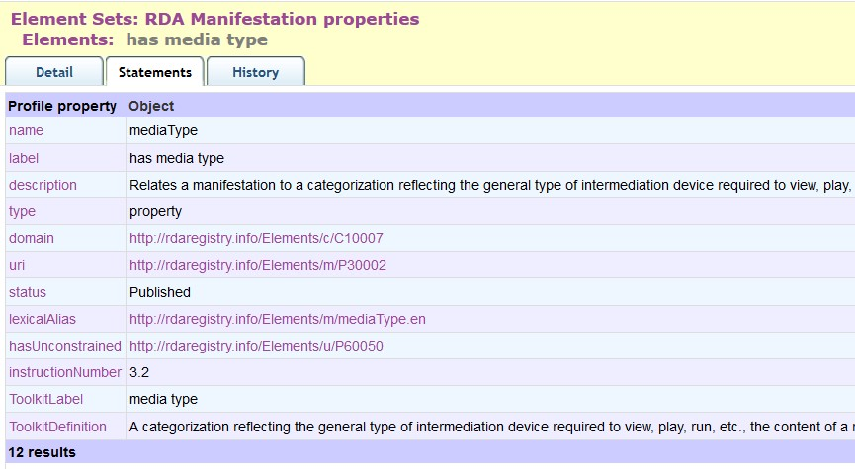

Slide 16
Canonical URI (language-free)

Slide 17
Canonical URI (language-free)
Lexical alias

Slide 18
Canonical URI (language-free)
Lexical alias
rdam:typeDeMédia.fr
rdam:medientyp.de
rdam:tipoDeMedio.es

Slide 19
Issues
Linked data structures cannot always be applied consistently across languages
  Inflected languages
  Subject-predicate-object syntax may not be compatible; e.g. verbalized predicate labels
    (is) donor (of)
    (has) donor
Translations may not be direct/exact
  Conceptual mis-alignment

Slide 20
Describing change
Vocabularies in time

Slide 21
Versioning
Vocabularies change
  Additions, deletions, amendments, typos
Linked open data is designed for persistence
  Cf Lots of Copies Keep Stuff Safe (LOCKSS)
  Lots of out-of-date stuff cannot be removed
Deletion is not helpful; deprecation is
Semantic coherency requires consistency
Semantic versioning helps applications decide

Slide 22
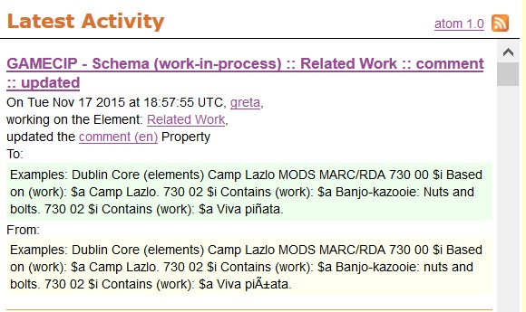

Slide 23
Alert feed

Slide 24
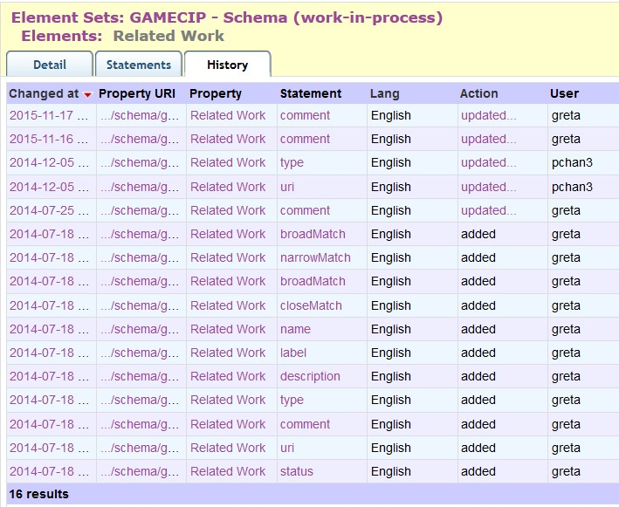
Alert feed
Change
history
(atomic)

Slide 25
Semantic versioning (RDA)
A change that has no effect on the semantics of any Element will result in a 'patch' version that will increment the third segment of the number: "1.1.X"

Slide 26
Semantic versioning (RDA)
A change that has no effect on the semantics of any Element will result in a 'patch' version that will increment the third segment of the number: "1.1.X"
A change that affects the semantics of any property of any Element will result in a 'minor' version that will increment the second segment "1.X.0", and reset the third segment to 0

Slide 27
Semantic versioning (RDA)
A change that has no effect on the semantics of any Element will result in a 'patch' version that will increment the third segment of the number: "1.1.X"
A change that affects the semantics of any property of any Element will result in a 'minor' version that will increment the second segment "1.X.0", and reset the third segment to 0
A change that breaks backwards semantic compatibility will result in a 'major' version change that increments the first segment "X.0.0", and resets the other segments to 0. We expect major versions to be extremely rare.

Slide 28
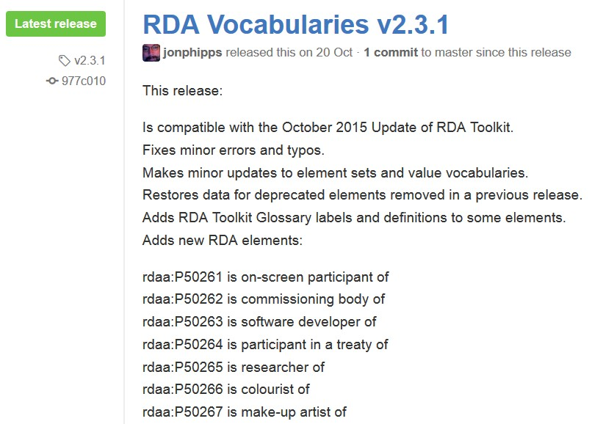
GitHub
Version
Control
Roll-back to previous versions allows applications
to synchronize with compatible (semantic) version

Slide 29
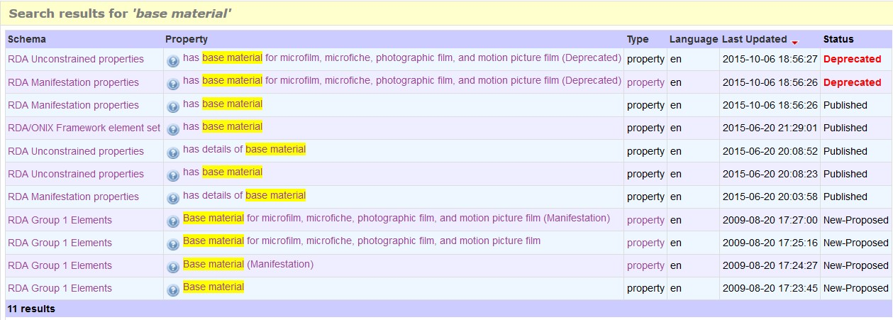

Slide 30
Status keeps track of development

Slide 31
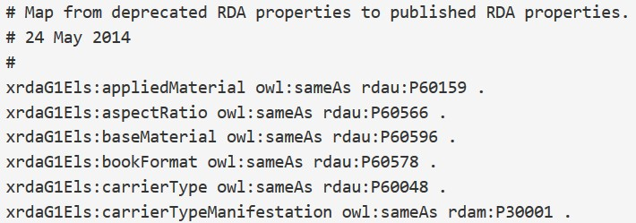
Status keeps track of development
Deprecation
map helps
applications
re-synch

Slide 32
Semantic maps
Vocabularies in nets

Slide 33
Semantic mapping
Links two classes, properties, or concepts
from the same or different namespaces
b:
Class
sub-class of
a:
Class

Slide 34
Semantic mapping
Links two classes, properties, or concepts
from the same or different namespaces
coarse/dumb
b:
Class
sub-class of
a:
Class
fine/smart

Slide 35
Semantic mapping
Links two classes, properties, or concepts
from the same or different namespaces
coarse/dumb
b:
Class
sub-class of
a:
Class
fine/smart

Slide 36
Semantic mapping
Links two classes, properties, or concepts
from the same or different namespaces
Equivalence
coarse/dumb
b:
Class
sub-class of
a:
Class
fine/smart

Slide 37
Semantic mapping
Links two classes, properties, or concepts
from the same or different namespaces
Equivalence
coarse/dumb
b:
Class
b:
property
sub-class of
sub-property of
a:
Class
a:
property
fine/smart

Slide 38
Semantic mapping
Links two classes, properties, or concepts
from the same or different namespaces
Equivalence
coarse/dumb
b:
Class
b:
property
b:
concept
sub-class of
sub-property of
narrower of
a:
Class
a:
property
a:
concept
fine/smart

Slide 39
Element sets (schema)
Map of
“Audience”
isbd:
“has note on use or audience”
dct:
“audience”
rdaw:
“Intended audience”
schema:
“audience”
m21:
“Target audience”
frbrer:
“has intended audience”
m21:
“Target audience of …”
Notes:
Semantic mapping allows dataset triples that use specific element sets and value vocabularies to automatically generate triples using elements and values from other vocabularies at the same or broader level of granularity.
In this example, elements for the relationship “audience”, between a library resource and its intended level of user, are taken from different published schema, including MARC 21, FRBR, RDA, Dublin Core, and ISBD. They can be related using a single, simple, machine-readable ontology property, rdfs:subPropertyOf, that relates an element to a broader element.
Data can be transferred automatically along the direction of the relationship arrow, from finer to broader meaning. This is known as “dumbing-down”: the data loses specificity at each stage and becomes less “smart” in its semantics.
Data cannot be “smartened-up” automatically: machines are dumb, and cannot get something for nothing, information-wise.
Many of the “audience” elements have associated value vocabularies. These can also be linked using semantic mappings, but a human is required to determine the semantics of each value, as given in definitions, before choosing the appropriate relationship.

Slide 40
Element sets (schema)
Map of
“Audience”
isbdu:
“has note on use or audience”
Unconstrained
versions
isbd:
“has note on use or audience”
rdau:
“Intended audience”
dct:
“audience”
rdaw:
“Intended audience”
schema:
“audience”
m21:
“Target audience”
frbrer:
“has intended audience”
m21:
“Target audience of …”
Notes:
Semantic mapping allows dataset triples that use specific element sets and value vocabularies to automatically generate triples using elements and values from other vocabularies at the same or broader level of granularity.
In this example, elements for the relationship “audience”, between a library resource and its intended level of user, are taken from different published schema, including MARC 21, FRBR, RDA, Dublin Core, and ISBD. They can be related using a single, simple, machine-readable ontology property, rdfs:subPropertyOf, that relates an element to a broader element.
Data can be transferred automatically along the direction of the relationship arrow, from finer to broader meaning. This is known as “dumbing-down”: the data loses specificity at each stage and becomes less “smart” in its semantics.
Data cannot be “smartened-up” automatically: machines are dumb, and cannot get something for nothing, information-wise.
Many of the “audience” elements have associated value vocabularies. These can also be linked using semantic mappings, but a human is required to determine the semantics of each value, as given in definitions, before choosing the appropriate relationship.

Slide 41
Element sets (schema)
Map of
“Audience”
isbdu:
“has note on use or audience”
Unconstrained
versions
isbd:
“has note on use or audience”
rdau:
“Intended audience”
rdfs:subPropertyOf
dct:
“audience”
rdaw:
“Intended audience”
schema:
“audience”
m21:
“Target audience”
frbrer:
“has intended audience”
m21:
“Target audience of …”
Notes:
Semantic mapping allows dataset triples that use specific element sets and value vocabularies to automatically generate triples using elements and values from other vocabularies at the same or broader level of granularity.
In this example, elements for the relationship “audience”, between a library resource and its intended level of user, are taken from different published schema, including MARC 21, FRBR, RDA, Dublin Core, and ISBD. They can be related using a single, simple, machine-readable ontology property, rdfs:subPropertyOf, that relates an element to a broader element.
Data can be transferred automatically along the direction of the relationship arrow, from finer to broader meaning. This is known as “dumbing-down”: the data loses specificity at each stage and becomes less “smart” in its semantics.
Data cannot be “smartened-up” automatically: machines are dumb, and cannot get something for nothing, information-wise.
Many of the “audience” elements have associated value vocabularies. These can also be linked using semantic mappings, but a human is required to determine the semantics of each value, as given in definitions, before choosing the appropriate relationship.

Slide 42
Element sets (schema)
Map of
“Audience”
isbdu:
“has note on use or audience”
Unconstrained
versions
Value vocabularies (KOS)
isbd:
“has note on use or audience”
rdau:
“Intended audience”
rdfs:subPropertyOf
Broader/narrower/same?
dct:
“audience”
m21:
e
BBFC:
18?
“adult”
rdaw:
“Intended audience”
schema:
“audience”
MPAA:
NC-17?
pbcore:
adult
“adult”
m21:
“Target audience”
frbrer:
“has intended audience”
umarc:
m
“adult, general”
m21:
“Target audience of …”
umarc:
k
“adult, serious”
Notes:
Semantic mapping allows dataset triples that use specific element sets and value vocabularies to automatically generate triples using elements and values from other vocabularies at the same or broader level of granularity.
In this example, elements for the relationship “audience”, between a library resource and its intended level of user, are taken from different published schema, including MARC 21, FRBR, RDA, Dublin Core, and ISBD. They can be related using a single, simple, machine-readable ontology property, rdfs:subPropertyOf, that relates an element to a broader element.
Data can be transferred automatically along the direction of the relationship arrow, from finer to broader meaning. This is known as “dumbing-down”: the data loses specificity at each stage and becomes less “smart” in its semantics.
Data cannot be “smartened-up” automatically: machines are dumb, and cannot get something for nothing, information-wise.
Many of the “audience” elements have associated value vocabularies. These can also be linked using semantic mappings, but a human is required to determine the semantics of each value, as given in definitions, before choosing the appropriate relationship.

Slide 43
Inference rules: sub-property
ex:
Property1
“has author”@en
ex:“has label”
ex:
Property2
“has creator”@en
ex:“has label”

Slide 44
Inference rules: sub-property
ex:
Property1
“has author”@en
ex:“has label”
ex:
“is sub-
property
of”
ex:
Property2
“has creator”@en
ex:“has label”

Slide 45
Inference rules: sub-property
ex:
Property1
“has author”@en
ex:“has label”
ex:
“is sub-
property
of”
ex:
Property2
“has creator”@en
ex:“has label”
ex:
“This work”
ex:“has author”
“Gordon Dunsire”

Slide 46
Inference rules: sub-property
ex:
Property1
“has author”@en
ex:“has label”
ex:
“is sub-
property
of”
ex:
Property2
“has creator”@en
ex:“has label”
ex:
“This work”
ex:“has author”
“Gordon Dunsire”
ex:
“This work”
ex:“has creator”
“Gordon Dunsire”

Slide 47
Inference rules: sub-property
ex:
Property1
“has author”@en
ex:“has label”
ex:
“is sub-
property
of”
ex:
Property2
“has creator”@en
ex:“has label”
ex:
“This work”
ex:“has author”
“Gordon Dunsire”
ex:
“This work”
ex:“has creator”
“Gordon Dunsire”

Slide 48
Unconstrained properties
Remove semantics
of (dumb-down)
specific classes
RDA
ISBD
Work
Expression
Manifestation
Item
Resource
Notes:
The RDA Registry contains an element set that is not tied to the RDA entities. The “unconstrained” elements parallel the RDA elements but have general definitions, so they can be used by applications that do not require the finer granularity and semantics of RDA and FRBR.
This allows RDA data to interoperate with data from another community. For example, there is an agreed alignment between ISBD (International Standard Bibliographic Description) elements and RDA elements. The alignment is the basis of a set of linked data maps between ISBD and RDA data.
The diagram shows the maps between the RDA and ISBD element sets and their unconstrained versions. The maps preserve semantic coherence by removing the information about RDA’s WEMI entities and ISBD’s Resource entity; the semantic relationship between these entities is not simple and direct.
The diagram is part of the “linked data cloud” of RDF maps, and is not itself an RDF graph. For example, the map between ISBD and the unconstrained RDA elements represented by a single line is an RDF graph, the first part of which is shown.

Slide 49
Unconstrained properties
Remove semantics
of (dumb-down)
specific classes
Unconstrained
(No entity
Specified)
RDAU
ISBDU
RDA
ISBD
Work
Expression
Manifestation
Item
Resource
Notes:
The RDA Registry contains an element set that is not tied to the RDA entities. The “unconstrained” elements parallel the RDA elements but have general definitions, so they can be used by applications that do not require the finer granularity and semantics of RDA and FRBR.
This allows RDA data to interoperate with data from another community. For example, there is an agreed alignment between ISBD (International Standard Bibliographic Description) elements and RDA elements. The alignment is the basis of a set of linked data maps between ISBD and RDA data.
The diagram shows the maps between the RDA and ISBD element sets and their unconstrained versions. The maps preserve semantic coherence by removing the information about RDA’s WEMI entities and ISBD’s Resource entity; the semantic relationship between these entities is not simple and direct.
The diagram is part of the “linked data cloud” of RDF maps, and is not itself an RDF graph. For example, the map between ISBD and the unconstrained RDA elements represented by a single line is an RDF graph, the first part of which is shown.

Slide 50
Unconstrained properties
Remove semantics
of (dumb-down)
specific classes
Unconstrained
(No entity
Specified)
RDAU
ISBDU
RDA
ISBD
Work
Expression
Manifestation
Item
Resource
Notes:
The RDA Registry contains an element set that is not tied to the RDA entities. The “unconstrained” elements parallel the RDA elements but have general definitions, so they can be used by applications that do not require the finer granularity and semantics of RDA and FRBR.
This allows RDA data to interoperate with data from another community. For example, there is an agreed alignment between ISBD (International Standard Bibliographic Description) elements and RDA elements. The alignment is the basis of a set of linked data maps between ISBD and RDA data.
The diagram shows the maps between the RDA and ISBD element sets and their unconstrained versions. The maps preserve semantic coherence by removing the information about RDA’s WEMI entities and ISBD’s Resource entity; the semantic relationship between these entities is not simple and direct.
The diagram is part of the “linked data cloud” of RDF maps, and is not itself an RDF graph. For example, the map between ISBD and the unconstrained RDA elements represented by a single line is an RDF graph, the first part of which is shown.

Slide 51
Unconstrained properties
Remove semantics
of (dumb-down)
specific classes
Unconstrained
(No entity
Specified)
RDAU
ISBDU
RDA
ISBD
Work
Expression
Manifestation
Item
Resource
Notes:
The RDA Registry contains an element set that is not tied to the RDA entities. The “unconstrained” elements parallel the RDA elements but have general definitions, so they can be used by applications that do not require the finer granularity and semantics of RDA and FRBR.
This allows RDA data to interoperate with data from another community. For example, there is an agreed alignment between ISBD (International Standard Bibliographic Description) elements and RDA elements. The alignment is the basis of a set of linked data maps between ISBD and RDA data.
The diagram shows the maps between the RDA and ISBD element sets and their unconstrained versions. The maps preserve semantic coherence by removing the information about RDA’s WEMI entities and ISBD’s Resource entity; the semantic relationship between these entities is not simple and direct.
The diagram is part of the “linked data cloud” of RDF maps, and is not itself an RDF graph. For example, the map between ISBD and the unconstrained RDA elements represented by a single line is an RDF graph, the first part of which is shown.

Slide 52
Unconstrained properties
Remove semantics
of (dumb-down)
specific classes
[Linked data cloud, not RDF graph]
Unconstrained
(No entity
Specified)
RDAU
ISBDU
RDA
ISBD
Work
Expression
Manifestation
Item
Resource
Notes:
The RDA Registry contains an element set that is not tied to the RDA entities. The “unconstrained” elements parallel the RDA elements but have general definitions, so they can be used by applications that do not require the finer granularity and semantics of RDA and FRBR.
This allows RDA data to interoperate with data from another community. For example, there is an agreed alignment between ISBD (International Standard Bibliographic Description) elements and RDA elements. The alignment is the basis of a set of linked data maps between ISBD and RDA data.
The diagram shows the maps between the RDA and ISBD element sets and their unconstrained versions. The maps preserve semantic coherence by removing the information about RDA’s WEMI entities and ISBD’s Resource entity; the semantic relationship between these entities is not simple and direct.
The diagram is part of the “linked data cloud” of RDF maps, and is not itself an RDF graph. For example, the map between ISBD and the unconstrained RDA elements represented by a single line is an RDF graph, the first part of which is shown.

Slide 53
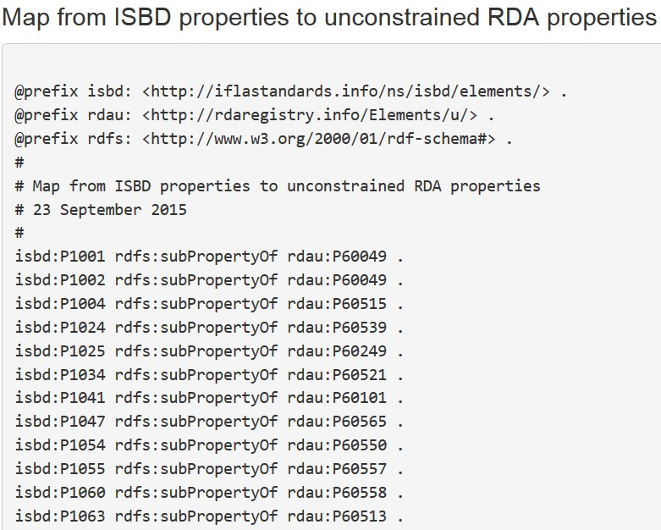
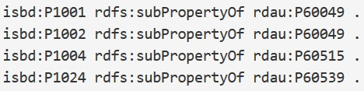
Unconstrained properties
Remove semantics
of (dumb-down)
specific classes
[Linked data cloud, not RDF graph]
Unconstrained
(No entity
Specified)
RDAU
ISBDU
RDA
ISBD
Work
Expression
Manifestation
Item
Resource
Notes:
The RDA Registry contains an element set that is not tied to the RDA entities. The “unconstrained” elements parallel the RDA elements but have general definitions, so they can be used by applications that do not require the finer granularity and semantics of RDA and FRBR.
This allows RDA data to interoperate with data from another community. For example, there is an agreed alignment between ISBD (International Standard Bibliographic Description) elements and RDA elements. The alignment is the basis of a set of linked data maps between ISBD and RDA data.
The diagram shows the maps between the RDA and ISBD element sets and their unconstrained versions. The maps preserve semantic coherence by removing the information about RDA’s WEMI entities and ISBD’s Resource entity; the semantic relationship between these entities is not simple and direct.
The diagram is part of the “linked data cloud” of RDF maps, and is not itself an RDF graph. For example, the map between ISBD and the unconstrained RDA elements represented by a single line is an RDF graph, the first part of which is shown.

Slide 54
Discussion
http://www.gordondunsire.com/presentations.htm
http://www.gordondunsire.com/publicationsrecent.htm
https://www.w3.org/community/bpmlod/
  Best Practices for Multilingual Linked Open Data
http://www.rdaregistry.info/rgAbout/versions.html
http://www.rdaregistry.info/Maps/

