Slide 1
International Bibliographic Standards, Linked Data, and the Impact on Library Cataloging
Gordon Dunsire
A NISO/DCMI Webinar
24 August 2011

Slide 2
Overview
Bibliographic standards
International Federation of Library Associations and Institutions (IFLA)
Others
Representation in Resource Description Framework (RDF)
Creating triples from catalogue records
Impact and implications for catalogues

Slide 3
IFLA standards
RDF representations of standards for “universal” bibliographic control are being developed
“FR” (Functional Requirements) family of models
For Bibliographic Records (FRBR)
For Authority Data (FRAD)
For Subject Authority Data (FRSAD)
International Standard Bibliographic Description (ISBD)
Record structure and content standard for exchange of national metadata
UNIMARC
Encoding for ISBD records (Bibliographic) and FRAD (Authorities)

Slide 4
Representation in RDF
Entities => RDF classes
E.g. FRBR “Person”
Attributes, tags, (sub)fields, relationships => RDF properties
E.g. ISBD “title proper”
E.g. UNIMARC “200 $a” (title proper)
E.g. FRBR “title of the manifestation”
Controlled term values => SKOS vocabularies
E.g. ISBD Area 0 (content and media type)

Slide 5
FR family
Each model has its own namespace
To reflect historical development
Each re-uses earlier RDF elements
Consolidated model under development
Being informed by analysis of RDF representation
FRBR RDF published
FRBRer (entity-relationship) ontology
Namespace elements plus OWL
FRBRoo (object-oriented)
Extension of CIDOC Conceptual Reference Model (for museums)
FRAD and FRSAD imminent
Approved at IFLA 2011 conference

Slide 6
ISBD
Element set and vocabularies for content and media types
Namespace now published
DC Application Profile in development
Models the ISBD record
What properties (fields)
Mandatory? Repeatable?
Aggregated statements
Sub-elements and punctuation

Slide 7
ISBD AP snippet
<!-- Area 0 is mandatory and non-repeatable-->
<StatementTemplate ID="hasContentFormAndMediaTypeArea" minOccurs="1" maxOccurs="1" type="nonliteral">
<Property>http://iflastandards.info/ns/isbd/elements/P1158</Property>
<!-- Area 0 is an aggregated statement with SES -->
<NonLiteralConstraint descriptionTemplateRef="DThasContentFormAndMediaTypeArea">
<ValueStringConstraint>
<SyntaxEncodingScheme>http://iflastandards.info/ns/isbd/elements/C2003
</SyntaxEncodingScheme>
</ValueStringConstraint>
</NonLiteralConstraint>
</StatementTemplate>

Slide 8
UNIMARC
Proposal for RDF representation made at IFLA 2011
http://conference.ifla.org/sites/default/files/files/papers/ifla77/187-dunsire-en.pdf
Discussed with Permanent UNIMARC Committee
Decision taken to proceed

Slide 9
Other library standards in RDF (1)
RDA: resource description and access
Content standard based on FR models
Refines the FR properties
Many more controlled vocabularies than AACR
Anglo-American Cataloguing Rules
MODS/MADS (Metadata Object/Authority Description Schema)
Metadata structure based on MARC21
Library of Congress Name Authority File in MADS RDF
RDF representation of MODS just beginning ...

Slide 10
Other library standards in RDF (2)
BIBO: Bibliographic Ontology
Classes and properties for citations and bibliographic references
DCMI Metadata Terms (Dublin Core)
High-level common-denominator classes and properties for memory institution metadata
Lots of controlled vocabularies
Library of Congress Subject Headings, Rameau (French subject headings), SWD (German subject headings), Dewey Decimal Classification, RDA vocabularies, etc.

Slide 11
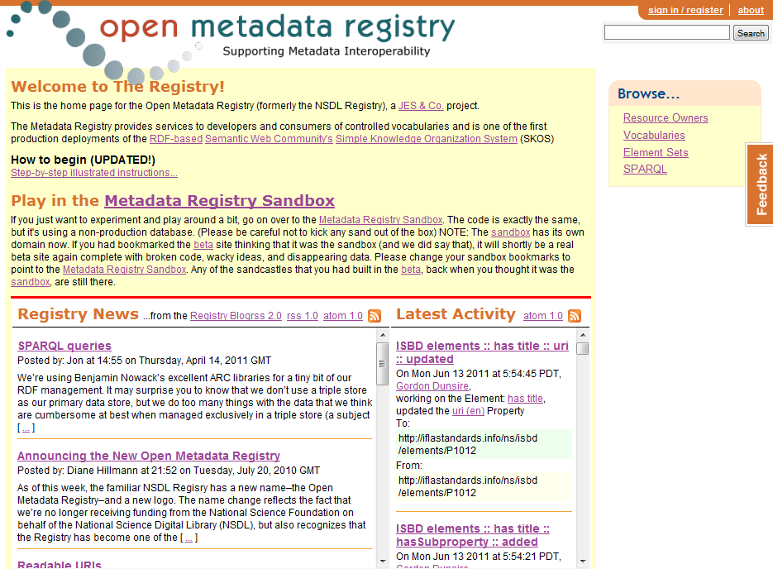

Slide 12
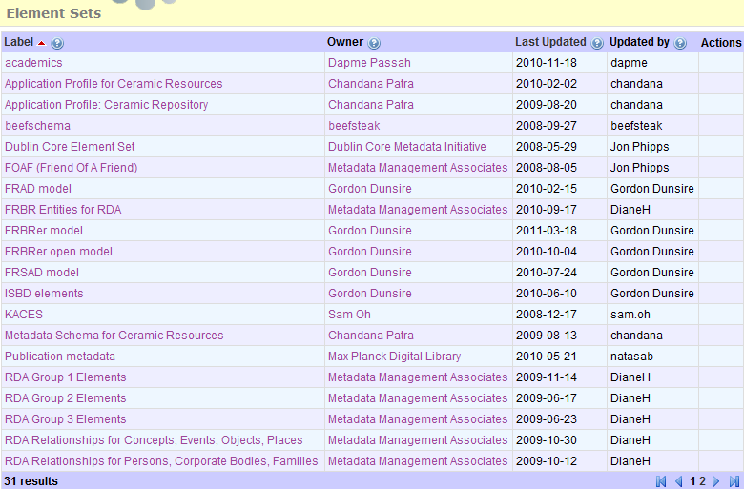

Slide 13
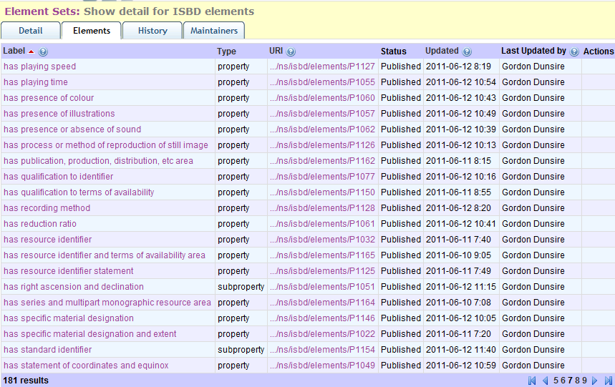

Slide 14
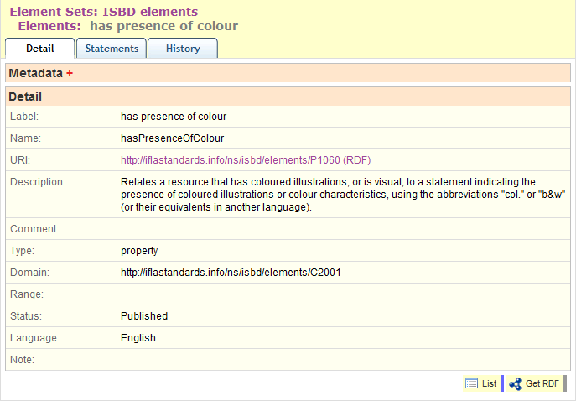

Slide 15
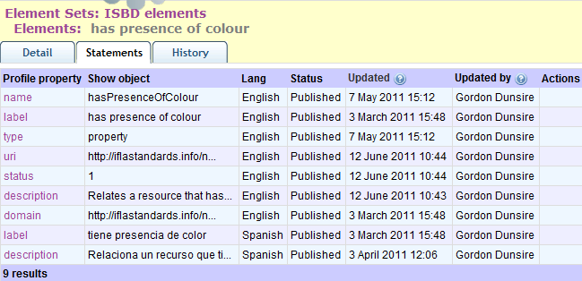

Slide 16
From record to triples (in 9 stages)
Very large numbers of records
Catalogue records, finding aids, etc.
300 million; 1 billion?
High quality metadata
In comparison with other communities
Each record may generate many triples
30 “raw” triples (no inferences) per MARC record?
Very, very large numbers of triples
Billions? Trillions?

Slide 17
1. Take a record
Field/attribute | Value
Record ID | 54321
Title | Museum archives: an introduction
Author | Wythe, Deborah
Date | 2004
LCSH | Museum archives
Media/GMD | Electronic
Content form | Text

Slide 18
2. Disaggregate to single statements
Record | Attribute | Value
54321 | (has) title | Museum archives: an introduction
54321 | (has) author | Wythe, Deborah
54321 | (has) date | 2004
54321 | (has) LCSH | Museum archives
54321 | (has) media type | Electronic
54321 | (has) content form | Text

Slide 19
3. Create URI for record
Must be unique, so 54321 no good on its own
http URIs are a good thing (W3C)
So add record ID to a unique http domain
E.g. http://MyLibraryX.com (unique to the library)
+ 54321
http://MyLibraryX.com/54321
(or http://MyLibraryX.com#54321)
This is not a URL!

Slide 20
4. Replace record ID with URI
URI | Attribute | Value
mlx:54321 | (has) title | Museum archives: an introduction
mlx:54321 | (has) author | Wythe, Deborah
mlx:54321 | (has) date | 2004
mlx:54321 | (has) LCSH | Museum archives
mlx:54321 | (has) media type | Electronic
mlx:54321 | (has) content form | Text
“mlx” = qname (xmlns) = shorthand for “http://MyLibraryX.com/”

Slide 21
5. Find URIs for attributes
Attributes are modelled as RDF properties (predicates) in “element set” namespaces
E.g. Dublin Core terms (dct); ISBD (isbd); FRBR (frbrer); RDA (rdaxxx); Bibliographic Ontology (bibo); etc.
Choose a namespace, find property with same (or closest) “meaning” (e.g. definition) as attribute
Nearest property minimises loss of information
Get URI for property
If no suitable property, choose another namespace
Properties do not have to come from single namespace
Match and mix!

Slide 22
5 (cont). Find URI for title
http://purl.org/dc/terms/title (dct:title)
http://iflastandards.info/ns/isbd/elements/P1014 (isbd:P1014)
hasTitleProper
http://RDVocab.info/Elements/titleProper (rdaGR1:titleProper)

Slide 23
5 (cont). Find URI for author
dct:creator
rdarole:author
(isbd does not cover “headings”)

Slide 24
5 (cont). Find URI for date
dct:date
isbd:P1018
hasDateOfPublicationProductionDistribution
rdaGr1:dateOfPublication

Slide 25
5 (cont). Find URI for LCSH
LCSH is a subject vocabulary
Controlled terms
So attribute is really “subject”
And the term itself is the value
dct:subject

Slide 26
5 (cont). Find URI for media type
Assuming record uses new ISBD Area 0 ...
isbd:P1003
hasMediaType

Slide 27
5 (cont). Find URI for content form
Assuming record uses new ISBD Area 0 ...
isbd: P1001
hasContentForm

Slide 28
6. Replace attributes with URIs
URI | URI | Value
mlx:54321 | isbd:P1014 | Museum archives: an introduction
mlx:54321 | rdarole:author | Wythe, Deborah
mlx:54321 | isbd:P1018 | 2004
mlx:54321 | dct:subject | Museum archives
mlx:54321 | isbd:P1003 | Electronic
mlx:54321 | isbd:P1001 | Text

Slide 29
7. Find URIs for values
If object of a triple is a URI, it can link to the subject of another triple with the same URI
Linked data!
Values from controlled vocabularies may have URIs
Possible vocabularies: author, subject, ISBD Area 0
NOT: title, date
For author: Virtual International Authority File (VIAF)
For LCSH: Library of Congress Authorities & Vocabularies
For ISBD Area 0: Open Metadata Registry

Slide 30
7 (cont). Find URI for author
Author: Wythe, Deborah
VIAF: http://www.viaf.org/
viaf:31899419/#Wythe,+Deborah

Slide 31
7 (cont). Find URI for subject (LCSH)
LCSH: Museum archives
LoC: http://id.loc.gov/authorities/
lcsh:/sh85088707#concept

Slide 32
7 (cont). Find URIs for ISBD Area 0
Media type: Electronic
ISBD media type
isbdmt:T1002
Content form: Text
ISBD Content form
isbdcf:T1009

Slide 33
8. Replace values with URIs
subject | predicate | object
mlx:54321 | isbd:P1014 | “Museum archives: an introduction”
mlx:54321 | rdarole:author | viaf:31899419/#Wythe,+Deborah
mlx:54321 | isbd:P1018 | “2004”
mlx:54321 | dct:subject | lcsh:/sh85088707#concept
mlx:54321 | isbd:P1003 | isbdmt:T1002
mlx:54321 | isbd:P1001 | isbdcf:T1009

Slide 34
9. Publish triples (linked data)
mlx:54321 | isbd:P1014 | “Museum archives: an introduction”
mlx:54321 | rdarole:author | viaf:31899419/#Wythe,+Deborah
mlx:54321 | isbd:P1018 | “2004”
mlx:54321 | dct:subject | lcsh:/sh85088707#concept
mlx:54321 | isbd:P1003 | isbdmt:T1002
mlx:54321 | isbd:P1001 | isbdcf:T1009

Slide 35
Linked data chains
mlx:54321 | dct:subject | lcsh:/sh85088707#concept
lcsh:/sh85088707#concept | skos:related | rameau:XXX
rameau:XXX | frbrer:isSubjectOf | mly:98765
mly:98765 | rda:titleOfTheWork | “Managing archives in museums”
rameau:XXX | skos:prefLabel | “archives du musée”
Notes:
Check all: rameau-lcsh links? Skos:equivalentTerm? Etc.

Slide 36
Linked data cluster = “record”
mlx:54321 | isbd:P1014 | “Museum archives: an introduction”
mlx:54321 | rdarole:author | viaf:31899419/#Wythe,+Deborah
mlx:54321 | isbd:P1018 | “2004”
mlx:54321 | dct:subject | lcsh:/sh85088707#concept
mlx:54321 | isbd:P1003 | isbdmt:T1002
mlx:54321 | isbd:P1001 | isbdcf:T1009

Slide 37
Duplication and legacy records
Many copies of legacy records
Copied and amended for local use
Danger of minting multiple URIs for the same resource
National bibliographic agencies have significant role to play
As memory/cultural institutions
The linked-data memory/culture of a nation
Proposal from IFLA Namespaces Task Group to IFLA Bibliography Section

Slide 38
FRBRization
FRBR splits record into four functional parts
User-centred functions
Subject of a FRBR triple is one of the parts, not the resource as a whole
But subject of ISBD triple is the resource as a whole
Class collisions can be avoided by using unbounded (no domain or range) versions of properties

Slide 39
A short history of the evolution of the library catalogue record
Notes:
This presentation is based on part of a presentation given at the IFLA satellite meeting “RDA: Resource Description and Access: Foundations, changes and implementation”, Québec City, Canada, 8 Aug 2008.
It, in turn, is part of several larger presentations given as part of outreach efforts during the development of RDA.

Slide 40
In the beginning ...
Lee, T. B.
Cataloguing has a future. - Audio disc
(Spoken word). - Donated by the author.
1. Metadata
... the catalogue card
Notes:
In the beginning was the catalogue card. Well, it was my first encounter with a catalogue.
This is an example of a catalogue card. We know it is a catalogue card rather than any other kind of card because it has a hole at the bottom. The hole serves multiple functions, particularly if a rod is passed through all the holes in a drawer full of cards. This prevents users accidentally or deliberately filing cards out of order; it prevents the cards in the drawer from being accidentally or deliberately spilled out onto the floor; it tells you which way is down.
The text tells you which way is front - for most but not all cards (but that is another story).
The text is metadata – the example is vaguely self-referential. There is not enough metadata to be really useful. For example, there is no indication of where this item is located (although a sign above the catalogue drawers may well say “For audio discs, please ask at the Audiovisual Desk”).
But there is enough metadata to illustrate how catalogues and their contents have, and are, evolving.

Slide 41
From flat-file record ...
Bibliographic description
Name authority
Author:
Lee, T. B.
Name:
Title:
Cataloguing has a future
Biography:
Content type:
Spoken word
...
Carrier type:
Audio disc
Subject authority
Subject:
Metadata
Term:
Provenance:
Donated by the author
Definition:
...
... to relational record
Notes:
The first stage was automation. Here, all the metadata from the card have been stored in a computer file. The metadata are separated out into different attributes (or fields or cells) in a regular way; all records have the same set (or sub-set) of attributes. This structure is implicit in the metadata on the card, where the attributes are indicated by various punctuation devices (such as brackets), but not always identified specifically. This type of file is known as a flat-file record, as all the metadata are stored in a monolithic two-dimensional , or flat, structure.
The flat-file is not an efficient way of storing metadata if there is a lot of repetition of content between records. One area of repetition in library metadata can be found in the names of persons and organizations; a lot of authors write more than one book, and many documents can be produced by organizations in the course of their business. Repetition is minimized by storing a single record, itself also flat-file, containing metadata for the person or organization. The record is linked to the related bibliographic record using a numerical identifier,. In library terminology, the bibliographic description and name authority records are linked via an authority control number
The same approach works for subject descriptors taken from controlled vocabularies. A single subject authority record is linked to many bibliographic descriptions. Note that the control numbers are transparent to humans; instead, he authority headings (name or subject term) are displayed on the fly using the link.
This type of file structure is known as a relational database.

Slide 42
From flat-file description ...
Bibliographic description
Name authority
Author:
Name:
Lee, T. B.
Title:
Cataloguing has a future
Biography:
Work
...
Content type:
Spoken word
Author:
Carrier type:
Audio disc
Subject authority
Subject:
Subject:
Term:
Metadata
Expression
Provenance:
Donated by the author
Definition:
Content type:
Spoken word
...
Manifestation
Item
... to FRBR record
Notes:
This method of storing descriptive metadata separately from authority headings which act as access points for the description began to be implemented in the 1970s, and is used by the majority of automated library catalogues today. But a new approach is being developed based on the Functional Requirements for Bibliographic Records (FRBR) model published in 1998.
FRBR groups descriptive metadata attributes into four component sets connected in a more-or-less hierarchical way. At the lowest level is the Item, containing metadata about a specific copy of a resource. In this example, the provenance note only applies to this copy.
The next grouping of metadata is the Manifestation, which describes the way information is carried by the resource. Metadata include the title taken from the disc label.
The other two groupings are, continuing up the hierarchy, Expression and Work. Expression metadata describe the content of the resource. Work metadata describe the abstract concept behind the resource, including who conceived it and what the subject is.
A Work can have more than one Expression (for example a translation), which can have more than one Manifestation (for example audiocassette and compact disc), which can have more than one Item (copy). This results in duplication, such as two Expressions using the same Work metadata. Applying the same database principles as for authority headings, a FRBR record should be stored in four separate files which are linked via some kind of identifier or control number.

Slide 43
From FRBR record ...
Work
Name authority
Author:
Name:
Lee, T. B.
Subject:
Subject authority
Expression
Content type:
Spoken word
Term:
Metadata
Manifestation
RDA content type
Title:
Cataloguing has a future
Term:
Carrier type:
Audio disc
RDA carrier type
Item
Provenance:
Term:
Donor:
Donated by the author
Amazon/Publisher
Title:
... to extinction!
Notes:
In this example, the Work component of the FRBR record does not contain any metadata content, just the structure in the form of attribute names ,and transparent links to the content of the authority files.
RDA: resource description and access is the successor to the Anglo-American Cataloguing Rules for determining bibliographic record structure and content. It is fully compatible with FRBR. One of its features is widespread use of controlled terms for metadata content. We can apply the same approach as for authority files, and store the controlled terms in their own file, linked to the relevant component of the FRBR record. Content type is one of the RDA attributes using a controlled vocabulary.
The same for carrier type.
The provenance attribute in the Item component record refers to the author and is an implicit duplication of some of the content of the author attribute, which is authority-controlled. We can minimize this duplication by refining the provenance attribute into the more specific donor attribute and isolating the author reference as the content of that attribute. The donor attribute is then linked to the same name authority record as the author attribute.
This just leaves the manifestation title within the FRBR record. But we could link the attribute to a publisher or bookseller file of titles …
And end up with a FRBR record which contains only attribute names and links. The record is reduced to its bare-bones structure, and effectively is extinct.

Slide 44
Where is the record?
Implicit, not explicit
Everywhere and nowhere
A semantic Web will allow machines to create the record just-in-time
We will not have to maintain records just-in-case
The user will have control over the presentation
I want to see an archive or library or museum or Amazon or Google or Flickr or ? display
And by avoiding duplication, we can all get on with describing new stuff ...
Notes:
Where has the bibliographic record gone? Its content has been completely disaggregated to multiple records stored elsewhere in the local system or in remote systems. Library of Congress Subject Headings are already available in a format suitable for this approach, known as linked data. The Virtual International Authority File for names is also available as linked data. Linked data is the basis of the Semantic Web.
The bibliographic record is implicit. The attribute names and links are used to assemble an explicit record on demand. The metadata content is efficiently stored and maintained (any change to authority content is immediately reflected in the assembled record). Catalogues do not have to store any of the metadata locally just-in-case a user needs it; the metadata record is presented just-in-time.
Different sets and arrangements of attributes, reflecting practice in various information communities, can be made available for user choice. The method of assembling the displayed record is the same regardless of the particular attributes used, so there is no reason why the metadata cannot be shown in a familiar or useful format.
The current pre-FRBR environment involves huge amounts of duplicated effort with multiple copies of records being maintained separately at the local level. But we all have backlogs of new bibliographic resources to describe.

Slide 45
The hyperdimensional (Tardis) card
W3C Library
Audio shop
Lee, T. B.
Cataloguing has a future. - Audio disc
(Spoken word). - Donated by the author.
1. Metadata
Spoken word archive
Lee Museum
“TARDIS four port USB hub, for office-bound Time Lords:
Open a time vortex on your desk” – Pocket-lint
Notes:
So the two-dimensional catalogue card has evolved into something with more than two dimensions. How much more is difficult to say; it could be fractal (between two and three, or three and four, dimensions). Time (the fourth dimension) may be a necessary or desirable feature.
The same metadata supports multiple views appropriate for different user and service contexts. There is no reason why one of those views should not be the catalogue card itself.
But the hole has been replaced by information technology and communications devices which also serve to “bring it all together”. Here, the multi-port USB interconnector is a synecdoche for the Semantic Web.
Cataloguers must evolve too, and be prepared to roam far and wide through space/time to create, maintain, and use bibliographic metadata.

Slide 46
Metadata focus
Shift of focus of metadata creation, maintenance, storage, preservation (by professionals, amateurs, machines)
From Record
To Statement(s) = triple(s)
But metadata display ...
... aggregates triples (from multiple sources) to create records on the fly

Slide 47
Thank you!
gordon@gordondunsire.com
http://metadataregistry.org/
Open Metadata Registry
http://www.ifla.org/en/node/5353
IFLA Namespaces Task Group (needs updated)
http://dublincore.org/dcmirdataskgroup/
DCMI/RDA Task Group (in revision)

