Slide 1
Multilingual bibliographic standards in RDF: the IFLA experience
Gordon Dunsire
Independent Consultant; Chair of IFLA Namespaces Technical Group
Presented at breakout session Requirements Gathering: Best practices for Multilingual Linked Open Data (BP-MLOD),
as part of the W3C Multilingual Web Workshop, Rome, 2013

Slide 2
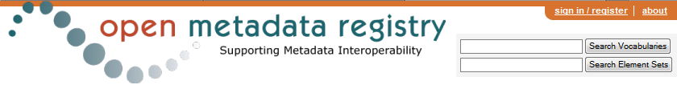
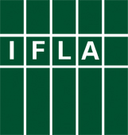
International Federation of Library Associations and Institutions (IFLA) maintains global standards for the library/bibliographic environment:
Functional Requirements for Bibliographic Records (FRBR)/Authority Data (FRAD)/Subject Authority Data (FRSAD)
International Standard Bibliographic Description (ISBD)
UNIMARC
… as RDF element sets and value vocabularies

Slide 3
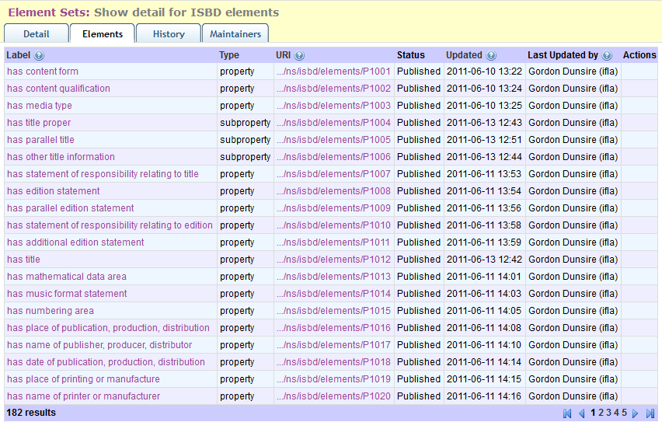
Opaque URIs
7 official languages
Bibliographic standards developed in English
Translated into many (7++) languages

Slide 4
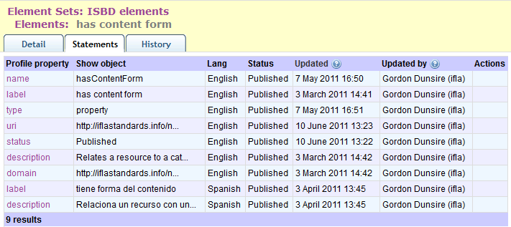
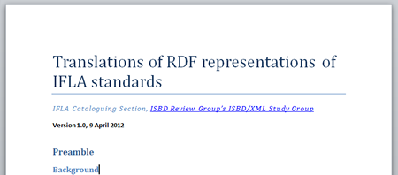
Scope
Style
Reference source
Disambiguation

Slide 5
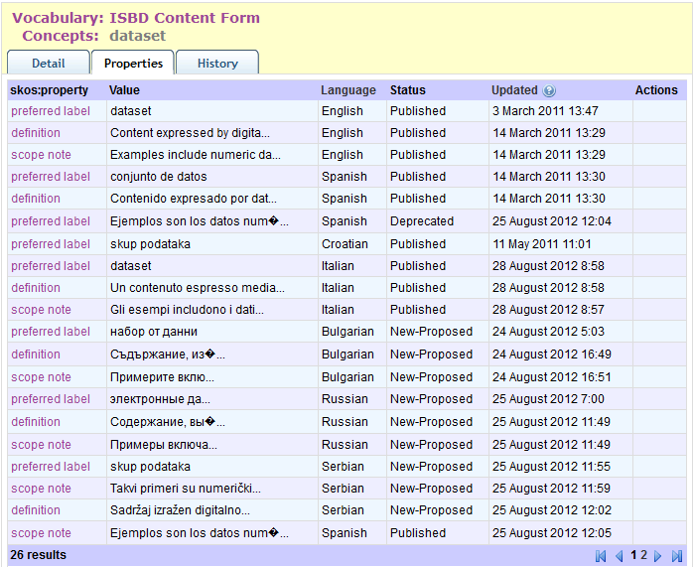
Partial translation
Local schedule

Slide 6
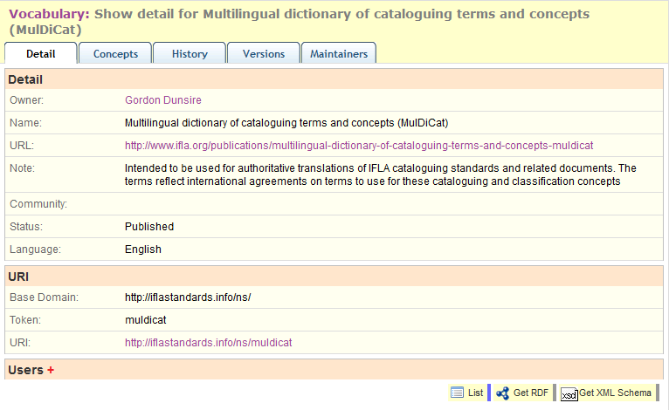
RDF value vocabulary
… for authoritative translations of IFLA cataloguing standards and related documents.

Slide 7
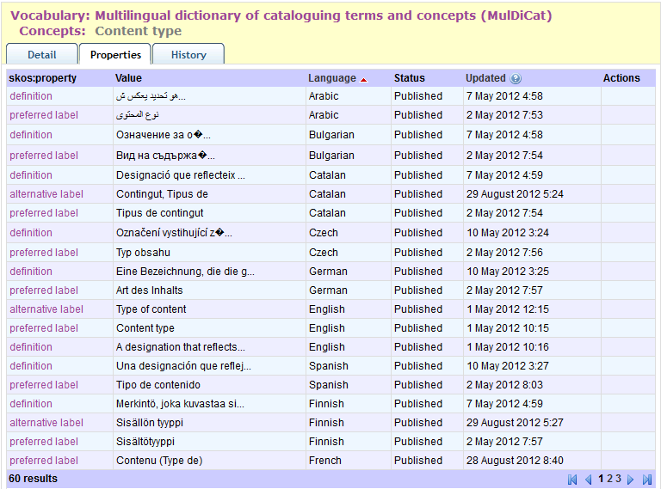
26+ languages

Slide 8
End
gordon@gordondunsire.com
http://iflastandards.info/ns/fr/
http://iflastandards.info/ns/isbd/
MulDiCat
http://metadataregistry.org/vocabulary/show/id/299.html
UNIMARC
Real soon now

