Slide 1
Multilingual Issues in the Representation of International Bibliographic Standards for the Semantic Web
Gordon Dunsire
Independent Consultant; Chair of IFLA Namespaces Technical Group
Presented at W3C Multilingual Web Workshop, Rome, 12-13 March 2013

Slide 2

International Federation of Library Associations and Institutions (IFLA) maintains global standards for the library/bibliographic environment:
Functional Requirements family of models for
Bibliographic Records (FRBR)
Authority Data (FRAD)
Subject Authority Data (FRSAD)
International Standard Bibliographic Description (ISBD)
Catalogue record structure and content
UNIMARC
Catalogue and Authority record data format
Based on ISBD

Slide 3
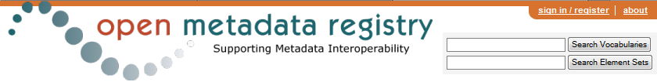
IFLA has its own namespace
“http://iflastandards.info”
Used for representation of models, schemas, and terminologies as element sets and value vocabularies in Resource Description Framework
Supports conversion of bibliographic records to library linked data without loss of information
Element sets and vocabularies maintained in the Open Metadata Registry

Slide 4
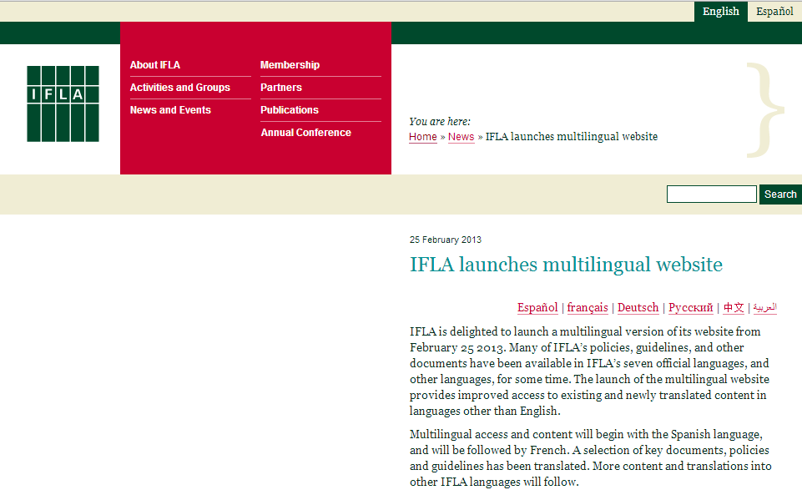
7 official languages
Bibliographic standards developed in English
Translated into many (7++) languages
Multilingual website launched February 2013
with Spanish version

Slide 5
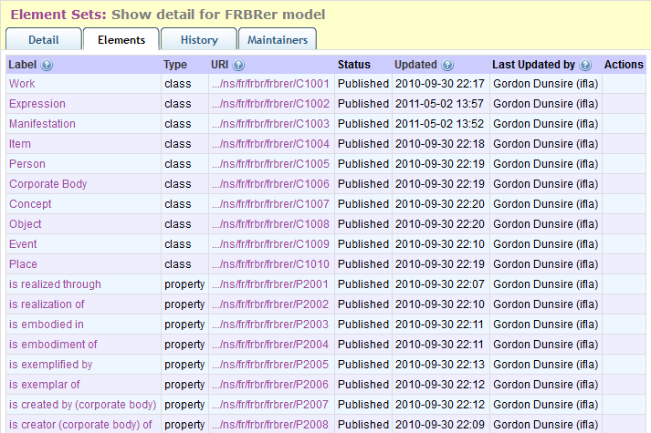
Opaque URIs

Slide 6
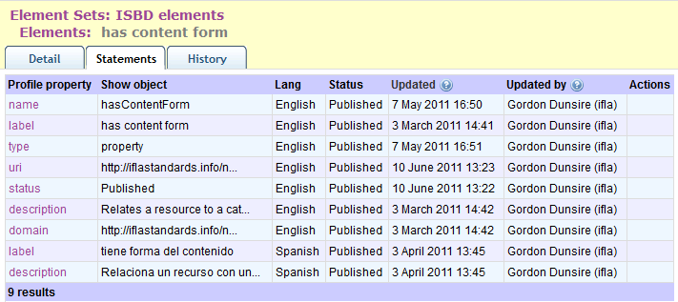
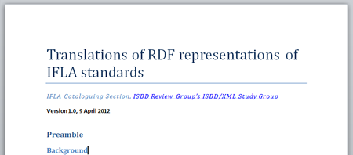
Translation into Spanish exposed some issues

Slide 7
Translation issues
Scope
Priority for developers: Element definition and label
Priority for users: Concept label and definition
Style (verbal phrasing, CamelCase, etc.)
What is ok in one language may not be in another
Source
Translation of namespace vs source documentation
Disambiguation
Methods for creating unique labels may vary between languages
Language inflection (not an issue in English)

Slide 8
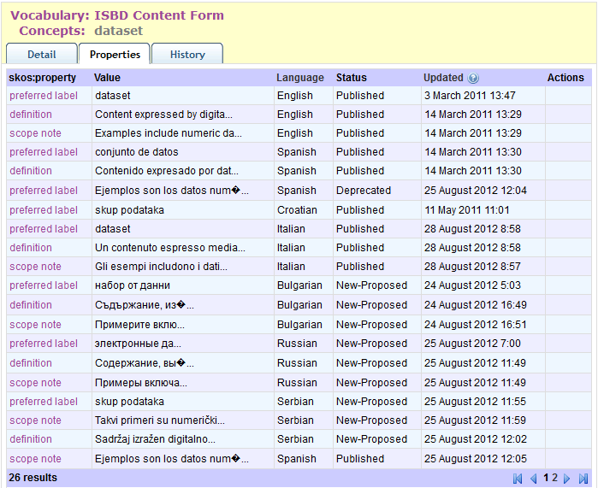
Partial translation
Local schedule

Slide 9
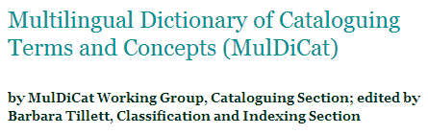
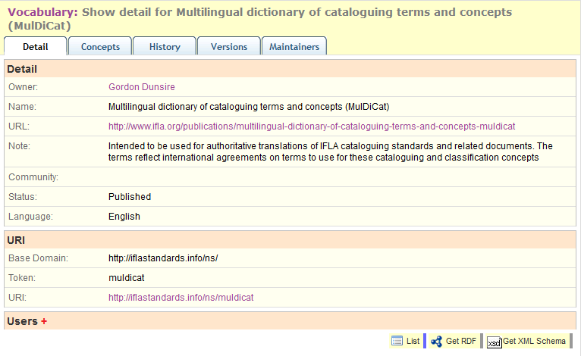
RDF value vocabulary
… for authoritative translations of IFLA cataloguing standards and related documents.

Slide 10
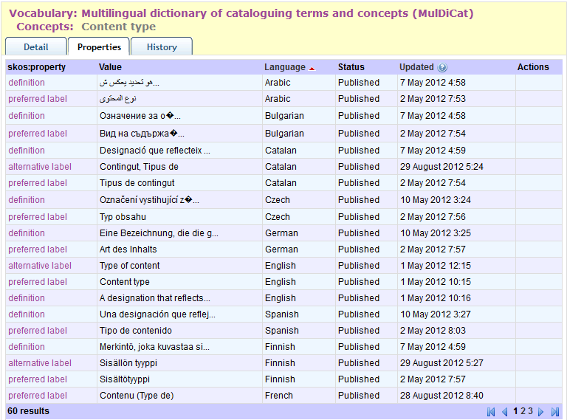
26+ languages

Slide 11
Thank you!
gordon@gordondunsire.com
http://iflastandards.info/ns/fr/
http://iflastandards.info/ns/isbd/
MulDiCat
http://metadataregistry.org/vocabulary/show/id/299.html
UNIMARC
Real soon now

