Slide 1
Metadata vocabulary alignment: opportunities and challenges
Gordon Dunsire
Presented to Workshop: Vocabularies and the potential for linkage, at Making metadata work, Joint Meeting of ISKO UK, IRSG and DCMI, London, England, 23 June 2014

Slide 2
Overview
Failure of centralized, top-down standards
  IFLA UBC Programme
Result is a mix of long-established and new standards for resource description
  Overlap considerable, and inevitable
  The resource remains the same
RDF supports interoperability at finest common level of dumbness
  A matter of relative granularity
Infrastructure required to maintain maps
  Protocols, version control, provenance

Slide 3
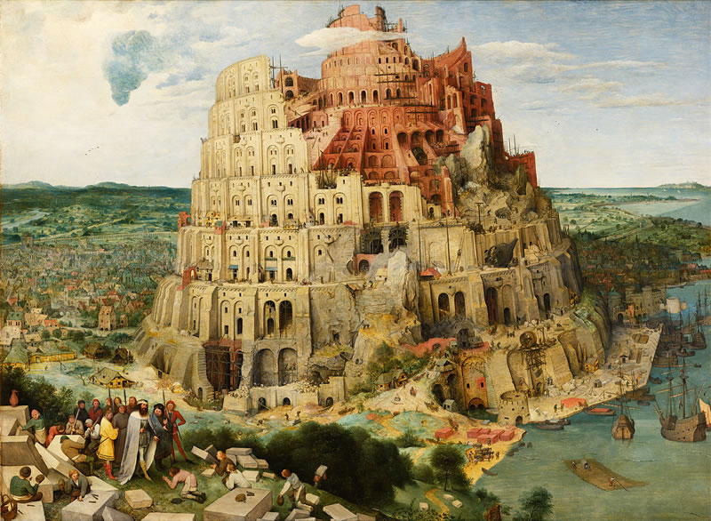

Universal
Bibliographic
Control
KOS++
Confusing
tongues?
RDF
BIBFRAME:
Bibliographic
Framework
FR: Functional
Requirements
ISBD: International Standard
Bibliographic Description
Say what
we mean
BibO:
Bibliographic
Ontology
DC: Dublin Core
RDA: Resource
Description
and Access
CRM: Conceptual
Reference Model
MARC21
schema.org
UNIMARC

Slide 4
Element sets (schema)
Map of
“Audience”
isbdu:
“has note on use or audience”
Unconstrained
versions
Value vocabularies (KOS)
isbd:
“has note on use or audience”
rdau:
“Intended audience”
rdfs:subPropertyOf
Broader/narrower/same?
dct:
“audience”
m21:
e
BBFC:
18?
“adult”
rdaw:
“Intended audience”
schema:
“audience”
MPAA:
NC-17?
pbcore:
adult
“adult”
m21:
“Target audience”
frbrer:
“has intended audience”
umarc:
m
“adult, general”
m21:
“Target audience of …”
umarc:
k
“adult, serious”

Slide 5
Management infrastructure
What happens if an element or concept changes?
  Protocol for change notification and re-mapping
Who are the parties to such a protocol?
  Registry of ownership and provenance
Self-governing or third party arbitration?
How reliable is the map?
  Version control? Meta-metadata? Provenance!

Slide 6
Thank you!
gordon@gordondunsire.com

