Slide 1
Marathon RDA
Gordon Dunsire
Chair, RDA Steering Committee
Presented at Bibliothèque national de France, Paris,
2 May 2016

Slide 2
1: Evolution of RDA

Slide 3
RDA: resource description and access
“RDA is a package of data elements, guidelines, and instructions for creating library and cultural heritage resource metadata that are well-formed according to international models for user-focussed linked data applications.”
  RDA Board, 2015
  http://www.rda-rsc.org/node/235
Notes:
The RDA Board, formerly the Committee of Principals for RDA, made this statement as part of an announcement affirming commitment to the internationalisation of RDA: resource description and access.

Slide 4
Progress on RDA governance
November 6, 2015: Change of name
Committee of Principals
For RDA
(CoP)
RDA Board
Joint Steering Committee
For Development of RDA
(JSC)
RDA
Steering Committee
(RSC)
http://www.rda-rsc.org/
Notes:
The Committee of Principals and Joint Steering Committee changed names in November 2015.

Slide 5
RDA Steering Committee
North America
Europe
Asia
Chair of RDA Board
Latin America
& the Caribbean
Africa
Oceania
ALA Publishing
Chair
Technical Team Liaison
Secretary
Translations Team Liaison
Examples Editor
Wider Community Engagement
Notes:
This is the final structure of the RSC.
Members marked in blue are already in place.
Members marked in gray have clear transition paths.
The other members are in preliminary stages of transition planning.

Slide 6
RDA Working Groups
Standing
Working Groups→
Technical
Translations
Aggregates
Music
←Task and Finish
Working Groups
Archives
Places
Capitalization Instructions
Rare materials
Fictitious Entities
RDA/ONIX Framework
Relationship Designators
Notes:
Working groups marked in green are active.
A new Rare Materials Working Group is about to be implemented.
This has taken priority over the new Archives Working Group, which is in the preliminary stages of planning.

Slide 7
Contexts (next 2-3 years)
Governance transition
FRBR Library Reference Model
International standards (IFLA, ISSN, …)
Toolkit review and re-organization

Slide 8
FRBR-LRM and RDA
LRM “a high-level conceptual model … intended as a guide or basis on which to elaborate cataloguing rules”
RDA guidance, instructions, elements
“operates at a greater level of generality than FRBRoo, which seeks to be comparable in terms of generality with CIDOC CRM”
RDA cultural heritage communities
LRM “this model is developed very much with semantic web technologies in mind”
RDA linked data communities

Slide 9
FRBR-LRM and RDA entities
Any Thing:
Covers all other types of thing
Res
has appellation
Nomen
is created by
W
E
Agent
M
is type of
Place
I
Collective
agent
is associated with
is modified by
Timespan
P
F
C

Slide 10
From attributes to relationships
has manifestation
statement
Publication statement
Transcribed
has place of publication
Nomen
Place
has publisher’s name
M
C
Nomen
Recorded
Timespan
Nomen
has date of publication

Slide 11
The 4-fold path
The “4-fold path” supports catalogue cards, flat file schema, RDBMS, and linked data (RDA database implementation scenarios)
Describing a related entity:
Unstructured description
Structured description
Identifier
URI
General guidance and instructions:
Simple
Less duplication
Easier to translate

Slide 12
2: RDA data in production

Slide 13
To ensure semantic clarity:
RDA in MARC
MARC Authority?
MARC
Work
0xx
1xx
2xx
3xx
…
MARC
Expression
0xx
1xx
2xx
3xx
…
MARC
Manifestation
0xx
1xx
2xx
3xx
…
MARC
Item
0xx
1xx
2xx
3xx
…
MARC
Person
0xx
1xx
2xx
3xx
…
MARC
Family
0xx
1xx
2xx
3xx
…
MARC
Corporate Body
0xx
1xx
2xx
3xx
…
MARC
Place
0xx
1xx
2xx
…
MARC
Timespan
0xx
1xx
2xx
…
MARC
Nomen
0xx
1xx
2xx
…

Slide 14
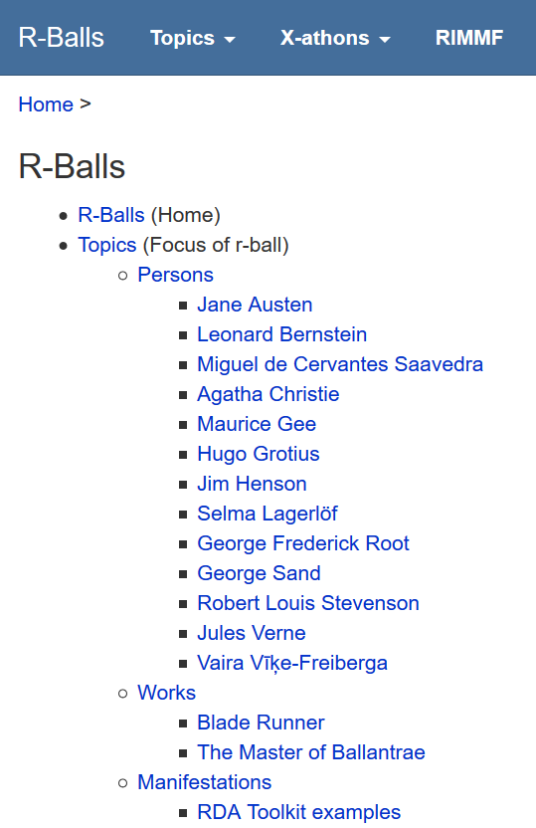
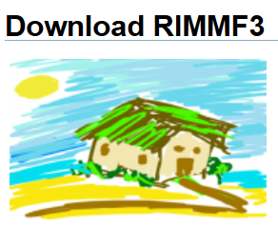
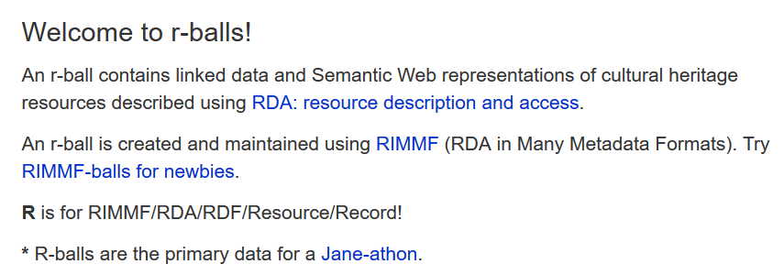
http://rballs.info
RDA data: r-balls

Slide 15
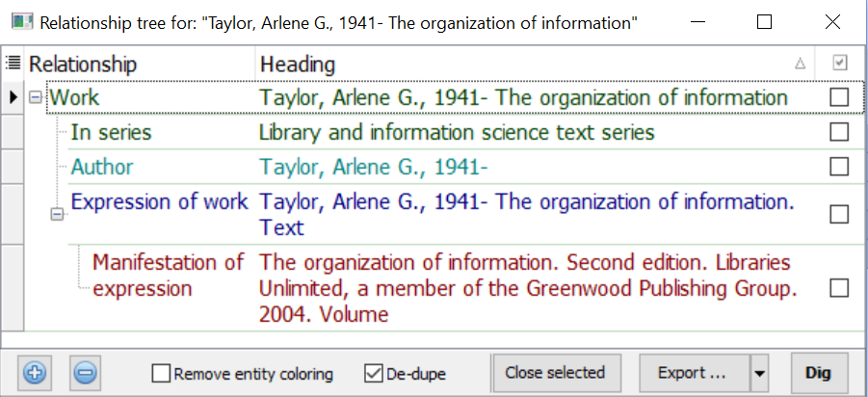
RIMMF relationship tree (R-Tree)

Slide 16
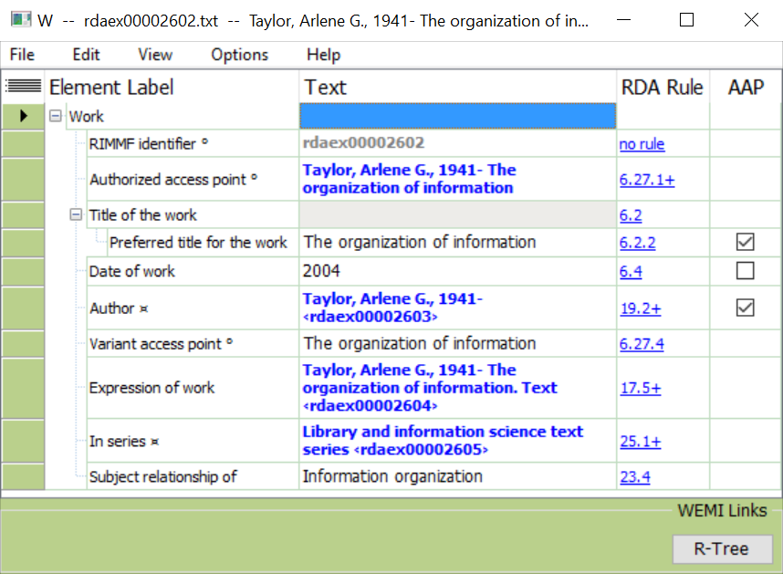
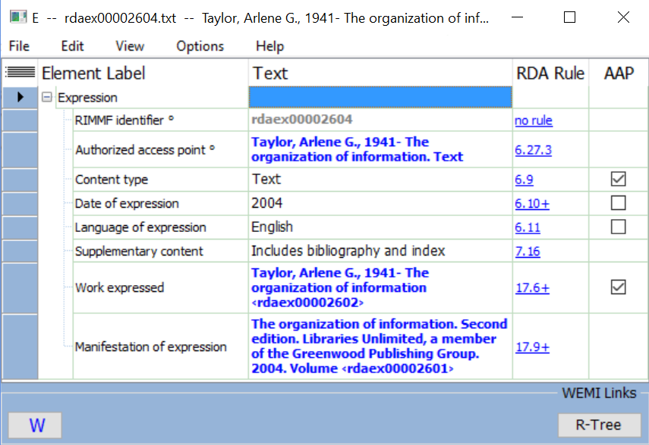
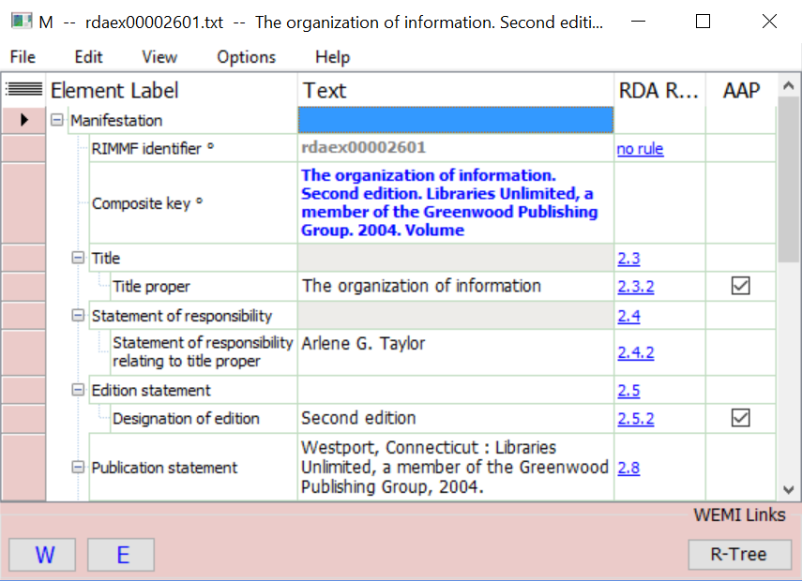

Slide 17
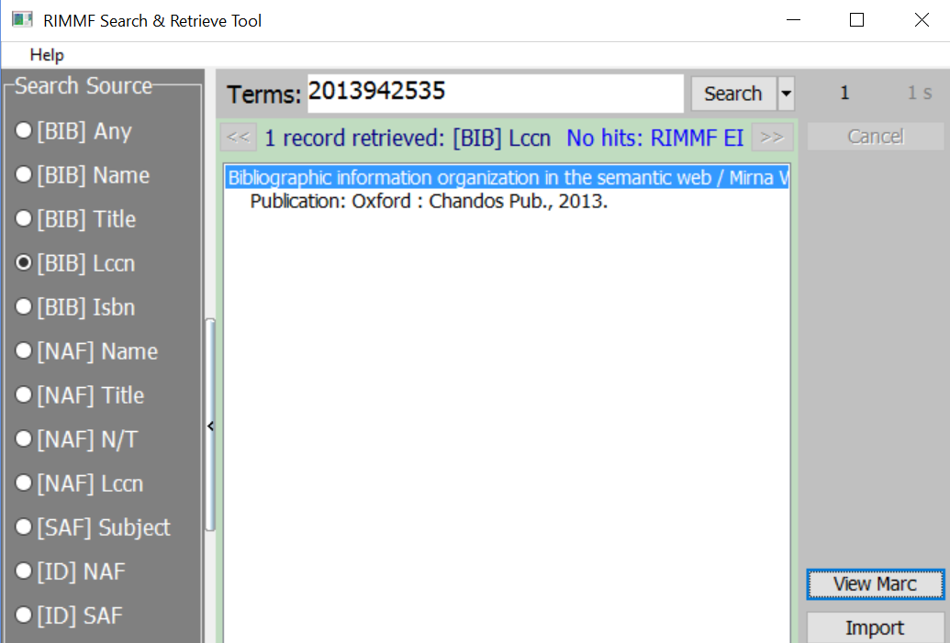
RIMMF import from Library of Congress MARC21 catalogue

Slide 18
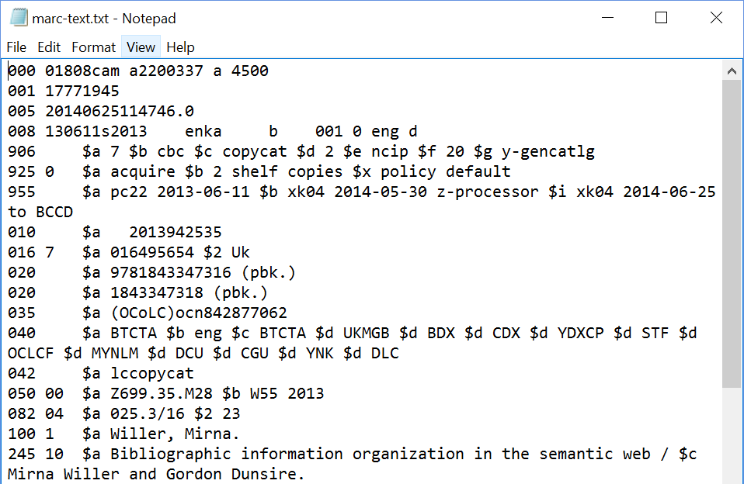
MARC21 record

Slide 19
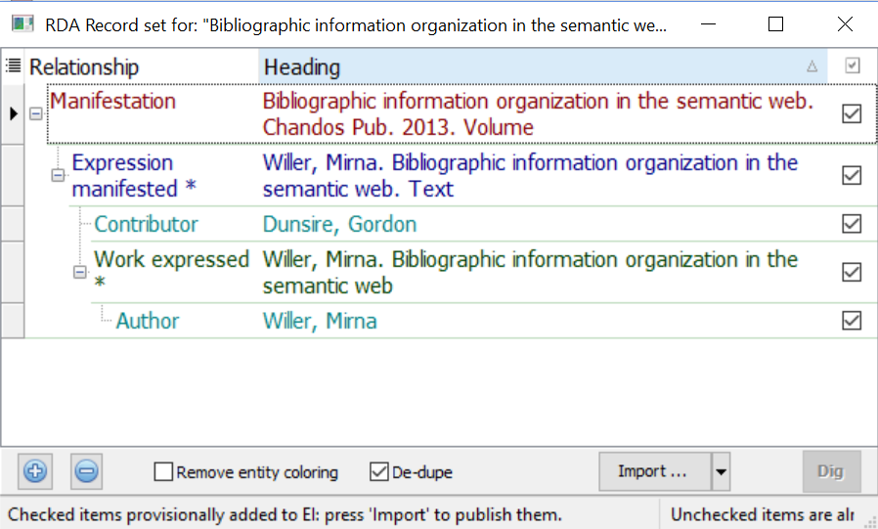
RIMMF FRBRizes MARC21 record to RDA data set

Slide 20
RDA data
“RDA is a package of data elements, guidelines, and instructions for creating library and cultural heritage resource metadata that are well-formed according to international models for user-focussed linked data applications.”
RDA Toolkit provides the user-focussed elements, guidelines, and instructions.
RDA Registry provides the infrastructure for well-formed, linked, RDA data applications. Open Metadata Registry (OMR) provides linked data representation of RDA elements.
Notes:
The RDA data ecosystem is summed up in this sentence introducing the RDA Board’s announcement of RDA’s strategic directions.
The RDA package is delivered by an infrastructure of two interacting services.
The human-facing components, including the guidelines and instructions, are the Toolkit.
The data-facing components are contained in the Registry.
Applying the data capture and storage techniques in RDA Toolkit to the data architecture in the RDA Registry produces well-formed data for RDA applications.

Slide 21
Linked data and RDF
Resource Description Framework (RDF)
  RDA based on Dublin Core Abstract Model (DCAM)
Designed for machine-processing of metadata at global scale (Semantic Web)
  24/7/365
  Trillions of operations per second
  The cloud
Connecting the crowd
  The universe of human discourse

Slide 22
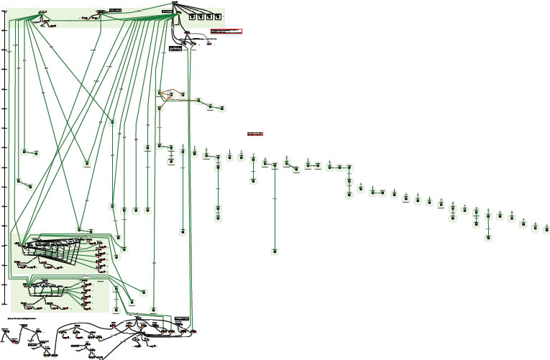
Complexity of relationships: Moby Dick
Diagram using FRBR entities and relationships
Printed editions
“OrsonWhales” mash-up (YouTube)
Ronald J. Murray: From Moby Dick to mash-ups
http://www.slideshare.net/RonMurray/from-mobydick-to-mashups
Notes:
RDA data is designed to reflect the complexity of relationships found in library and cultural heritage resources.
This is an example of a paper exercise to draw the relationships between the various printed editions of Herman Melville’s novel “Moby Dick”.
The complex sub-graph at the bottom represents a multimedia mash-up of Moby Dick with Orson Welles (who acted in the film of Moby Dick).
This diagram can be readily extended.
We could add the film starring Gregory Peck as Captain Ahab, and other film and tv adaptations, in multiple formats and editions. And the various recordings of the instrumental “Moby Dick” (for solo drummer!) by Led Zeppelin, and all the other recordings by the group, in multiple formats and editions. And so on.

Slide 23
RDA in RDF
RDA controlled terminologies represented as RDF value vocabularies
  Example: RDA carrier type vocabulary
Entities, attributes, and relationships represented as RDF element sets
  Entities represented in RDF as classes
  Attributes and relationships represented in RDF as properties (“predicates”)
  Example: RDA manifestation properties

Slide 24
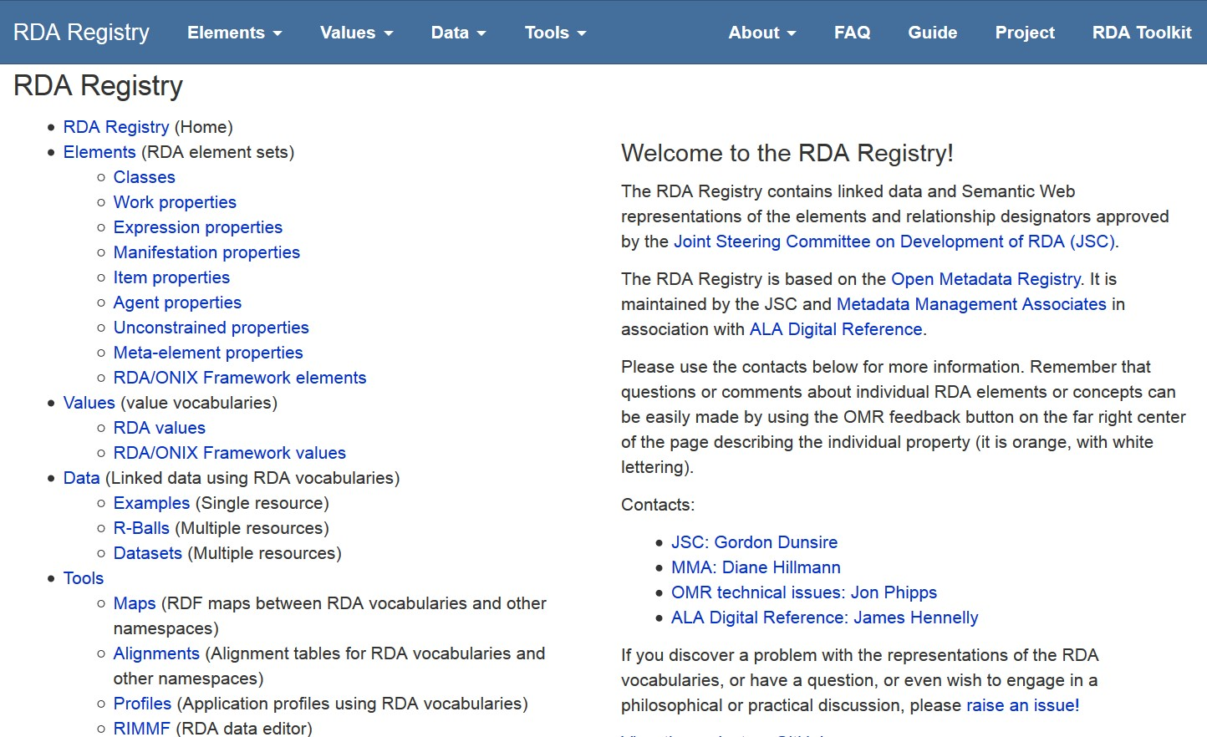
RDA Registry: rdaregistry.info
RDA Reference
Elements, attributes, relationships
Values
Other Glossary terms
Translations and partial translations
Notes:
The RDA Registry provides access to linked data versions of the RDA element sets and value vocabularies.
The Registry also provides access to tools for creating and editing RDA data and making it interoperate with non-RDA and non-FRBR applications.

Slide 25
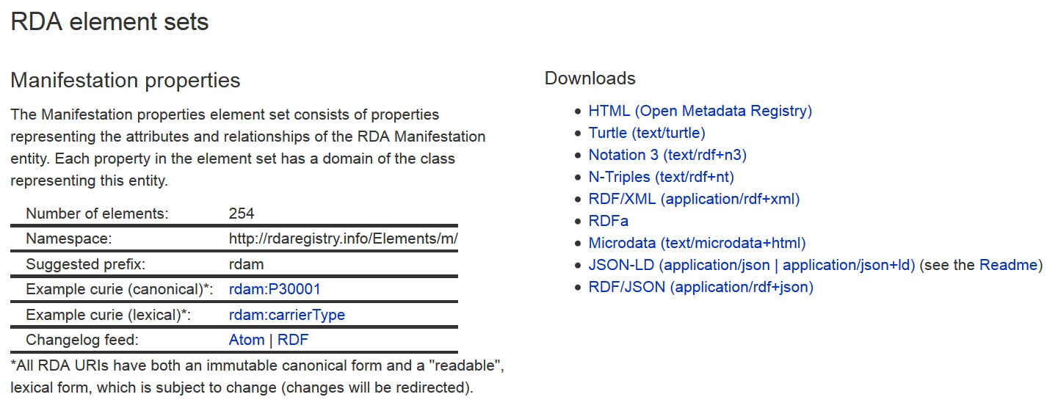
Except HTML for humans
RDF linked data serializations
Formal or canonical URI is “opaque”
- not intended for human readability
Lexical URI is intended for human readability
in different languages
Notes:
RDA URIs are opaque and do not hint at their meaning or semantics. This avoids issues of language and changes of label.
RDA has developed lexical URIs that can be “read” more easily by developers. These can be in any language; the lexical URIs are automatically linked to the canonical URI.
Each RDA element set and value vocabulary can be freely downloaded in different versions or serializations of RDF.
Human-readable versions are available in the Open Metadata Registry

Slide 26
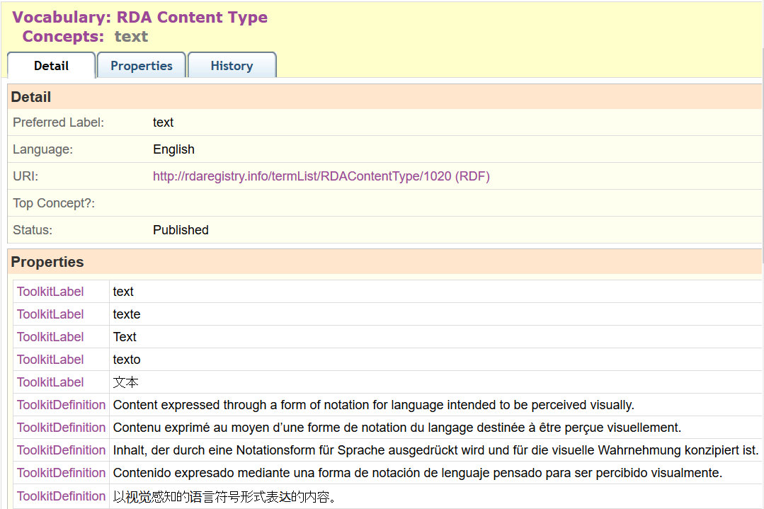
Multilingual linked data
RDF as global language
French
German
Spanish
Chinese
…
Notes:
This is a partial screen-shot of the OMR view of the RDA Media type “microform”.
The term label, definition, and scope note in multiple languages are linked to the URI for the term. This basic feature of RDF, the separation of strings (labels, etc.) from things (URIs), is fully exploited by the RDA Registry.
Value vocabularies are represented using SKOS (Simple Knowledge Organization System) elements. SKOS allows one preferred label per language, and as many definitions and notes as are required. RDA uses SKOS elements for broader, narrower, and term or concept equivalence to represent semantic hierarchies and maps.
The RDA Toolkit is currently available in French, German, and Spanish, with Finnish and Italian translations scheduled for the next series of updates. A separate translation is published in China. The RDA Translations Policy requires all full translations of the Toolkit to be represented in linked data format in the Registry.
Partial translations covering the RDA Reference data of element sets and value vocabularies will also be added to the Registry.

Slide 27
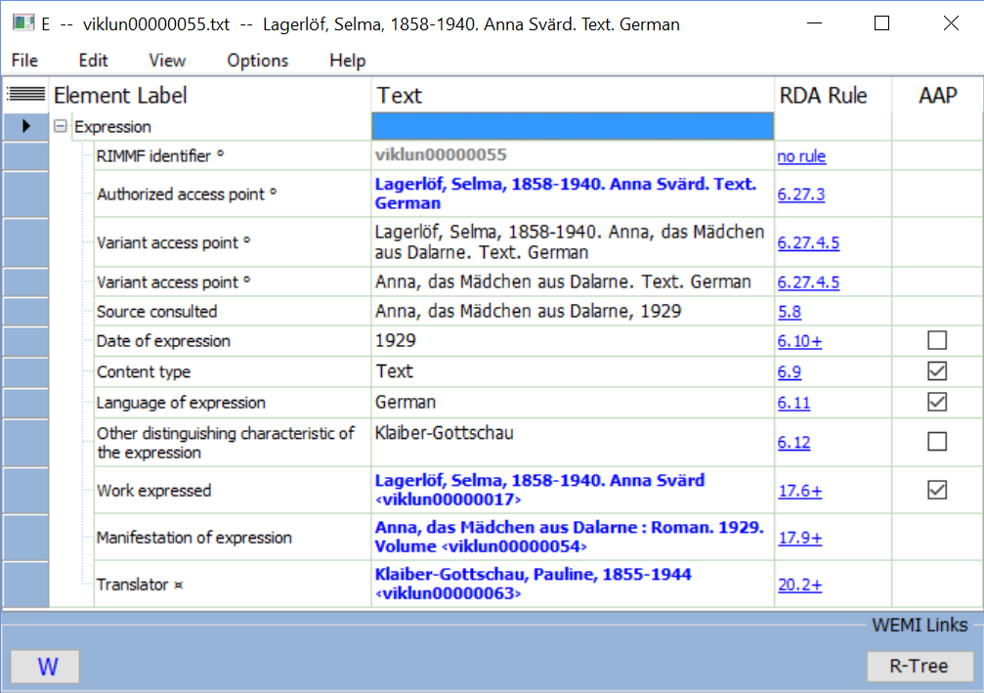
Multilingual data
Swedish work
German translation
English cataloguer

Slide 28
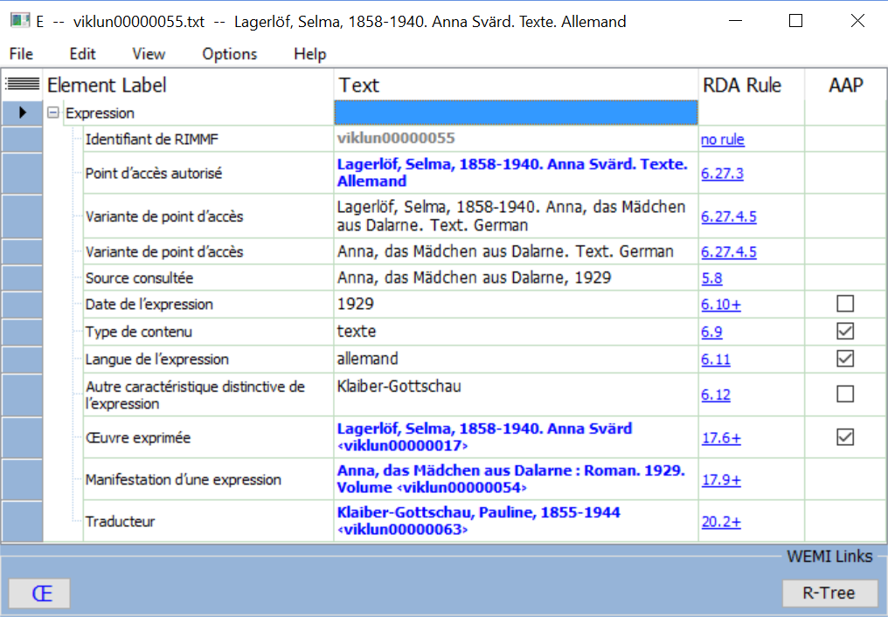
Polylingual data
French cataloguer

Slide 29
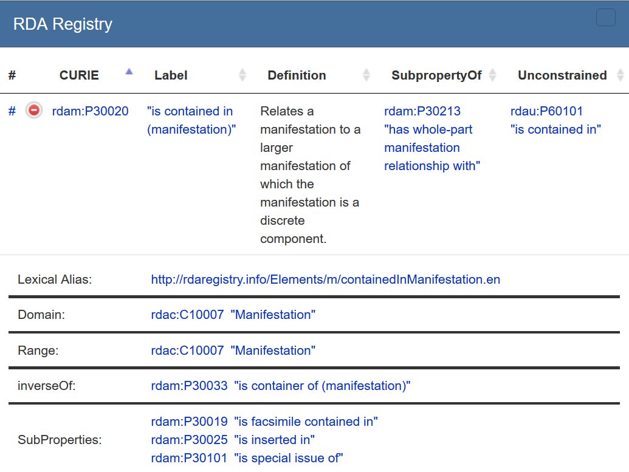
http://rdaregistry.info/Elements/m/P30020
De-referenced

Slide 30
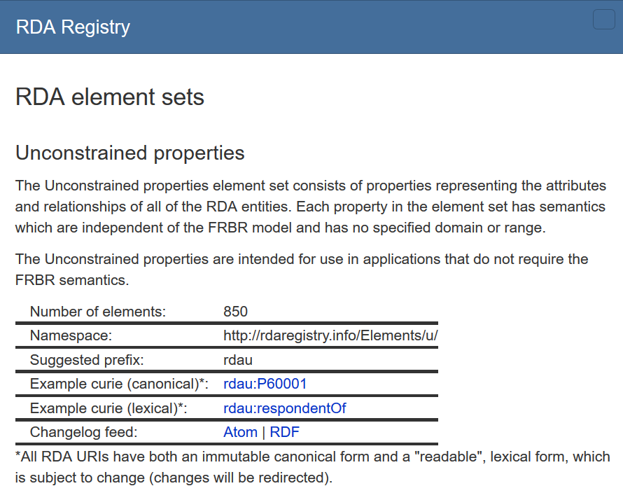
Unconstrained linked data
Example: Contributor
Relates a resource to an agent contributing to a resource.
Remove FRBR model to
“dumb-down”
semantics to common level of granularity
“resources” and “agents”

Slide 31
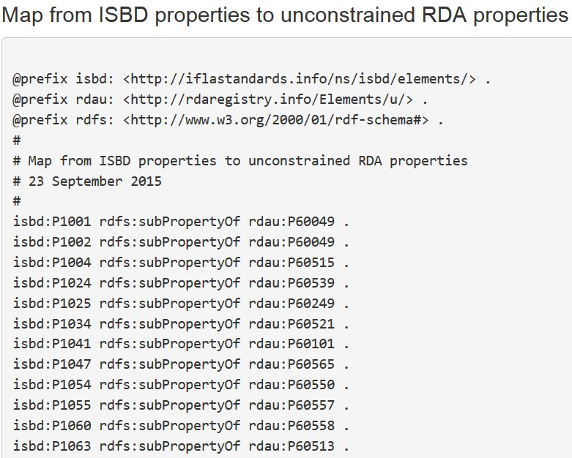
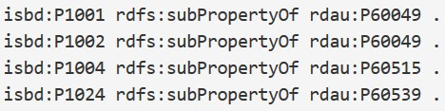
Beyond RDA data: ISBD
[Linked data cloud, not RDF graph]
Unconstrained
(No entity
Specified)
RDAU
ISBDU
RDA
ISBD
Work
Expression
Manifestation
Item
Resource
Notes:
The RDA Registry contains an element set that is not tied to the RDA entities. The “unconstrained” elements parallel the RDA elements but have general definitions, so they can be used by applications that do not require the finer granularity and semantics of RDA and FRBR.
This allows RDA data to interoperate with data from another community. For example, there is an agreed alignment between ISBD (International Standard Bibliographic Description) elements and RDA elements. The alignment is the basis of a set of linked data maps between ISBD and RDA data.
The diagram shows the maps between the RDA and ISBD element sets and their unconstrained versions. The maps preserve semantic coherence by removing the information about RDA’s WEMI entities and ISBD’s Resource entity; the semantic relationship between these entities is not simple and direct.
The diagram is part of the “linked data cloud” of RDF maps, and is not itself an RDF graph. For example, the map between ISBD and the unconstrained RDA elements represented by a single line is an RDF graph, the first part of which is shown.

Slide 32
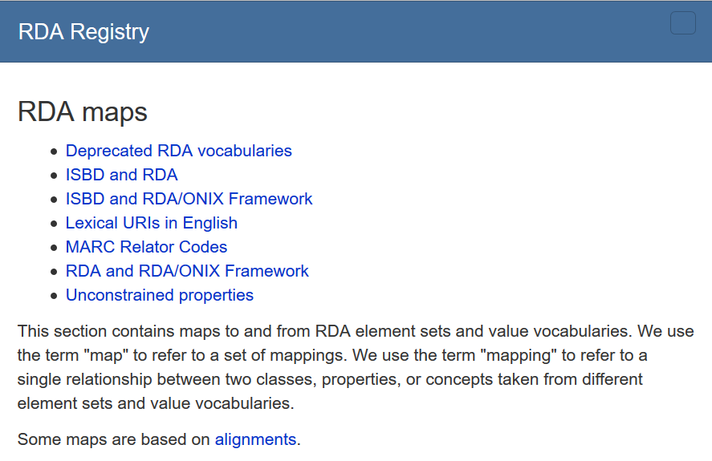
Multi-schema linked data
Many local dialects
Linking RDA to:
ISBD
MARC21
RDA/ONIX Framework
…

Slide 33
Does BIBFRAME fit here?
Semantic map of manifestation carrier/media type
element
dc:
format
dct:
format
schema:
encoding
rdau:
P60050
m21:
M338__b
rdam:
P30002
isbd:
P1003
rdam:
P30001

Slide 34
3: Synthesis and general discussion

Slide 35


The (metadata) Grail
Item
describes
itself
Master
Catalogue
Record
Interpreted by professional intermediaries
Using arcane rules and processes
Representation
Title page, cover, introduction, etc.
(by author, publisher, etc.)

Slide 36
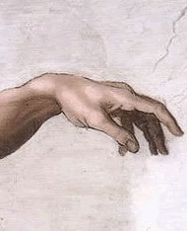
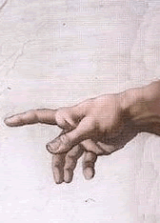
Universal Bibliographic Control
Agreed at international level with global scope
Top-down,
one size
fits all
One
record
structure
One
content
rules
One
encoding
format

Slide 37
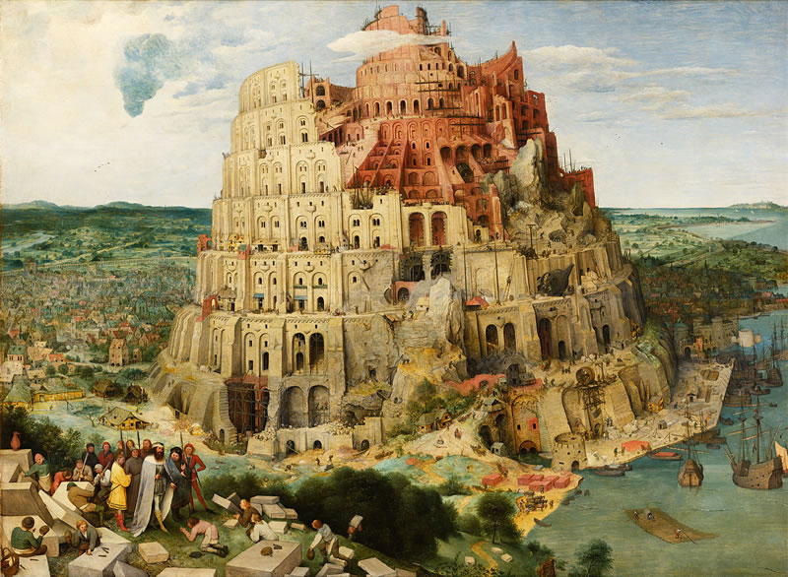
Digital world
All content on one carrier
Global is the connected local
Web is the fundamental structure
Control structures crumble

Slide 38
Open World Assumption
The absence of data is not data about absence
Always something more to say!
The “record” is never complete

Slide 39
From record to statement cluster
N
-----
Manifestation
---------------
--------------
----
-------------------
…
--------
N
W
C
M
--------- : ----, ----
E
M

Slide 40
Anyone can say Anything about Any thing
There is no test of truth; only inconsistency
Provenance is important!
Who said that?
What “rules” were used?
Provenance required for each statement
[triple + 1 = quad store]

Slide 41
Who says?
Publisher metadata:
Electronic copyright deposit
=> 80% of British Library intake
The Crowd:
Social media
Reviews, etc.
Professionals:
Recording and relationships
X
The Expert Crowd:
Crowd-sourcing
Paraprofessionals:
Transcription
(smart phone apps)
Machines:
Indexing
Inferencing

Slide 42
Linked data vs Semantic Web
Dumb?
Smart!
Linked data:
RDBMS
Closed world
Blank nodes
Minimal semantics
Local
Semantic Web:
RDF
Open world
All nodes identified
Embedded semantics
Global
Easy to develop with local infrastructure
Hard to develop with global infrastructure

Slide 43
Thank you!
rscchair@rdatoolkit.org
http://www.rda-rsc.org/ [RDA Steering Committee]
http://www.rdaregistry.info/
http://metadataregistry.org/
http://www.marcofquality.com/wiki/rimmf3/

