Slide 1
Mapping FRBR, ISBD, RDA, and other namespaces to DC for interoperability
Gordon Dunsire
Presented at Kunnskapsorganisasjonsdagene 2013, 7-8 February 2013, Oslo, Norway

Slide 2
Overview
Dublin Core origins and intention to be model for subsequent refinement
Proliferation of richer international schemas
RDA, FRBR, ISBD
Mapping and the sub-property ladder
Unconstrained elements
Interoperability
Role/place of BIBFRAME and schema.org

Slide 3
3 phases of Dublin Core
Dublin, Ohio [not Dublin, Ireland]
OCLC/NCSA Metadata Workshop, 1995
1) 15 element "core metadata" for simple and generic resource descriptions
2) Then extended set of DCMI Metadata Terms for use with RDF
3) Current focus on Application profiles

Slide 4
The RDA domino …
2007 London meeting between RDA: resource description and access, and Semantic Web communities
Including DCMI (Dublin Core Metadata Initiative)
DCMI/RDA Task Group formed to develop
RDA Element Vocabulary
RDA DC Application Profile based on FRBR and FRAD
Functional Requirements for Bibliographic Records/Authority Data
RDA Value Vocabularies using RDF/RDFS/SKOS
Resource Description Framework/Schema/Simple Knowledge Organization System

Slide 5
… Domino effect
Decision at IFLA conference 2007 to develop an element set vocabulary for FRBR, and subsequently FRAD and FRSAD (Subject Authority Data)
FRBRoo (object oriented) extension to CIDOC Context Reference Model in development since 2003
Unofficial FRBR element set already published
Decision at IFLA conference 2009 to develop an element set and value vocabularies for ISBD (International Standard Bibliographic Description)

Slide 6

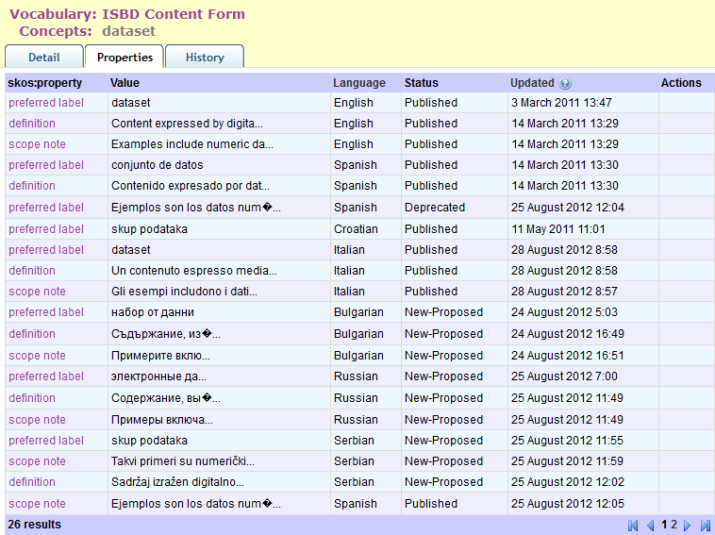
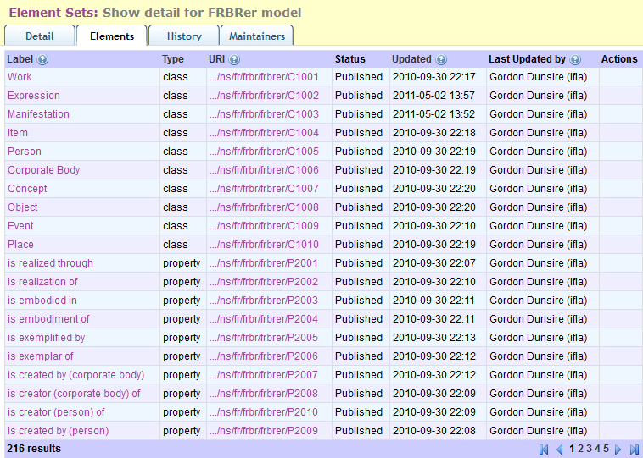
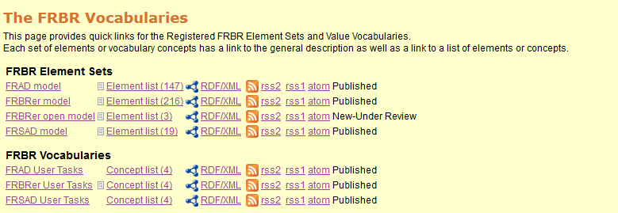
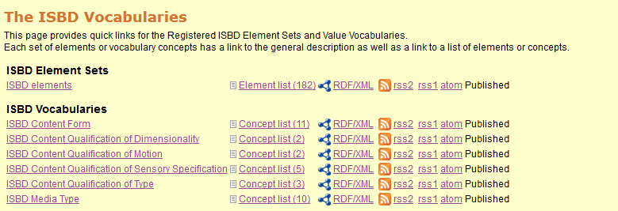
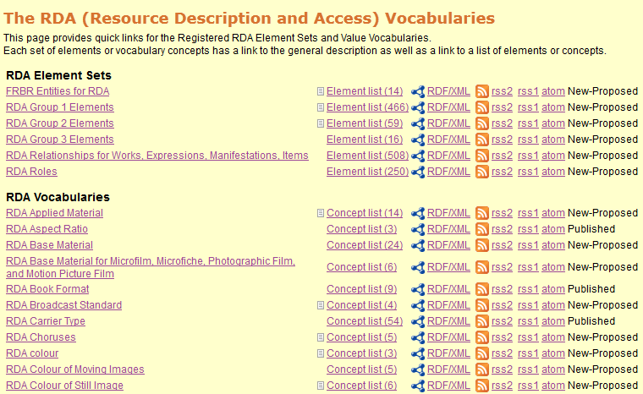
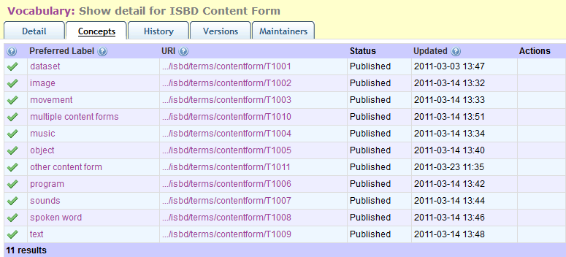
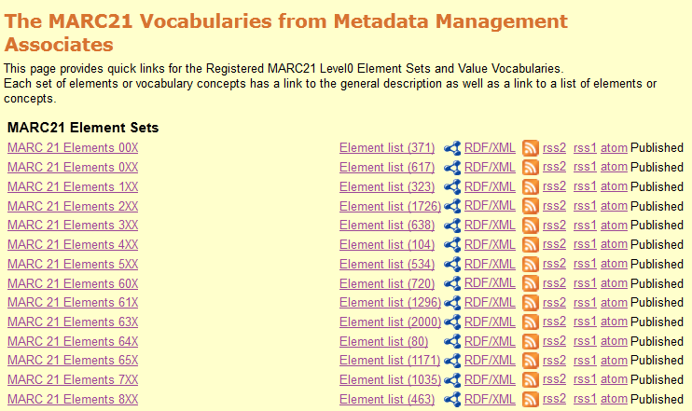

Slide 7



MARC21 Swamp

Slide 8

Introducing: Timmy the turtle
I’m a triple!
(in ttl)*
*Terse triple language =
“turtle”

Slide 9
How to refine an RDF property [example: Dublin Core]
Triple:
Subject
Predicate
Object
This resource
has format
Blu-ray Disc
“String”
or
Data:
Thing
Property
Thing
dc:format
is a
Range=
MediaType
OrExtent
Refine:
dct:format

Slide 10
Semantic constraints
Property range defines a class for the data triple object
Property domain defines a class for the data triple subject
Property definition
is intended for human interpretation
“The file format, physical medium, or dimensions of the resource.”@en
DCMI:“Intelligent dumb-down”
sub-property
Property definition
can be refined [“qualified”]; e.g.
“The physical medium of the resource.”@en
Notes:
Informed element dumb-down: “Recursively resolve sub-property relationships until a recognised property is reached and substitute the property URI of that property for the existing property URI in the statement.” Available at: http://dublincore.org/documents/2005/03/07/abstract-model/#sect-5

Slide 11
Semantic reasoning: the sub-property ladder
Semantic rule:
If property1 sub-property of property2;
Then data triple: Resource property1 “string”
Implies data triple: Resource property2 “string”
dc:format
Resource has format “audio”
rdfs:
subPropertyOf
dumber=
lose information
dct:format
Resource has format
Audio
1 rung
on a ladder

Slide 12


Are you feeling lonely and unlinked?
Want to meet similar turtles?
Take the sub-property ladder to new places!
Dumb-up today!
… (Dumber)
Cloned turtles

Slide 13
From top down to bottom up, core to crust …
ISBD property:
P1003
“Relates a resource to a category that records the type or types of carrier used to convey the content.”@en
RDA property:
mediaTypeManifestation
“A categorization reflecting the general type of intermediation device required to view, play, run, etc., the content of a resource. .”@en
RDA property:
carrierTypeManifestation
“A categorization reflecting the format of the storage medium and housing of a carrier in combination with the type of intermediation device required to view, play, run, etc., the content of a resource. .”@en
MARC21 property:
M338__b
“Code for the category of carrier used to convey the content of the resource. .”@en

Slide 14
Semantic map of selected carrier formats
dc:
format
Unconstrained:
No domain or range
dct:
format
unc:
mediaType
m21:
M338__b
rda:
mediaTypeManifestation
isbd:
P1003
rda:
carrierTypeManifestation
Rdfs:subPropertyOf

Slide 15





FRBR
Zoo!
MARC21
Swamp
Everglades of
Dublin Core!
ISBD
Marsh!
Bog of RDA!

Slide 16
Bottom rungs of the sub-property ladder
dc:
format
Resource
has format
“audio”
unconstrained:
mediaType
Something
has media type
“audio”
rda:
mediaTypeManifestation
Manifestation
has media type
audio
rda:
carrierTypeManifestation
Manifestation
has carrier type
audio disc

Slide 17
More rungs …
dc:
format
Resource
has format
“audio”
dct:
format
Resource
has Media type or extent
audio
sd
isbd:
P1003
ISBD Resource
has media type
audio
m21:
338__b
Something
has carrier type code in Carrier Type
sd

Slide 18
Unconstrained properties
MARC 21 is unconstrained
ISBD constrained by ISBD Resource
RDA constrained by FRBR & FRAD Work, Expression, Manifestation, Item, Person, Family, Corporate Body
What is the semantic relationship between ISBD Resource and WEMI?
[Not Resource=Manifestation, etc.!]

Slide 19
Interoperability
DCMI level 2 of interoperability
Formal semantic interoperability
“based on the shared formal model provided by RDF, which is used to support Linked Data”
Sub-property ladder and other maps allow data to be merged at a level of “lowest common semantic”
Or any higher level
DCMI levels 3 and 4 => Application profiles
Phase 3: Still under construction
Sharing data from local to global applications

Slide 20
BIBFRAME
“a high-level model for the library community … within a much broader context, … well beyond the library community”
“more than a mere replacement for the library community's current model/format, MARC. It is the foundation for the future of bibliographic description”
A bold claim for something which does not mention ICP (International Cataloguing Principles)
First draft has fewer classes than FRBR
Is this rich enough for library applications?
Can it be a common framework for FRBR/RDA, ISBD, local schemas, etc.?

Slide 21
schema.org
“collection of schemas, i.e., html tags, that webmasters can use to markup their pages in ways recognized by major search providers”
very generic data model derived from RDF Schema
“sponsors”: Google, Yahoo, Microsoft Corporation
Semantic extension of web indexing
Global-scale, general properties
Covers bibliographic environment from the start
Working Group looking at extensions for a better fit with bibliographic metadata

Slide 22
dc:
format
Does BIBFRAME fit here?
dct:
format
unc:
mediaType
schema:
encodes
m21:
M338__b
rda:
mediaTypeManifestation
isbd:
P1003
rda:
carrierTypeManifestation

Slide 23
Thank you – questions?
gordon@gordondunsire.com
OMR
http://metadataregistry.org/
DCMI
http://dublincore.org/
http://schema.org/
BIBFRAME
http://www.loc.gov/marc/transition/
That’s all,
Folks!

